Slide 1
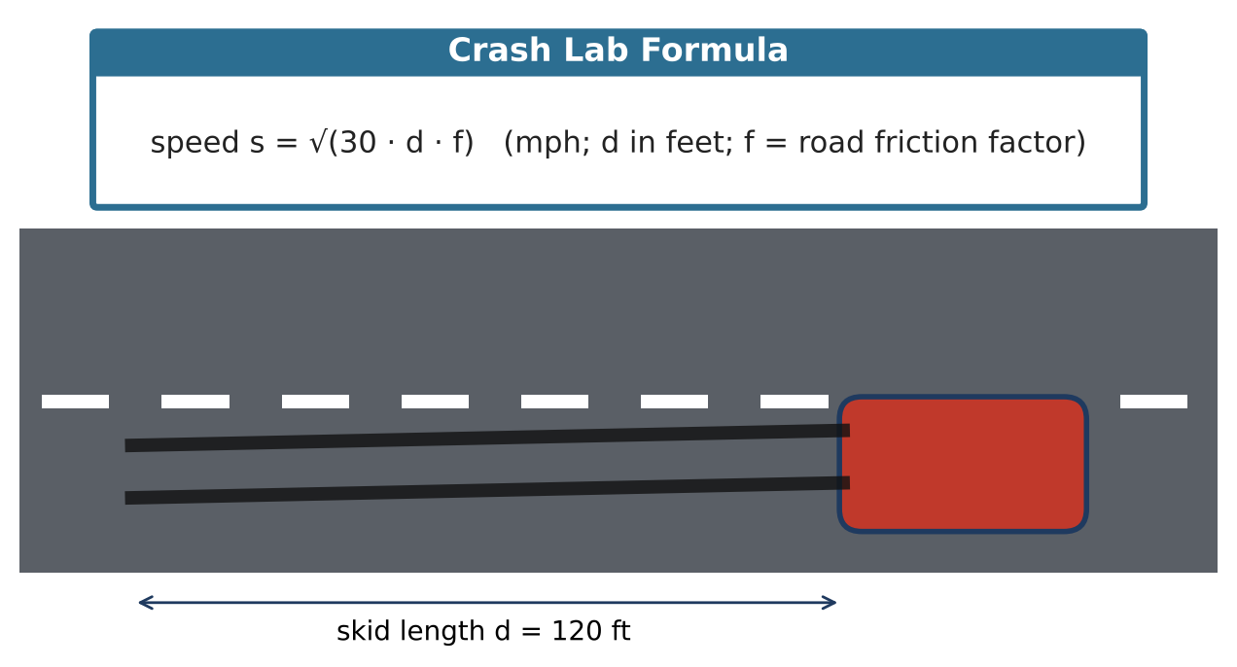
ALGEBRA 2 · UNIT 5: RADICALS & RATIONAL EXPONENTS
Crash Scene Investigator
Use radical formulas and rational exponents to reconstruct an accident and study motion.
CP1 Project
2–3 class periods
Name: ______________________ Group: ______________________

Slide 2
The Scenario
CP1
A car skidded 120 feet on a dry road before stopping in a 45-mph zone. Accident investigators use s = √(30df), where s is speed in mph, d is skid length in feet, and f is the road's friction factor (dry asphalt 0.75, wet asphalt 0.45).
Your lab will estimate speeds, solve for unknowns, and explore other formulas with radicals and rational exponents, then write a report.
Algebra 2 · Unit 5: Radicals & Rational Exponents · Crash Scene Investigator

Slide 3
Learning Goals & Timeline
CP1
Learning Goals
Timeline
• I can rewrite between radicals and rational exponents.
• I can solve and rearrange radical formulas.
• I can graph square-root functions as transformations.
Day 1
The Skid Marks
Day 2
Solve & Graph
Day 3
Orbits & Report
Final
Investigation Report + reflection
Algebra 2 · Unit 5: Radicals & Rational Exponents · Crash Scene Investigator

Slide 4
Part 1: The Skid Marks
CP1
Day 1 · Use s = √(30df).
1. Find the dry-road speed for a 120-ft skid in simplest radical form. Then write the formula using a rational exponent.
2. Solve the formula for d. Use it to find the skid length at 45 mph and at 60 mph on dry asphalt.
3. A second skid is 4 times as long on the same road. Show algebraically that the speed is 2 times as large.
Algebra 2 · Unit 5: Radicals & Rational Exponents · Crash Scene Investigator

Slide 5
Part 2: Solve & Graph
CP1
Day 2 · Check every solution.
4. Solve √(x + 7) = x − 5 and identify any extraneous solution.
5. Solve ∛(2x − 3) = 3.
6. Describe s(d) = √(22.5d) as a transformation of y = √d. Graph both.
7. On a wet road, s(d) = √(13.5d). Is this graph above or below the dry graph? Why?
Algebra 2 · Unit 5: Radicals & Rational Exponents · Crash Scene Investigator

Slide 6
Part 3: Orbits & Report
CP1
Day 3 · Kepler: T² = a³, where T is the orbit time in years and a is the average distance from the Sun in AU. So T = a¹·⁵.
8. Mars has a = 1.52 AU. Find its orbit time.
9. Saturn's orbit takes 29.5 years. Solve for a (use the ⅔ power) and find a.
10. Write the case report and include one radical and one rational-exponent result.
Algebra 2 · Unit 5: Radicals & Rational Exponents · Crash Scene Investigator

Slide 7
Final Product: Investigation Report
CP1
Your final product must include:
☐ Skid analysis with a rearranged formula
☐ Solved radical equations
☐ Graphs and transformations
☐ Orbit calculations
☐ Report
Algebra 2 · Unit 5: Radicals & Rational Exponents · Crash Scene Investigator

Slide 8
Scoring Rubric
CP1
Criteria | 4 – Exceeds | 3 – Meets | 2 – Approaching | 1 – Beginning
Mathematical Accuracy | All calculations and solutions are correct; answers include units and are checked. | Nearly all work is correct; minor errors do not change conclusions. | Several errors; some conclusions are affected. | Many errors or missing work.
Reasoning & Justification | Clear, complete explanations connect every answer to the situation; uses precise vocabulary. | Explanations are mostly clear and connected to the situation. | Explanations are brief or partly unclear. | Little or no explanation.
Application & Design | Conclusions are supported by correct radical calculations, and any extraneous solutions are identified. Goes beyond the minimum with a creative, realistic choice. | Conclusions are supported by correct radical calculations, and any extraneous solutions are identified. | Design is incomplete or only partly uses the math from the unit. | Design is missing or unrelated to the unit math.
Communication & Presentation | Report includes speed estimates with simplified radicals, solved formulas, a graph, and a conclusion about the case. Polished, organized, and visually engaging. | Report includes speed estimates with simplified radicals, solved formulas, a graph, and a conclusion about the case. Organized and easy to follow. | Product is missing required parts or is hard to follow. | Product is mostly missing.
Algebra 2 · Unit 5: Radicals & Rational Exponents · Crash Scene Investigator

Slide 9
Reflection
CP1
R1. Why is a¹·⁵ the same as a√a?
R2. How does the friction factor change the graph?
Algebra 2 · Unit 5: Radicals & Rational Exponents · Crash Scene Investigator

