Slide 1
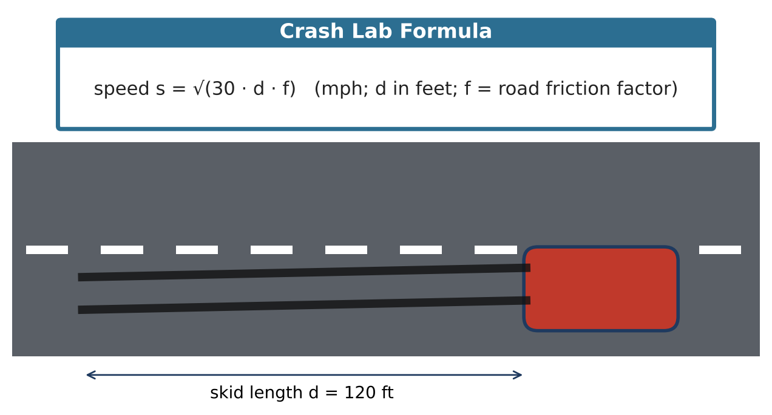
ALGEBRA 2 · UNIT 5: RADICALS & RATIONAL EXPONENTS
Crash Scene Investigator
Use radical formulas and rational exponents to reconstruct an accident and study motion.
CP2 Project
2–3 class periods
Name: ______________________ Group: ______________________

Slide 2
The Scenario
CP2
A car skidded 120 feet on a dry road before stopping in a 45-mph zone. Accident investigators use s = √(30df), where s is speed in mph, d is skid length in feet, and f is the road's friction factor (dry asphalt 0.75, wet asphalt 0.45).
Your lab will estimate speeds, solve for unknowns, and explore other formulas with radicals and rational exponents, then write a report.
Algebra 2 · Unit 5: Radicals & Rational Exponents · Crash Scene Investigator

Slide 3
Learning Goals & Timeline
CP2
Learning Goals
Timeline
• I can evaluate and simplify radical expressions.
• I can solve radical equations and check for extraneous solutions.
• I can use radical formulas in science.
Day 1
The Skid Marks
Day 2
Solve & Check
Day 3
Pendulums & Report
Final
Investigation Report + reflection
Algebra 2 · Unit 5: Radicals & Rational Exponents · Crash Scene Investigator

Slide 4
Part 1: The Skid Marks
CP2
Day 1 · Use s = √(30df).
1. Find the speed for d = 120 ft on dry asphalt (f = 0.75). Write the exact answer in simplest radical form and as a decimal.
2. Was the driver speeding in the 45-mph zone?
3. Find the speed for the same skid on wet asphalt (f = 0.45). Simplify the radical.
4. How long would the skid be on dry asphalt at exactly 45 mph? Solve 45 = √(22.5d).
Algebra 2 · Unit 5: Radicals & Rational Exponents · Crash Scene Investigator

Slide 5
Part 2: Solve & Check
CP2
Day 2 · Square both sides, then check every answer.
5. Solve √(x + 7) = x − 5. Check both answers and identify any extraneous solution.
6. Explain why squaring both sides can create an answer that doesn't work.
7. Make a table for s(d) = √(22.5d) with d = 0, 40, 90, 160 and sketch the graph.
Algebra 2 · Unit 5: Radicals & Rational Exponents · Crash Scene Investigator

Slide 6
Part 3: Pendulums & Report
CP2
Day 3 · A pendulum's period is T = 2π√(L ÷ 32), with L in feet and T in seconds.
8. Find the period of an 8-ft pendulum.
9. Find the period of a 2-ft pendulum. How does making the pendulum 4 times shorter change the period?
10. Write a short report on the crash case using your answers.
Algebra 2 · Unit 5: Radicals & Rational Exponents · Crash Scene Investigator

Slide 7
Final Product: Investigation Report
CP2
Your final product must include:
☐ Speed calculations with simplified radicals
☐ Radical equation with check
☐ Graph of the speed function
☐ Case report
Algebra 2 · Unit 5: Radicals & Rational Exponents · Crash Scene Investigator

Slide 8
Scoring Rubric
CP2
Criteria | 4 – Exceeds | 3 – Meets | 2 – Approaching | 1 – Beginning
Mathematical Accuracy | All calculations and solutions are correct; answers include units and are checked. | Nearly all work is correct; minor errors do not change conclusions. | Several errors; some conclusions are affected. | Many errors or missing work.
Reasoning & Justification | Clear, complete explanations connect every answer to the situation; uses precise vocabulary. | Explanations are mostly clear and connected to the situation. | Explanations are brief or partly unclear. | Little or no explanation.
Application & Design | Conclusions are supported by correct radical calculations, and any extraneous solutions are identified. Goes beyond the minimum with a creative, realistic choice. | Conclusions are supported by correct radical calculations, and any extraneous solutions are identified. | Design is incomplete or only partly uses the math from the unit. | Design is missing or unrelated to the unit math.
Communication & Presentation | Report includes speed estimates with simplified radicals, solved formulas, a graph, and a conclusion about the case. Polished, organized, and visually engaging. | Report includes speed estimates with simplified radicals, solved formulas, a graph, and a conclusion about the case. Organized and easy to follow. | Product is missing required parts or is hard to follow. | Product is mostly missing.
Algebra 2 · Unit 5: Radicals & Rational Exponents · Crash Scene Investigator

Slide 9
Reflection
CP2
R1. Why do we have to check answers to radical equations?
R2. Why does a 4-times-longer skid only double the speed?
Algebra 2 · Unit 5: Radicals & Rational Exponents · Crash Scene Investigator

