Slide 1
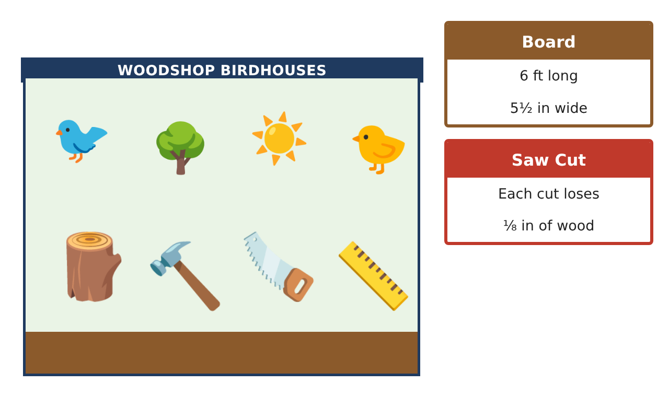
PRE-ALGEBRA (7TH) · UNIT 5: OPERATIONS WITH FRACTIONS
Birdhouse Builders
Measure, cut, and assemble birdhouses using fraction and mixed-number operations.
CP2 Project
2–3 class periods
Name: ______________________________ Group: ______________________________

Slide 2
The Scenario
CP2
The science club is putting birdhouses around the school garden. Each birdhouse is cut from wooden boards measured in feet and inches, and the measurements use fractions of an inch.
You will use fraction operations to plan every cut, avoid wasting wood, and design your own birdhouse.
Pre-Algebra (7th) · Unit 5: Operations with Fractions · Birdhouse Builders

Slide 3
Learning Goals & Timeline
CP2
Learning Goals
Timeline
• I can compare and order fractions and mixed numbers.
• I can add and subtract mixed numbers to plan cuts.
• I can multiply and divide fractions to find how many pieces fit.
Day 1
Read the Measurements
Day 2
Plan the Cuts
Day 3
Customary Units
Final
Birdhouse Build Plan + reflection
Pre-Algebra (7th) · Unit 5: Operations with Fractions · Birdhouse Builders

Slide 4
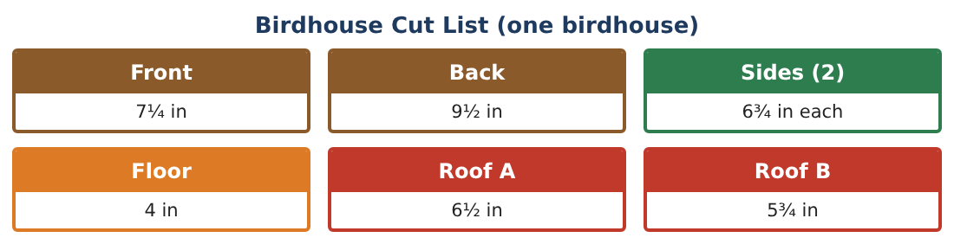
Part 1: Read the Measurements
CP2
Day 1 · Use the Cut List.
1. Order the pieces from shortest to longest.
2. Write 7¹⁄₄ and 6³⁄₄ as decimals.
3. Which is longer, Roof A (6¹⁄₂ in) or a side (6³⁄₄ in)? By how much?
4. Write 9¹⁄₂ as an improper fraction.
Pre-Algebra (7th) · Unit 5: Operations with Fractions · Birdhouse Builders

Slide 5
Part 2: Plan the Cuts
CP2
Day 2 · Add and subtract mixed numbers.
5. Find the total length of the front and back.
Starter: 7¹⁄₄ + 9²⁄₄ = ___
6. Find the total length of all seven pieces (two sides).
7. A board is 72 inches long. How much is left after cutting one birdhouse (ignore the saw cuts)?
8. How many 6³⁄₄-inch sides can you cut from 25¹⁄₂ inches?
Pre-Algebra (7th) · Unit 5: Operations with Fractions · Birdhouse Builders

Slide 6
Part 3: Customary Units
CP2
Day 3 · 12 inches = 1 foot.
9. How many feet is 46¹⁄₂ inches?
10. Paint covers 2¹⁄₂ birdhouses per can. How many cans for 10 birdhouses?
11. Draw your own birdhouse and label every piece with a fraction measurement. Find the total length of wood.
Pre-Algebra (7th) · Unit 5: Operations with Fractions · Birdhouse Builders

Slide 7
Final Product: Birdhouse Build Plan
CP2
Your final product must include:
☐ Your birdhouse drawing with labeled pieces
☐ Ordered list of pieces
☐ Total wood needed in inches and feet
☐ Leftover wood from one board
☐ Paint plan
Pre-Algebra (7th) · Unit 5: Operations with Fractions · Birdhouse Builders

Slide 8
Scoring Rubric
CP2
Criteria | 4 – Exceeds | 3 – Meets | 2 – Approaching | 1 – Beginning
Mathematical Accuracy | All calculations and solutions are correct; answers include units and are checked. | Nearly all work is correct; minor errors do not change conclusions. | Several errors; some conclusions are affected. | Many errors or missing work.
Reasoning & Justification | Clear, complete explanations connect every answer to the situation; uses precise vocabulary. | Explanations are mostly clear and connected to the situation. | Explanations are brief or partly unclear. | Little or no explanation.
Application & Design | Cut plans, scaling, and equations use fraction operations correctly and produce a buildable birdhouse. Goes beyond the minimum with a creative, realistic choice. | Cut plans, scaling, and equations use fraction operations correctly and produce a buildable birdhouse. | Design is incomplete or only partly uses the math from the unit. | Design is missing or unrelated to the unit math.
Communication & Presentation | Build plan includes the drawing, cut list, board plan, and materials. Polished, organized, and visually engaging. | Build plan includes the drawing, cut list, board plan, and materials. Organized and easy to follow. | Product is missing required parts or is hard to follow. | Product is mostly missing.
Pre-Algebra (7th) · Unit 5: Operations with Fractions · Birdhouse Builders

Slide 9
Reflection
CP2
R1. How do you add mixed numbers with different denominators?
R2. Why do you round DOWN when finding how many pieces you can cut?
Pre-Algebra (7th) · Unit 5: Operations with Fractions · Birdhouse Builders

