Slide 1
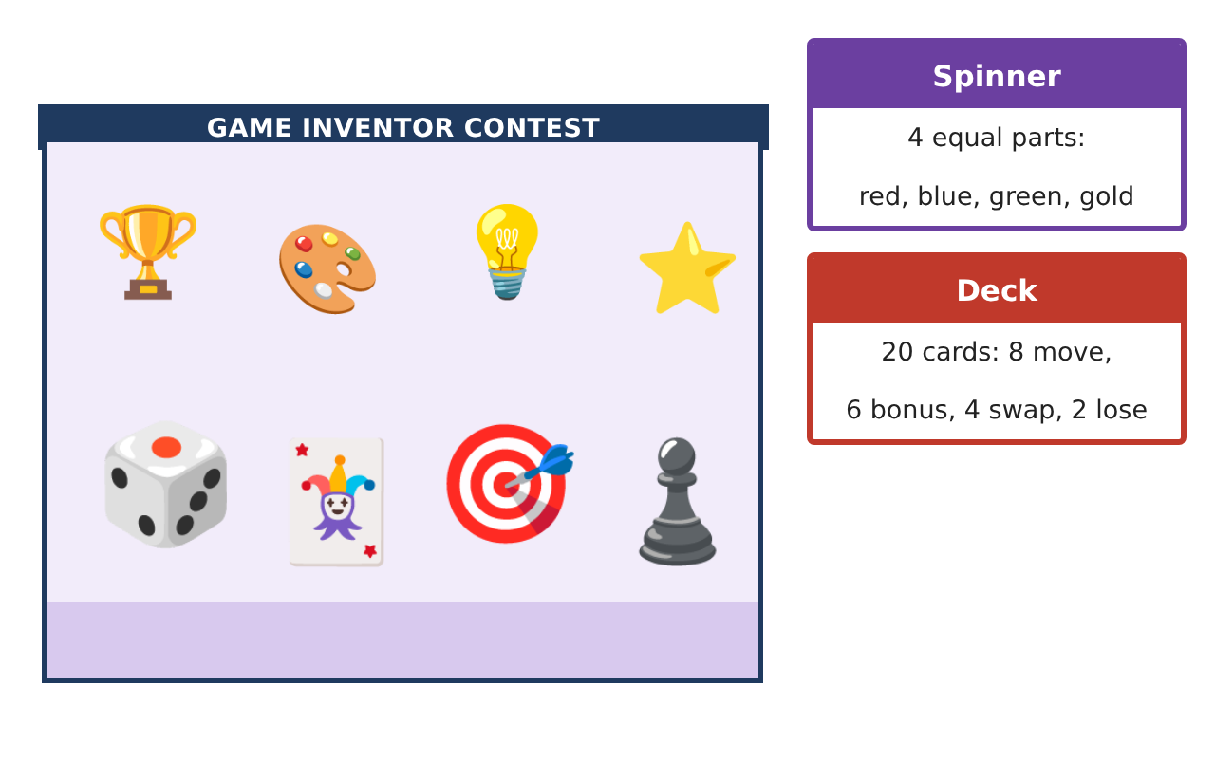
PRE-ALGEBRA (7TH) · UNIT 12: DATA ANALYSIS AND PROBABILITY
Board Game Inventor
Use probability, counting, and data to invent and test a fair board game.
CP1 Project
2–3 class periods
Name: ______________________________ Group: ______________________________

Slide 2
The Scenario
CP1
A game company is holding a contest for the best new family board game. Your game must use dice, a spinner, and a deck of cards, and it must be fair and fun.
You will use probability and data to design the rules, test the game, and prove it is fair.
Pre-Algebra (7th) · Unit 12: Data Analysis and Probability · Board Game Inventor

Slide 3
Learning Goals & Timeline
CP1
Learning Goals
Timeline
• I can compute probabilities of independent and dependent events.
• I can use permutations and combinations to count.
• I can analyze playtest data with displays and statistics.
Day 1
Compound Events
Day 2
Counting
Day 3
Test & Fix
Final
Game Box & Rule Book + reflection
Pre-Algebra (7th) · Unit 12: Data Analysis and Probability · Board Game Inventor

Slide 4
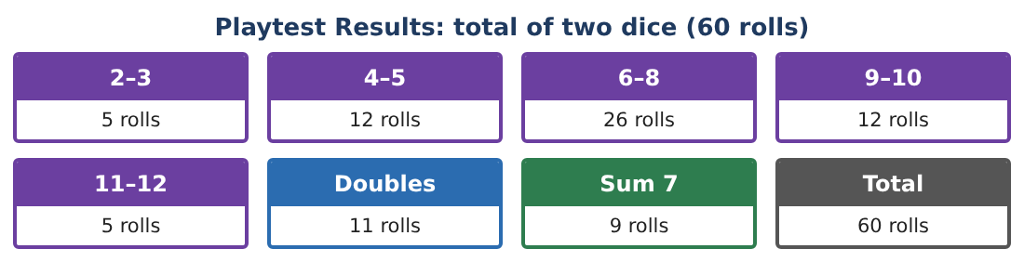
Part 1: Compound Events
CP1
Day 1 · Spinner (4 equal colors), deck of 20 cards (8 move, 6 bonus, 4 swap, 2 lose), two dice.
1. Find P(sum of two dice is 8 or more).
2. Find P(spin red and draw a bonus card).
3. Draw two cards without replacement. Find P(both bonus).
4. Draw two cards with replacement. Find P(both bonus). Why is it different?
Pre-Algebra (7th) · Unit 12: Data Analysis and Probability · Board Game Inventor

Slide 5
Part 2: Counting
CP1
Day 2 · Players choose tokens and turn order.
5. In how many orders can 4 players take turns?
6. There are 8 tokens. In how many ways can 4 players each choose a different token (order matters)?
7. A player chooses 3 of the 8 bonus powers (order does not matter). How many choices?
8. Explain why the token question is a permutation and the powers question is a combination.
Pre-Algebra (7th) · Unit 12: Data Analysis and Probability · Board Game Inventor

Slide 6
Part 3: Test & Fix
CP1
Day 3 · Use the Playtest Results card.
9. Compare the experimental probability of rolling 6–8 with the theoretical probability.
10. In the current rules, Player 1 wins on doubles and Player 2 wins on a sum of 7. Is that fair? Use theoretical probabilities.
11. Write your rule book with at least three rules, each with its probability, and explain why your game is fair.
Pre-Algebra (7th) · Unit 12: Data Analysis and Probability · Board Game Inventor

Slide 7
Final Product: Game Box & Rule Book
CP1
Your final product must include:
☐ Probabilities of compound events
☐ Counting with permutations and combinations
☐ Playtest comparison
☐ Fairness analysis
☐ Rule book and game board
Pre-Algebra (7th) · Unit 12: Data Analysis and Probability · Board Game Inventor

Slide 8
Scoring Rubric
CP1
Criteria | 4 – Exceeds | 3 – Meets | 2 – Approaching | 1 – Beginning
Mathematical Accuracy | All calculations and solutions are correct; answers include units and are checked. | Nearly all work is correct; minor errors do not change conclusions. | Several errors; some conclusions are affected. | Many errors or missing work.
Reasoning & Justification | Clear, complete explanations connect every answer to the situation; uses precise vocabulary. | Explanations are mostly clear and connected to the situation. | Explanations are brief or partly unclear. | Little or no explanation.
Application & Design | Probabilities, counts, and playtest analysis are correct and used to make the game fair. Goes beyond the minimum with a creative, realistic choice. | Probabilities, counts, and playtest analysis are correct and used to make the game fair. | Design is incomplete or only partly uses the math from the unit. | Design is missing or unrelated to the unit math.
Communication & Presentation | Rule book includes probabilities, the board, playtest displays, and a fairness argument. Polished, organized, and visually engaging. | Rule book includes probabilities, the board, playtest displays, and a fairness argument. Organized and easy to follow. | Product is missing required parts or is hard to follow. | Product is mostly missing.
Pre-Algebra (7th) · Unit 12: Data Analysis and Probability · Board Game Inventor

Slide 9
Reflection
CP1
R1. How can you tell whether two events are independent?
R2. Why are more playtests better?
Pre-Algebra (7th) · Unit 12: Data Analysis and Probability · Board Game Inventor

