Slide 1
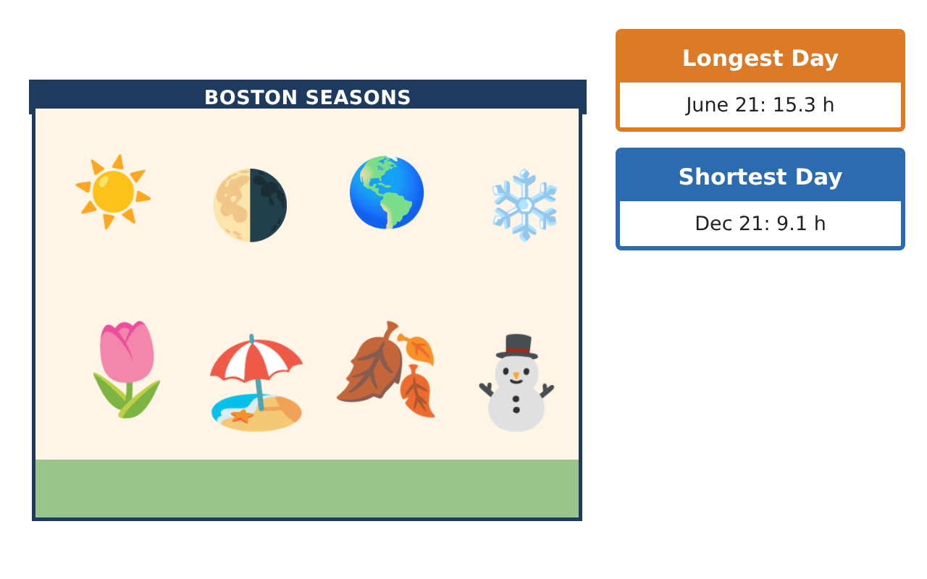
PRECALCULUS · UNIT 4: TRIGONOMETRIC FUNCTIONS
Daylight and Seasons
Model hours of daylight and temperatures with sinusoidal functions.
CP2 Project
2–3 class periods
Name: ______________________________ Group: ______________________________

Slide 2
The Scenario
CP2
The parks department wants to schedule outdoor events when there is plenty of daylight and comfortable weather. Daylight and temperature rise and fall every year in a repeating pattern.
You will use the unit circle and sinusoidal functions to model the seasons and recommend event dates.
Precalculus · Unit 4: Trigonometric Functions · Daylight and Seasons

Slide 3
Learning Goals & Timeline
CP2
Learning Goals
Timeline
• I can convert between degrees and radians and use the unit circle.
• I can find amplitude, midline, and period from data.
• I can use a sinusoidal model to make predictions.
Day 1
Earth’s Orbit
Day 2
Daylight Model
Day 3
Plan Events
Final
Seasonal Planning Report + reflection
Precalculus · Unit 4: Trigonometric Functions · Daylight and Seasons

Slide 4
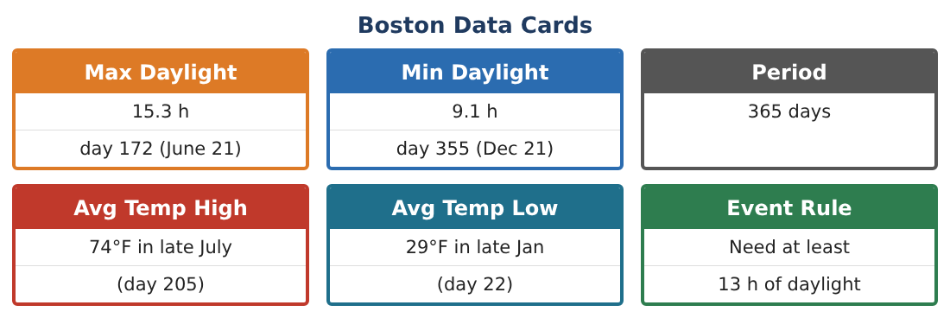
Part 1: Earth’s Orbit
CP2
Day 1 · Earth travels around the Sun once every 365 days.
1. How many degrees does Earth travel in one day? (Round to two decimals.)
2. Convert 90° and 180° to radians.
3. Find sin π⁄6, cos π⁄3, and sin π⁄2 using the unit circle.
4. In which quadrant is an angle of 5π⁄4? Give its sine and cosine signs.
Precalculus · Unit 4: Trigonometric Functions · Daylight and Seasons

Slide 5
Part 2: Daylight Model
CP2
Day 2 · Use the Boston Data Cards.
5. Find the midline (average of max and min daylight).
Starter: (max + min) ÷ 2
6. Find the amplitude.
7. What is the period in days?
8. A model is D(t) = 3.1 sin(2π⁄365(t − 80)) + 12.2. Find D(80) and D(172).
Precalculus · Unit 4: Trigonometric Functions · Daylight and Seasons

Slide 6
Part 3: Plan Events
CP2
Day 3 · Use your model.
9. Find D(1) (January 1) and D(200) (mid-July).
10. Use a table to estimate the first day with at least 13 hours of daylight.
11. Recommend three event dates and explain using the model.
Precalculus · Unit 4: Trigonometric Functions · Daylight and Seasons

Slide 7
Final Product: Seasonal Planning Report
CP2
Your final product must include:
☐ Degree-radian conversions and unit-circle values
☐ Amplitude, midline, and period
☐ Daylight model with predictions
☐ Event dates
☐ Seasonal report
Precalculus · Unit 4: Trigonometric Functions · Daylight and Seasons

Slide 8
Scoring Rubric
CP2
Criteria | 4 – Exceeds | 3 – Meets | 2 – Approaching | 1 – Beginning
Mathematical Accuracy | All calculations and solutions are correct; answers include units and are checked. | Nearly all work is correct; minor errors do not change conclusions. | Several errors; some conclusions are affected. | Many errors or missing work.
Reasoning & Justification | Clear, complete explanations connect every answer to the situation; uses precise vocabulary. | Explanations are mostly clear and connected to the situation. | Explanations are brief or partly unclear. | Little or no explanation.
Application & Design | Sinusoidal models are built from data and used correctly to predict and solve for event dates. Goes beyond the minimum with a creative, realistic choice. | Sinusoidal models are built from data and used correctly to predict and solve for event dates. | Design is incomplete or only partly uses the math from the unit. | Design is missing or unrelated to the unit math.
Communication & Presentation | Report includes models, graphs, solutions, and a clear recommendation. Polished, organized, and visually engaging. | Report includes models, graphs, solutions, and a clear recommendation. Organized and easy to follow. | Product is missing required parts or is hard to follow. | Product is mostly missing.
Precalculus · Unit 4: Trigonometric Functions · Daylight and Seasons

Slide 9
Reflection
CP2
R1. Why is a sine function a good model for daylight?
R2. What does the midline represent?
Precalculus · Unit 4: Trigonometric Functions · Daylight and Seasons

