Slide 1
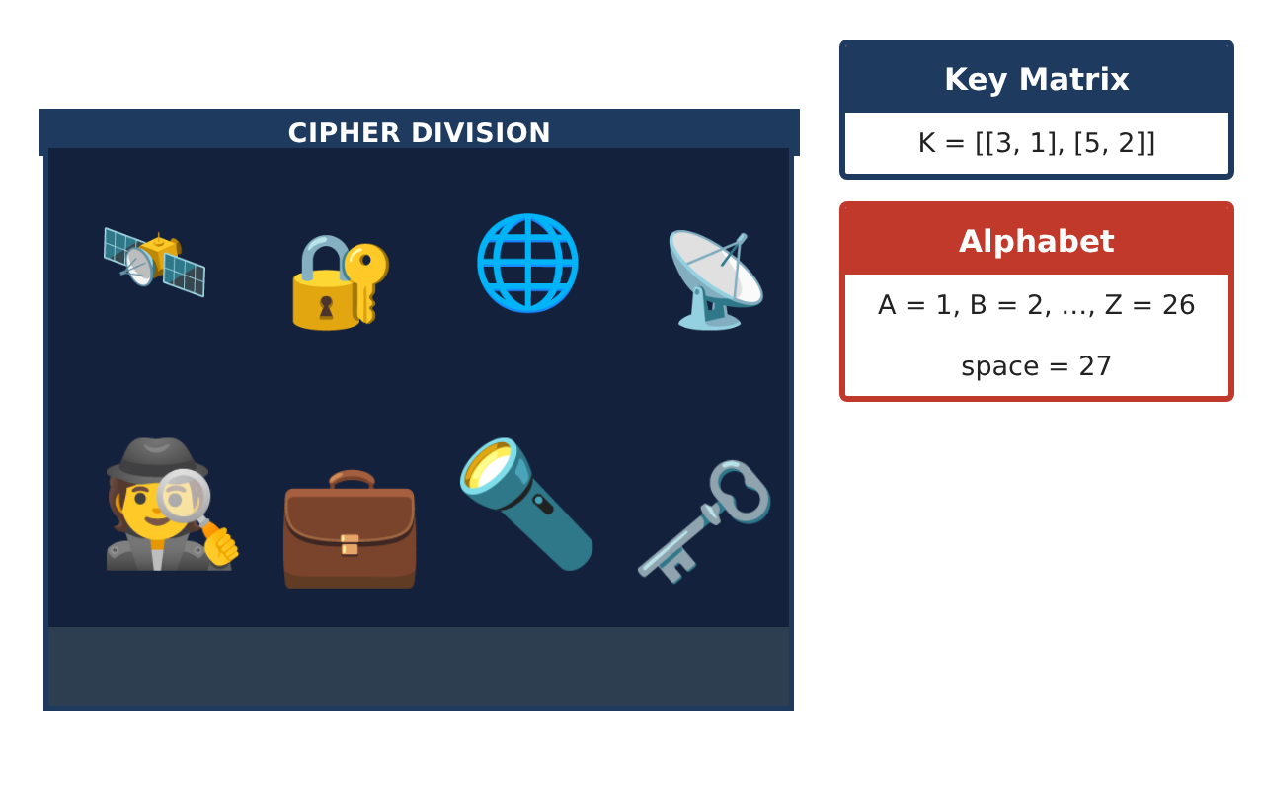
PRECALCULUS · UNIT 6: MATRICES
Spy Agency Codes
Use matrices to manage inventory, encode secret messages, and solve systems.
CP2 Project
2–3 class periods
Name: ______________________________ Group: ______________________________

Slide 2
The Scenario
CP2
Welcome to the Cipher Division. Agents carry gadgets from three warehouses, field reports must be encoded so enemies cannot read them, and supply problems arrive as systems of equations.
You will use matrices to track gadgets, encode and decode messages, and solve supply problems.
Precalculus · Unit 6: Matrices · Spy Agency Codes

Slide 3
Learning Goals & Timeline
CP2
Learning Goals
Timeline
• I can add matrices and multiply by a scalar.
• I can multiply a matrix by a column matrix.
• I can encode a message with a key matrix.
Day 1
Inventory
Day 2
Costs
Day 3
Secret Codes
Final
Agent Mission File + reflection
Precalculus · Unit 6: Matrices · Spy Agency Codes

Slide 4
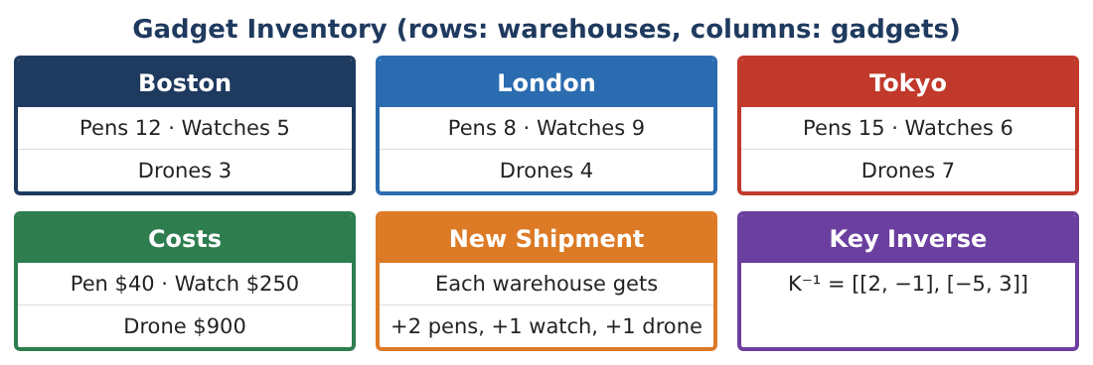
Part 1: Inventory
CP2
Day 1 · Write the inventory as a 3 × 3 matrix I (rows Boston, London, Tokyo; columns pens, watches, drones).
1. Write matrix I and give its dimensions.
2. Add the New Shipment matrix S = [[2, 1, 1], [2, 1, 1], [2, 1, 1]] to I.
3. The agency doubles the original inventory. Find 2I.
4. What does the entry in row 3, column 3 of I mean?
Precalculus · Unit 6: Matrices · Spy Agency Codes

Slide 5
Part 2: Costs
CP2
Day 2 · Cost column matrix C = [40, 250, 900] (pens, watches, drones).
5. Find the value of the Boston gadgets: 12(40) + 5(250) + 3(900).
Starter: 12 × 40 + 5 × ___ + 3 × ___
6. Find I · C (the value of each warehouse).
7. Which warehouse has the most valuable inventory?
8. Why can we multiply a 3 × 3 matrix by a 3 × 1 matrix?
Precalculus · Unit 6: Matrices · Spy Agency Codes

Slide 6
Part 3: Secret Codes
CP2
Day 3 · Key K = [[3, 1], [5, 2]]. Letters: A = 1, …, Z = 26.
9. Write the word HI as a column matrix.
10. Encode HI by computing K · [8, 9].
11. Decode [33, 58] using K⁻¹ = [[2, −1], [−5, 3]]. Do you get HI back?
Precalculus · Unit 6: Matrices · Spy Agency Codes

Slide 7
Final Product: Agent Mission File
CP2
Your final product must include:
☐ Inventory matrices and operations
☐ Warehouse values
☐ Encoded and decoded message
☐ Explanation of dimensions
☐ Mission file
Precalculus · Unit 6: Matrices · Spy Agency Codes

Slide 8
Scoring Rubric
CP2
Criteria | 4 – Exceeds | 3 – Meets | 2 – Approaching | 1 – Beginning
Mathematical Accuracy | All calculations and solutions are correct; answers include units and are checked. | Nearly all work is correct; minor errors do not change conclusions. | Several errors; some conclusions are affected. | Many errors or missing work.
Reasoning & Justification | Clear, complete explanations connect every answer to the situation; uses precise vocabulary. | Explanations are mostly clear and connected to the situation. | Explanations are brief or partly unclear. | Little or no explanation.
Application & Design | Matrix operations, inverses, and determinants are correct and used for inventory, codes, and systems. Goes beyond the minimum with a creative, realistic choice. | Matrix operations, inverses, and determinants are correct and used for inventory, codes, and systems. | Design is incomplete or only partly uses the math from the unit. | Design is missing or unrelated to the unit math.
Communication & Presentation | Mission file includes matrices, coded messages, solved systems, and explanations. Polished, organized, and visually engaging. | Mission file includes matrices, coded messages, solved systems, and explanations. Organized and easy to follow. | Product is missing required parts or is hard to follow. | Product is mostly missing.
Precalculus · Unit 6: Matrices · Spy Agency Codes

Slide 9
Reflection
CP2
R1. Why do the dimensions have to match to add matrices?
R2. Why does the inverse matrix decode the message?
Precalculus · Unit 6: Matrices · Spy Agency Codes

