Slide 1
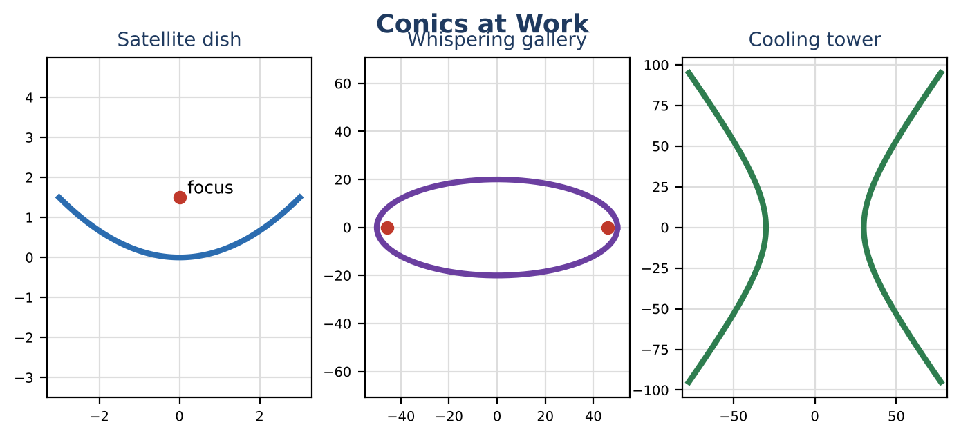
ALGEBRA 2 · UNIT 9: CONIC SECTIONS
Signals & Dishes
Use circles, parabolas, ellipses, and hyperbolas to design communication technology.
CP1 Project
2–3 class periods
Name: ______________________ Group: ______________________

Slide 2
The Scenario
CP1
SignalWorks builds cell towers, satellite dishes, and even whispering galleries for science museums. Each design depends on one of the conic sections.
You will analyze each design with its equation, then create a coverage plan for a new town.
Algebra 2 · Unit 9: Conic Sections · Signals & Dishes

Slide 3
Learning Goals & Timeline
CP1
Learning Goals
Timeline
• I can write conic equations in standard form by completing the square.
• I can find foci, vertices, and asymptotes.
• I can design with conic properties.
Day 1
Towers & Dishes
Day 2
Ellipses & Hyperbolas
Day 3
Coverage Map
Final
Engineering Design Brief + reflection
Algebra 2 · Unit 9: Conic Sections · Signals & Dishes

Slide 4
Part 1: Towers & Dishes
CP1
Day 1 · Write each equation in standard form.
1. A tower's coverage boundary is x² + y² − 6x + 2y − 6 = 0. Complete the square to find its center and radius.
2. Design a dish that is 8 ft across and 1 ft deep. Write its equation x² = 4py and find the focus.
3. Write the equation of a circle centered at (−2, 4) that passes through (1, 8).
Algebra 2 · Unit 9: Conic Sections · Signals & Dishes

Slide 5
Part 2: Ellipses & Hyperbolas
CP1
Day 2 · Find all key features.
4. For x² ÷ 2500 + y² ÷ 400 = 1, find the vertices, co-vertices, and foci.
5. For x² ÷ 900 − y² ÷ 1600 = 1, find the vertices, foci, and asymptotes.
6. Classify each: 4x² + 9y² = 36; x² − y² = 16; y = 2x² − 3; x² + y² = 25.
Algebra 2 · Unit 9: Conic Sections · Signals & Dishes

Slide 6
Part 3: Coverage Map
CP1
Day 3 · Cover houses (0, 0), (4, 2), (−3, 5), and (6, −4) with as few 5-mile towers as possible.
7. Place the towers and write their equations.
8. Show every house is covered.
9. Explain why your number of towers is the minimum (or near it).
Algebra 2 · Unit 9: Conic Sections · Signals & Dishes

Slide 7
Final Product: Engineering Design Brief
CP1
Your final product must include:
☐ Standard-form equations
☐ Dish design
☐ Feature tables
☐ Coverage plan
Algebra 2 · Unit 9: Conic Sections · Signals & Dishes

Slide 8
Scoring Rubric
CP1
Criteria | 4 – Exceeds | 3 – Meets | 2 – Approaching | 1 – Beginning
Mathematical Accuracy | All calculations and solutions are correct; answers include units and are checked. | Nearly all work is correct; minor errors do not change conclusions. | Several errors; some conclusions are affected. | Many errors or missing work.
Reasoning & Justification | Clear, complete explanations connect every answer to the situation; uses precise vocabulary. | Explanations are mostly clear and connected to the situation. | Explanations are brief or partly unclear. | Little or no explanation.
Application & Design | Coverage plan uses correct circle equations and point tests, and every conic feature is correct. Goes beyond the minimum with a creative, realistic choice. | Coverage plan uses correct circle equations and point tests, and every conic feature is correct. | Design is incomplete or only partly uses the math from the unit. | Design is missing or unrelated to the unit math.
Communication & Presentation | Brief includes each conic's equation, key features (center, foci, vertices, radius), and a coverage map. Polished, organized, and visually engaging. | Brief includes each conic's equation, key features (center, foci, vertices, radius), and a coverage map. Organized and easy to follow. | Product is missing required parts or is hard to follow. | Product is mostly missing.
Algebra 2 · Unit 9: Conic Sections · Signals & Dishes

Slide 9
Reflection
CP1
R1. Why does completing the square reveal a circle's center?
R2. How do ellipses and hyperbolas differ in the relationship among a, b, and c?
Algebra 2 · Unit 9: Conic Sections · Signals & Dishes

