Slide 1
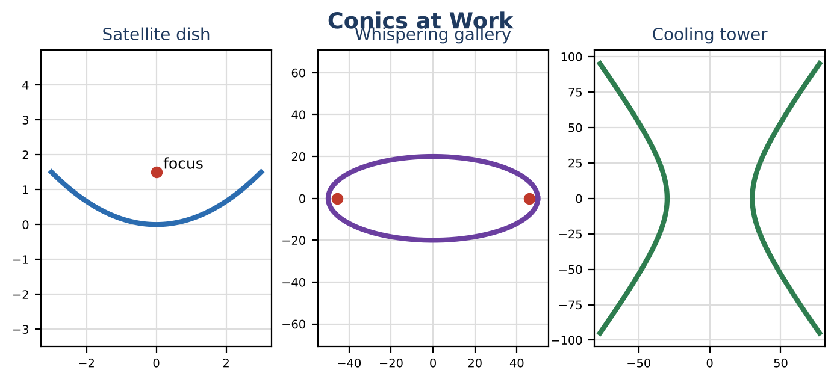
ALGEBRA 2 · UNIT 9: CONIC SECTIONS
Signals & Dishes
Use circles, parabolas, ellipses, and hyperbolas to design communication technology.
CP2 Project
2–3 class periods
Name: ______________________ Group: ______________________

Slide 2
The Scenario
CP2
SignalWorks builds cell towers, satellite dishes, and even whispering galleries for science museums. Each design depends on one of the conic sections.
You will analyze each design with its equation, then create a coverage plan for a new town.
Algebra 2 · Unit 9: Conic Sections · Signals & Dishes

Slide 3
Learning Goals & Timeline
CP2
Learning Goals
Timeline
• I can identify features of conics from their equations.
• I can test whether a point is inside a circle.
• I can use the focus of a parabola.
Day 1
Towers & Dishes
Day 2
Ellipses & Hyperbolas
Day 3
Coverage Map
Final
Engineering Design Brief + reflection
Algebra 2 · Unit 9: Conic Sections · Signals & Dishes

Slide 4
Part 1: Towers & Dishes
CP2
Day 1 · A tower covers the region inside (x − 3)² + (y + 1)² = 16 (miles).
1. Find the tower's location (center) and coverage radius.
2. Is a house at (6, 2) covered? Is one at (5, 1)? Substitute to check.
3. A satellite dish has the shape x² = 6y. For x² = 4py the focus is at (0, p). Where should the receiver go?
4. How deep is the dish if it is 6 ft across (x from −3 to 3)?
Algebra 2 · Unit 9: Conic Sections · Signals & Dishes

Slide 5
Part 2: Ellipses & Hyperbolas
CP2
Day 2 · Use the formulas.
5. A whispering gallery has the shape x² ÷ 2500 + y² ÷ 400 = 1 (feet). Find a, b, and c = √(a² − b²). Where should two people stand to hear whispers?
6. A cooling tower's side has the shape x² ÷ 900 − y² ÷ 1600 = 1. Find a, b, and c = √(a² + b²).
7. Match each conic to its real-world use and say why the shape is useful.
Algebra 2 · Unit 9: Conic Sections · Signals & Dishes

Slide 6
Part 3: Coverage Map
CP2
Day 3 · Plan coverage for a town with houses at (0, 0), (4, 2), (−3, 5), and (6, −4).
8. Place one or two towers (radius 5 miles each). Write each equation.
9. Test every house.
10. Draw the map.
Algebra 2 · Unit 9: Conic Sections · Signals & Dishes

Slide 7
Final Product: Engineering Design Brief
CP2
Your final product must include:
☐ Coverage map with circle equations
☐ Dish focus and depth
☐ Gallery and tower features
☐ Design brief
Algebra 2 · Unit 9: Conic Sections · Signals & Dishes

Slide 8
Scoring Rubric
CP2
Criteria | 4 – Exceeds | 3 – Meets | 2 – Approaching | 1 – Beginning
Mathematical Accuracy | All calculations and solutions are correct; answers include units and are checked. | Nearly all work is correct; minor errors do not change conclusions. | Several errors; some conclusions are affected. | Many errors or missing work.
Reasoning & Justification | Clear, complete explanations connect every answer to the situation; uses precise vocabulary. | Explanations are mostly clear and connected to the situation. | Explanations are brief or partly unclear. | Little or no explanation.
Application & Design | Coverage plan uses correct circle equations and point tests, and every conic feature is correct. Goes beyond the minimum with a creative, realistic choice. | Coverage plan uses correct circle equations and point tests, and every conic feature is correct. | Design is incomplete or only partly uses the math from the unit. | Design is missing or unrelated to the unit math.
Communication & Presentation | Brief includes each conic's equation, key features (center, foci, vertices, radius), and a coverage map. Polished, organized, and visually engaging. | Brief includes each conic's equation, key features (center, foci, vertices, radius), and a coverage map. Organized and easy to follow. | Product is missing required parts or is hard to follow. | Product is mostly missing.
Algebra 2 · Unit 9: Conic Sections · Signals & Dishes

Slide 9
Reflection
CP2
R1. Why is the receiver placed at the focus?
R2. How does a circle equation come from the distance formula?
Algebra 2 · Unit 9: Conic Sections · Signals & Dishes

