Slide 1
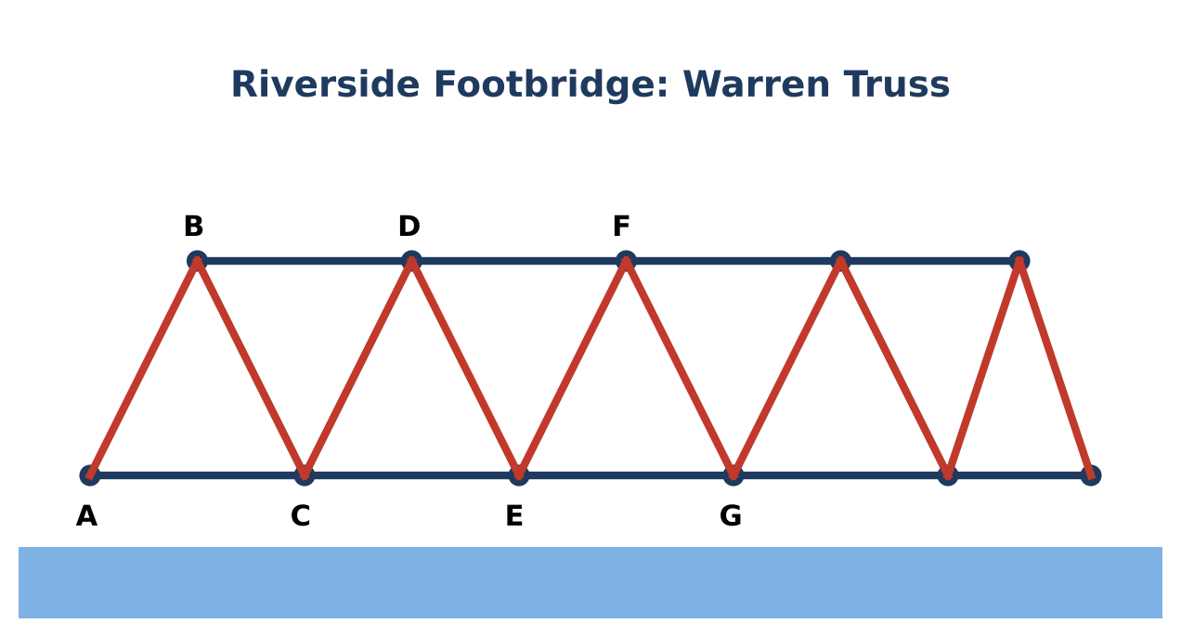
GEOMETRY · UNIT 3: TRIANGLE CONGRUENCE
Bridge Truss Inspector
Prove triangles congruent to inspect and design a footbridge truss.
CP1 Project
2–3 class periods
Name: ______________________ Group: ______________________

Slide 2
The Scenario
CP1
The town's new footbridge uses a Warren truss: a chain of triangles between a top beam and a bottom beam. Triangles are rigid, so a truss made of congruent triangles spreads the load evenly.
The inspector needs proof that the triangles are congruent, plus the missing measurements. Then the town wants your design for a second bridge.
Geometry · Unit 3: Triangle Congruence · Bridge Truss Inspector

Slide 3
Learning Goals & Timeline
CP1
Learning Goals
Timeline
• I can prove triangles congruent with SSS, SAS, ASA, AAS, and HL.
• I can use CPCTC to prove parts congruent.
• I can solve problems with isosceles triangles.
Day 1
Inspect the Triangles
Day 2
Proofs & Isosceles Triangles
Day 3
Design a Truss
Final
Truss Inspection Report + reflection
Geometry · Unit 3: Triangle Congruence · Bridge Truss Inspector

Slide 4
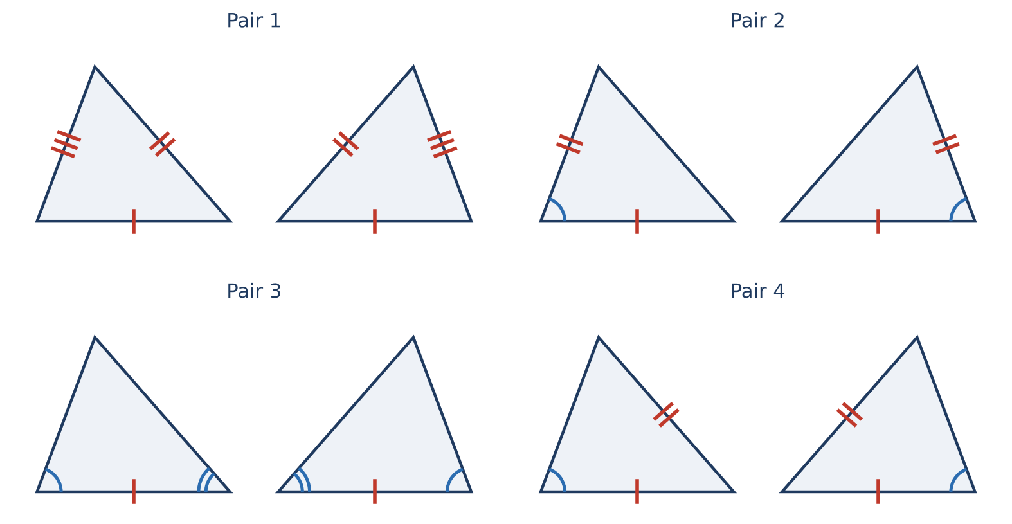
Part 1: Inspect the Triangles
CP1
Day 1 · Justify every decision.
1. Name the shortcut for each pair or explain why there isn't one.
2. Two right triangles in the bridge's support have congruent hypotenuses and one pair of congruent legs. Which shortcut applies? Why does this not contradict "SSA doesn't work"?
3. Write a congruence statement for two triangles in the truss and list all six pairs of corresponding parts.
Geometry · Unit 3: Triangle Congruence · Bridge Truss Inspector

Slide 5
Part 2: Proofs & Isosceles Triangles
CP1
Day 2 · Use algebra and proof.
4. △ABC ≅ △DEF with AB = 3x − 2, DE = 2x + 5, m∠C = (5z − 10)°, and m∠F = (3z + 14)°. Find x, z, AB, and m∠C.
5. An isosceles truss triangle has base angles (3x + 5)° and (5x − 15)°. Find all three angles.
6. Given: B is the midpoint of AD and of CE (segments AD and CE cross at B). Prove: AC ∥ ED.
Geometry · Unit 3: Triangle Congruence · Bridge Truss Inspector

Slide 6
Part 3: Design a Truss
CP1
Day 3 · Design a 40-foot truss with congruent isosceles triangles.
7. Choose the base length and the height of each triangle. Sketch the truss with markings.
8. Prove that two adjacent triangles in your truss are congruent.
9. Find the total length of beam material you need (use the Pythagorean Theorem for the slanted members).
Geometry · Unit 3: Triangle Congruence · Bridge Truss Inspector

Slide 7
Final Product: Truss Inspection Report
CP1
Your final product must include:
☐ Congruence decisions and statements
☐ CPCTC proof
☐ Solved measurements
☐ Truss design with proof and material total
Geometry · Unit 3: Triangle Congruence · Bridge Truss Inspector

Slide 8
Scoring Rubric
CP1
Criteria | 4 – Exceeds | 3 – Meets | 2 – Approaching | 1 – Beginning
Mathematical Accuracy | All calculations and solutions are correct; answers include units and are checked. | Nearly all work is correct; minor errors do not change conclusions. | Several errors; some conclusions are affected. | Many errors or missing work.
Reasoning & Justification | Clear, complete explanations connect every answer to the situation; uses precise vocabulary. | Explanations are mostly clear and connected to the situation. | Explanations are brief or partly unclear. | Little or no explanation.
Application & Design | Truss design uses congruent triangles with correct markings and a valid congruence justification. Goes beyond the minimum with a creative, realistic choice. | Truss design uses congruent triangles with correct markings and a valid congruence justification. | Design is incomplete or only partly uses the math from the unit. | Design is missing or unrelated to the unit math.
Communication & Presentation | Inspection report includes congruence decisions with shortcuts, solved measurements, at least one proof, and a labeled truss design. Polished, organized, and visually engaging. | Inspection report includes congruence decisions with shortcuts, solved measurements, at least one proof, and a labeled truss design. Organized and easy to follow. | Product is missing required parts or is hard to follow. | Product is mostly missing.
Geometry · Unit 3: Triangle Congruence · Bridge Truss Inspector

Slide 9
Reflection
CP1
R1. Why is HL a special case that works?
R2. How does CPCTC let you prove lines parallel?
Geometry · Unit 3: Triangle Congruence · Bridge Truss Inspector

