Slide 1
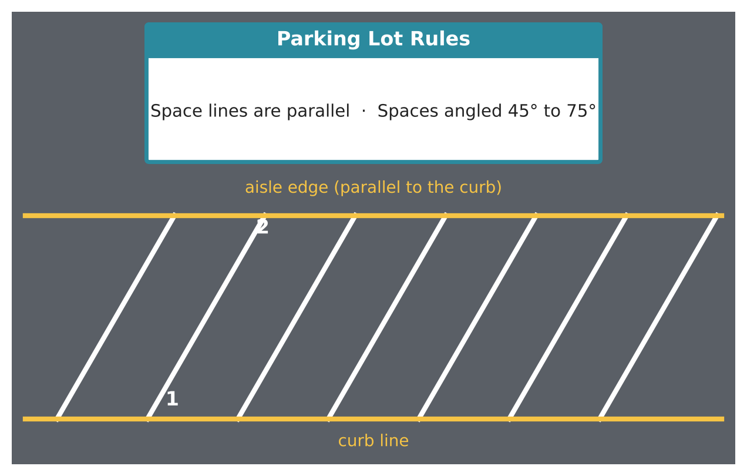
GEOMETRY · UNIT 2: ANGLES AND PARALLEL LINES
Parking Lot Designer
Use parallel lines and transversals to design an angled parking lot.
CP2 Project
2–3 class periods
Name: ______________________ Group: ______________________

Slide 2
The Scenario
CP2
The school is repaving its parking lot, and the facilities director wants angled spaces that are easier to pull into. The stripes for the spaces must all be parallel, and the curb and aisle edges are parallel too.
That means every stripe is a transversal crossing two parallel lines, so the angles must follow the parallel-line rules. You will check the plan, find the missing angles, and design your own lot.
Geometry · Unit 2: Angles and Parallel Lines · Parking Lot Designer

Slide 3
Learning Goals & Timeline
CP2
Learning Goals
Timeline
• I can name angle pairs formed by parallel lines and a transversal.
• I can use angle relationships to find missing angles.
• I can use the triangle angle sum.
Day 1
Angle Pairs on the Lot
Day 2
Use Algebra
Day 3
Design Your Lot
Final
Parking Lot Blueprint + reflection
Geometry · Unit 2: Angles and Parallel Lines · Parking Lot Designer

Slide 4
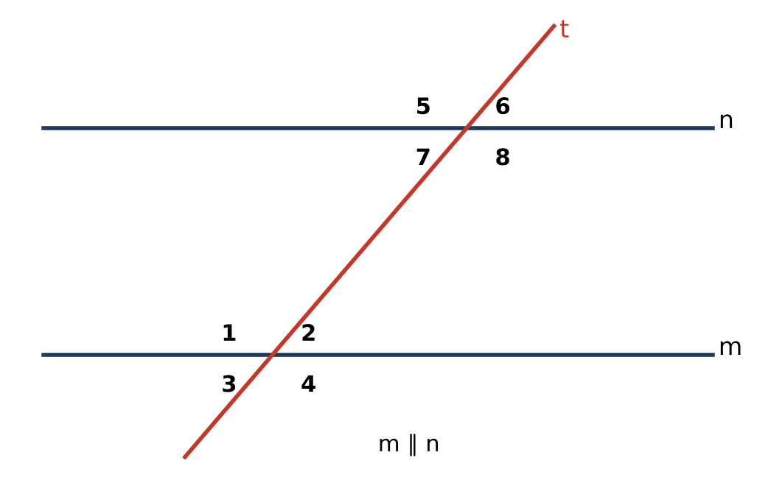
Part 1: Angle Pairs on the Lot
CP2
Day 1 · Lines m and n are parallel. Line t is a stripe (transversal).
1. Name a pair of corresponding angles, alternate interior angles, and same-side interior angles in the diagram.
2. If m∠2 = 60°, find the measures of the other seven angles.
3. Which angle pairs are congruent and which are supplementary?
Geometry · Unit 2: Angles and Parallel Lines · Parking Lot Designer

Slide 5
Part 2: Use Algebra
CP2
Day 2 · Write and solve an equation for each.
4. Alternate interior angles measure (3x + 15)° and (5x − 25)°. Find x and the angle measure.
5. Same-side interior angles measure (2y + 10)° and (4y − 10)°. Find y and both angles.
6. A triangular traffic island has angles x°, 2x°, and 3x°. Find each angle.
7. An exterior angle of the island measures 130°. One remote interior angle is 70°. Find the other.
Geometry · Unit 2: Angles and Parallel Lines · Parking Lot Designer

Slide 6
Part 3: Design Your Lot
CP2
Day 3 · Rules: stripes are parallel, and spaces make an angle between 45° and 75° with the curb.
8. Draw a curb and an aisle edge that are parallel. Choose an angle for your spaces and draw at least five stripes.
9. Label all eight angles at one stripe and explain how you found them.
10. Add a triangular island and label its angles.
Geometry · Unit 2: Angles and Parallel Lines · Parking Lot Designer

Slide 7
Final Product: Parking Lot Blueprint
CP2
Your final product must include:
☐ Blueprint with parallel stripes and an angle between 45° and 75°
☐ Labeled angles at one stripe with reasons
☐ Traffic island with angle measures
☐ A note to the facilities director
Geometry · Unit 2: Angles and Parallel Lines · Parking Lot Designer

Slide 8
Scoring Rubric
CP2
Criteria | 4 – Exceeds | 3 – Meets | 2 – Approaching | 1 – Beginning
Mathematical Accuracy | All calculations and solutions are correct; answers include units and are checked. | Nearly all work is correct; minor errors do not change conclusions. | Several errors; some conclusions are affected. | Many errors or missing work.
Reasoning & Justification | Clear, complete explanations connect every answer to the situation; uses precise vocabulary. | Explanations are mostly clear and connected to the situation. | Explanations are brief or partly unclear. | Little or no explanation.
Application & Design | Design follows the rules (parallel stripes, angles between 45° and 75°) with every angle justified. Goes beyond the minimum with a creative, realistic choice. | Design follows the rules (parallel stripes, angles between 45° and 75°) with every angle justified. | Design is incomplete or only partly uses the math from the unit. | Design is missing or unrelated to the unit math.
Communication & Presentation | Blueprint shows parallel stripes, labeled angle measures with reasons, and a traffic island. Polished, organized, and visually engaging. | Blueprint shows parallel stripes, labeled angle measures with reasons, and a traffic island. Organized and easy to follow. | Product is missing required parts or is hard to follow. | Product is mostly missing.
Geometry · Unit 2: Angles and Parallel Lines · Parking Lot Designer

Slide 9
Reflection
CP2
R1. Why do all the stripes have to make the same angle with the curb?
R2. Which angle relationship was most useful? Why?
Geometry · Unit 2: Angles and Parallel Lines · Parking Lot Designer

