Slide 1
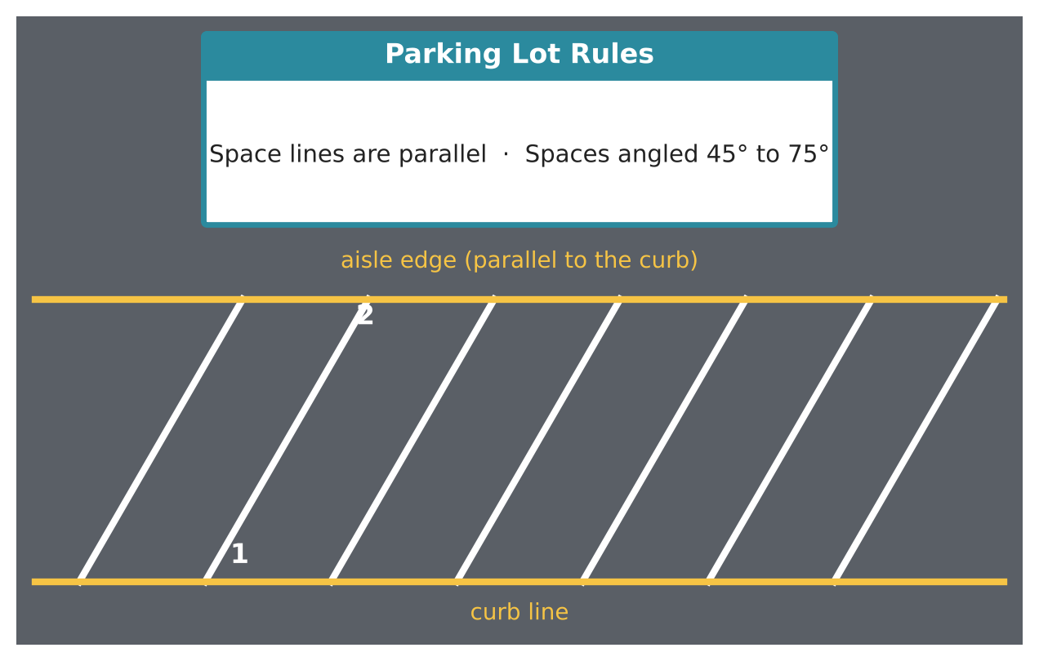
GEOMETRY · UNIT 2: ANGLES AND PARALLEL LINES
Parking Lot Designer
Use parallel lines and transversals to design an angled parking lot.
Honors Project
2–3 class periods
Name: ______________________ Group: ______________________

Slide 2
The Scenario
Honors
The school is repaving its parking lot, and the facilities director wants angled spaces that are easier to pull into. The stripes for the spaces must all be parallel, and the curb and aisle edges are parallel too.
That means every stripe is a transversal crossing two parallel lines, so the angles must follow the parallel-line rules. You will check the plan, find the missing angles, and design your own lot.
Geometry · Unit 2: Angles and Parallel Lines · Parking Lot Designer

Slide 3
Learning Goals & Timeline
Honors
Learning Goals
Timeline
• I can write two-column proofs about parallel lines.
• I can solve systems of equations that come from angle relationships.
• I can design within constraints and prove the design is correct.
Day 1
Systems from Angles
Day 2
Proofs & Islands
Day 3
Design & Prove
Final
Parking Lot Blueprint + reflection
Geometry · Unit 2: Angles and Parallel Lines · Parking Lot Designer

Slide 4
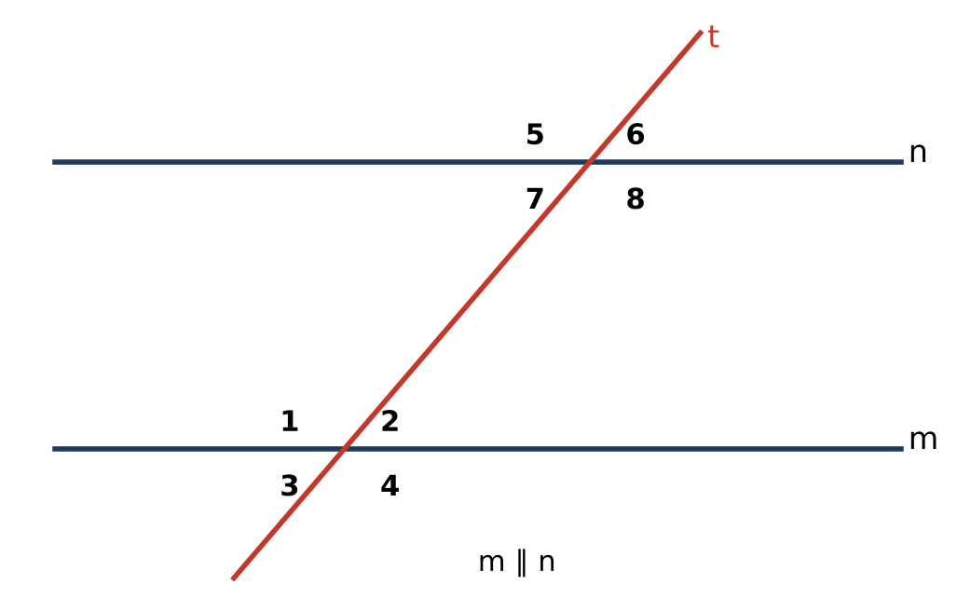
Part 1: Systems from Angles
Honors
Day 1 · Lines m and n are parallel; t is a stripe.
1. m∠1 = (3x + y)°, m∠5 = 110°, m∠2 = (2x − y)°, and m∠6 = 70°. Write a system and solve for x and y.
2. m∠3 = (x² − 5x)° and m∠6 = (2x + 18)°. Find all possible values of x that make the angles valid.
3. Prove: If m ∥ n, then ∠1 and ∠7 are supplementary.
Geometry · Unit 2: Angles and Parallel Lines · Parking Lot Designer

Slide 5
Part 2: Proofs & Islands
Honors
Day 2 · Justify every step.
4. Prove the Triangle Angle Sum Theorem using a line through one vertex parallel to the opposite side.
5. A triangular island has an exterior angle of (5x − 6)° and remote interior angles of (2x + 8)° and (x + 22)°. Find all interior angles.
6. Two stripes make angles of (4k − 3)° and (2k + 39)° with the curb at corresponding positions. For what k are they parallel? Is that k allowed by the 45° to 75° rule?
Geometry · Unit 2: Angles and Parallel Lines · Parking Lot Designer

Slide 6
Part 3: Design & Prove
Honors
Day 3 · Design a lot with stripes at a chosen angle θ, a crosswalk that is a transversal, and a triangular island.
7. Draw the design and give every angle in terms of θ.
8. Write a proof that your crosswalk makes equal angles with every stripe.
9. Choose θ so that the island's angles are θ, 2θ − 30, and a third angle that is a whole number between 45 and 75. Show your work.
Geometry · Unit 2: Angles and Parallel Lines · Parking Lot Designer

Slide 7
Final Product: Parking Lot Blueprint
Honors
Your final product must include:
☐ System and quadratic angle solutions
☐ Two proofs (parallel lines and triangle sum)
☐ Design with angles written in terms of θ
☐ Island design meeting the constraint
Geometry · Unit 2: Angles and Parallel Lines · Parking Lot Designer

Slide 8
Scoring Rubric
Honors
Criteria | 4 – Exceeds | 3 – Meets | 2 – Approaching | 1 – Beginning
Mathematical Accuracy | All calculations and solutions are correct; answers include units and are checked. | Nearly all work is correct; minor errors do not change conclusions. | Several errors; some conclusions are affected. | Many errors or missing work.
Reasoning & Justification | Clear, complete explanations connect every answer to the situation; uses precise vocabulary. | Explanations are mostly clear and connected to the situation. | Explanations are brief or partly unclear. | Little or no explanation.
Application & Design | Design follows the rules (parallel stripes, angles between 45° and 75°) with every angle justified. Goes beyond the minimum with a creative, realistic choice. | Design follows the rules (parallel stripes, angles between 45° and 75°) with every angle justified. | Design is incomplete or only partly uses the math from the unit. | Design is missing or unrelated to the unit math.
Communication & Presentation | Blueprint shows parallel stripes, labeled angle measures with reasons, and a traffic island. Polished, organized, and visually engaging. | Blueprint shows parallel stripes, labeled angle measures with reasons, and a traffic island. Organized and easy to follow. | Product is missing required parts or is hard to follow. | Product is mostly missing.
Geometry · Unit 2: Angles and Parallel Lines · Parking Lot Designer

Slide 9
Reflection
Honors
R1. Why does the Triangle Angle Sum proof need a parallel line?
R2. How did writing angles in terms of θ help your design?
Geometry · Unit 2: Angles and Parallel Lines · Parking Lot Designer

