Slide 1

CALCULUS · UNIT 8: DIFFERENTIAL EQUATIONS
Cold Case: Newton’s Cooling
Use differential equations, slope fields, and Euler’s method to solve a mystery with Newton’s Law of Cooling.
CP1 Project
2–3 class periods
Name: ______________________________ Group: ______________________________

Slide 2
The Scenario
CP1
A mug of cocoa was found on the desk of a missing museum key. The temperature of the cocoa was measured twice, and the room temperature is known. Newton’s Law of Cooling says the cocoa cools at a rate proportional to the difference between its temperature and the room.
You will use differential equations to decide when the cocoa was poured and which suspect was in the room at that time.
Calculus · Unit 8: Differential Equations · Cold Case: Newton’s Cooling

Slide 3
Learning Goals & Timeline
CP1
Learning Goals
Timeline
• I can use slope fields and Euler’s method to approximate solutions.
• I can solve separable differential equations.
• I can apply exponential models to solve problems.
Day 1
Euler’s Method
Day 2
Separation of Variables
Day 3
Case Analysis
Final
Case File Report + reflection
Calculus · Unit 8: Differential Equations · Cold Case: Newton’s Cooling

Slide 4
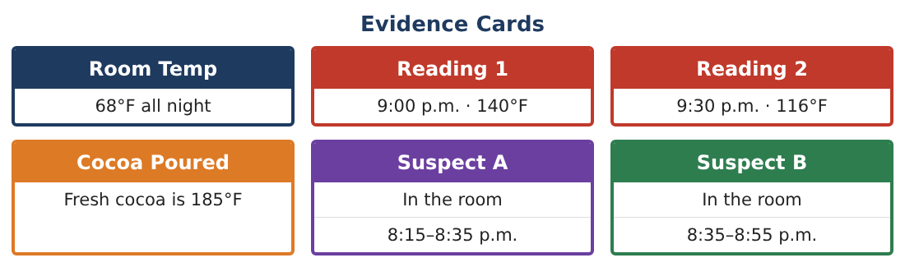
Part 1: Euler’s Method
CP1
Day 1 · dT⁄dt = −0.0135(T − 68), T(0) = 140 at 9:00 p.m.
1. Use Euler’s method with Δt = 10 min to estimate T(30).
2. Compare with the measured 116°F. Is Euler’s estimate an over- or underestimate? Why?
3. Sketch the slope field and your Euler path.
4. Find d²T⁄dt² in terms of T and use it to explain the concavity.
Calculus · Unit 8: Differential Equations · Cold Case: Newton’s Cooling

Slide 5
Part 2: Separation of Variables
CP1
Day 2 · Solve dT⁄dt = −k(T − 68), T(0) = 140.
5. Separate and integrate to find the general solution.
6. Use T(0) = 140 and T(30) = 116 to find A and k.
7. Find when the cocoa was 185°F.
8. Find when the cocoa reaches 80°F.
Calculus · Unit 8: Differential Equations · Cold Case: Newton’s Cooling

Slide 6
Part 3: Case Analysis
CP1
Day 3 · Use the Evidence Cards.
9. The thermometer may be off by ±2°F at 9:30 (114–118°F). Find the range of possible pour times.
10. Does the uncertainty change which suspect is implicated?
11. Write the case file with the model, calculations, and conclusion.
Calculus · Unit 8: Differential Equations · Cold Case: Newton’s Cooling

Slide 7
Final Product: Case File Report
CP1
Your final product must include:
☐ Euler approximation with error discussion
☐ Separable solution with constants
☐ Pour time and later temperatures
☐ Uncertainty analysis
☐ Case file
Calculus · Unit 8: Differential Equations · Cold Case: Newton’s Cooling

Slide 8
Scoring Rubric
CP1
Criteria | 4 – Exceeds | 3 – Meets | 2 – Approaching | 1 – Beginning
Mathematical Accuracy | All calculations and solutions are correct; answers include units and are checked. | Nearly all work is correct; minor errors do not change conclusions. | Several errors; some conclusions are affected. | Many errors or missing work.
Reasoning & Justification | Clear, complete explanations connect every answer to the situation; uses precise vocabulary. | Explanations are mostly clear and connected to the situation. | Explanations are brief or partly unclear. | Little or no explanation.
Application & Design | Differential equations are analyzed and solved correctly and used to reach a justified verdict. Goes beyond the minimum with a creative, realistic choice. | Differential equations are analyzed and solved correctly and used to reach a justified verdict. | Design is incomplete or only partly uses the math from the unit. | Design is missing or unrelated to the unit math.
Communication & Presentation | Case file includes the model, slope field, calculations, uncertainty, and verdict. Polished, organized, and visually engaging. | Case file includes the model, slope field, calculations, uncertainty, and verdict. Organized and easy to follow. | Product is missing required parts or is hard to follow. | Product is mostly missing.
Calculus · Unit 8: Differential Equations · Cold Case: Newton’s Cooling

Slide 9
Reflection
CP1
R1. Why does separation of variables give an exponential solution?
R2. How can measurement error affect a conclusion?
Calculus · Unit 8: Differential Equations · Cold Case: Newton’s Cooling

