Slide 1

CALCULUS · UNIT 8: DIFFERENTIAL EQUATIONS
Cold Case: Newton’s Cooling
Use differential equations, slope fields, and Euler’s method to solve a mystery with Newton’s Law of Cooling.
CP2 Project
2–3 class periods
Name: ______________________________ Group: ______________________________

Slide 2
The Scenario
CP2
A mug of cocoa was found on the desk of a missing museum key. The temperature of the cocoa was measured twice, and the room temperature is known. Newton’s Law of Cooling says the cocoa cools at a rate proportional to the difference between its temperature and the room.
You will use differential equations to decide when the cocoa was poured and which suspect was in the room at that time.
Calculus · Unit 8: Differential Equations · Cold Case: Newton’s Cooling

Slide 3
Learning Goals & Timeline
CP2
Learning Goals
Timeline
• I can verify a solution of a differential equation.
• I can read and sketch a slope field.
• I can use an exponential model to solve for time.
Day 1
Rates of Cooling
Day 2
Slope Field
Day 3
Solve the Case
Final
Case File Report + reflection
Calculus · Unit 8: Differential Equations · Cold Case: Newton’s Cooling

Slide 4
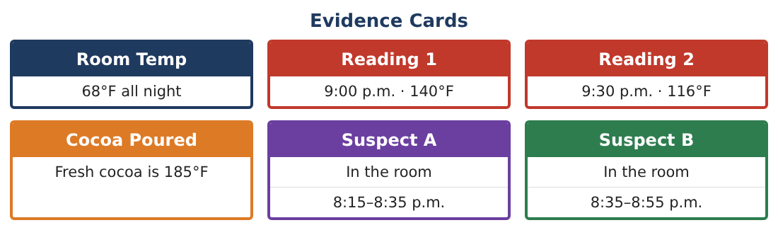
Part 1: Rates of Cooling
CP2
Day 1 · Newton’s Law: dT⁄dt = −k(T − 68).
1. Is dT⁄dt positive or negative when the cocoa is 140°F? What does that mean?
2. Where is the cocoa cooling fastest: at 140°F or 100°F? Why?
3. Verify that T = 68 + 72e^(−kt) satisfies dT⁄dt = −k(T − 68).
Starter: Differentiate T, then compare with −k(T − 68).
4. What happens to T as t becomes very large?
Calculus · Unit 8: Differential Equations · Cold Case: Newton’s Cooling

Slide 5
Part 2: Slope Field
CP2
Day 2 · Use k = 0.02 per minute: dT⁄dt = −0.02(T − 68).
5. Find the slope at T = 140, T = 104, T = 68, and T = 50.
6. Sketch the slope field for 0 ≤ t ≤ 60 and 40 ≤ T ≤ 160. Describe the pattern.
7. Sketch the solution through (0, 140).
8. Explain why the line T = 68 is a solution.
Calculus · Unit 8: Differential Equations · Cold Case: Newton’s Cooling

Slide 6
Part 3: Solve the Case
CP2
Day 3 · With t = 0 at 9:00 p.m.: T(t) = 68 + 72e^(−kt) and T(30) = 116.
9. Find k.
10. When was the cocoa 185°F? Solve 68 + 72e^(−kt) = 185 (t will be negative).
11. Which suspect was in the room when the cocoa was poured?
Calculus · Unit 8: Differential Equations · Cold Case: Newton’s Cooling

Slide 7
Final Product: Case File Report
CP2
Your final product must include:
☐ Verified model
☐ Slope field with a solution curve
☐ Value of k
☐ Time the cocoa was poured
☐ Case file naming the suspect
Calculus · Unit 8: Differential Equations · Cold Case: Newton’s Cooling

Slide 8
Scoring Rubric
CP2
Criteria | 4 – Exceeds | 3 – Meets | 2 – Approaching | 1 – Beginning
Mathematical Accuracy | All calculations and solutions are correct; answers include units and are checked. | Nearly all work is correct; minor errors do not change conclusions. | Several errors; some conclusions are affected. | Many errors or missing work.
Reasoning & Justification | Clear, complete explanations connect every answer to the situation; uses precise vocabulary. | Explanations are mostly clear and connected to the situation. | Explanations are brief or partly unclear. | Little or no explanation.
Application & Design | Differential equations are analyzed and solved correctly and used to reach a justified verdict. Goes beyond the minimum with a creative, realistic choice. | Differential equations are analyzed and solved correctly and used to reach a justified verdict. | Design is incomplete or only partly uses the math from the unit. | Design is missing or unrelated to the unit math.
Communication & Presentation | Case file includes the model, slope field, calculations, uncertainty, and verdict. Polished, organized, and visually engaging. | Case file includes the model, slope field, calculations, uncertainty, and verdict. Organized and easy to follow. | Product is missing required parts or is hard to follow. | Product is mostly missing.
Calculus · Unit 8: Differential Equations · Cold Case: Newton’s Cooling

Slide 9
Reflection
CP2
R1. Why does the cocoa cool more slowly over time?
R2. Why was t negative when solving for 185°F?
Calculus · Unit 8: Differential Equations · Cold Case: Newton’s Cooling

