Slide 1
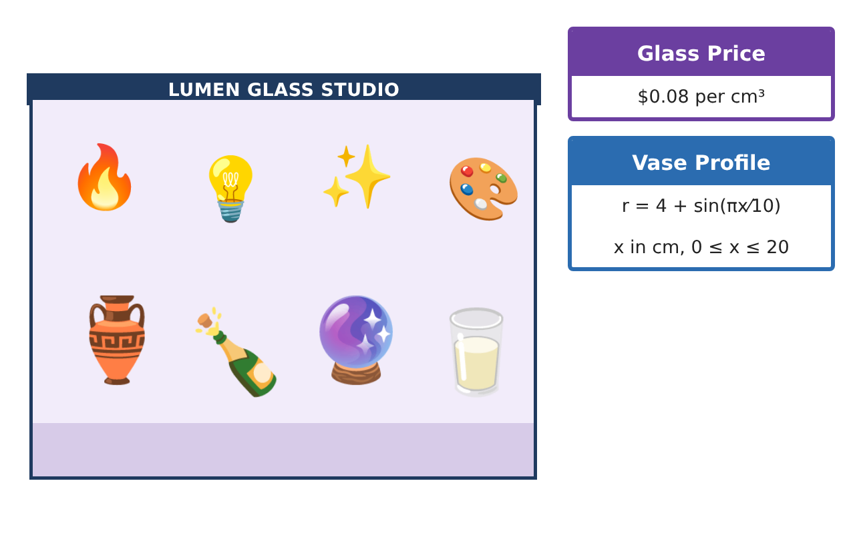
CALCULUS · UNIT 7: APPLICATIONS OF INTEGRALS
Glass Vase Studio
Use area between curves and volumes of revolution to design glass vases and bottles.
Honors Project
2–3 class periods
Name: ______________________________ Group: ______________________________

Slide 2
The Scenario
Honors
Lumen Glass Studio makes vases, bottles, and paperweights. Each design is a curve spun around an axis, the logo is a region between two curves, and glass is priced by volume.
You will use integrals to calculate the area and volume of each design and price the products.
Calculus · Unit 7: Applications of Integrals · Glass Vase Studio

Slide 3
Learning Goals & Timeline
Honors
Learning Goals
Timeline
• I can set up and evaluate area and volume integrals about any axis.
• I can compare methods and use technology appropriately.
• I can optimize a design using integral models.
Day 1
Logo Design
Day 2
Vase Engineering
Day 3
Paperweights
Final
Product Design Portfolio + reflection
Calculus · Unit 7: Applications of Integrals · Glass Vase Studio

Slide 4
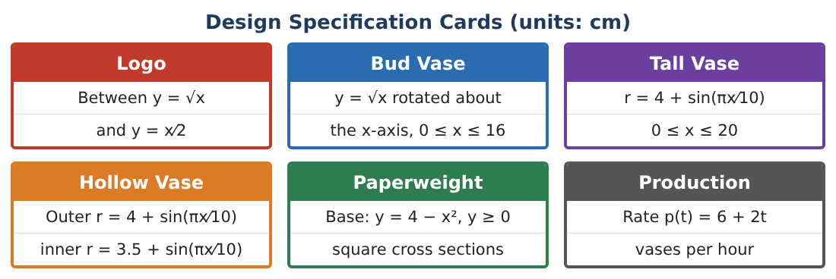
Part 1: Logo Design
Honors
Day 1 · Use the Design Specification Cards.
1. Find the area between y = √x and y = x⁄2 and the line x = 9 (two regions).
2. Find k so the vertical line x = k splits the logo (0 ≤ x ≤ 4) into two equal areas.
3. Rotate the logo about the x-axis. Find the volume (washer method).
4. Rotate the logo about the line y = −1. Find the volume.
Calculus · Unit 7: Applications of Integrals · Glass Vase Studio

Slide 5
Part 2: Vase Engineering
Honors
Day 2 · Hollow vase: outer 4 + s, inner 3.5 + s, s = sin(πx⁄10), 0 ≤ x ≤ 20.
5. Find the glass volume and the inside (water) volume.
6. The wall thickness is changed to w (inner r = 4 − w + s). Write the glass volume as a function of w.
7. The vase must hold at least 850 cm³ of water. What is the greatest wall thickness allowed?
8. Find the glass cost for that thickness.
Calculus · Unit 7: Applications of Integrals · Glass Vase Studio

Slide 6
Part 3: Paperweights
Honors
Day 3 · Base under y = 4 − x², y ≥ 0.
9. Compare the volumes with square and semicircular cross sections perpendicular to the x-axis.
10. Rotate the base about the y-axis. Use the disc method in y to find the volume.
11. Write the design portfolio with three products, their integrals, volumes, and prices.
Calculus · Unit 7: Applications of Integrals · Glass Vase Studio

Slide 7
Final Product: Product Design Portfolio
Honors
Your final product must include:
☐ Logo areas including split and rotations
☐ Vase thickness optimization
☐ Paperweight comparisons
☐ Prices for each product
☐ Design portfolio
Calculus · Unit 7: Applications of Integrals · Glass Vase Studio

Slide 8
Scoring Rubric
Honors
Criteria | 4 – Exceeds | 3 – Meets | 2 – Approaching | 1 – Beginning
Mathematical Accuracy | All calculations and solutions are correct; answers include units and are checked. | Nearly all work is correct; minor errors do not change conclusions. | Several errors; some conclusions are affected. | Many errors or missing work.
Reasoning & Justification | Clear, complete explanations connect every answer to the situation; uses precise vocabulary. | Explanations are mostly clear and connected to the situation. | Explanations are brief or partly unclear. | Little or no explanation.
Application & Design | Areas and volumes are set up and evaluated correctly and used to price and design products. Goes beyond the minimum with a creative, realistic choice. | Areas and volumes are set up and evaluated correctly and used to price and design products. | Design is incomplete or only partly uses the math from the unit. | Design is missing or unrelated to the unit math.
Communication & Presentation | Portfolio includes diagrams, integrals, results, and prices. Polished, organized, and visually engaging. | Portfolio includes diagrams, integrals, results, and prices. Organized and easy to follow. | Product is missing required parts or is hard to follow. | Product is mostly missing.
Calculus · Unit 7: Applications of Integrals · Glass Vase Studio

Slide 9
Reflection
Honors
R1. How does rotating about a different axis change the radius?
R2. Why did the water-volume requirement limit wall thickness?
Calculus · Unit 7: Applications of Integrals · Glass Vase Studio

