Slide 1
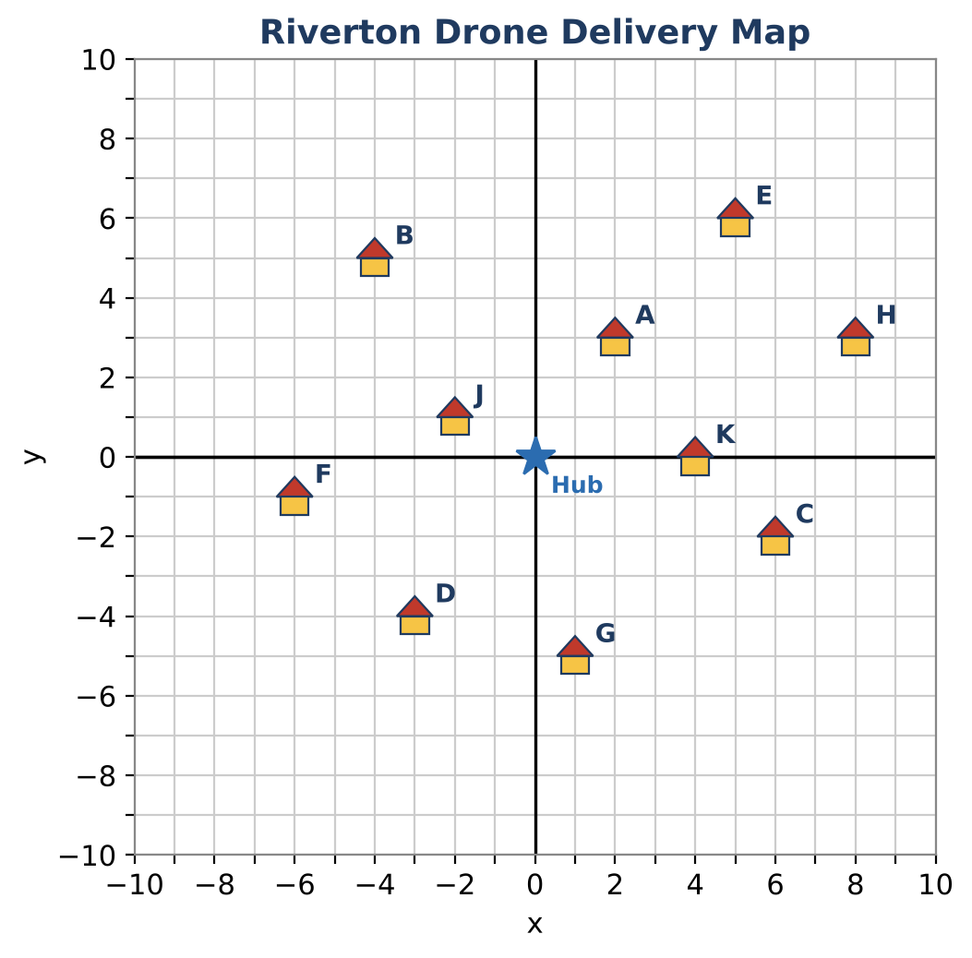
ALGEBRA 1 · UNIT 6: SYSTEMS OF EQUATIONS AND INEQUALITIES
Drone Delivery Zones
Map delivery zones with inequalities so every house gets its package.
Honors Project
2–3 class periods
Name: ______________________ Group: ______________________

Slide 2
The Scenario
Honors
SkyDrop, a new drone delivery company, has launched in the town of Riverton. Each drone covers a zone, and every zone is the solution region of an inequality on the town's coordinate map.
Customers are complaining that some houses never get deliveries! Your team will figure out which houses are in each zone, find the gaps, and design new zones so that every house is served.
Algebra 1 · Unit 6: Systems of Equations and Inequalities · Drone Delivery Zones

Slide 3
Learning Goals & Timeline
Honors
Learning Goals
Timeline
• I can write a system of inequalities from the vertices of a region.
• I can model a distance limit with absolute value inequalities.
• I can design a region that includes some points and excludes others.
Day 1
The Express Zone
Day 2
Battery Range
Day 3
Design a Second Hub
Final
Delivery Zone Map + reflection
Algebra 1 · Unit 6: Systems of Equations and Inequalities · Drone Delivery Zones

Slide 4
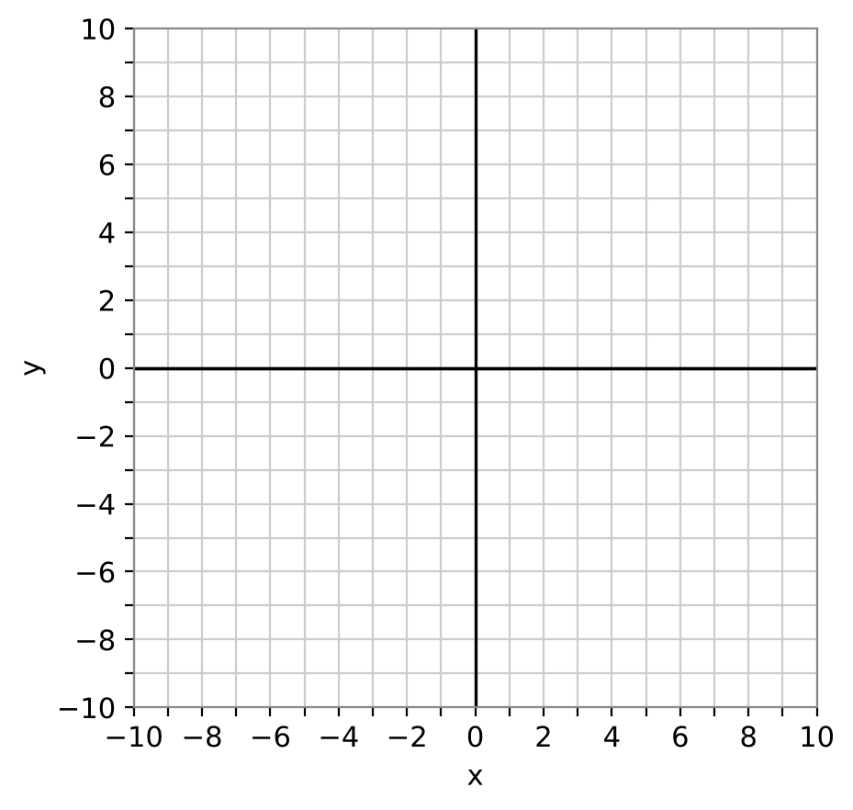
Part 1: The Express Zone
Honors
Day 1 · The Express Zone is the triangle with vertices (−2, −2), (6, −2), and (2, 6), boundaries included.
1. Write the equation of each side of the triangle.
2. Write a system of three inequalities for the Express Zone. Use a test point to choose each symbol.
3. Which houses are in the Express Zone? Show your checks.
4. Write a system for the same triangle with the boundaries NOT included. Which house changes?
Algebra 1 · Unit 6: Systems of Equations and Inequalities · Drone Delivery Zones

Slide 5
Part 2: Battery Range
Honors
Day 2 · Drones fly only along streets (horizontal and vertical). From the hub (0, 0), the trip to (x, y) is |x| + |y| blocks. Batteries allow at most 8 blocks.
5. Write the battery rule as an inequality. Test houses A, B, and C.
6. In Quadrant I, |x| + |y| ≤ 8 becomes x + y ≤ 8. Write the inequality for each of the other three quadrants.
7. Graph the region |x| + |y| ≤ 8. What shape is it? List every house inside it.
8. Which houses are inside the battery range but outside the Express Zone?
Algebra 1 · Unit 6: Systems of Equations and Inequalities · Drone Delivery Zones

Slide 6
Part 3: Design a Second Hub
Honors
Day 3 · SkyDrop will build a second hub so every house is within 8 blocks of a hub.
9. Choose a location (h, k) for the new hub. Write its battery range as |x − h| + |y − k| ≤ 8.
10. Show that every house is within range of at least one hub.
11. Graph both diamonds and explain how you chose (h, k).
Algebra 1 · Unit 6: Systems of Equations and Inequalities · Drone Delivery Zones

Slide 7
Final Product: Delivery Zone Map
Honors
Your final product must include:
☐ The Express Zone system and graph
☐ The battery-range diamond with its four inequalities
☐ A coverage table for both hubs
☐ Second-hub design with justification
☐ A final service map with legend
Algebra 1 · Unit 6: Systems of Equations and Inequalities · Drone Delivery Zones

Slide 8
Scoring Rubric
Honors
Criteria | 4 – Exceeds | 3 – Meets | 2 – Approaching | 1 – Beginning
Mathematical Accuracy | All calculations and solutions are correct; answers include units and are checked. | Nearly all work is correct; minor errors do not change conclusions. | Several errors; some conclusions are affected. | Many errors or missing work.
Reasoning & Justification | Clear, complete explanations connect every answer to the situation; uses precise vocabulary. | Explanations are mostly clear and connected to the situation. | Explanations are brief or partly unclear. | Little or no explanation.
Application & Design | New zones cover every unserved house, with correct boundaries and shading. Goes beyond the minimum with a creative, realistic choice. | New zones cover every unserved house, with correct boundaries and shading. | Design is incomplete or only partly uses the math from the unit. | Design is missing or unrelated to the unit math.
Communication & Presentation | Zone map shows every zone as a graphed inequality, lists the houses each zone serves, and shows full coverage. Polished, organized, and visually engaging. | Zone map shows every zone as a graphed inequality, lists the houses each zone serves, and shows full coverage. Organized and easy to follow. | Product is missing required parts or is hard to follow. | Product is mostly missing.
Algebra 1 · Unit 6: Systems of Equations and Inequalities · Drone Delivery Zones

Slide 9
Reflection
Honors
R1. How do four linear inequalities combine to make the diamond |x| + |y| ≤ 8?
R2. How did you use the houses that were farthest from the first hub to choose the second hub?
Algebra 1 · Unit 6: Systems of Equations and Inequalities · Drone Delivery Zones

