Slide 1
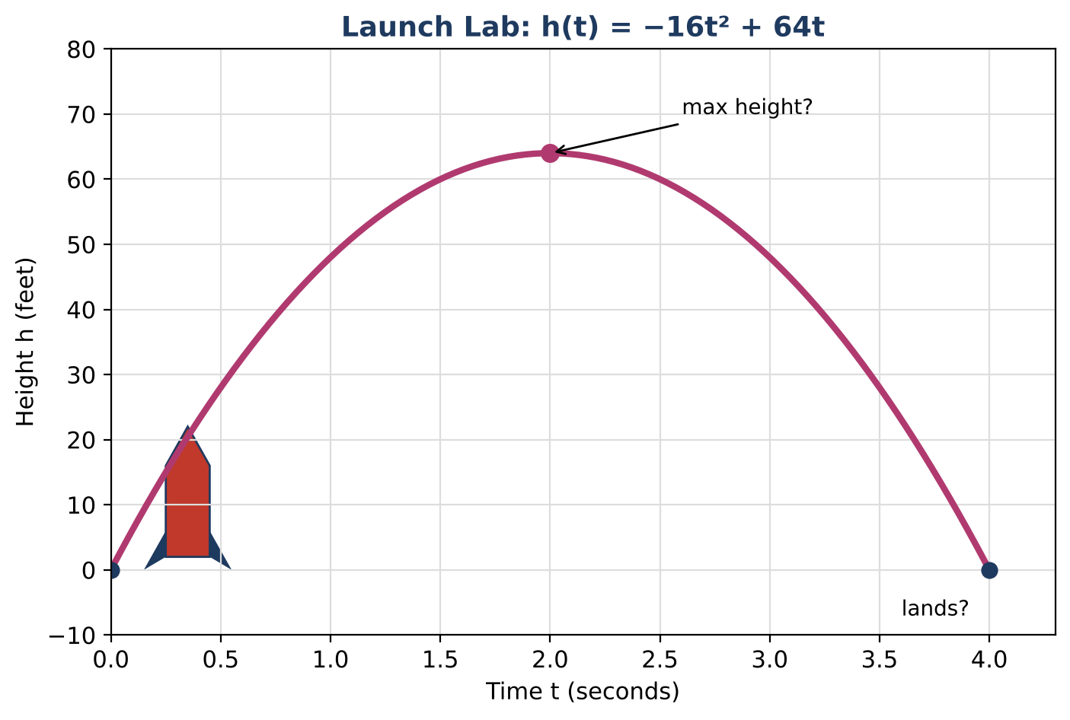
ALGEBRA 1 · UNIT 11: QUADRATIC FUNCTIONS AND EQUATIONS
Launch Lab
Model rockets and water balloons with quadratic functions.
CP2 Project
2–3 class periods
Name: ______________________ Group: ______________________

Slide 2
The Scenario
CP2
The science club is running a Launch Lab at the school fair: model rockets, water balloons, and a giant slingshot. Visitors want to know how high things go and when they will land.
Gravity makes the height of a launched object a quadratic function of time: h(t) = −16t² + vt + h₀, where v is the launch speed (feet per second) and h₀ is the starting height (feet). You will analyze the launches and then design your own.
Algebra 1 · Unit 11: Quadratic Functions and Equations · Launch Lab

Slide 3
Learning Goals & Timeline
CP2
Learning Goals
Timeline
• I can graph a quadratic function and identify its key features.
• I can solve quadratic equations by factoring in context.
• I can explain what the vertex and zeros mean for a launch.
Day 1
Rocket on the Ground
Day 2
Heights & Landings
Day 3
Design a Launch
Final
Launch Report + reflection
Algebra 1 · Unit 11: Quadratic Functions and Equations · Launch Lab

Slide 4
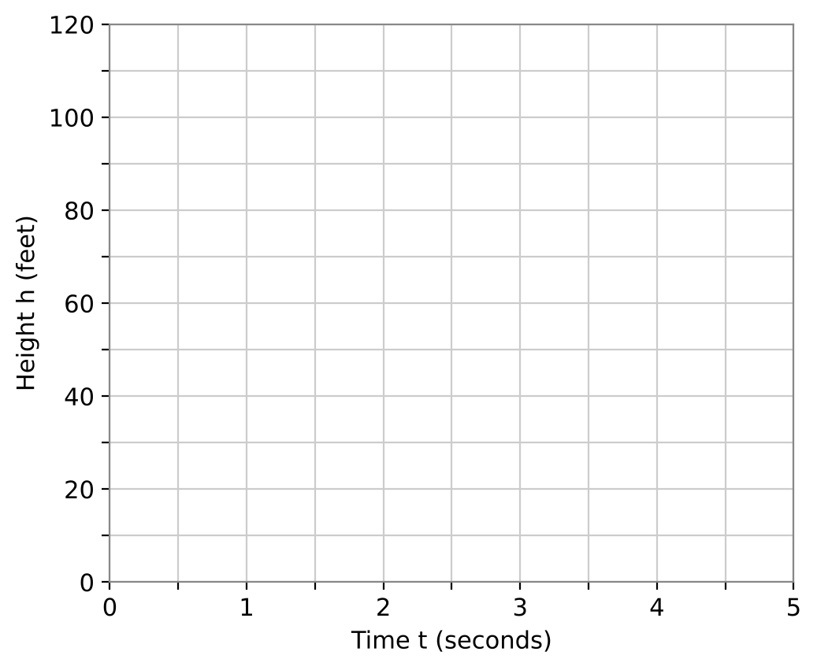
Part 1: Rocket on the Ground
CP2
Day 1 · A rocket is launched from the ground at 64 feet per second: h(t) = −16t² + 64t.
1. Complete the table.
2. Graph the function on the grid.
3. Find the vertex, the axis of symmetry, and the zeros. What does each mean for the rocket?
4. What are a reasonable domain and range for this launch?
t (s) | 0 | 1 | 2 | 3 | 4
h(t) (ft) | 0
Algebra 1 · Unit 11: Quadratic Functions and Equations · Launch Lab

Slide 5
Part 2: Heights & Landings
CP2
Day 2 · Solve by factoring.
5. Factor h(t) = −16t² + 64t. Use the factored form to explain when the rocket is on the ground.
6. When is the rocket 48 feet high? Solve −16t² + 64t = 48.
7. A water balloon is tossed up from a window: h(t) = −16t² + 16t + 32. Factor and find when it hits the ground.
8. Find the water balloon's maximum height. Use the axis of symmetry t = −b ÷ (2a).
Algebra 1 · Unit 11: Quadratic Functions and Equations · Launch Lab

Slide 6
Part 3: Design a Launch
CP2
Day 3 · Park rule: no launch may go higher than 100 feet. Your rocket launches from the ground.
9. Choose a launch speed v that is a multiple of 16. Write h(t) = −16t² + vt.
10. Find your rocket's maximum height and landing time. Does it follow the park rule?
11. Graph your launch and the original rocket on one grid. Compare the two.
Algebra 1 · Unit 11: Quadratic Functions and Equations · Launch Lab

Slide 7
Final Product: Launch Report
CP2
Your final product must include:
☐ Your launch function and graph
☐ Vertex, zeros, and their meanings
☐ The park-rule check
☐ A comparison with the 64 ft per second rocket
☐ A poster for the fair booth
Algebra 1 · Unit 11: Quadratic Functions and Equations · Launch Lab

Slide 8
Scoring Rubric
CP2
Criteria | 4 – Exceeds | 3 – Meets | 2 – Approaching | 1 – Beginning
Mathematical Accuracy | All calculations and solutions are correct; answers include units and are checked. | Nearly all work is correct; minor errors do not change conclusions. | Several errors; some conclusions are affected. | Many errors or missing work.
Reasoning & Justification | Clear, complete explanations connect every answer to the situation; uses precise vocabulary. | Explanations are mostly clear and connected to the situation. | Explanations are brief or partly unclear. | Little or no explanation.
Application & Design | Designed launch meets the height rule, with the vertex and zeros found algebraically. Goes beyond the minimum with a creative, realistic choice. | Designed launch meets the height rule, with the vertex and zeros found algebraically. | Design is incomplete or only partly uses the math from the unit. | Design is missing or unrelated to the unit math.
Communication & Presentation | Launch report shows the function, a labeled graph, maximum height, landing time, and a check of the park rule. Polished, organized, and visually engaging. | Launch report shows the function, a labeled graph, maximum height, landing time, and a check of the park rule. Organized and easy to follow. | Product is missing required parts or is hard to follow. | Product is mostly missing.
Algebra 1 · Unit 11: Quadratic Functions and Equations · Launch Lab

Slide 9
Reflection
CP2
R1. Why does a rocket's height graph make a parabola even though the rocket goes straight up and down?
R2. Why do we ignore negative solutions for time?
Algebra 1 · Unit 11: Quadratic Functions and Equations · Launch Lab

