Slide 1

Presentation on C Programming Project.
Project name:-
C –Banking Simulation
PREPARED BY:-
.
1.Ashish Bhattrai
2.Arjun Gautam.
4.Shishir Bhandari.
3.Aman Kulung.

Slide 2
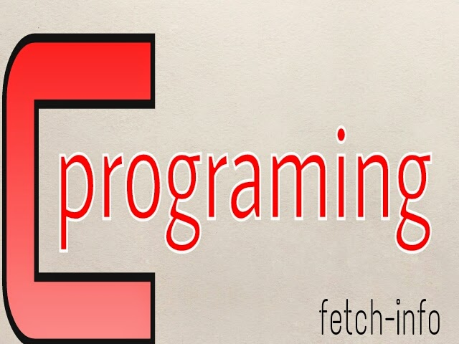


Introduction
*This C code provides a simple command-line interface for managing bank accounts.
*Users can perform various operations on their accounts.
*The code allows for easy navigation and management of bank accounts.
1
This Photo by Unknown Author is licensed under CC BY-NC
Notes:
Image source: https://www.itrelease.com/2021/04/advantages-and-disadvantages-of-command-line-interface-cli/

Slide 3
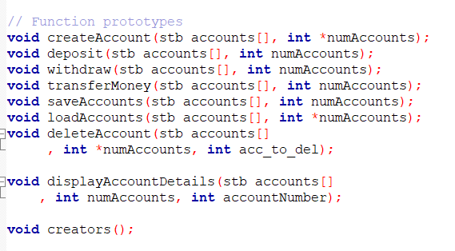
Function Prototypes

Slide 4
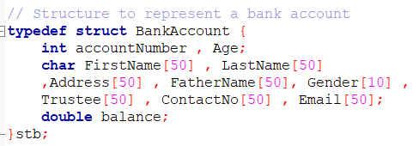
Structure
stb is the shortform to represent the struct bankAccount using typedef

Slide 5

Library Used

Slide 6
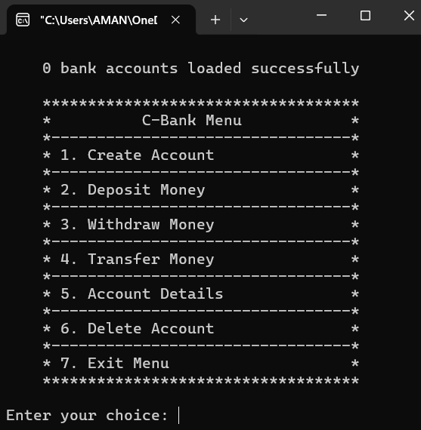
User-Friendly Interface
The command-line interface is designed for easy navigation and user interaction.
Users are guided through each step of account management operations.
Clear prompts and messages help users understand and utilize the functionalities effectively.
8
Notes:
Image source: http://www.wikihow.com/Use-the-Command-Line-Interface

Slide 7
Salient- Features:
Features:
*Users can easily switch between different accounts and perform transactions.
*Error handling is implemented to ensure data integrity and user-friendly interactions.
1.Accounts creation
2.Deposit money
3.Withdraw balance
4.Transfer balance
5.Accounts details
6.Accounts deletion
2
Notes:
Image source: https://mungfali.com/explore/UML-Use-Case-Examples

Slide 8
Conclusion
This C code offers a convenient solution for managing bank accounts through a simple command-line interface.
Users can perform essential banking operations efficiently and securely.
The code can serve as a foundation for further development and customization based on specific banking requirements.
6
Notes:
Image source: https://www.pinterest.ph/pin/428827195772802152/

Slide 9
References
Mainly regular class
Library Text book
Youtube
Senior dai
7

