Slide 1
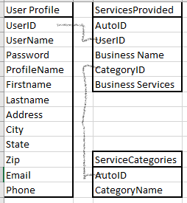
Service providers are able to enter their information and the business service they offer.
Consumers may create a user account when looking for service providers
Consumers are able to add service categories that are not available. Consumers can be contacted by Service Providers once that Category is added
A list of service categories that are available based on the service providers’ table

