Slide 1
---------------------------------------
-- AlwaysEncrypted in SQL 2016
---------------------------------------
-- This demo show how to configure AlwaysEncrypted
-- How to insert/update Encrypted data in SSMS
-- POC on AlwaysEncrypted limitations
/*************** Testing Env*******************/
-- SQL instance: sandboxdev802\localtest
-- SQL Host : sandboxdev802
-- Client : sandboxdev1001
/*************** Prerequisite *******************/
.Net Framework 4.6 installed
SSMS release 17 is required for data select/manipulation in SSMS
(Installer: \Sandboxdev802\sql2016\SSIS2016\SSMS-Setup-ENU14.0.17099)

Slide 2
---------------------------------------
-- Part 1: Create CMK and CEK
-- Part 2: Prepare data
-- Part 3: Encrypt Column on Host
-- Part 4: Decrypt dada on Client
-- Part 5: Parameterization for Always Encrypted
-- Part 6: Performance Impact of Always Encrypted
-- Part 7: Limitation of AlwaysEncrypted
---------------------------------------

Slide 3
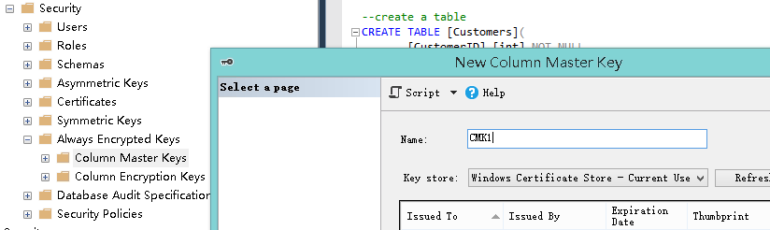
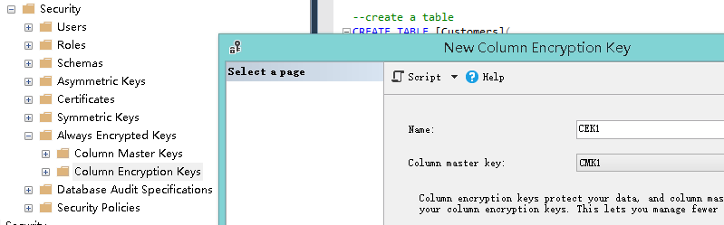
---------------------------------------
-- Part 1: Create CMK and CEK
---------------------------------------

Slide 4
            ---------------------------------------
            -- Part 2: Prepare data
            ---------------------------------------
USE [EncryptedDB]
GO
DROP table if exists [Customers] -- new SQL 2016 command
GO
--create a table
CREATE TABLE [Customers](
[CustomerID] [int] NOT NULL,
[FirstName] [nvarchar](25) NOT NULL,
[LastName] [nvarchar](25) NOT NULL,
[SIN] [nvarchar](11) NULL,
[CreditCardNumber] [nvarchar](25) NULL,
[EmailAddress] [nvarchar](50) NULL,
[PhoneNumber] [nvarchar](25) NULL,
[TerritoryID] [int] NULL)
GO
--insert some data
insert into [Customers] VALUES('19169','Arianna','Bryant','816-14-3866','77778052342171', 'arianna16@adventure-works.com','725-555-0131',1)
insert into [Customers] VALUES('17423','Arianna','Alexander','513-30-2965','77776580079386', 'arianna17@adventure-works.com','140-555-0167',1)
insert into [Customers] VALUES('17722','Jerome','Serrano','319-51-1661','55559881820491', 'jerome15@adventure-works.com','1 (11) 500 555-0136',8)
insert into [Customers] VALUES('22728','Arianna','Russell','239-35-4068','33338016910017', 'arianna18@adventure-works.com','179-555-0197',6)
insert into [Customers] VALUES('29187','Jerome','Ramos','918-75-6173','11115373226233', 'jerome16@adventure-works.com','1 (11) 500 555-0162',9)
insert into [Customers] VALUES('14902','Arianna','Diaz','162-76-6285','33331128313730', 'arianna19@adventure-works.com','142-555-0189',4)
insert into [Customers] VALUES('21817','Jerome','Carlson','833-14-5928','11113048024782', 'jerome17@adventure-works.com','1 (11) 500 555-0113',10)
insert into [Customers] VALUES('25991','Arianna','Hayes','302-26-4124','33336197015476', 'arianna20@adventure-works.com','582-555-0144',6)

Slide 5
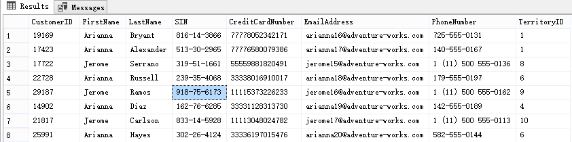
--view the data
SELECT [CustomerID]
,[FirstName]
,[LastName]
,[SIN]
,[CreditCardNumber]
,[EmailAddress]
,[PhoneNumber]
,[TerritoryID]
FROM [dbo].[Customers]
Normal View

Slide 6
---------------------------------------
-- Part 3: Encrypt Column on Host
---------------------------------------

Slide 7
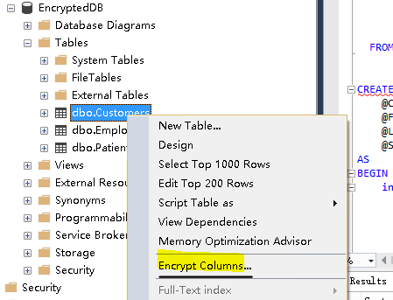
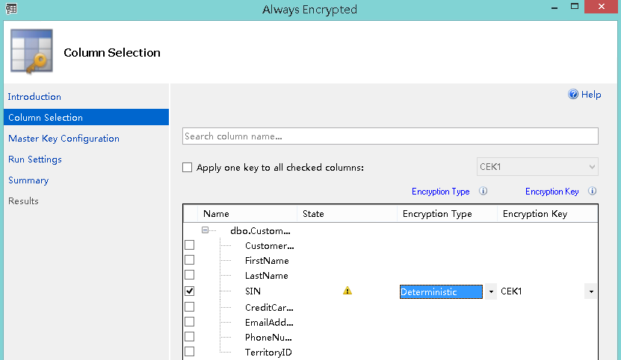
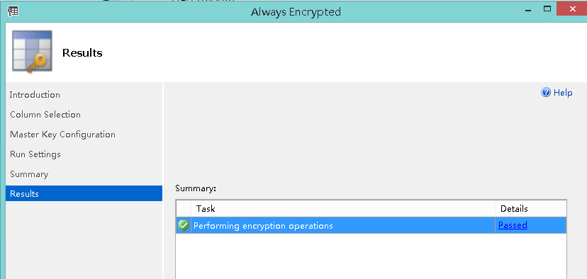
Deterministic vs Randomized

Slide 8
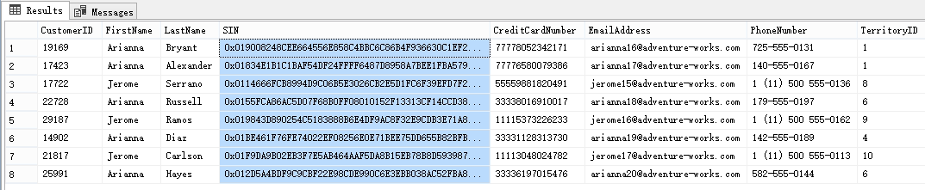
--view the data after Encrypted
SELECT [CustomerID]
,[FirstName]
,[LastName]
,[SIN]
,[CreditCardNumber]
,[EmailAddress]
,[PhoneNumber]
,[TerritoryID]
FROM [dbo].[Customers]
Column get encrypted!!
Compared with earlier view, to see the difference

Slide 9
--However you wont be able to update/insert or even query the encrypted column
in where clause
--Query filtering on Encrypted column would return error as below
--Need to use parameterized query.
select * from [dbo].[Customers]
where [SIN]='302-26-4124'
Msg 206, Level 16, State 2, Line 89
Operand type clash: varchar is incompatible with varchar(8000) encrypted with (encryption_type = 'DETERMINISTIC', encryption_algorithm_name = 'AEAD_AES_256_CBC_HMAC_SHA_256', column_encryption_key_name = 'CEK1', column_encryption_key_database_name = 'EncryptedDB') collation_name = 'Chinese_PRC_CI_AS'

Slide 10
--------------------------------------
-- Part 4: Decrypt dada on Client
--------------------------------------
Make sure you can access all column master keys configured for encrypted columns. For example, if your column master key is a certificate, you need to make sure the certificate is deployed on the machine, SSMS is running on.
Or, if your column master key is a key stored in Azure Key Vault, you need to make sure you have permissions to access the key (Also, you might be prompted to sign in to Azure.)
In this Demo:
1. Export the certificate from sandboxdev802, IE options->Content->Certificate, with private key;
2. Import the certificate into sandboxdev1001, using the private key above
3. On sandboxdev1001, connect to sandboxdev802\localtest, with AlwaysEncrypted enabled.

Slide 11
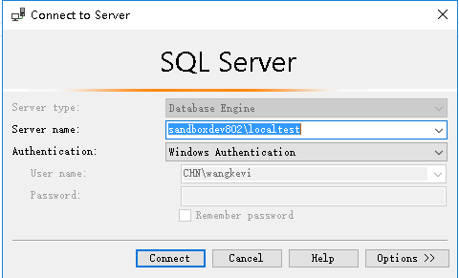
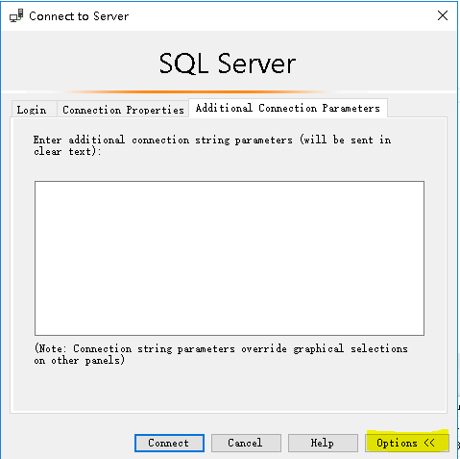
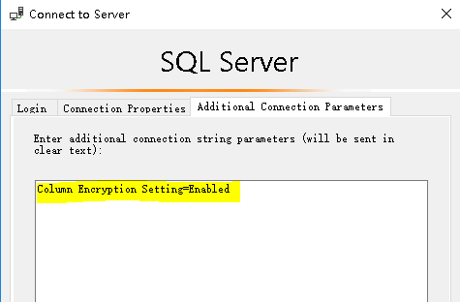
-- On client server: sandboxdev1001
Connect to sandboxdev802\localtest with Additional connection prarmeters:
Column Encryption Setting=Enabled

Slide 12
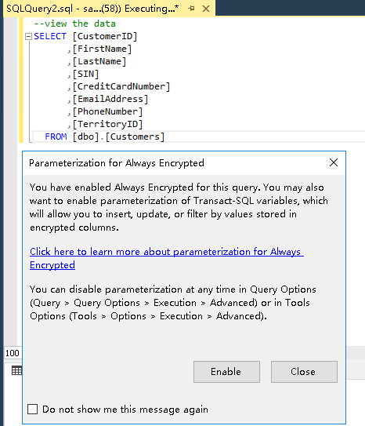
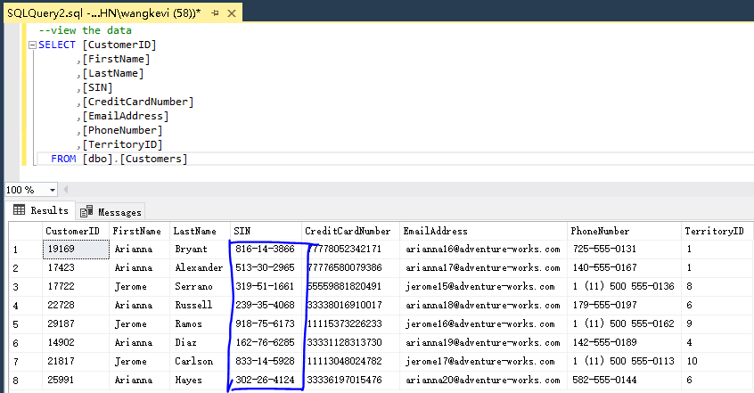
-- On client server sandboxdev1001 : Retrieve plaintext from encrypted column
If it prompts for Parameterization for Always Encrypted, you can
Enable it right now, or just close the window and later enable it
as you want.
See the data below, you successfully decrypt the data and
see the plaintext.

Slide 13
---------------------------------------
-- Part 5: Parameterization for Always Encrypted
---------------------------------------
You can only manipulate encrypted column in SSMS when:
You are using SSMS 2017
You have enabled Parameterization for Always Encrypted
You’re using parameterized query

Slide 14
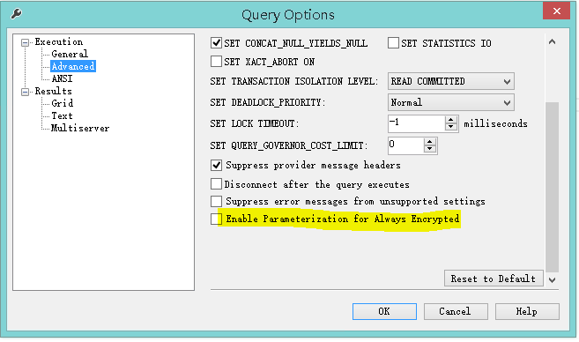
-- Enable Parameterization for Always Encrypted in SSMS2017
In SSMS, go to Query-> Query Options-> Execution->Advanced
Check box highlighted

Slide 15
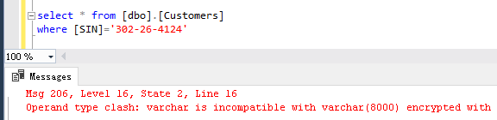
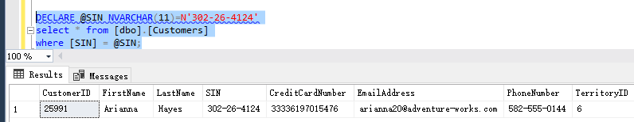
Normal query doesn’t work
Parameterized query is good

Slide 16
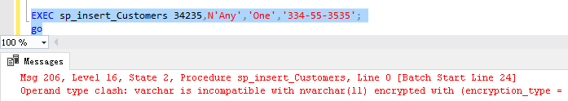
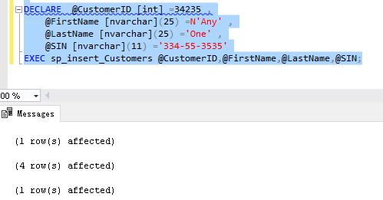
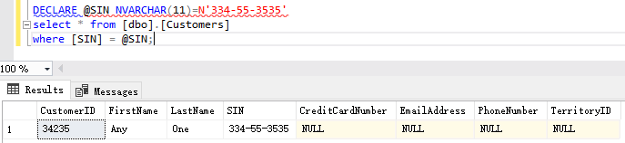
Create Procedure for parameterization
Normal query doesn’t work
CREATE PROCEDURE sp_insert_Customers(
@CustomerID [int] ,
@FirstName [nvarchar](25) ,
@LastName [nvarchar](25) ,
@SIN [nvarchar](11) )
AS
BEGIN
insert into [dbo].[Customers]([CustomerID]
,[FirstName]
,[LastName]
,[SIN])
SELECT @CustomerID ,
@FirstName ,
@LastName ,
@SIN
END
Parameterized query is good

Slide 17
--------------------------------------
-- Part 6: Performance Impact of Always Encrypted
--------------------------------------
https://sqlperformance.com/2015/08/sql-server-2016/perf-impact-always-encrypted
Here’s a blog about performance impact of Always Encrypted
Though for now I didn’t see the ‘tradeoff’ on Always Encrypted in my test yet.
To be continued…

Slide 18


Insert 500000 rows into same table
When there’s no column encrypted
go
truncate table [dbo].[Customers]
declare @cnt int = 0
declare @start datetime = getdate()
declare @end datetime
while @cnt <500000
begin
DECLARE @CustomerID [int] =34235 ,
@FirstName [nvarchar](25) =N'Any' ,
@LastName [nvarchar](25) ='One' ,
@SIN [nvarchar](11) ='334-55-3535',
@CreditCardNumber [nvarchar](25)='1234567890',
@EmailAddress [nvarchar](50)='hello@world.com',
@PhoneNumber [nvarchar](25)= '123-45-6789'
EXEC sp_insert_Customers @CustomerID,@FirstName,@LastName,@SIN,@CreditCardNumber,@EmailAddress,@PhoneNumber;
set @cnt = @cnt +1
end
set @end = getdate()
select DATEDIFF(SECOND,@start,@end) as Duration
With 3 columns(SIN,CreditCardNumber,PhoneNumber)
encrypted
Different with test result in previous blog
No negative impact is detected in this test…

Slide 19
--------------------------------------
-- Part 7: Limitation of AlwaysEncrypted
--------------------------------------

Slide 20
Limitations of Always Encrypted:
Columns using one of the following datatypes: xml, timestamp/rowversion, image, ntext, text, sql_variant, hierarchyid, geography, geometry, alias, user defined-types.
FILESTREAM columns
Columns with ROWGUIDCOL property
String (varchar, char, etc.) columns with non-bin2 collations
Columns that are keys for nonclustered indices using a randomized encrypted column as a key column (deterministic encrypted columns are fine)
Columns that are keys for clustered indices using a randomized encrypted column as a key column (deterministic encrypted columns are fine)
Columns that are keys for fulltext indices containing encrypted columns both randomized and deterministic
Columns referenced by computed columns (when the expression does unsupported operations for Always Encrypted)
Sparse column set
Columns that are referenced by statistics
Columns using alias type
Partitioning columns
Columns with default constraints
Columns referenced by unique constraints when using randomized encryption (deterministic encryption is supported)
Primary key columns when using randomized encryption (deterministic encryption is supported)
Referencing columns in foreign key constraints when using randomized encryption or when using deterministic encryption, if the referenced and referencing columns use different keys or algorithms
Columns referenced by check constraints
Columns in tables that use change data capture
Primary key columns on tables that have change tracking
Columns that are masked (using Dynamic Data Masking)
Columns in Stretch Database tables. (Tables with columns encrypted with Always Encrypted can be enabled for Stretch.)
Columns in external (PolyBase) tables (note: using external tables and tables with encrypted columns in the same query is supported)
Columns in table variables

Slide 21
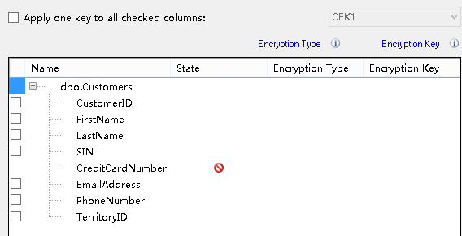
-- column with default constraint not supported
go
alter table [dbo].[Customers]
add constraint df_CreditCardNumber default (1234567890) for CreditCardNumber

Slide 22
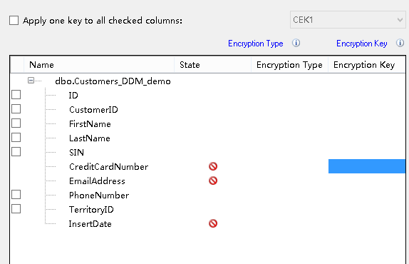
-- column with DDM not supported
CREATE TABLE [dbo].[Customers_DDM_demo](
[ID] [int] IDENTITY(1,1) NOT NULL,
[CustomerID] [int] NOT NULL,
[FirstName] [nvarchar](25) NOT NULL,
[LastName] [nvarchar](25) NOT NULL,
[SIN] [nvarchar](11) NULL,
[CreditCardNumber] [nvarchar](25) MASKED WITH (FUNCTION = 'partial(2, "%%%", 3)') NULL,
[EmailAddress] [nvarchar](50) MASKED WITH (FUNCTION = 'email()') NULL,
[PhoneNumber] [nvarchar](25) NULL,
[TerritoryID] [int] NULL,
[InsertDate] [datetime] NOT NULL,
PRIMARY KEY CLUSTERED
(
[ID] ASC
)WITH (PAD_INDEX = OFF, STATISTICS_NORECOMPUTE = OFF, IGNORE_DUP_KEY = OFF, ALLOW_ROW_LOCKS = ON, ALLOW_PAGE_LOCKS = ON) ON [PRIMARY]
) ON [PRIMARY]
GO

Slide 23
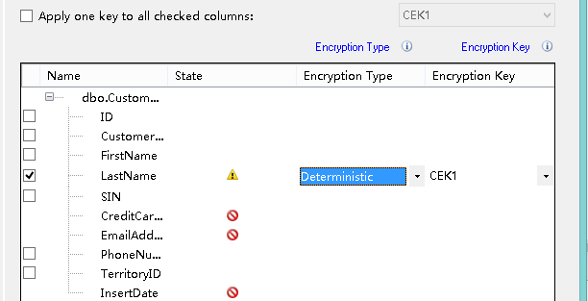
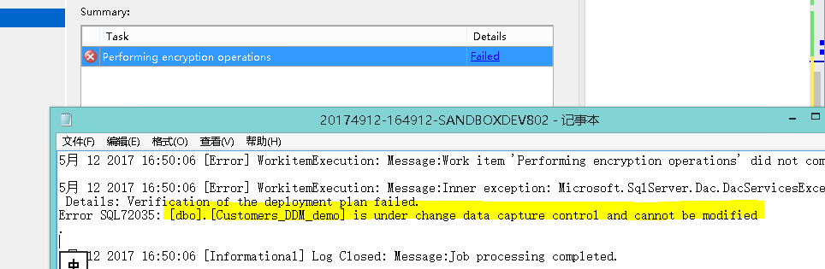
-- column with CDC not supported

Slide 24
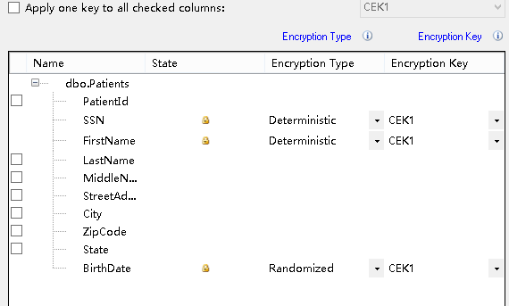
-- Try to enable CDC on encrypted columns
USE AKT
EXEC [sys].[sp_cdc_enable_table]
@source_schema ='dbo',@source_name='Patients',
@capture_instance='dbo_Patients',@supports_net_changes=1,
@role_name=null,@filegroup_name='CDC'
/*
Msg 22832, Level 16, State 1, Procedure sp_cdc_enable_table_internal, Line 639 [Batch Start Line 141]
Could not update the metadata that indicates table [dbo].[Patients] is enabled for Change Data Capture.
The failure occurred when executing the command 'sp_cdc_create_change_table'.
The error returned was 11430: 'Cannot enable change data capture on column 'SSN'. Change data capture is not supported for encrypted columns.'.
Use the action and error to determine the cause of the failure and resubmit the request.
*/
CDC is not support by AlwaysEncrypted !

