Slide 1
--------------------------------
-- DEMO: CDC Working with DDM
--------------------------------
This demo is to show how CDC working with Dynamic Data Masking(DDM)
Testing env: SQL SERVER 2016
Instance: Sandboxdev802\Localtest

Slide 2
--------------------------------
-- Prepare Data
--------------------------------
USE AKT
GO
DROP table if exists dbo.[Customers_DDM_demo] -- new SQL 2016 command
GO
--create a table
CREATE TABLE [Customers_DDM_demo](
[ID] int NOT NULL Identity(1,1),
[CustomerID] [int] NOT NULL,
[FirstName] [nvarchar](25) NOT NULL,
[LastName] [nvarchar](25) NOT NULL,
[SIN] [nvarchar](11) NULL,
[CreditCardNumber] [nvarchar](25) NULL,
[EmailAddress] [nvarchar](50) NULL,
[PhoneNumber] [nvarchar](25) NULL,
[TerritoryID] [int] NULL,
[InsertDate] datetime not null default(getdate())
)
GO
alter table dbo.Customers_DDM_Demo
add primary key (id asc)
--Create DDM_Read user & Grant select (read) permision on table
CREATE USER DDM_Read WITHOUT LOGIN

Slide 3
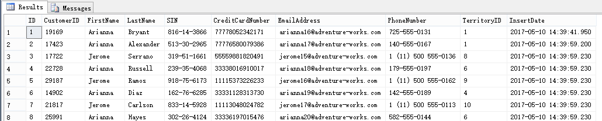
--insert some data
insert into dbo.[Customers_DDM_demo] VALUES('19169','Arianna','Bryant','816-14-3866','77778052342171', 'arianna16@adventure-works.com','725-555-0131',1,GETDATE())
insert into dbo.[Customers_DDM_demo] VALUES('17423','Arianna','Alexander','513-30-2965','77776580079386', 'arianna17@adventure-works.com','140-555-0167',1,GETDATE())
insert into dbo.[Customers_DDM_demo] VALUES('17722','Jerome','Serrano','319-51-1661','55559881820491', 'jerome15@adventure-works.com','1 (11) 500 555-0136',8,GETDATE())
insert into dbo.[Customers_DDM_demo] VALUES('22728','Arianna','Russell','239-35-4068','33338016910017', 'arianna18@adventure-works.com','179-555-0197',6,GETDATE())
insert into dbo.[Customers_DDM_demo] VALUES('29187','Jerome','Ramos','918-75-6173','11115373226233', 'jerome16@adventure-works.com','1 (11) 500 555-0162',9,GETDATE())
insert into dbo.[Customers_DDM_demo] VALUES('14902','Arianna','Diaz','162-76-6285','33331128313730', 'arianna19@adventure-works.com','142-555-0189',4,GETDATE())
insert into dbo.[Customers_DDM_demo] VALUES('21817','Jerome','Carlson','833-14-5928','11113048024782', 'jerome17@adventure-works.com','1 (11) 500 555-0113',10,GETDATE())
insert into dbo.[Customers_DDM_demo] VALUES('25991','Arianna','Hayes','302-26-4124','33336197015476', 'arianna20@adventure-works.com','582-555-0144',6,GETDATE())
select * from dbo.[Customers_DDM_demo]

Slide 4
--------------------------------
-- Demo 1: DDM 4 functions
--------------------------------

Slide 5
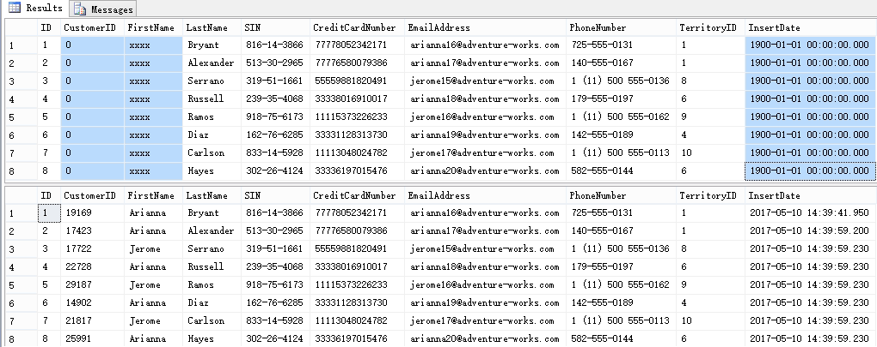
--1. Default function
alter table [dbo].[Customers_DDM_demo]
alter column CustomerID Add masked with (function='default()')
alter table [dbo].[Customers_DDM_demo]
alter column FirstName Add masked with (function='default()')
alter table [dbo].[Customers_DDM_demo]
alter column InsertDate Add masked with (function='default()')
-- Check the data using user DDM_Read who is having select permission on table
EXECUTE AS USER = 'DDM_Read'
SELECT * FROM [dbo].[Customers_DDM_demo]
REVERT
--Read by full permission
SELECT * FROM [dbo].[Customers_DDM_demo]

Slide 6
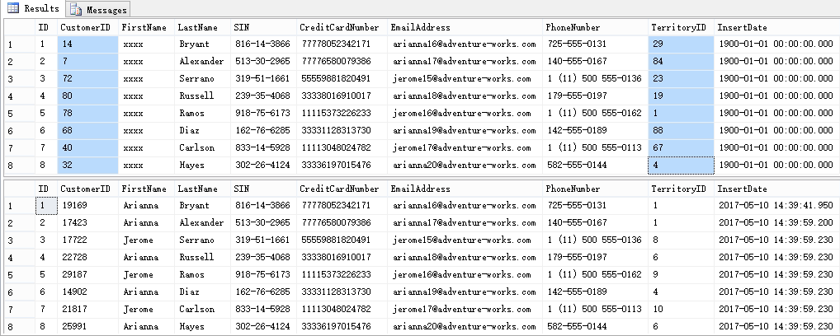
--2. Random function
alter table [dbo].[Customers_DDM_demo]
alter column CustomerID Add masked with (function='Random(1,100)')
alter table [dbo].[Customers_DDM_demo]
alter column TerritoryID Add masked with (function='Random(1,100)')
EXECUTE AS USER = 'DDM_Read'
SELECT * FROM [dbo].[Customers_DDM_demo]
REVERT
--Read by full permission
SELECT * FROM [dbo].[Customers_DDM_demo]

Slide 7
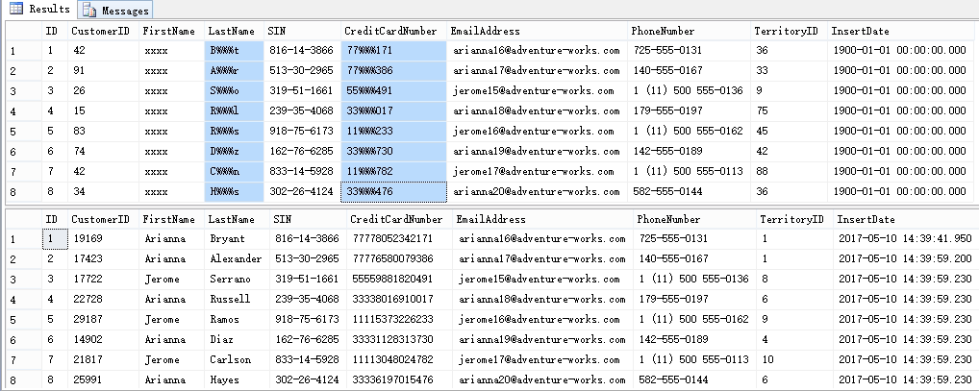
--3. Custom function
alter table [dbo].[Customers_DDM_demo]
alter column LastName Add masked with (function='Partial(1,"%%%",1)')
alter table [dbo].[Customers_DDM_demo]
alter column CreditCardNumber Add masked with (function='Partial(2,"%%%",3)')
EXECUTE AS USER = 'DDM_Read'
SELECT * FROM [dbo].[Customers_DDM_demo]
REVERT
--Read by full permission
SELECT * FROM [dbo].[Customers_DDM_demo]

Slide 8
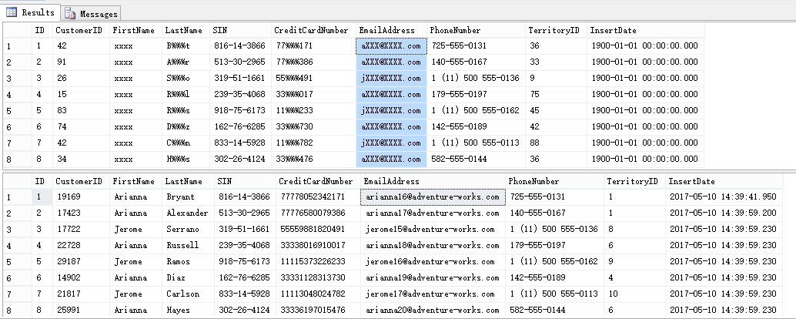
--4. Email function
alter table [dbo].[Customers_DDM_demo]
alter column EmailAddress Add masked with (function='Email()')
EXECUTE AS USER = 'DDM_Read'
SELECT * FROM [dbo].[Customers_DDM_demo]
REVERT
--Read by full permission
SELECT * FROM [dbo].[Customers_DDM_demo]

Slide 9
--Drop mask
alter table dbo.[Customers_DDM_demo] alter column CustomerID drop masked
alter table dbo.[Customers_DDM_demo] alter column FirstName drop masked
alter table dbo.[Customers_DDM_demo] alter column LastName drop masked
alter table dbo.[Customers_DDM_demo] alter column CreditCardNumber drop masked
alter table dbo.[Customers_DDM_demo] alter column EmailAddress drop masked
alter table dbo.[Customers_DDM_demo] alter column TerritoryID drop masked
alter table dbo.[Customers_DDM_demo] alter column InsertDate drop masked

Slide 10
--------------------------------
-- DEMO 2:CDC Enable before DDM
--------------------------------
How it works if CDC get enabled before DDM

Slide 11
--Enable CDC on demo table first
EXEC [sys].[sp_cdc_enable_db]
EXEC [sys].[sp_cdc_disable_table]
@source_schema ='dbo',@source_name='Customers_DDM_Demo',
@capture_instance='dbo_Customers_DDM_Demo'
EXEC [sys].[sp_cdc_enable_table]
@source_schema ='dbo',@source_name='Customers_DDM_Demo',
@capture_instance='dbo_Customers_DDM_Demo',@supports_net_changes=1,
@role_name=null,@filegroup_name='CDC'

Slide 12
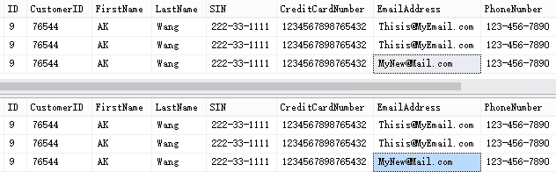
--Then apply Email mask function
alter table [dbo].[Customers_DDM_demo]
alter column EmailAddress Add masked with (function='Email()')
insert into dbo.[Customers_DDM_demo] VALUES('76544','AK','Wang','222-33-1111','1234567898765432', 'Thisis@MyEmail.com','123-456-7890',9,GETDATE())
update dbo.[Customers_DDM_demo]
set EmailAddress='MyNew@Mail.com'
where FirstName='AK'
EXECUTE AS USER = 'DDM_Read'
SELECT * FROM cdc.[dbo_Customers_DDM_demo_ct]
REVERT
--Read by full permission
SELECT * FROM cdc.[dbo_Customers_DDM_demo_ct]
Tracking table not masked!!

Slide 13
--------------------------------
-- DEMO 3: DDM apply before CDC
--------------------------------
How is it going if first add DDM and then enable CDC

Slide 14
--First add Mask then Enable CDC
UA AKT
alter table [dbo].[Customers_DDM_demo]
alter column EmailAddress drop masked
EXEC [sys].[sp_cdc_disable_table]
@source_schema ='dbo',@source_name='Customers_DDM_Demo',
@capture_instance='dbo_Customers_DDM_Demo'
alter table [dbo].[Customers_DDM_demo]
alter column EmailAddress Add masked with (function='Email()')
alter table [dbo].[Customers_DDM_demo]
alter column CreditCardNumber Add masked with (function='Partial(2,"%%%",3)')
EXEC [sys].[sp_cdc_enable_table]
@source_schema ='dbo',@source_name='Customers_DDM_Demo',
@capture_instance='dbo_Customers_DDM_Demo',@supports_net_changes=1,
@role_name=null,@filegroup_name='CDC'

Slide 15
--insert/update and check CDC tracking table
insert into dbo.[Customers_DDM_demo] VALUES('32423','Test','Again','234-33-5678','1234234634656757', 'Test@Mail.com','666-777-8888',8,GETDATE())
update dbo.[Customers_DDM_demo]
set EmailAddress='CanU@CME.com'
where FirstName='Test'

Slide 16
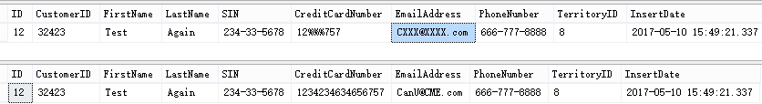
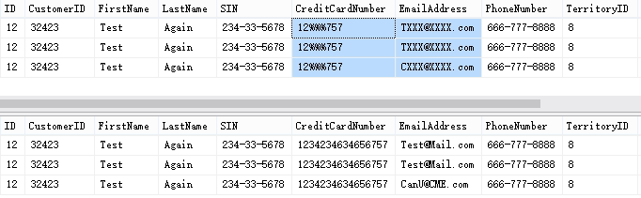
EXECUTE AS USER = 'DDM_Read'
SELECT * FROM dbo.[Customers_DDM_demo] where FirstName='Test'
REVERT
--Read by full permission
SELECT * FROM dbo.[Customers_DDM_demo] where FirstName='Test'
EXECUTE AS USER = 'DDM_Read'
SELECT * FROM cdc.[dbo_Customers_DDM_demo_ct]
REVERT
--Read by full permission
SELECT * FROM cdc.[dbo_Customers_DDM_demo_ct]
Both the main table and CDC tracking table are MASKED!!

Slide 17
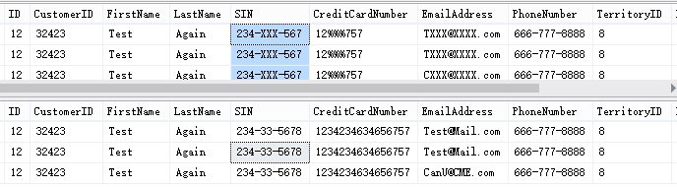
--1 more test
--manually apply DDM on CDC tracking table
alter table cdc.[dbo_Customers_DDM_demo_ct]
alter column [SIN] Add masked with (function='Partial(3,"-XXX-",4)')
EXECUTE AS USER = 'DDM_Read'
SELECT * FROM cdc.[dbo_Customers_DDM_demo_ct]
REVERT
--Read by full permission
SELECT * FROM cdc.[dbo_Customers_DDM_demo_ct]
You CAN also apply DDM
on CDC tracking table!!
DDM working!!

Slide 18
Conclusion
DDM can be easily added/dropped from table&column
CDC is working fine with DDM and DDM functions
DDM functions
Default function
Random function(only numeric)
Custom function
Email function
CDC must be enabled AFTER DDM applied on column. Only by this way CDC tracking table can be masked automatically.
You are allowed to add DDM on CDC tracking(_ct) table. DDM works too. However it’s not a regular way and not recommended.

