Slide 1
ABES ENGINEERING COLLEGE | COMPUTER SCIENCE & ENGINEERING
FaultGuard AI
Knowledge-Driven IoT Fault Diagnosis Assistant
Project Presentation
Akansha Kukshal
Enrollment No.: 2400320100117
Supervisor: Raveendra Reddy
Academic Year: 2026–2027
Dataset-driven software prototype • HCL Career Shaper

Slide 2
Project Overview
FaultGuard AI is a software prototype for monitoring machine-condition sensor data.
It combines a machine-learning anomaly detector with rule-based diagnostic hints.
A Streamlit dashboard presents sensor readings, status, and historical trends.
The current input path is based on the SKAB Valve 1 dataset and a sensor simulator.
01 • INTRODUCTION

Slide 3
Problem Statement
Industrial sensor streams can contain patterns that are difficult to review manually.
Delayed identification of unusual readings can slow down fault investigation.
Users need a structured workflow to receive readings, flag anomalies, store records, and inspect trends.
The project demonstrates this workflow in a dataset-driven prototype; it is not a certified industrial safety system.
02 • PROBLEM

Slide 4
Objectives
Detect
Diagnose
Store
Use a saved Random Forest model to classify sensor patterns as normal or anomalous.
Apply rule-based checks to suggest likely fault categories and recommendations.
Save readings and diagnosis fields for historical review.
Visualize
Document
Show status, sensor metrics, and trends in a Streamlit dashboard.
Report metrics and clearly distinguish recorded results from unverified tests.
03 • GOALS

Slide 5
System Architecture
SKAB Valve 1
CSV dataset
Sensor
simulator
MQTT publisher
+ HiveMQ
MQTT subscriber
+ ML inference
Diagnosis rules
+ PostgreSQL
Streamlit
Dashboard
→
→
→
→
→
Input
Generate
Transport
Detect
Record
Display
The code also writes the latest record to latest_data.json for dashboard use. The dashboard includes fallback paths for historical data; the complete live pipeline has not been independently verified.
04 • DESIGN

Slide 6
Technology Stack
Python
Random Forest + StandardScaler
MQTT + HiveMQ
Sensor simulation, inference, diagnosis and data handling
Saved model and feature scaling for anomaly detection
Message transport between publisher and subscriber
PostgreSQL
Streamlit + Plotly
SKAB Valve 1
Storage of sensor readings and diagnosis fields
Interactive dashboard and trend visualization
Dataset used for training and simulated input
05 • IMPLEMENTATION

Slide 7
Machine-Learning Approach
Eight sensor features are selected: accelerometer RMS values, current, pressure, temperature, thermocouple, voltage, and volume-flow RMS.
Missing feature values are filled using the training-data median; records are sorted chronologically.
An 80/20 chronological split is used in the training script.
The configured classifier is RandomForestClassifier with 200 trees and class_weight='balanced'.
The model artifact reports 93.17% accuracy; the result has not been independently reproduced for this presentation.
06 • MODEL

Slide 8
Recorded Model Metrics
Accuracy
Normal recall
Anomaly recall
93.17% recorded in model_metrics.json
99.92% recorded
80.08% recorded
Confusion matrix in the artifact (actual rows, predicted columns):
[[2396, 2], [246, 989]]
These are stored project metrics, not a fresh evaluation run. Anomaly recall indicates that some anomalies were missed in the recorded evaluation.
07 • EVALUATION

Slide 9
Diagnosis and Dashboard
Diagnosis layer
Dashboard layer
When an anomaly is flagged, rule-based checks inspect sensor ranges to suggest a cause category such as pressure, flow, vibration, electrical, or thermal.
Displays status and sensor values, including temperature, current, voltage, vibration, flow rate, anomaly probability, and historical plots.
Dashboard data can come from the JSON file, PostgreSQL, or historical CSV fallback paths, depending on runtime configuration.
A deployed dashboard may use historical CSV data when local MQTT and PostgreSQL services are unavailable.
08 • OUTPUT

Slide 10
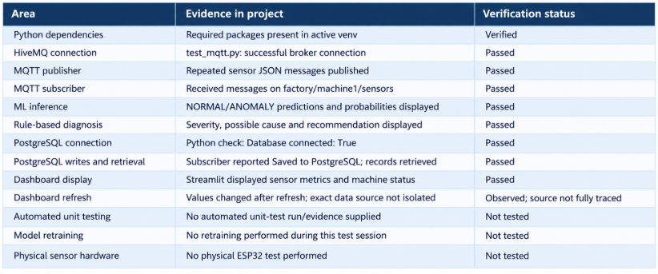
Testing and Verification Status
09 • VALIDATION

Slide 11
Limitations and Future Work
Verify and document the complete MQTT → inference → PostgreSQL → dashboard path.
Dependencies verified and declared in requirements.txt, including paho-mqtt and python-dotenv.
Add repeatable integration tests, logs, and clearer handling for missing or stale sensor data.
Validate the model on a separate held-out dataset and inspect false negatives before operational use.
Consider hardware integration only after the software pipeline is verified.
10 • NEXT STEPS

Slide 12
Conclusion
FaultGuard AI demonstrates a modular approach to sensor-data monitoring, anomaly detection, rule-based diagnostic hints, data storage, and visualization.
The next milestone is to verify the end-to-end workflow and collect reproducible test evidence.
Akansha Kukshal • ABES Engineering College • HCL Career Shaper

