Slide 1
Postability Scorer
A personalized model that learns your Instagram aesthetic
and recommends photos from your camera roll to post.

Slide 2
The Problem & Goal
The Problem
The Goal
Thousands of photos sit on your camera roll.
Only a handful ever get posted to Instagram.
Scrolling through everything to pick the right one is slow, annoying, and inconsistent.
Build a model that learns your personal aesthetic from your past Instagram posts...
...and ranks camera roll photos by how likely you are to post them.

Slide 3
The key insight: Why I rebuilt the model?
v1
v2 (This Version)
Binary classifier
Instagram photos = postable (1)
Camera roll = not postable (0)
The flaw: camera roll photos aren't 'bad' - they're just unposted.
Result: only 2/10 recommendations felt right.
Similarity-based ranking
Builds a taste profile from your IG posts (global centroid + aesthetic clusters).
Scores camera roll by cosine similarity to that profile, combined with quality features.
Result: 6-7/10 recommendations felt right.
→

Slide 4
How It Works
1
CLIP Embeddings
2
Taste Profile
Both IG posts and camera roll photos are embedded using CLIP (ViT-B/32) - a vision model that maps images to a 512-dim semantic space.
Your Instagram posts form a global taste centroid. KMeans (k=4) also finds aesthetic sub-clusters in your posts.
3
Quality Features
4
Final Score
6 engineered features per photo: sharpness, brightness, contrast, saturation, face detection, center composition.
Score = 0.65 × style similarity + 0.35 × quality score. Quality is normalized to YOUR posting standards, not a universal benchmark.

Slide 5
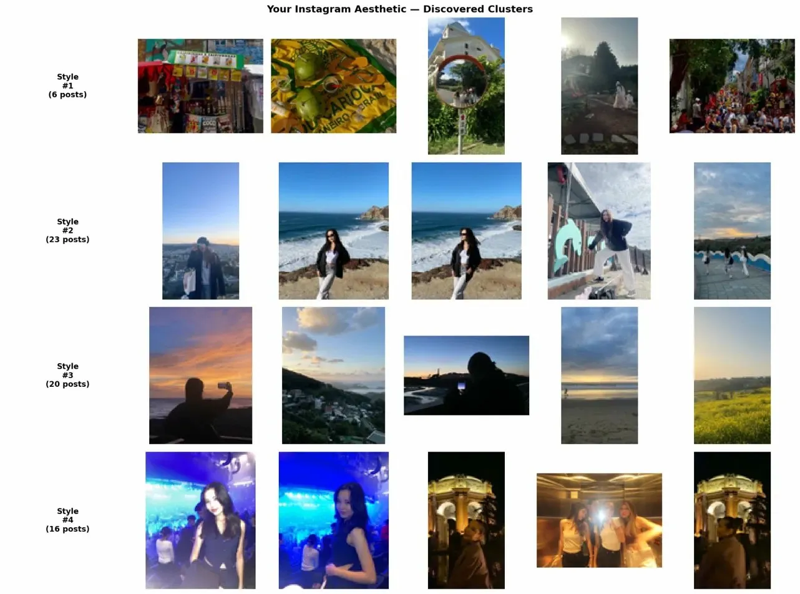
Discovering my aesthetic - 4 clusters
KMeans found 4 visually distinct posting styles in my Instagram history:

Slide 6
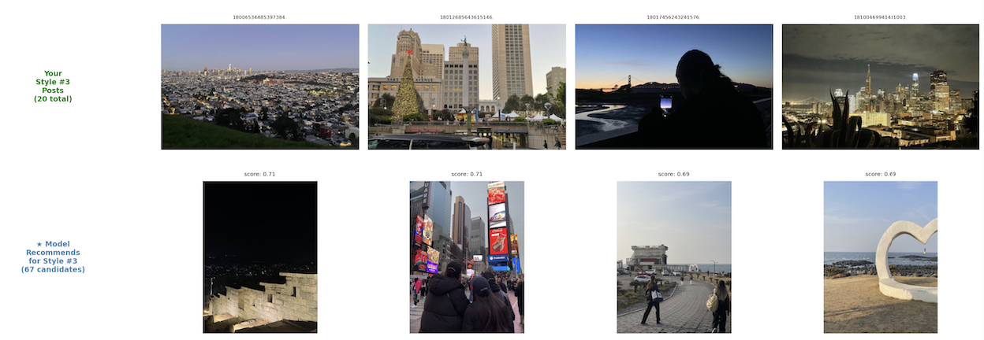
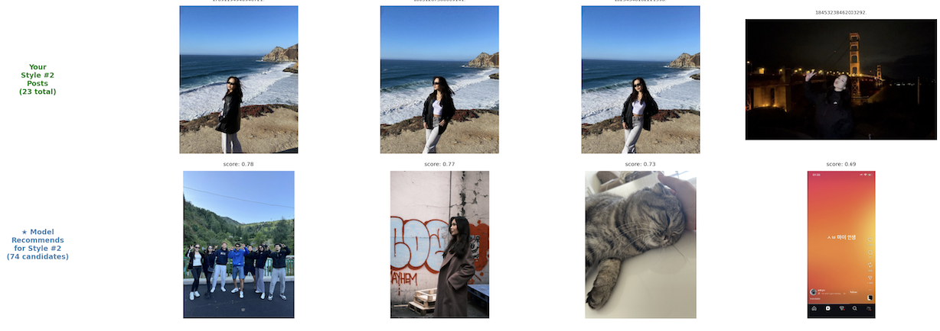
Cluster
Recommendation
Cluster
Recommendation

Slide 7
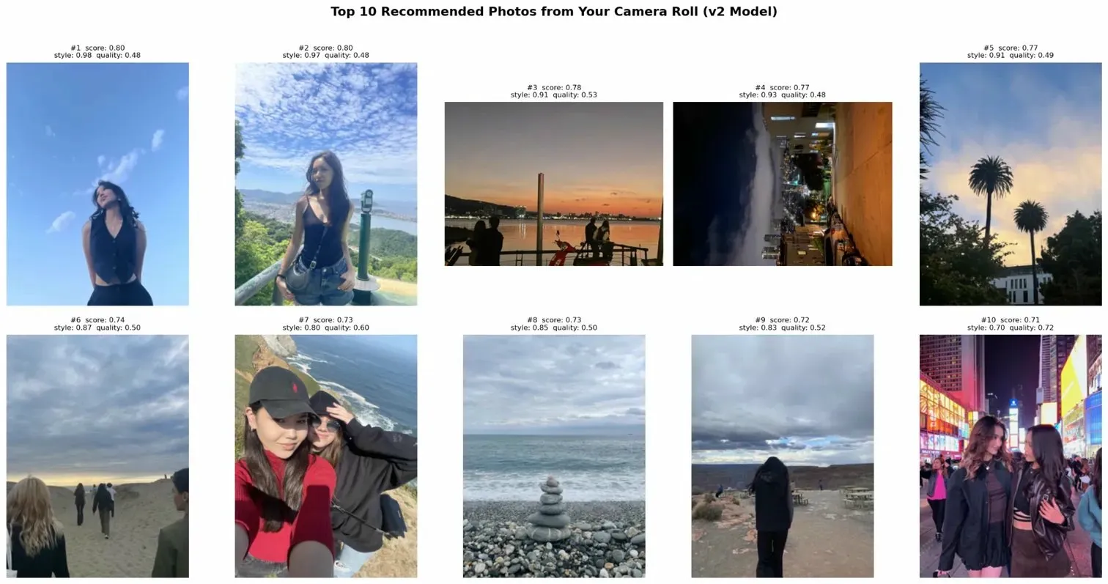
Top 10 recommendations - v2 model

Slide 8
Evaluation
60%
60%
~20%
Precision@10
Precision@20
v1 baseline
6 out of 10 I'd actually post
12 out of 20 I'd actually post
2 out of 10 felt right
How I evaluated:
Since there are no ground-truth labels for the camera roll, I built a self-evaluation loop: walked through the top 20 recommendations one by one and recorded whether I would actually post each one. This gives a Precision@K metric. I also tried training a re-ranking layer (logistic regression on my labeled data) but with only 20 training examples it overfit badly: v2's 60% beat v3's 25%, so I stayed with v2.

Slide 9
Limitations & What's Next
Limitations
If I Had More Time
Visual only
No caption, mood, or timing context.
Taste shift
Older posts may not reflect current aesthetic (but old photos still trained the model.)
More labels
Label 100+ photos to properly train a re-ranker like LTR or XGBoost.
Recency weighting
Discount older posts so the model tracks taste evolution.
App wrapper
Package it as a mobile tool that can read a real camera roll and return a ranked shortlist.

