Slide 1
Imagine Cup 2011 Presentation
Janne Ariluoto
Harri Johansson
Antti Knutas
Tommi Kähkönen

Slide 2
Structure
Introduction
The Case for Greendel
Features
System Architecture
Busness Case
Conclusions

Slide 3
Facts
Energy prices will increase
People will become more interested in energy consumption
High energy prices will interest people in alternatives

Slide 4
The Vision
Gathering energy consumption data from homes
Connecting people to their information also helps regulate consumption
Notes:
“Providing information about energy consumption to the masses”

Slide 5
The Greendel Project
Greendel is a system that helps people connect their behavior to consumption
Cloud-hosted system connects to
Power meter
Power generators
Provides accurate real-time information

Slide 6
The Case
Greendel is more accurate and feature-rich than other solutions
Cloud hosting makes fixed costs small
Marketed to
Energy-conscious homeowners
Small-scale renewable energy producers

Slide 7
Features
Monitor in real time
Power consumption
Power production
Environmental factors
Available on the web, desktop and mobile
Integrates with social media applications
Integration options with remotely readable meters
Intelligent management of power spikes

Slide 8
Architecture
Flexible
Scalable
Interoperable

Slide 9
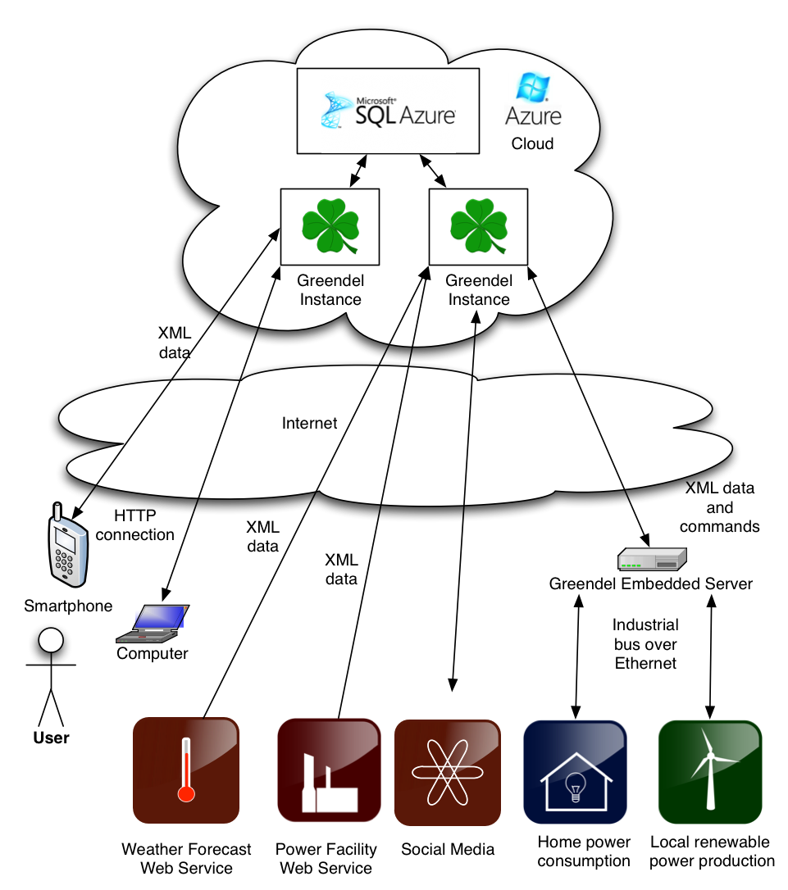

Slide 10
The Latest in Cloud Technologies
Microsoft Azure hosting
IronRuby on Rails web scripting
Plugin-architecture for interacting with remote web services
Standardized XML communications
Intelligence in the .NET-based cloud
Windows Mobile 7 Client
Embedded Linux monitoring platform

Slide 11
The Business Case
People are willing to pay a little money in order to save a lot more money
If we assume a constant saving of 300W: ~26kWh or 114e saved per year
Households
Finland: 2’406’000 (1% 24060)
California: 13’433’718 (1% 134337)

Slide 12
Conclusions
Interest in energy consumption will rise with energy prices
People will have to learn to regulate their consumption in the future
Greendel is there to provide accurate data to a wide variety of users

