Slide 1
Imagine Cup 2011 Presentation
Janne Ariluoto
Harri Johansson
Antti Knutas
Tommi Kähkönen

Slide 2
Structure
Introduction
The Case for Greendel
Features
System Architecture
Busness Case
Conclusions
Demo

Slide 3
Facts
Energy prices will increase
Pricing will become more complicated
People will become more concerned about energy consumption more interested in energy consumption
High energy prices will interest people in alternatives

Slide 4
Today

Slide 5
Future

Slide 6
The Vision
Gathering energy consumption data from homes
Connecting people to their information also helps regulate consumption
Notes:
“Providing information about energy consumption to the masses”

Slide 7
The Greendel Project
Greendel is a system that helps people connect their behavior to consumption
Cloud-hosted system connects to
Power meter
Power generators
Provides accurate real-time information

Slide 8
The Case
Greendel is more accurate and feature-rich than other solutions
Cloud hosting makes fixed costs small
Marketed to
Energy-conscious homeowners
Small-scale renewable energy producers

Slide 9
Features
Monitor in real time
Power consumption
Power production
Environmental factors
Available on the web, desktop and mobile
Integrates with social media applications
Integration options with remotely readable meters
Intelligent management of power spikes

Slide 10
Architecture
Cooperation of industry standard software and outsourced cloud hosting:
Flexible
Scalable
Interoperable

Slide 11
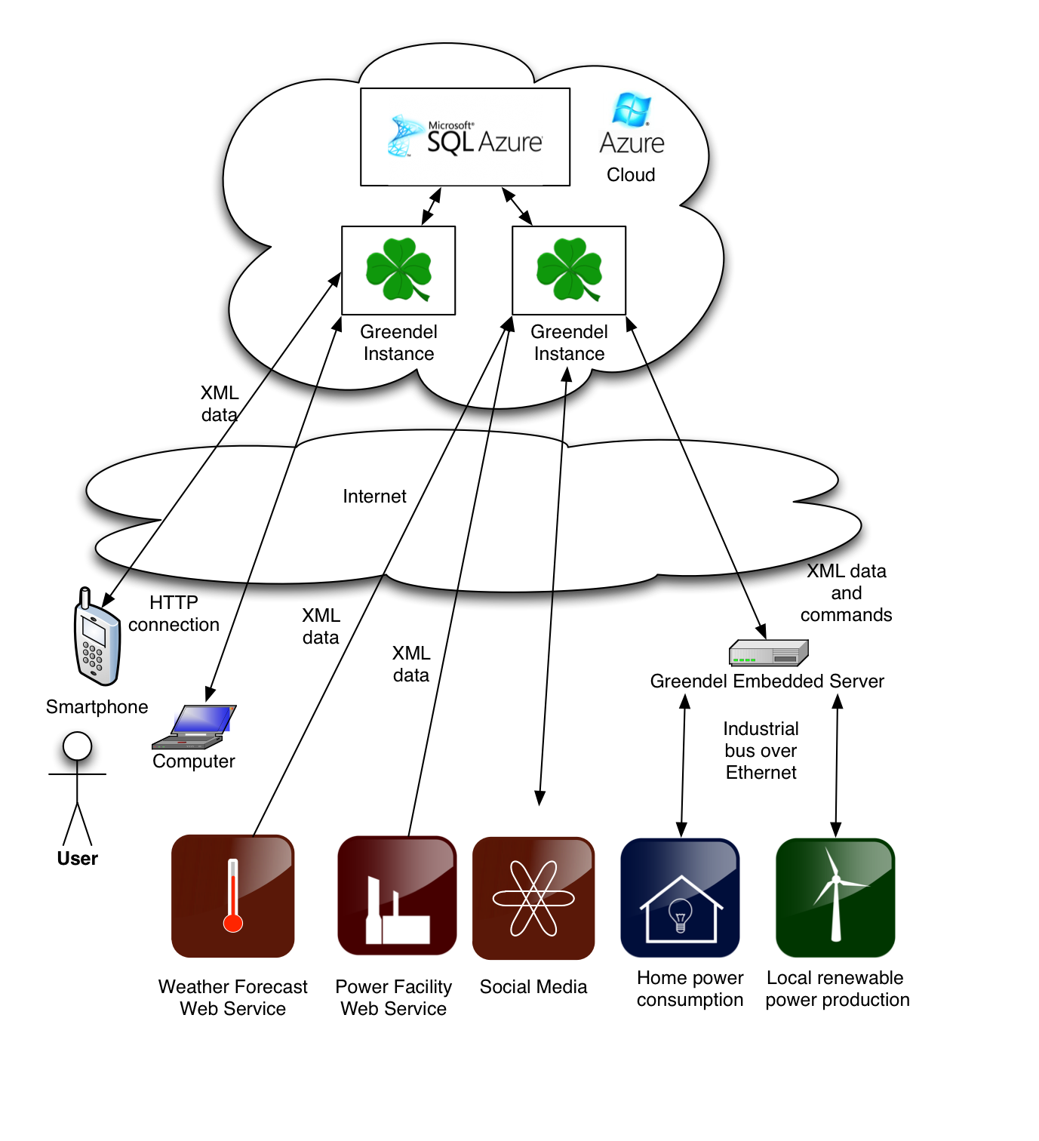

Slide 12
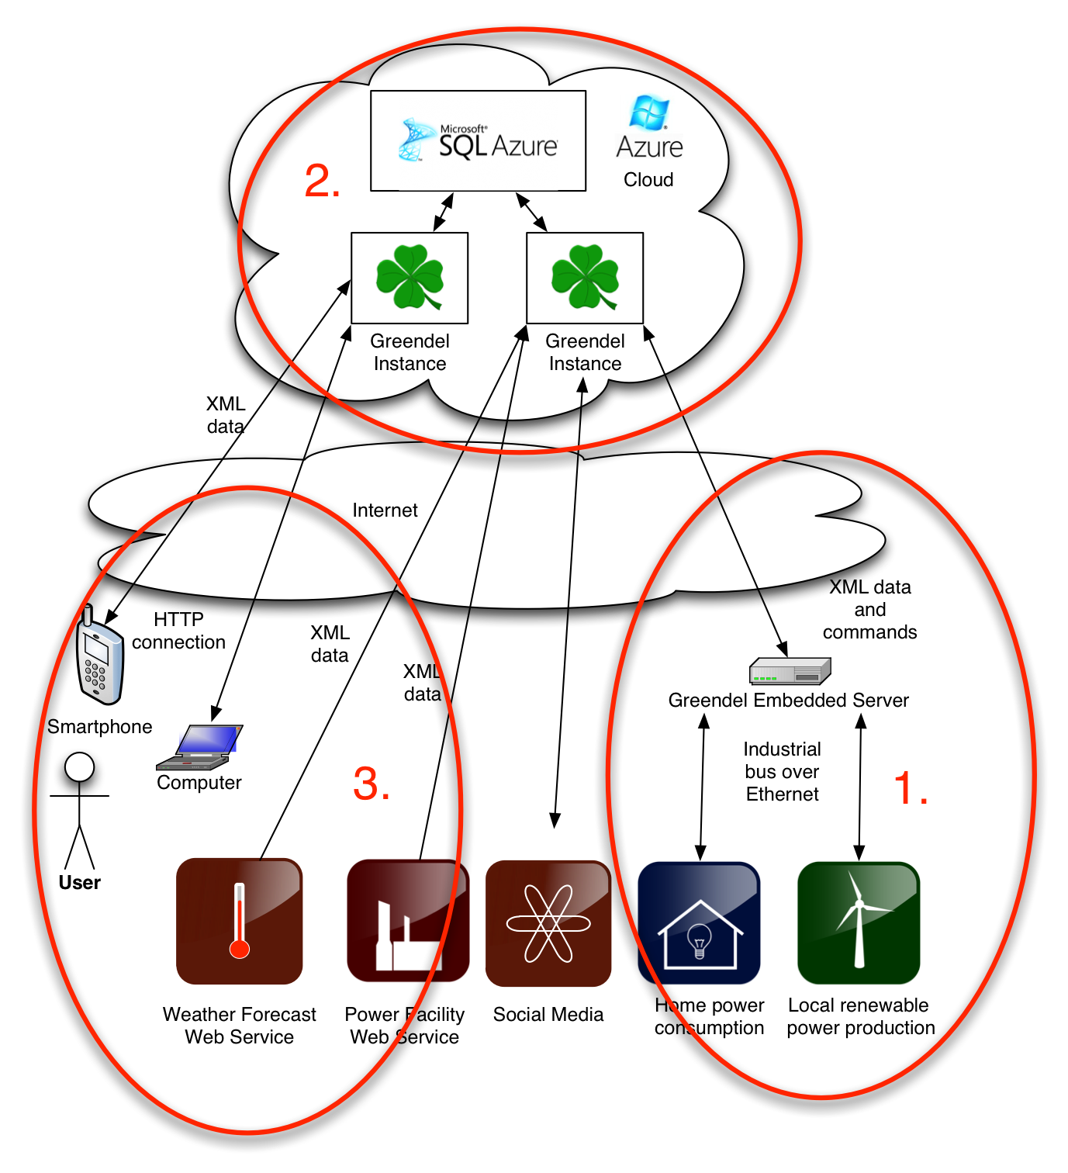

Slide 13
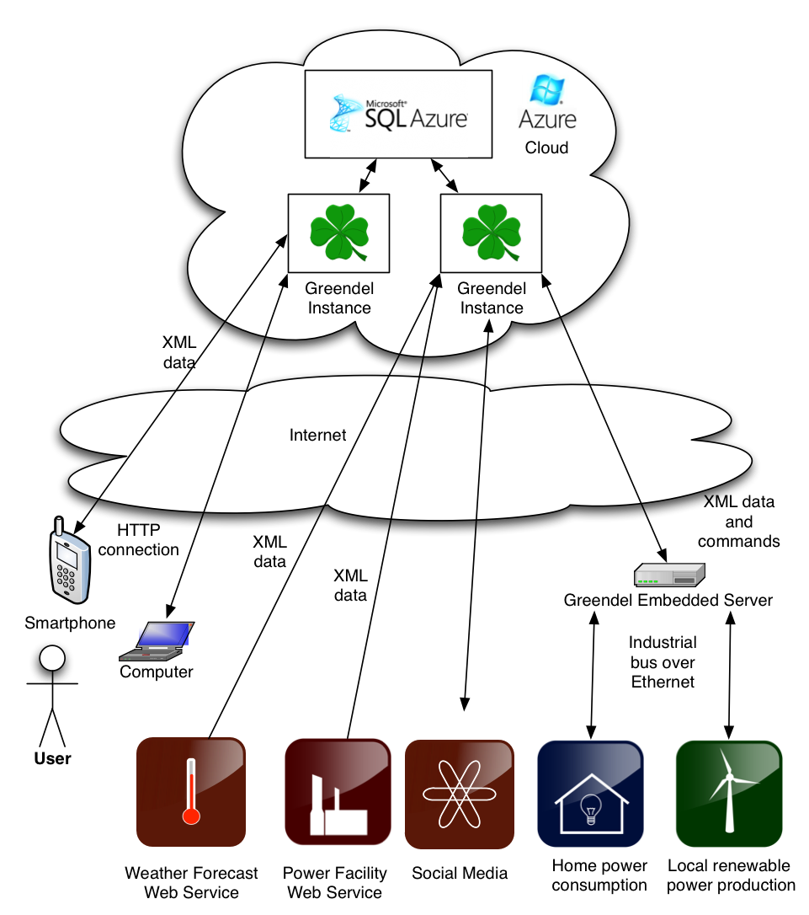

Slide 16
The Latest in Cloud Technologies
Microsoft Azure hosting
IronRuby on Rails web scripting
Plugin-architecture for interacting with remote web services
Standardized XML communications
Intelligence in the .NET-based cloud
Windows Mobile 7 Client
Embedded Linux monitoring platform

Slide 17
The Business Case
People are willing to pay a little money in order to save a lot more money
If we assume a constant saving of 150W: ~1300kWh or 60e saved per year
Households
Finland: 2’406’000 (1% 24060)
California: 13’433’718 (1% 134337)

Slide 18
Low unit costs and scalable servers
Devices: One-time investment of 120e
Subscription: 12e / year per client
Hosting costs: Estimated 50c per month per client
Profit: 60k euros per year per 10k clients
Future developments: Power company deals and eco-friendly product advertising

Slide 19
Conclusions
Interest in energy consumption will rise with energy prices
People will have to learn to regulate their consumption in the future
Greendel is there to provide accurate data to a wide variety of users

