Slide 1
Imagine Cup 2011 Presentation
Janne Ariluoto
Harri Johansson
Antti Knutas
Tommi Kähkönen

Slide 2
Structure
Introduction
The Case for Greendel
Features
System Architecture
Busness Case
Conclusions
Demo

Slide 3
Facts
Energy prices will increase
Pricing will become more complicated
People will become more concerned about energy consumption more interested in energy consumption
High energy prices will interest people in alternatives

Slide 4
Today

Slide 5
Future

Slide 6
The Vision
Greener tomorrow
Kerää esitä/ymmärrä hallitse
Raises energy awareness
Gathering energy consumption data from homes
Connecting people to their information helps to manage consumption
Notes:
“Providing information about energy consumption to the masses”

Slide 7
The Solution
Greendel fullfills our vision of greener tomorrow
Cloud-hosted system connects to
Power meter
Power generators
Provides accurate real-time information

Slide 8
Features yhdistettynä solutioniin?
(4 eri ryhmää, lause jokaisesta)
Monitor in real time
Power consumption
Power production
Environmental factors
Available on the web, desktop and mobile
Integrates with social media applications
Integration options with remotely readable meters
Intelligent management of power spikes

Slide 9
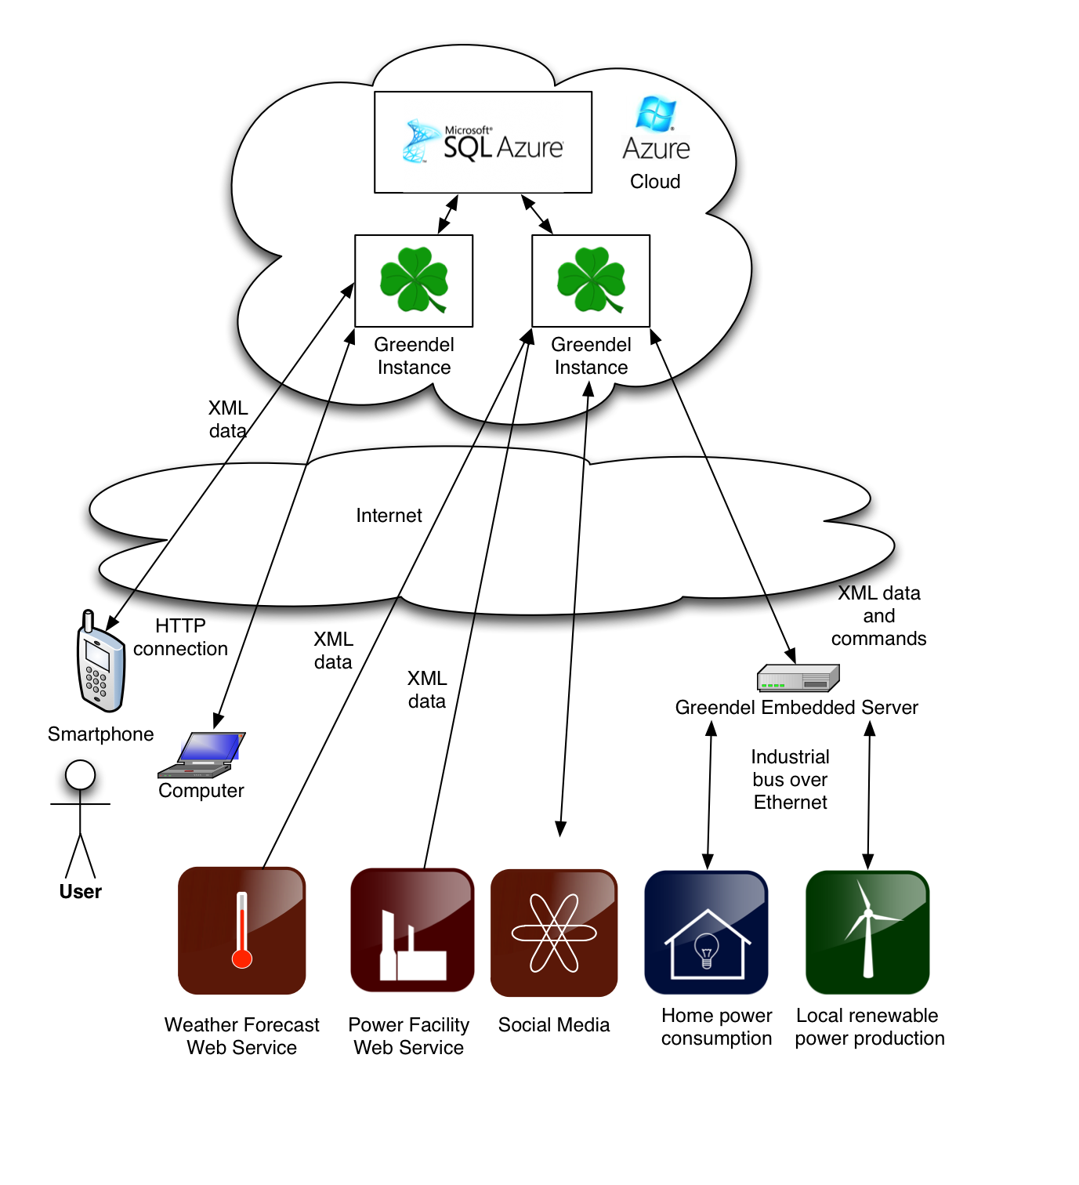

Slide 10
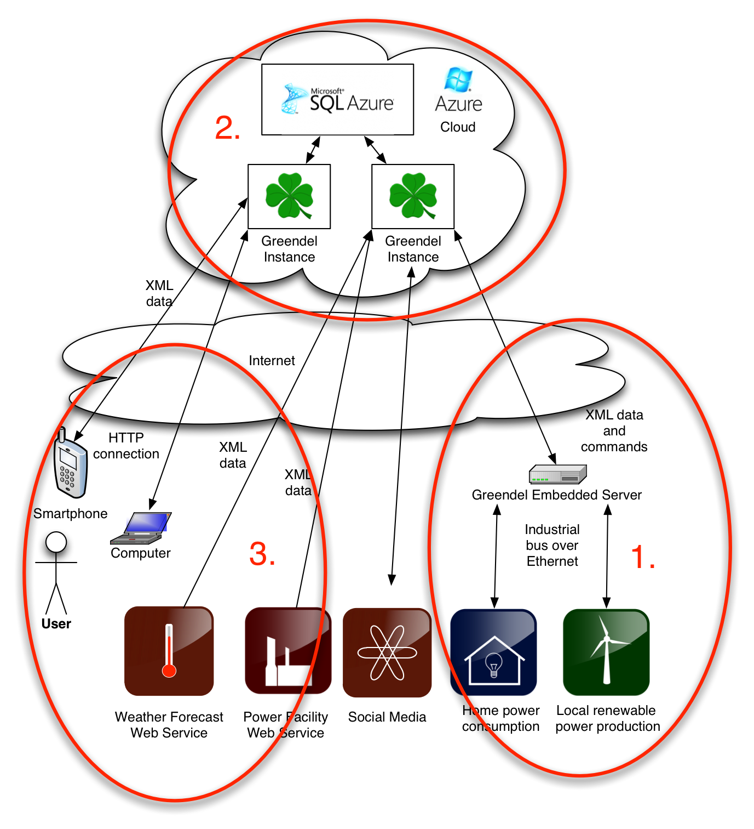

Slide 11
The interoperable set of technologies
Microsoft Azure hosting
IronRuby on Rails web scripting
Plugin-architecture for interacting with remote web services
Standardized XML communications
Intelligence in the .NET-based cloud
Windows Mobile 7 Client
Embedded monitoring platform

Slide 12
Viability
Greendel is more accurate and feature-rich than other solutions
Cloud hosting makes fixed costs small
Marketed to
Energy-conscious homeowners
Small-scale renewable energy producers

Slide 13
Achievable benefits
Vihreän energiatuotannon lisäys
People are willing to pay a little money in order to save a lot more money
If we assume a constant saving of 150W: ~1300kWh or 60e saved per year (10 % säästö = …)
Households (bisneskeissiin)
Finland: 2’406’000 (1% 24060)
California: 13’433’718 (1% 134337)

Slide 14
Low unit costs and scalable servers
Mitä me saadaan ja mitä asiakas maksaa?
Devices: One-time investment of 120 €
Subscription: 60 € / year per household
Hosting costs: Estimated 50c per month per client
Profit: xx € per year per xx clients
Future developments: Power company deals and eco-friendly product advertising

Slide 15
Now with the demo

Slide 16
Conclusions
Interest in energy consumption will rise with energy prices
People will have to learn to regulate their consumption in the future
Greendel is there to provide accurate data to a wide variety of users
SLOGAN

