Slide 1

Imagine Cup 2011 Presentation
Janne Ariluoto
Harri Johansson
Antti Knutas
Tommi Kähkönen

Slide 2
Structure
Introduction
The Case for Greendel
Features
System Architecture
Busness Case
Conclusions

Slide 3
Facts
Energy prices will increase
People will become more interested in energy consumption
High energy prices will interest people in alternatives

Slide 4
The Vision
Gathering energy consumption data from homes
Connecting people to their information also helps regulate consumption
Notes:
“Providing information about energy consumption to the masses”

Slide 5
The Greendel Project
Greendel is a system that helps people connect their behavior to consumption
Cloud-hosted system connects to
  Power meter
  Power generators
Provides accurate real-time information

Slide 6
The Case
Greendel is more accurate and feature-rich than other solutions
Cloud hosting makes fixed costs small
Marketed to
  Energy-conscious homeowners
  Small-scale renewable energy producers

Slide 7
Features
Monitor in real time
  Power consumption
  Power production
  Environmental factors
Available on the web, desktop and mobile
Integrates with social media applications
Integration options with remotely readable meters
Intelligent management of power spikes

Slide 8
Architecture
Flexible
Scalable
Interoperable

Slide 9
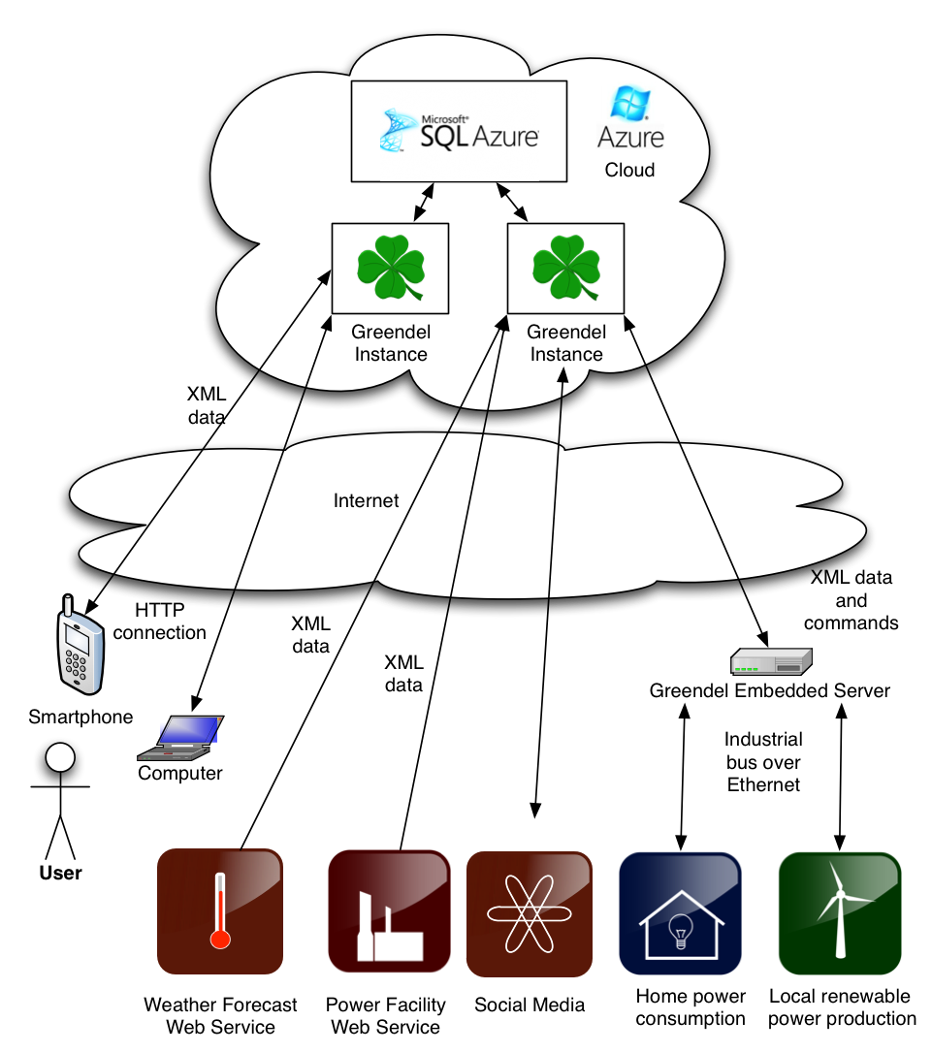

Slide 10
The Latest in Cloud Technologies
Microsoft Azure hosting
IronRuby on Rails web scripting
Plugin-architecture for interacting with remote web services
Standardized XML communications
  Intelligence in the .NET-based cloud
  Windows Mobile 7 Client
  Embedded Linux monitoring platform

Slide 11
The Business Case
People are willing to pay a little money in order to save a lot more money
If we assume a constant saving of 300W: ~26kWh or 114e saved per year
Households
  Finland: 2’406’000 (1% 24060)
  California: 13’433’718 (1% 134337)

Slide 12
The Business Case, pt. 2
Make product projection graphs and product price calculations here

Slide 13
Conclusions
Interest in energy consumption will rise with energy prices
People will have to learn to regulate their consumption in the future
Greendel conserves natural resources by encouraging people to save on their own
Greendel is there to provide accurate data to a wide variety of users

