Slide 1
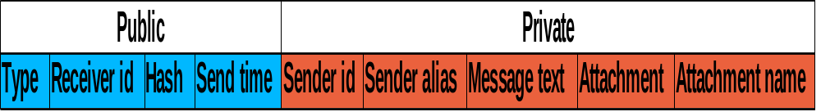
Messages and privacy
To protect privacy, users are identified by random identifier
Messages are split into public and private parts
Private part can be encrypted

