Slide 1


Slide 2
G3A
Crowdsource your social network

Slide 3
The Why
Importance of social networks
Single point of failure
Corporate spying
Government censorship
Unexpected events
Ad-hoc social networking

Slide 4
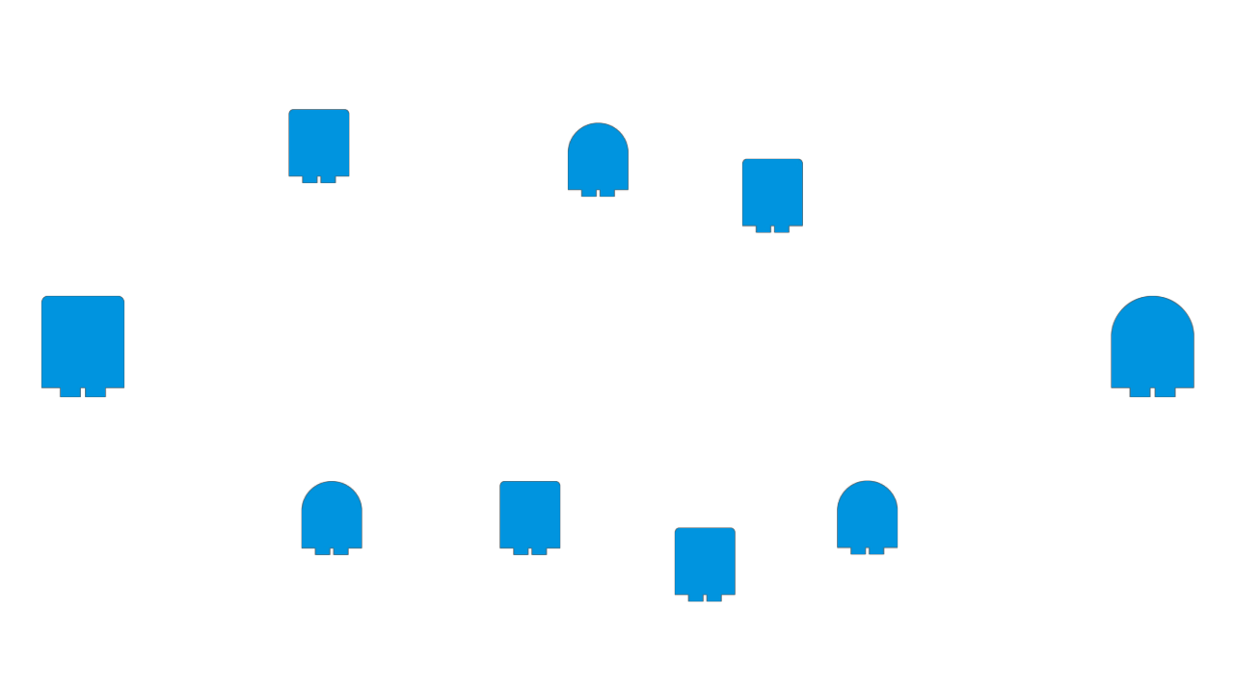
The How

Slide 5
The How
Opportunistic ad-hoc message routing
P2P with mobile phones
Local sharing
Routed broadcast

Slide 6
The Who
Local, temporary social groups
Classes
Big events
Accident sites
Demonstrations
In essence: Flexible collaboration in novel situations

Slide 7
The With
Windows Phone 7
P2P Networking
Multicast
Unicast
Local database
Storage
Routing

Slide 8
The Way
Demo

Slide 9
The End
Question, comments

