Slide 1
G3A
Crowdsource your messaging
Kallonen
Karki
Knutas
Kähkönen

Slide 2
What is TinyCircle?
Opportunistic messaging system with heavy emphasis on privacy for mobile devices
Opportunistic
Messages travel hop-by-hop from TinyCircle device to another
Privacy-aware
Messages can be encrypted using public key encryption → private messaging
Messages can be signed → verification of sender/content

Slide 3
Crowdsource your messaging
The routing of messages happen through the use of other TinyCircle devices
Hop-by-hop from device to another
Use the system and offer your device as a routing point for others
You are not dependent on infrastructure of a company or government – you are only dependent on other TinyCircle users!

Slide 4
Opportunistic routing
The devices exchange messages with other TinyCircle devices in the same local network
Hop-by-hop from sender to receiver
Store and forward
Try to send message closer to destination
Messages contain information of sender and receiver and the route is decided on the fly
Servers available to reduce the number of hops needed when connected to Internet

Slide 5
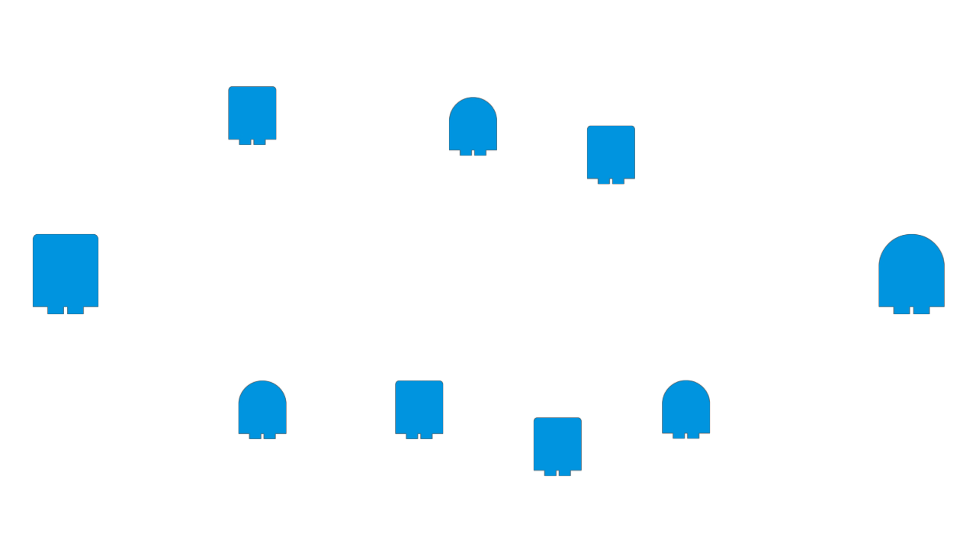
Opportunistic routing

Slide 6
Where to use TinyCircle
Local, temporary social groups
Classrooms
Big events
Accident sites
Demonstrations
In essence: Flexible collaboration in novel situations

Slide 7
Why TinyCircle?
No need for Internet connection
Messaging will not stop if lines are down
Distributed system
No single point of failure
No censorship
Free messaging
Messages remain private
Spying not possible

Slide 8
How it works?
Windows Phone 7
P2P Networking in local network
Multicast
Unicast
Web service in the internet (Azure)
Store and forward messages
Local database
Storage
Routing

Slide 9
Business model
The system needs a lot of users to work
Need for free version
The users of free version form the backbone of TinyCircle network
Premium version for sale
More features
Send pictures or other files.

Slide 10
Demo

Slide 11
The End
Question, comments

