Slide 1
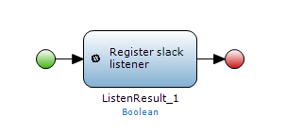
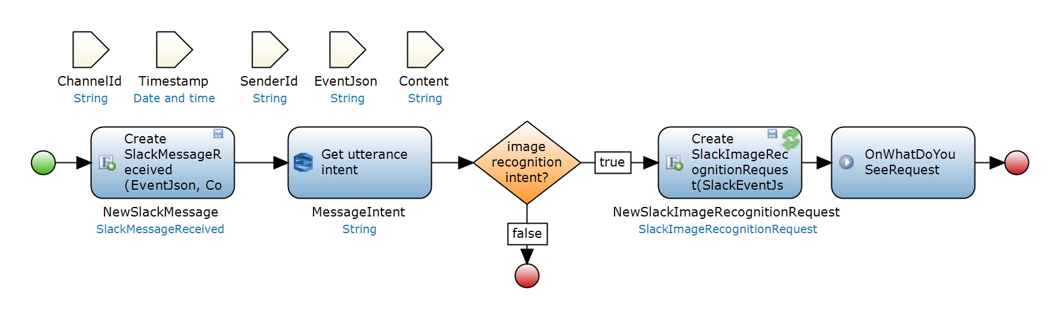
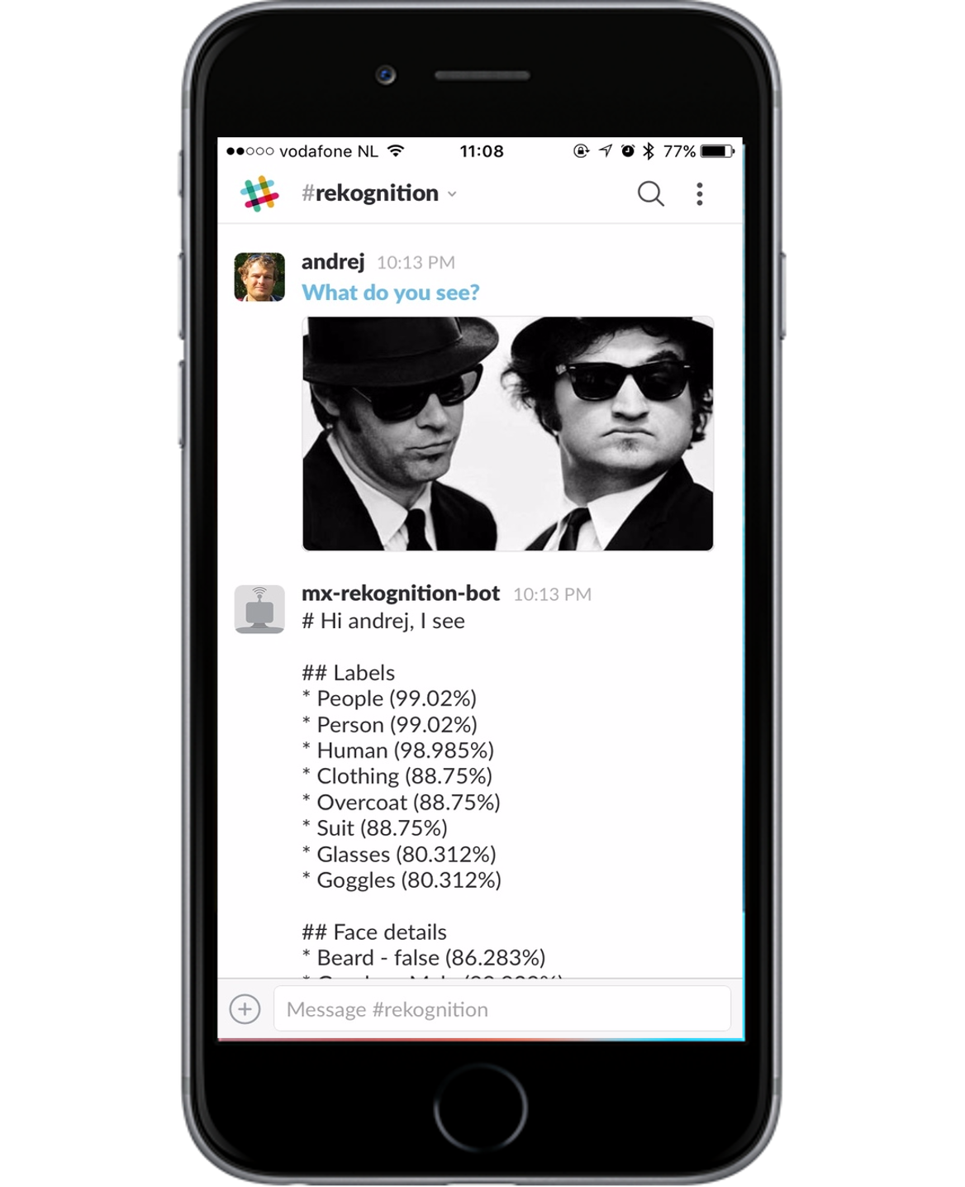
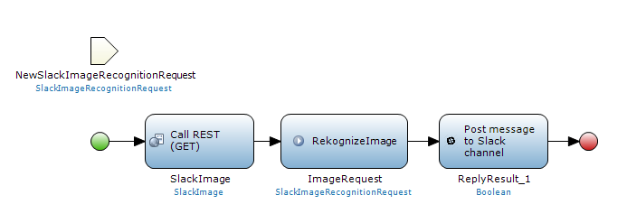
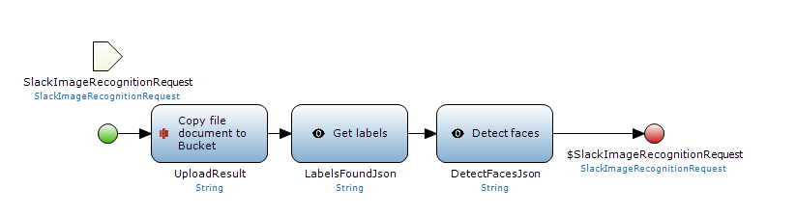
Mendix App
Slack Server
1. Register slack listener
2. What do you see?
3. Call Mx MF with message
AWS Lex
4. Determine intent of message
5. Get message image
AWS S3
6. Upload image to AWS S3
10. Send Response to user
9. Send response to slack channel
AWS Rekognition
7. Detect labels for image
8. Detect faces on image

