Slide 1
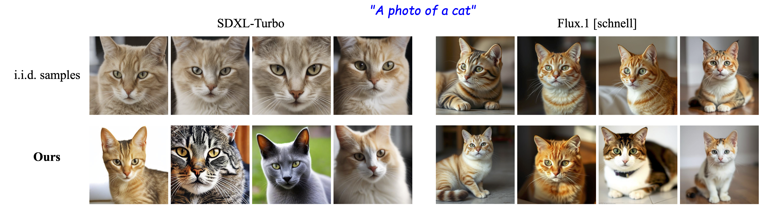
It’s Never Too Late:
Noise Optimization for Collapse Recovery in Trained Diffusion Models
Anne Harrington*, A. Sophia Koepke*, Shyamgopal Karthik, Trevor Darrell, Alexei A. Efros
CVPR 2026

Slide 2
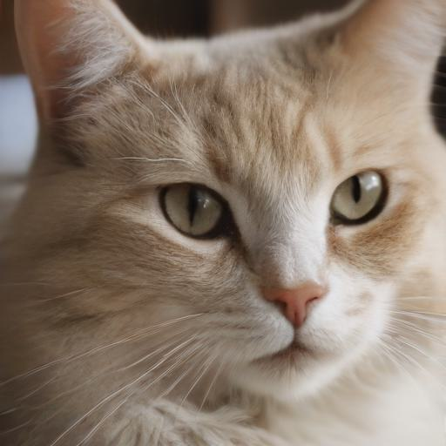

The magic of text to image diffusion models ✨
“a photo of a cat”
Diffusion Model
denoising steps…

Slide 3
What if we keep generating…?
“a photo of a cat”

Slide 4
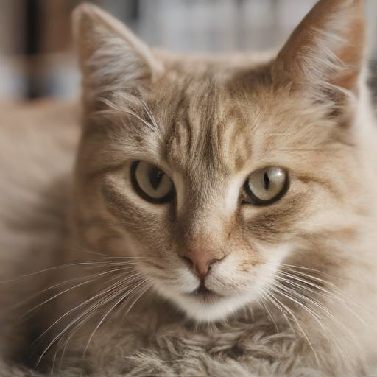
What if we keep generating…?
“a photo of a cat”

Slide 5
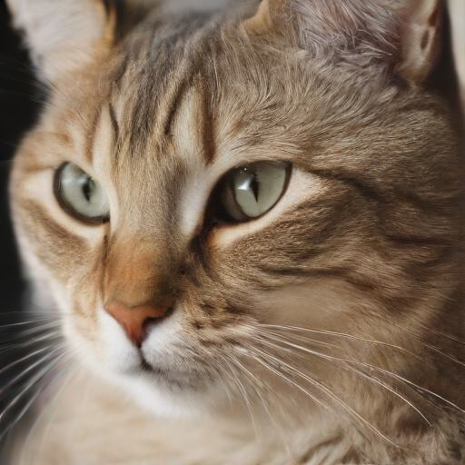
What if we keep generating…?
“a photo of a cat”

Slide 6
What if we keep generating…?
“a photo of a cat”

Slide 7
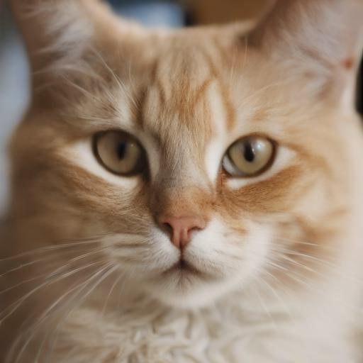
What if we keep generating…?
“a photo of a cat”

Slide 8
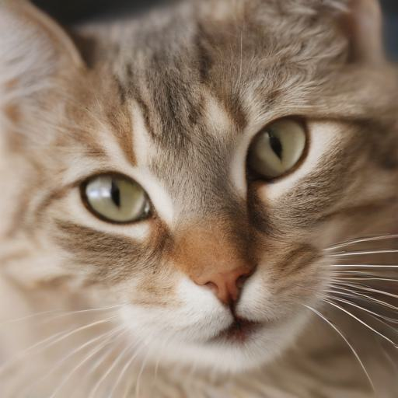
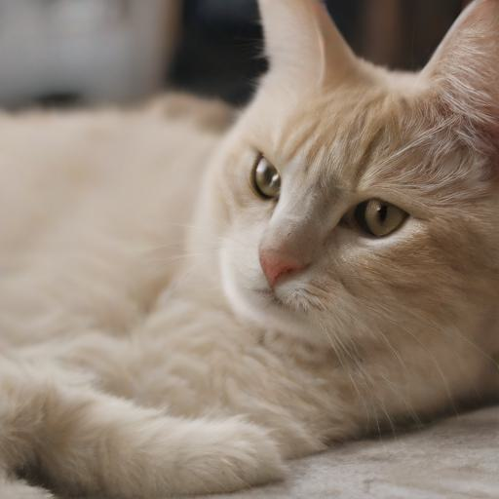
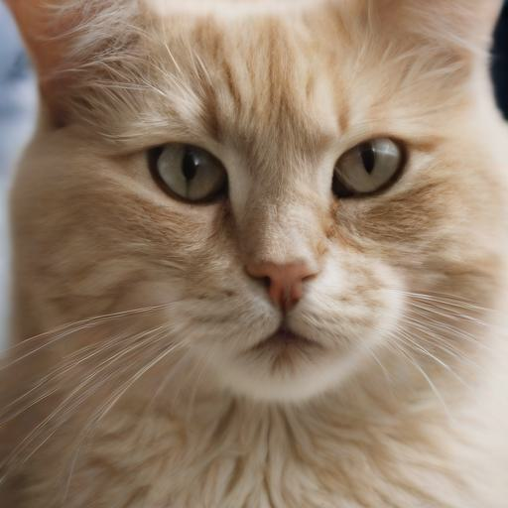
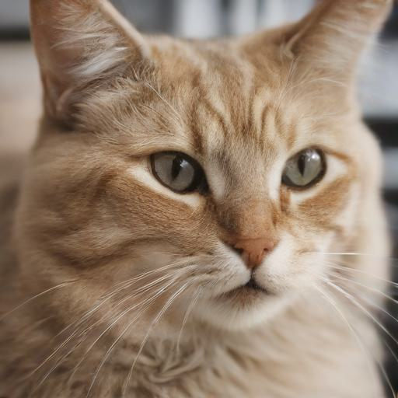
…mode collapse
“a photo of a cat”

Slide 9
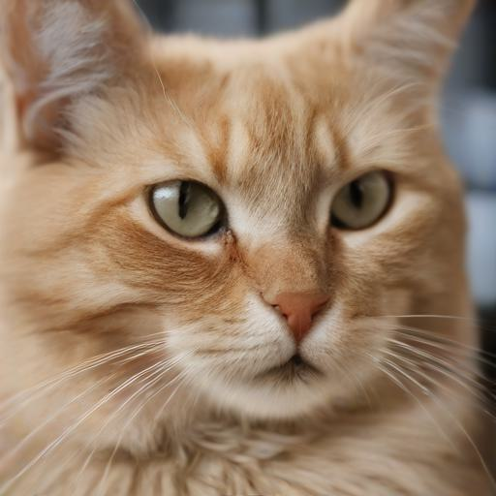
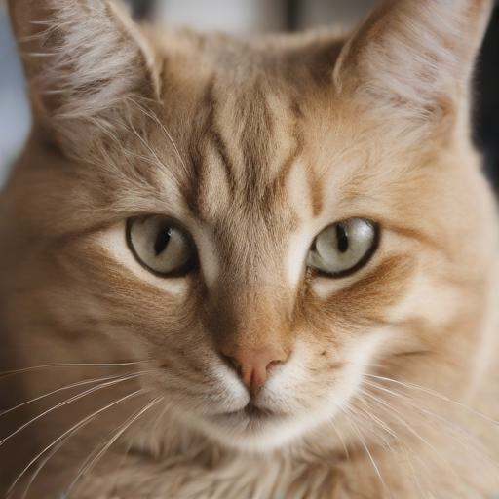
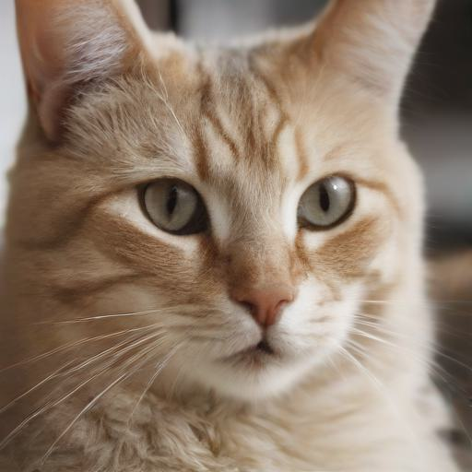
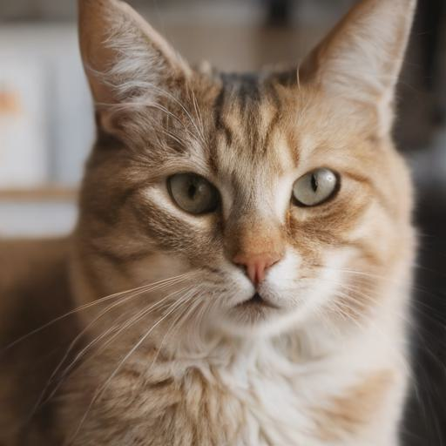
…mode collapse
“a photo of a cat”

Slide 10
Can we recover visual diversity?

Slide 11
We could select more diverse sets
“a photo of a cat”

Slide 12
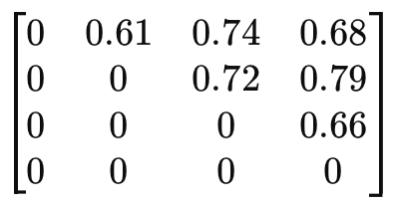
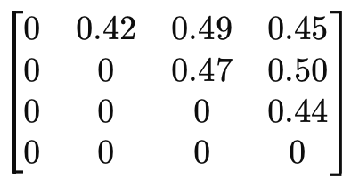
Scaling Group Inference (Parmar et al. 2025)
cosine dissimilarity score
DINO

Slide 13
Options do we have?
“a photo of a cat”
Diffusion Model
denoising steps…

Slide 14
Options do we have?
🔥
“a photo of a cat”
🔥
Diffusion Model
🔥
denoising steps…

Slide 15
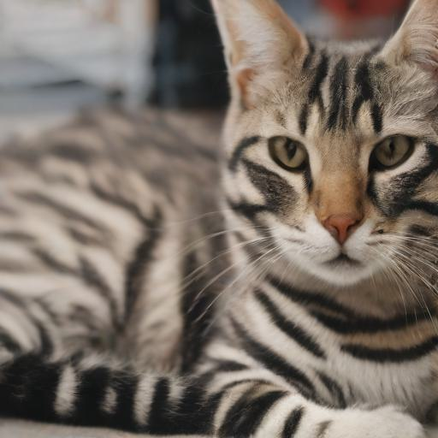
Options do we have?
“a photo of a cat with stripes”
🔥
“a photo of a cat”
🔥
Diffusion Model
🔥
denoising steps…

Slide 16
Options do we have?
❄️
“a photo of a cat”
🔥
Diffusion Model
🔥
denoising steps…

Slide 17
Options do we have?
❄️
“a photo of a cat”
🔥
Diffusion Model
🔥
denoising steps…

Slide 18
Options do we have?
❄️
“a photo of a cat”
❄️
Diffusion Model
🔥
denoising steps…

Slide 19




Our solution – optimize initial noise for output diversity
❄️Prompt
“a photo of a cat”
Noise Initialization

Slide 20
Our solution – optimize initial noise for output diversity
❄️Prompt
“a photo of a cat”
❄️
Diffusion Model
Noise Initialization

Slide 21
Our solution – optimize initial noise for output diversity
❄️Prompt
“a photo of a cat”
❄️
❄️
Diffusion Model
Noise Initialization

Slide 22
Our solution – optimize initial noise for output diversity
❄️Prompt
“a photo of a cat”
❄️
Diffusion Model
Noise Initialization
❄️
Diversity + Quality Objectives

Slide 23
Our solution – optimize initial noise for output diversity
❄️Prompt
“a photo of a cat”
❄️
🔥
🔥
Diffusion Model
🔥
🔥
Noise Initialization
❄️
Diversity + Quality Objectives

Slide 24
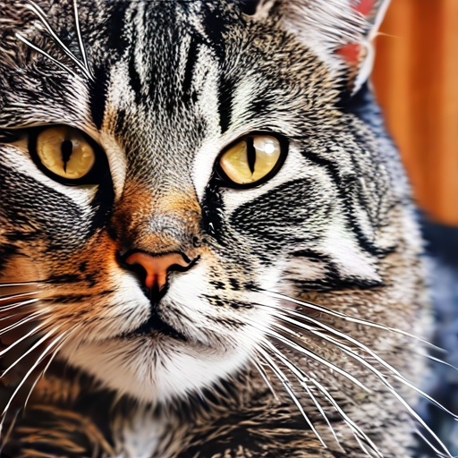
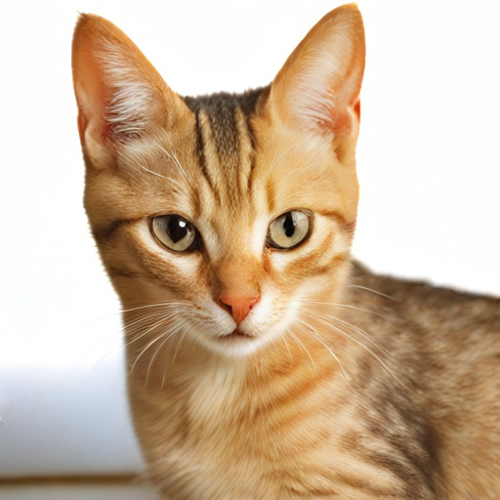
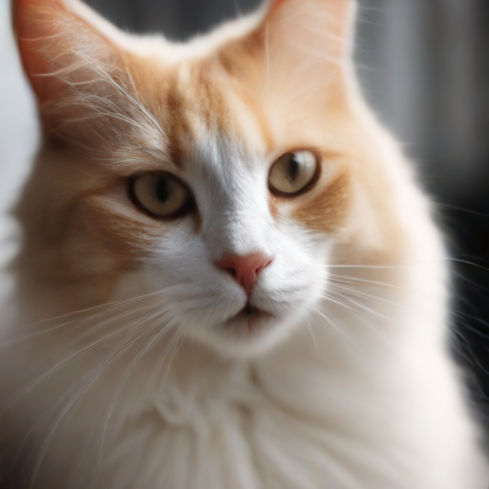
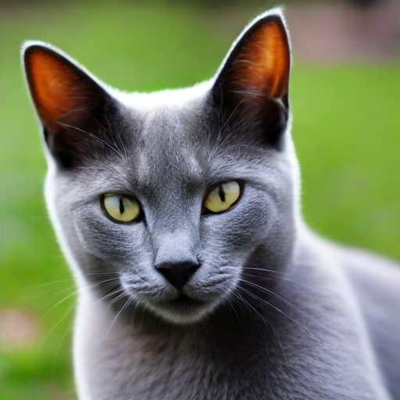
Our solution – optimize initial noise for output diversity
❄️Prompt
“a photo of a cat”
❄️
🔥
🔥
Diffusion Model
🔥
🔥
Noise Initialization
❄️
Diversity + Quality Objectives

Slide 25
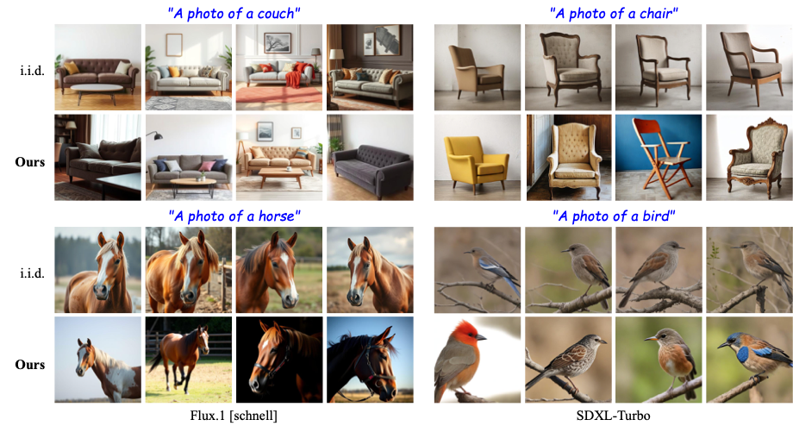
Our method improves diversity in color, orientation, and style across models

Slide 26
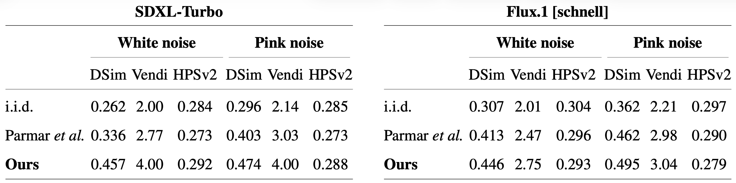
We achieve superior diversity scores on GenEval while maintaining quality

Slide 27
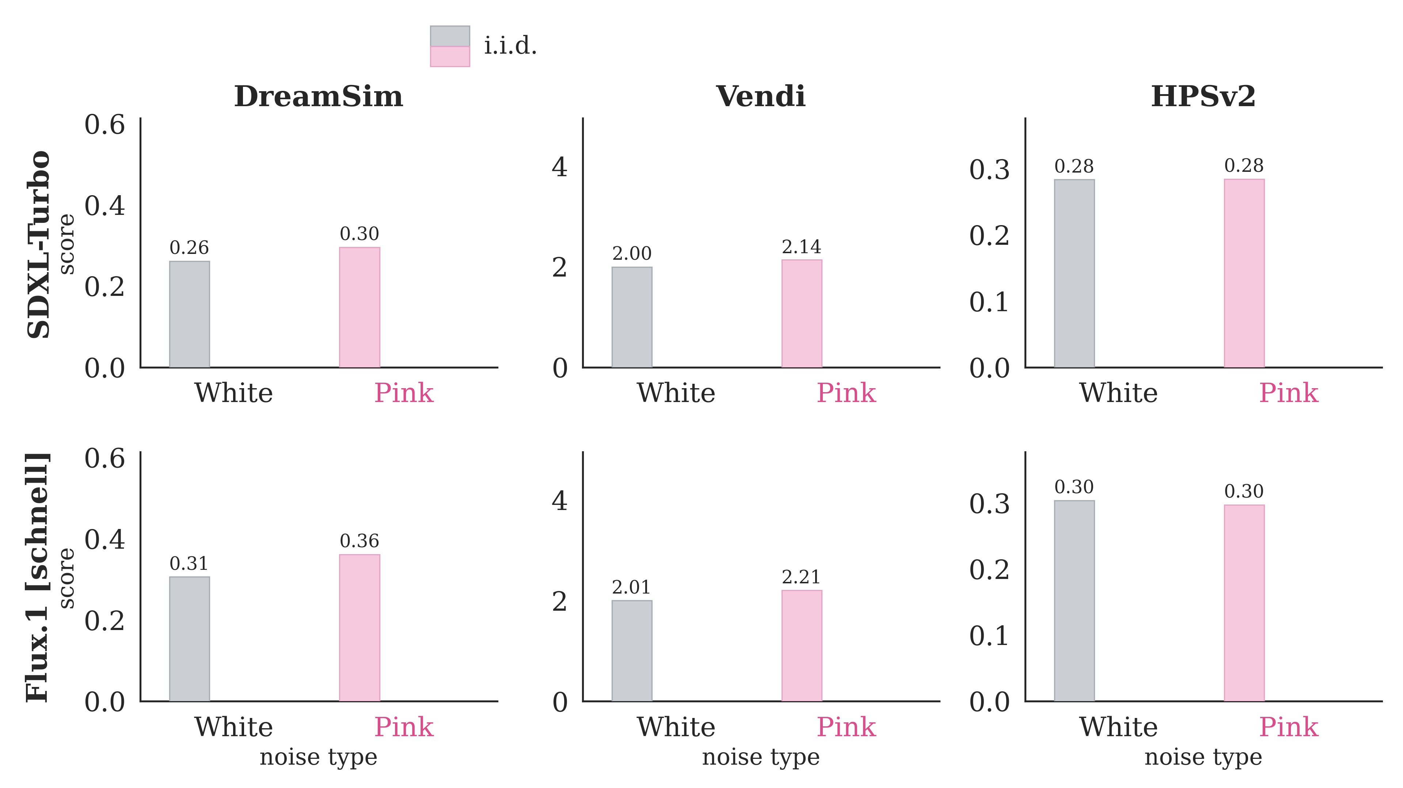
We achieve superior diversity scores on GenEval while maintaining quality

Slide 28
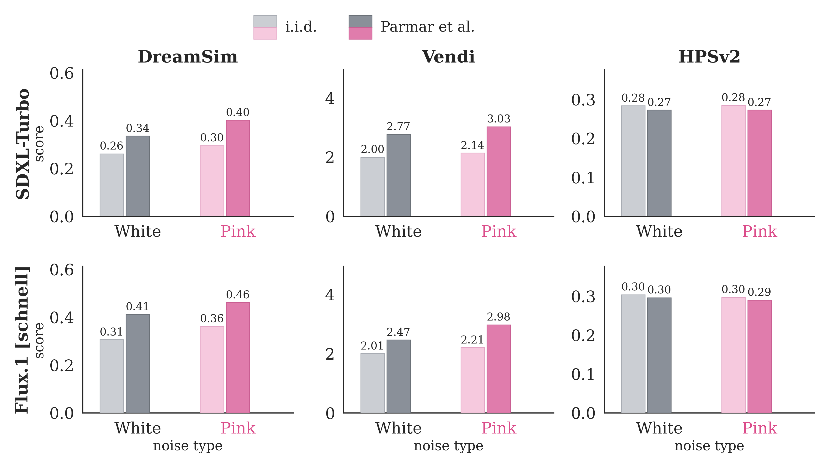
We achieve superior diversity scores on GenEval while maintaining quality

Slide 29
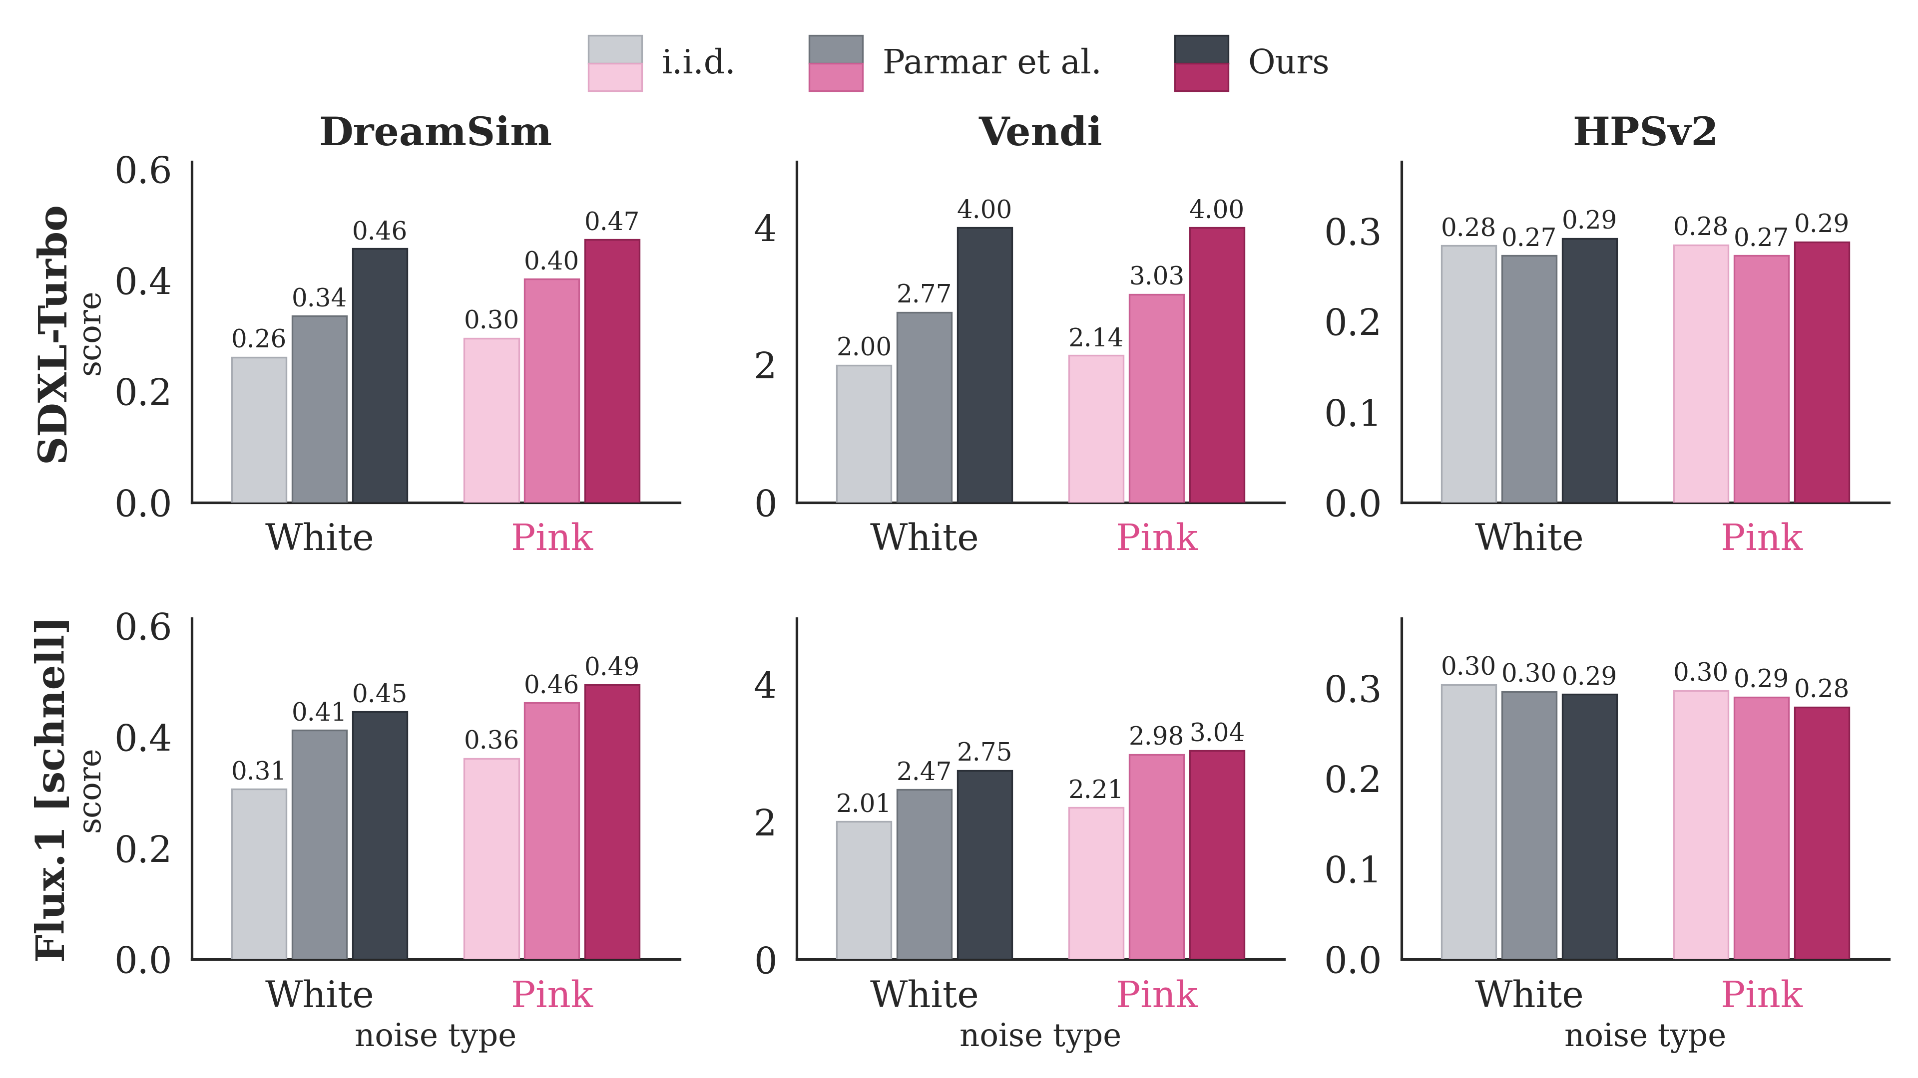
We achieve superior diversity scores on GenEval while maintaining quality

Slide 30
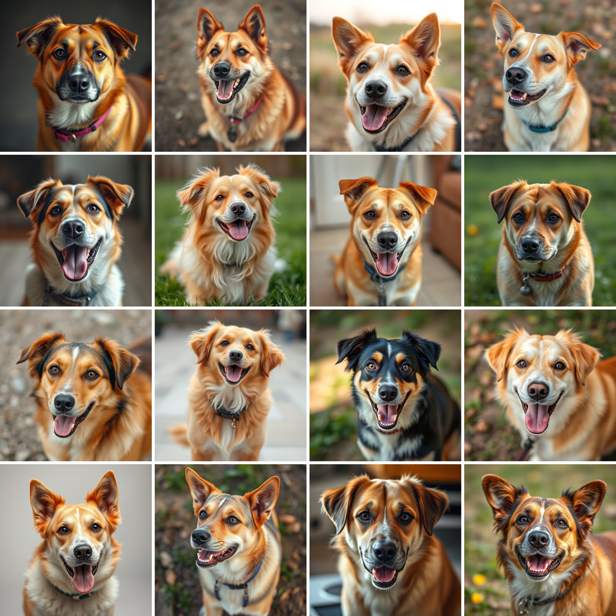
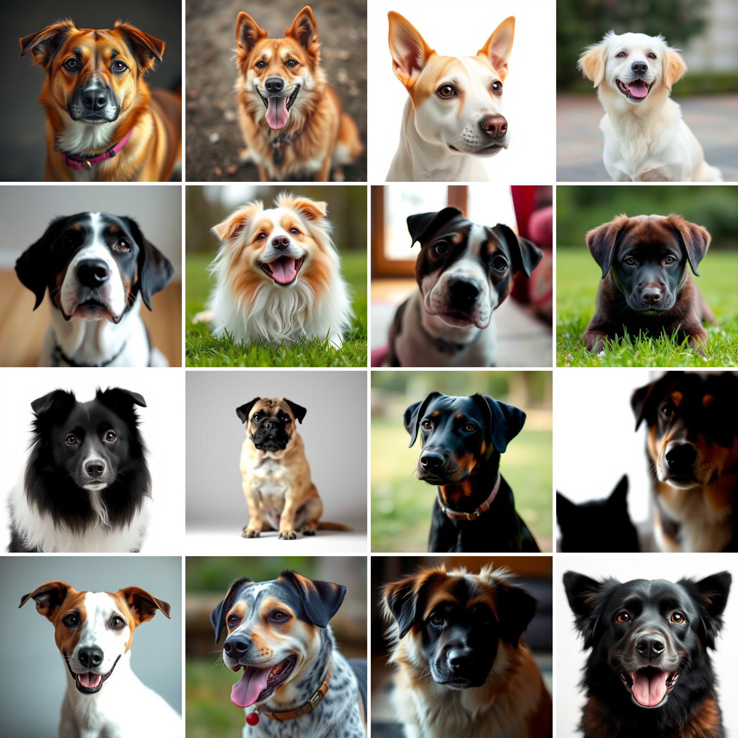
Our method scales to large, diverse image sets via sequential generation
“A photo of a dog”
i.i.d.
Ours

Slide 31
We increase diversity even on highly specified prompts
A picturesque autumn scene where a quaint cottage with a thatched roof sits beside a tranquil lake, surrounded by trees with leaves in vibrant shades of orange, red, and yellow. The cottage's wooden exterior is complemented by white-framed windows, and a stone chimney rises above the roofline. The lake reflects the warm fall colors, creating a mirror image of the foliage and the small structure on its calm surface.

Slide 32
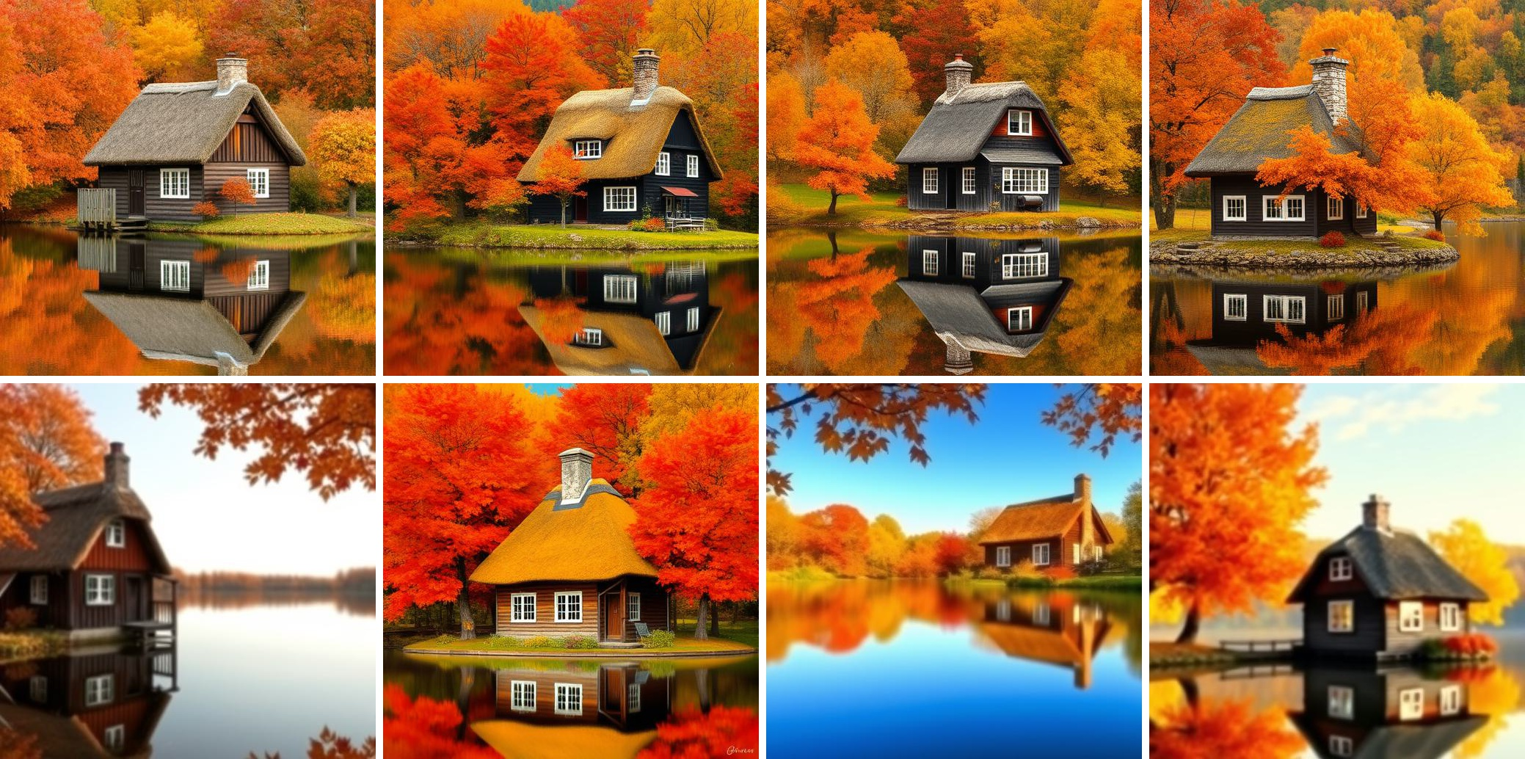
We increase diversity even on highly specified prompts
A picturesque autumn scene where a quaint cottage with a thatched roof sits beside a tranquil lake, surrounded by trees with leaves in vibrant shades of orange, red, and yellow. The cottage's wooden exterior is complemented by white-framed windows, and a stone chimney rises above the roofline. The lake reflects the warm fall colors, creating a mirror image of the foliage and the small structure on its calm surface.
i.i.d.

Slide 33
We increase diversity even on highly specified prompts
A picturesque autumn scene where a quaint cottage with a thatched roof sits beside a tranquil lake, surrounded by trees with leaves in vibrant shades of orange, red, and yellow. The cottage's wooden exterior is complemented by white-framed windows, and a stone chimney rises above the roofline. The lake reflects the warm fall colors, creating a mirror image of the foliage and the small structure on its calm surface.
i.i.d.
Ours

Slide 34
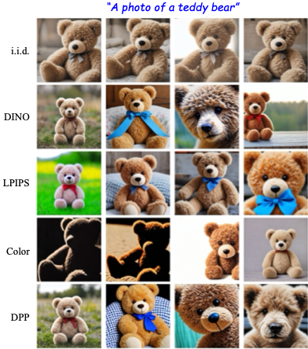
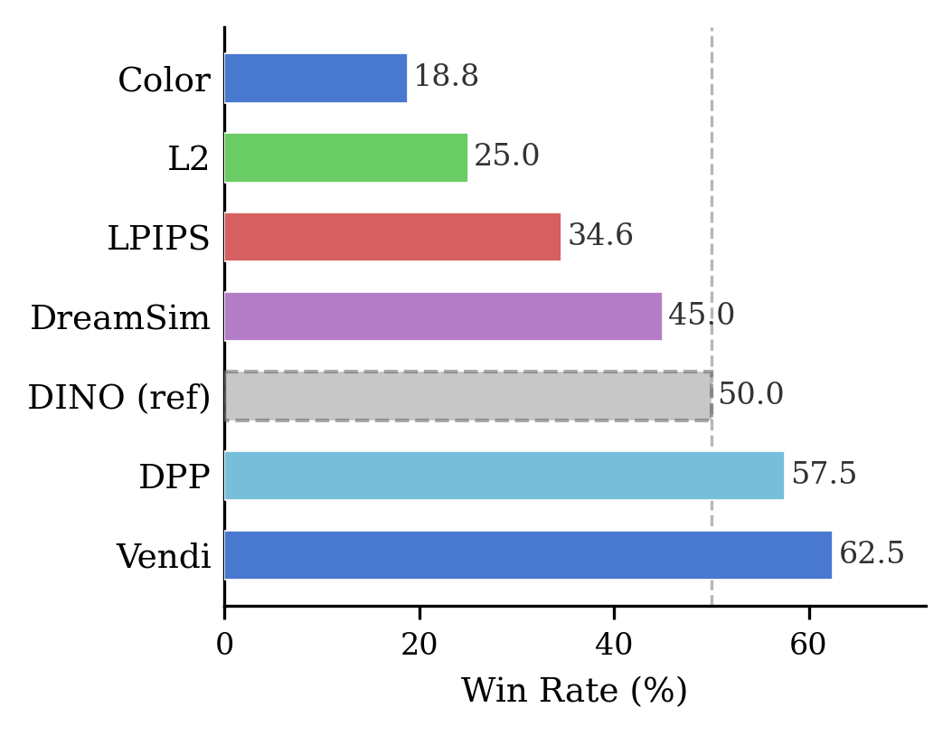
Diversity is metric dependent, set level objectives preferred

Slide 35
What happens to the noise?

Slide 36
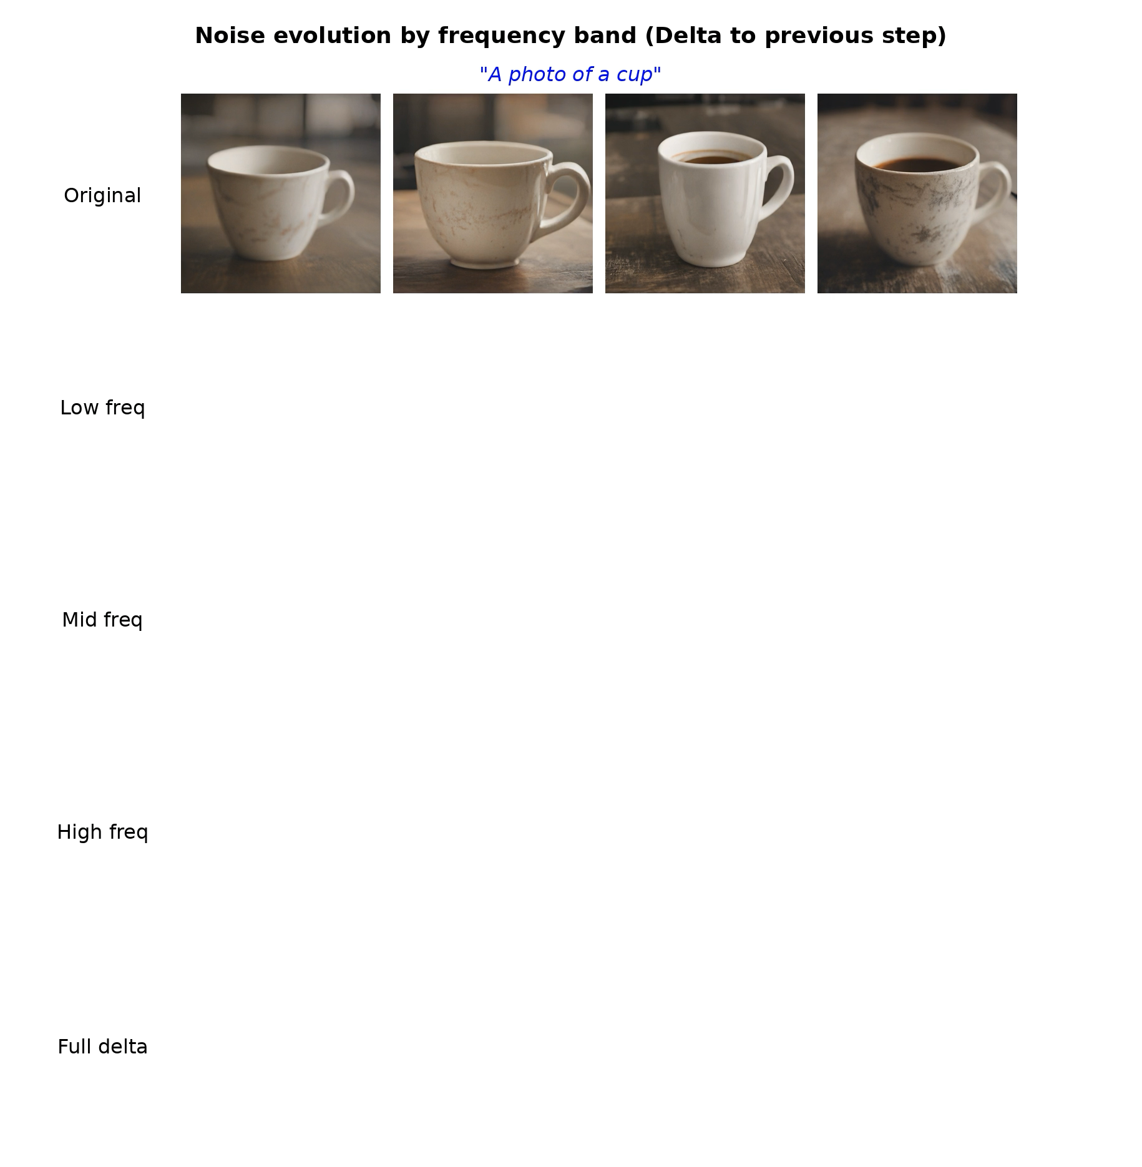
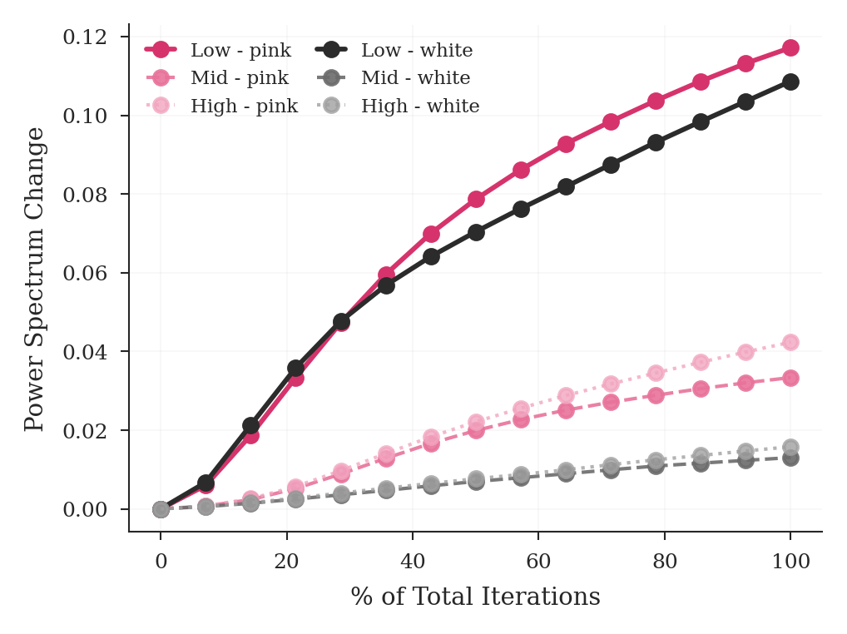
Optimization changes low frequency information the most

Slide 37





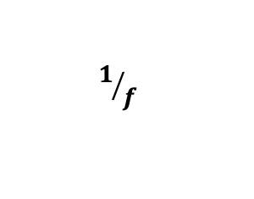
Noise can be initialized with different frequency profiles
White
Pink
Blue
Power Spectral Density:
$$constant$$
$$1/{f^{}}$$
$$f^{}$$
Low frequencies
High frequencies

Slide 38
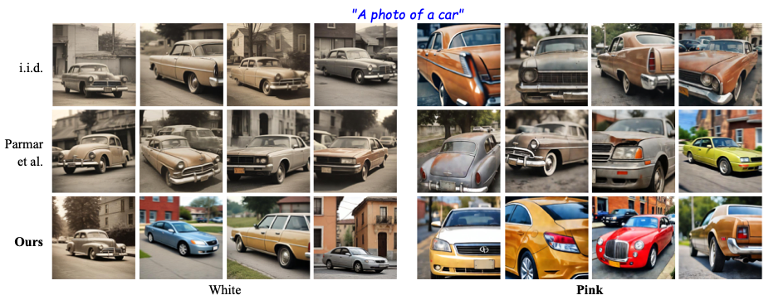
Boosting low frequencies via pink noise initialization improves diversity at inference and during optimization

Slide 39
It’s never too late!
By changing only the starting noise, we can recover lost diversity in text-to-image diffusion models.

Slide 40
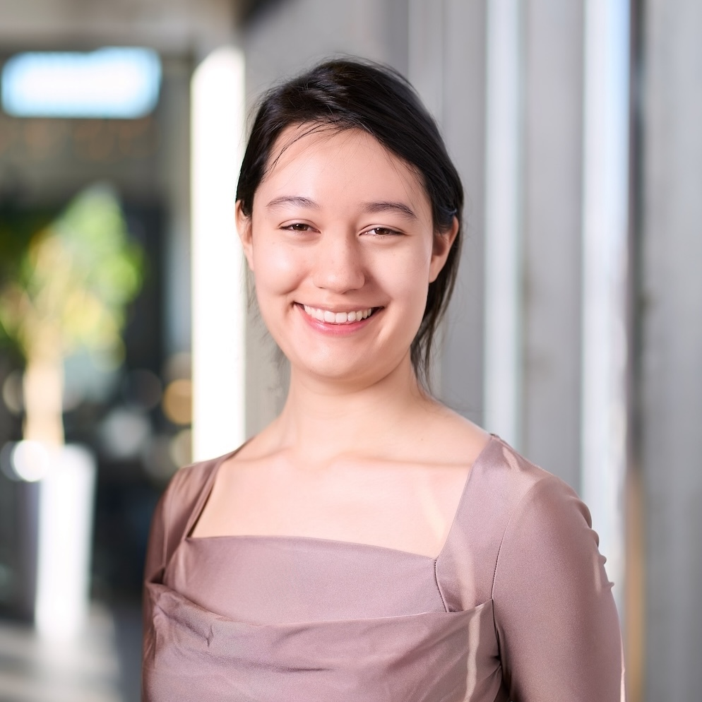
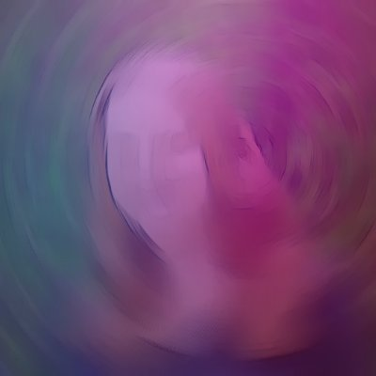
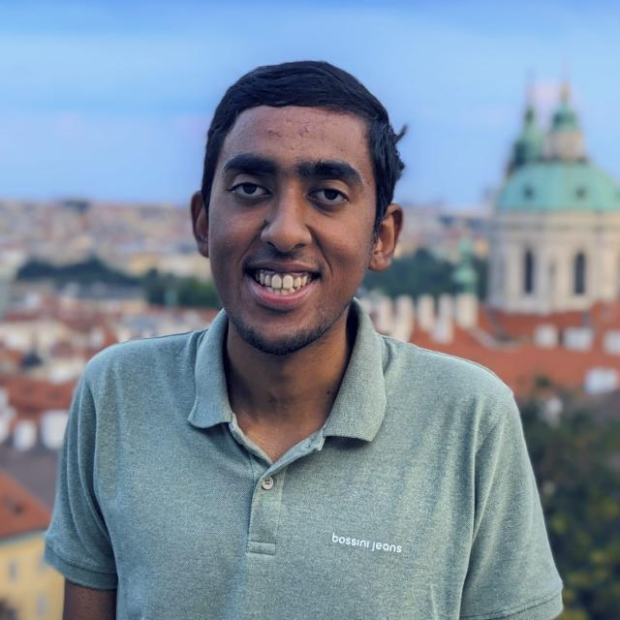
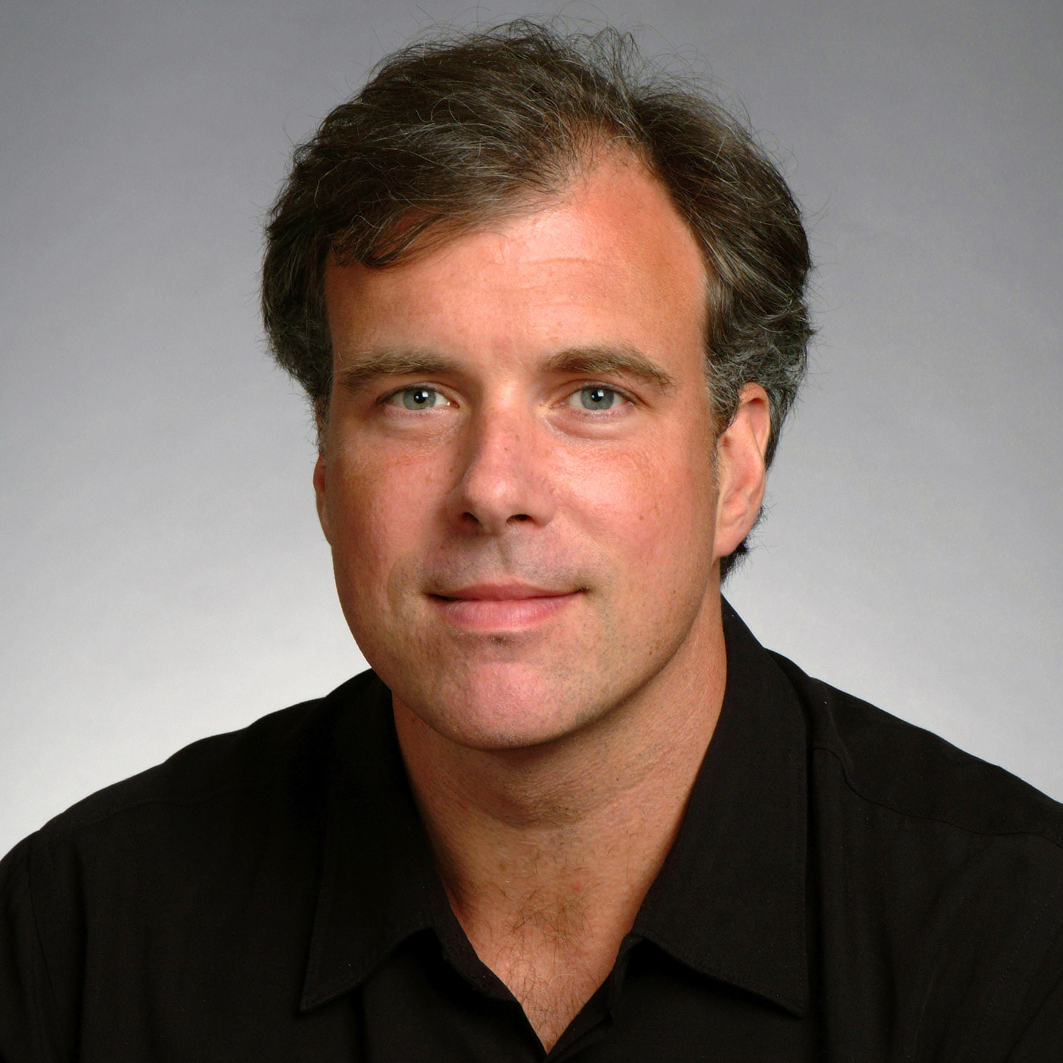
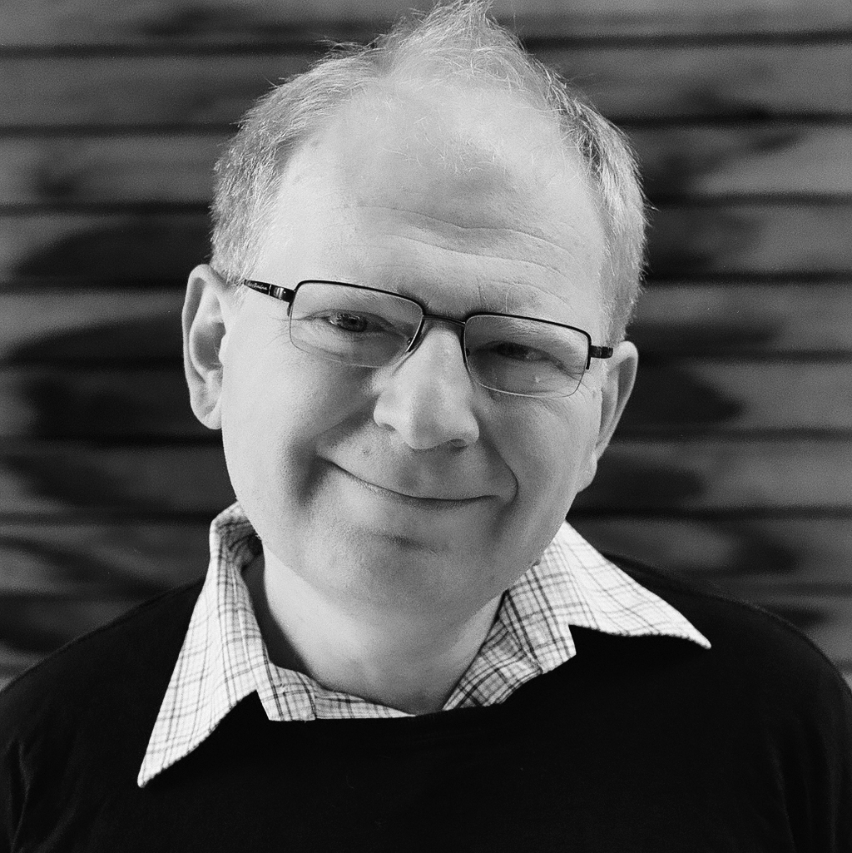

Acknowledgements
Anne Harrington*
A. Sophia Koepke*
Shyamgopal Karthik
Trevor Darrell
Alexei A. Efros

