Slide 1
Private Dependencies

Slide 2
Breaking changes, a story
ML.NET used Google.Protobuf 3.5 to generate ONNX files
TensorFlow.NET used Google.Protobuf 3.9 to save TF files
ML.NET wanted to take a dependency on TensorFlow.NET
But wait:

Slide 3
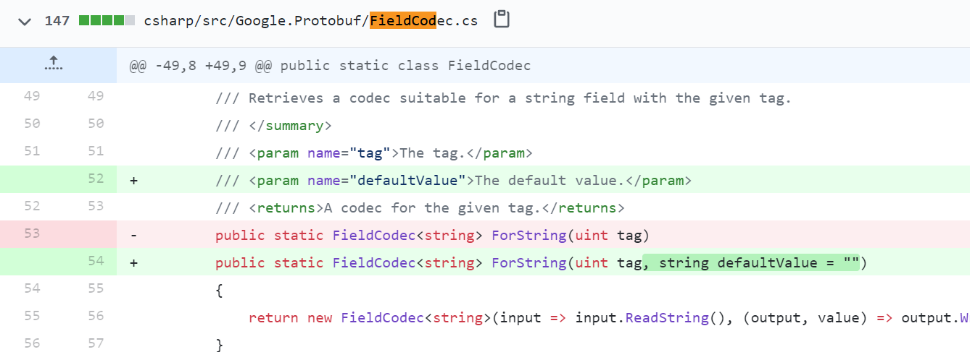
Between version 3.5 and 3.9 an innocuous-looking change was merged in Google.Protobuf

Slide 4
Breaking changes, a story
This change mean that ML.NET was stuck. It couldn’t take a dependency on TF.NET because the versions were incompatible.
There was no way for ML.NET to get unstuck themselves.
Either:
ONNX needed to update to Google.Protobuf 3.9
TensorFlow.NET needed to downgrade to Google.Protobuf 3.5
Google.Protobuf needed to add the old API back
This is what eventually happened

Slide 5
Ideas
Java has the concept of “shading” dependencies
Can be done at library build time, or app build time.
https://medium.com/@akhaku/java-class-shadowing-and-shading-9439b0eacb13

Slide 6
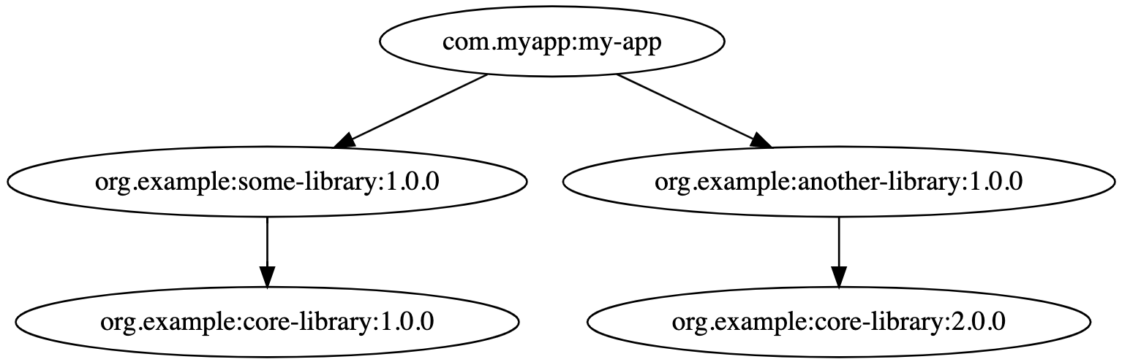
Shading in Java

Slide 7
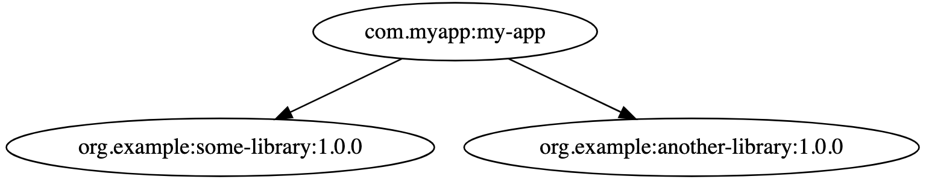
Shading in Java

Slide 8
Ideas
In .NET we could follow this same idea of “shading”, but re-writing IL for the dependent libraries
This only works for IL, and not native dependencies
Another option would be to create “hive” directories for dependencies
The dependencies of Onnx could bring Google.Protobuf 3.5 into the “Onnx Dependency Directory”
The dependencies of TF.NET could bring Google.Protobuf 3.9 into the “TF.NET Dependency Directory”

Slide 9
Ideas
These could be “app-time” knobs where the app dev decides which dependencies should be “shaded”
Could also use SemVer
If the Major Version changes between dependencies -> split the dependencies
The library could have a “SemVer aware” flag, which would turn on the split dependencies by default

Slide 10
Ideas
Create an “API Compat” tool that developers can run compat with the last released version
This catches breaking changes earlier – before releasing the breaking change
Could run
During CI
On upload to nuget feed

Slide 11
Links
As a .NET platform team member, I understand whether Java-style shading would be a useful feature #5730
https://github.com/dotnet/core/issues/5730

