Slide 1
.NET 6 Ecosystem Features
Immo Landwerth

Slide 2
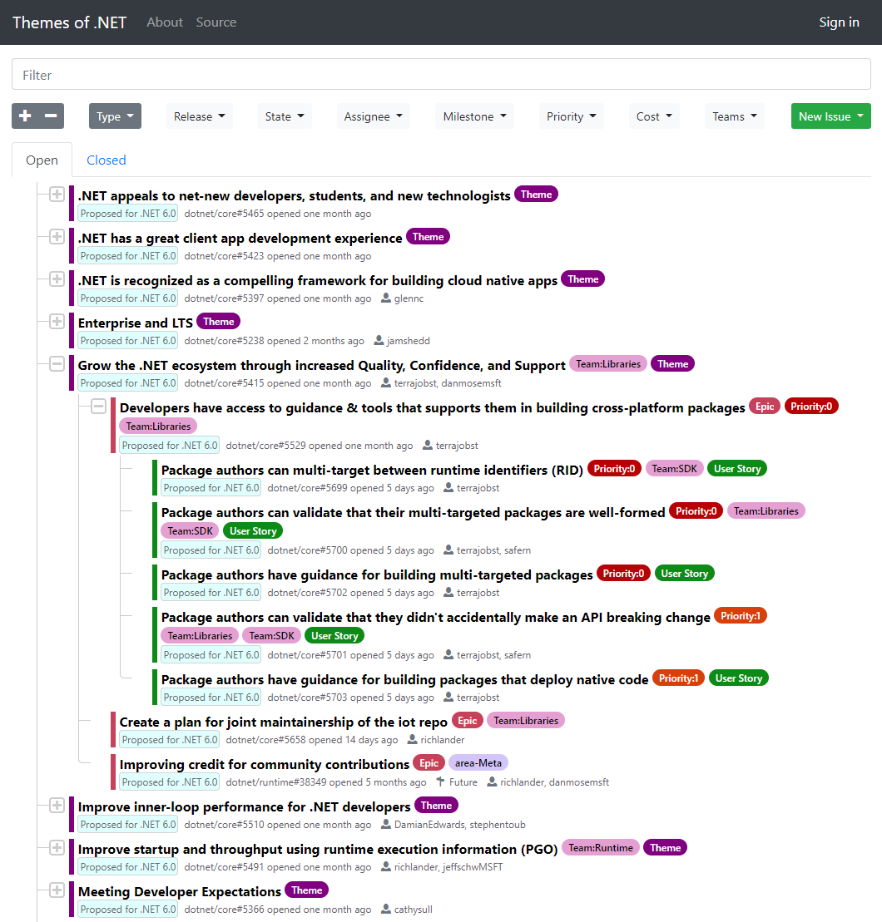
themesof.net
.NET 6.0 Planning is in the open

Slide 3


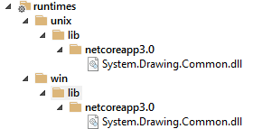
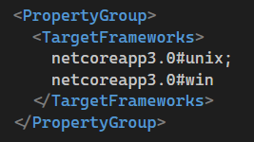
Package authors can multi-target between runtime identifiers
Framework (TFM) based multi-targeting:
Runtime (RID) based multi-targeting:

Slide 4
Package authors can multi-target between runtime identifiers
Multi target for architecture and operating system, even if the OS doesn’t have a dedicated framework
Package native assets

Slide 5

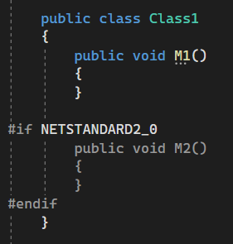
Package authors can validate that their multi-targeted packages are well-formed
Can you spot the bug?
This means code compiled against .NET Standard 2.0 can’t run on .NET 5

Slide 6

Package authors can validate that their multi-targeted packages are well-formed
Can you spot the bug?
Different assembly names means code built for .NET Standard can’t run on .NET Core

Slide 7
Package authors can validate that they didn't accidentally make an API breaking change
In the dotnet/runtime repo we’re using a tool called ApiCompat that can validate two assembly sets, A and B
It checks whether compiling against set A means you can run on set B
Multiple ways to leverage this:
Did I make a breaking change?
A := V1, B := V2
Is my package well formed?
A := netstandard2.0 binaries, B := netcoreapp3.0 binaries
We want to productize this tool and allow integrate it into the build

Slide 8
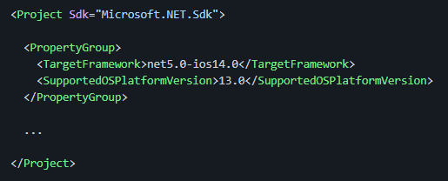
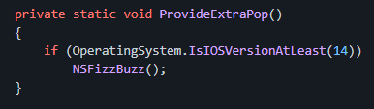
Extending Platform-Compat Analyzer
Annotating operating system APIs with version information
Android
iOS, macOS, watchOS, tvOS
WinRT

