Slide 1

Simple forex simulator
Developed by Team Bits & Coins
Members:
Joe Bizal
Aidan Fleischer
Andrew Koerner
Paul Quint

Slide 2
Requirements
Needed a program to fit our client, Prof. Hamza’s needs.
Requirements:
1. Complex (not rudimentary)
2. Clean Interface
3. Easy to use
Knowing this, we focused on usability and portability
For this, we chose Java
Most portable language, clean apps

Slide 3
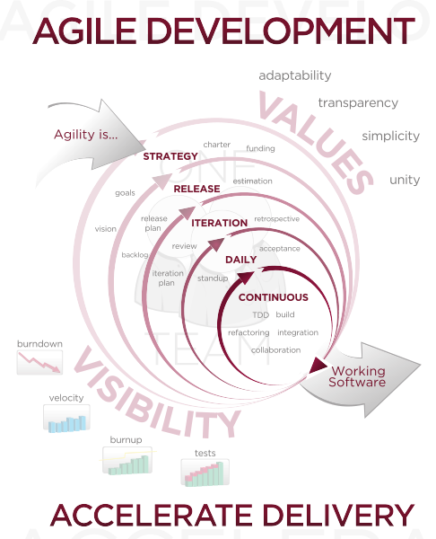
Our Engineering Process Model
Abbreviated
Agile Programming
-Due to triple constraints

Slide 4
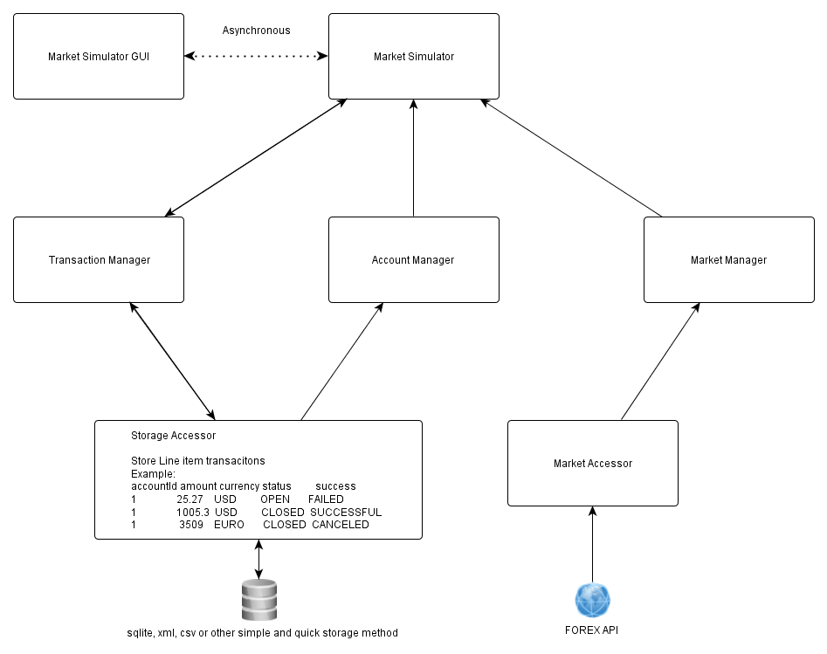
Architecture

Slide 5
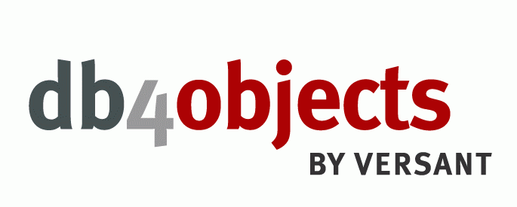
Storage Accessor:
Saves data to storage
Retrieves data from storage
Used db4o database since easy to reuse, thus don’t need to re-implement storage solution

Slide 6
Market Accessor:
Retrieves current exchange rate
Exchange rate gathered from Gson library to get current market data according to Google
Updates in real-time to ensure accuracy
Google data consistent, ensures reliability

Slide 7
Transaction Manager:
Pushes and pulls Transaction data to and from the StorageAccessor
Processes data pulled

Slide 8
Account Manager:
Pulls account data from StorageAccessor
Processes data pulled for Market Simulator

Slide 9
Market Manager:
Pulls market data from the MarketAccessor
Processes data pulled for Market Simulator

Slide 10
Market Simulator:
Receives transaction data from Transaction Manager
Receives account data from Account Manager
Receives Market data from Market Manager
Processes received data and sends it to the Market Simulator GUI
Simulates market pressure

Slide 11
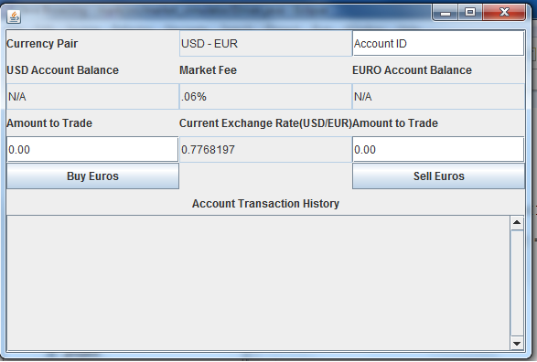
Market Simulator GUI:
Allows for imputing transaction data and displays the results of the transaction
Sends and receives data to Market Simulator
Clear labels and Spartan interface enhance usability

Slide 12
The Result

Slide 13
Processes Used
Separation of Tasks
Different classes assigned to different members
PM clearly responsible for setting schedule and maintaining Version control
Emulated the Surgical Team
Consistent Scheduling
Daily meetings
Nightly timetables

Slide 14



Tools to help Productivity
Github
Collaboration, Management
Java + Eclipse IDE
Email

Slide 15


Engineering Challenges and Solutions
Communication
Schedules
Learning Github
Timeframe
Risk Management techniques such as outlining the risks in our milestone helped prepare us for these.

Slide 16
FIN.

