Slide 1
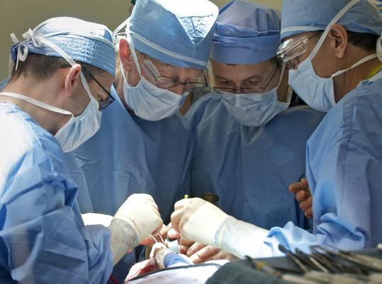

The Surgical Team
Joe Bizal
Aidan Fleischer
Andrew Koerner
Paul Quint
Abdelbaset Hamza
The Mythical Man-month

Slide 2
The Problem
Large disparity between programmers’ productivity and performance
No correlation between experience and performance
Team size has a direct effect on performance

Slide 3
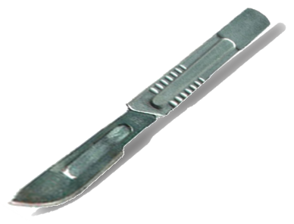
The Solution
Treat every programming team as a surgical team

Slide 4
What does this mean?
Highly skilled managers no longer manage teams of mediocre programmers.
There is one person “cutting” i.e., a small high precision team of specialized individuals.
In a conventional team partners are equal this is not true of a surgical team where the surgeon settles differences unilaterally

Slide 5
Surgical team breakdown
Keeping with the surgical team mantra the team can be broken down into individual constitutes(surgeon, nurse et cetera)

Slide 6
The Surgeon
Chief Programmer
Designs, codes and tests program
Writes documentation
Must have great talent, ten years experience and considerable systems and application knowledge

Slide 7
The Copilot
Surgeon’s right hand man
Can do any part of the job, but is less experienced
May write code but is not responsible for any part of the code
Shares in design as a thinker, discussant, and evaluator
Represents team in discussions of function and interface with other teams

Slide 8
The Administrator
Handles money, people, space and machines
Interfaces with administration of the rest of the organization
The surgeon has the final say on personnel, raises, space and so on, but he must spend very little time on these things.
Administrator caries the burden for him

Slide 9
The Editor
For maximum clarity, the surgeon must generate the documentation
The surgeon then hands off the draft to the editor
The editor criticized it, rework it, and provide references and bibliography

Slide 10
Secretary
Handle project correspondence and non-product files

Slide 11
Clerk
Responsible for maintaining of all technical records.
Enhances the teams work-products
Maintains repositories

Slide 12
The toolsmith
Maintains team tools(ide, debugger, productivity tools, other software tools)
Constructing, maintaining and upgrading special tools
Construct specialized utilities for development

Slide 13
The Tester
Responsible for maintaining a bank of reliable test cases
Responsible for maintaining test for integration testing and component-wise testing

Slide 14
The Language Lawyer
Experts at the semantics and language rules of team languages

Slide 15
Questions?

