Slide 1
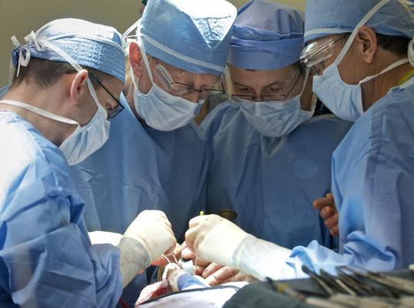

Joe Bizal
Aidan Fleischer
Andrew Koerner
Paul Quint
The Mythical Man-month
The Surgical Team

Slide 2
The Problem
How to build a large program managing lots of people?
Good programmers can be 5x-10x as productive as mediocre ones
Communication can be problematic, scaling as badly as n^2
Can we simply use a small team?

Slide 3
The Dilemma and Solution
Small teams are best
But, they can't accomplish a lot by themselves

Slide 4
The Surgeon
Chief Programmer
Designs, codes and tests program
Writes documentation
Must have great talent, ten years experience and considerable systems and application knowledge

Slide 5
The Copilot
Surgeon’s right hand man
Can do any part of the job, but is less experienced
May write code but is not responsible for any part of the code
Shares in design as a thinker, discussant, and evaluator
Represents team in discussions of function and interface with other teams

Slide 6
The Administrator
Handles money, people, space and machines
Interfaces with administration of the rest of the organization
The surgeon has the final say on personnel, raises, space and so on, but he must spend very little time on these things.
Administrator caries the burden for him

Slide 7
The Editor
For maximum clarity, the surgeon must generate the documentation
The surgeon then hands off the draft to the editor
The editor criticized it, rework it, and provide references and bibliography

