Slide 1
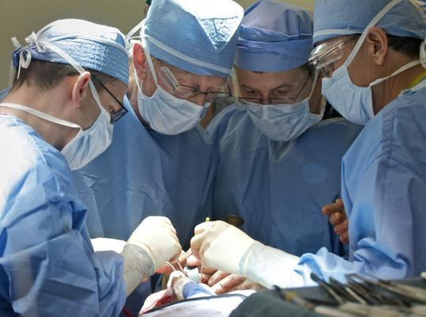

The Surgical Team
Joe Bizal
Aidan Fleischer
Andrew Koerner
Paul Quint
The Mythical Man-month

