Slide 1
● PRODUCTION-GRADE · GA
GCP × SRE × O11y
Multi-region GKE platform with Grafana-on-BigQuery observability
2 GKE clusters
Multi-Cluster Ingress
Cloud Armor WAF
BigQuery + Grafana
GCP Multi-Cluster GKE Platform
Two Web Apps · Global Load Balancing · Grafana-on-BigQuery Observability
Leadership Review | Platform Engineering
AI Engineer / SRE Architect – Abhay Ojha
Notes:
MEETING NOTES — Title Slide
- Welcome leadership team
- Purpose: Review the GCP multi-cluster platform architecture, delivery plan, and key decisions
- Platform: two stateless web apps across two GKE clusters in different regions
- Fronted by a global HTTPS load balancer; full observability via Grafana + BigQuery
- All infrastructure is Terraform — single 'terraform apply' provisions everything

Slide 2
GCP × SRE × O11y · PRODUCTION-GRADE · GA
Agenda
1. Executive Summary & Business Value
2. Architecture Overview
3. GKE Cluster Design
4. Application Deployment Strategy
5. Traffic Flow & Global Load Balancing
6. Security Posture
7. Observability & Grafana Dashboards
8. High Availability & Disaster Recovery
9. CI/CD Pipeline
10. Project Timeline & Effort
11. Key Design Decisions
12. Risks & Mitigations
13. Next Steps & Ask
AI Engineer / SRE Architect – Abhay Ojha
Notes:
MEETING NOTES — Agenda
- Walk through agenda so leadership knows what to expect
- Invite questions at any point or hold for end
- Total time: ~30–40 minutes
- Key decision points will be called out on relevant slides

Slide 3
GCP × SRE × O11y · PRODUCTION-GRADE · GA
Executive Summary
What We're Building
A production-grade, multi-region GCP platform running two web apps with global load balancing, full observability, and zero-downtime failover
Why It Matters
Sub-second regional failover — no DNS changes, no customer impact
Single Terraform apply provisions the entire stack — repeatable, auditable, drift-free
Enterprise security: Workload Identity, Binary Authorization, Cloud Armor WAF, no JSON keys
Grafana dashboards on BigQuery provide deep operational visibility + forensic investigation
Key Numbers
2 regions (us-central1, us-east1) · 2 GKE clusters · 2 apps · 4 Grafana panels
~15.5 engineer-days total effort · 7–20 calendar days depending on team size
AI Engineer / SRE Architect – Abhay Ojha
Notes:
MEETING NOTES — Executive Summary
- Complete platform-as-code: not just infra, but apps, CI/CD, observability, and security
- Multi-Cluster Ingress: instant failover (seconds, not minutes like DNS-based)
- All infra is version-controlled Terraform — no manual console clicks
- Security baked in: no SA keys, WAF at the edge, binary authorization blocks unattested images
- 15.5 engineer-day estimate covers everything from VPC to Grafana dashboards
- With 2 engineers: 10–12 calendar days

Slide 4
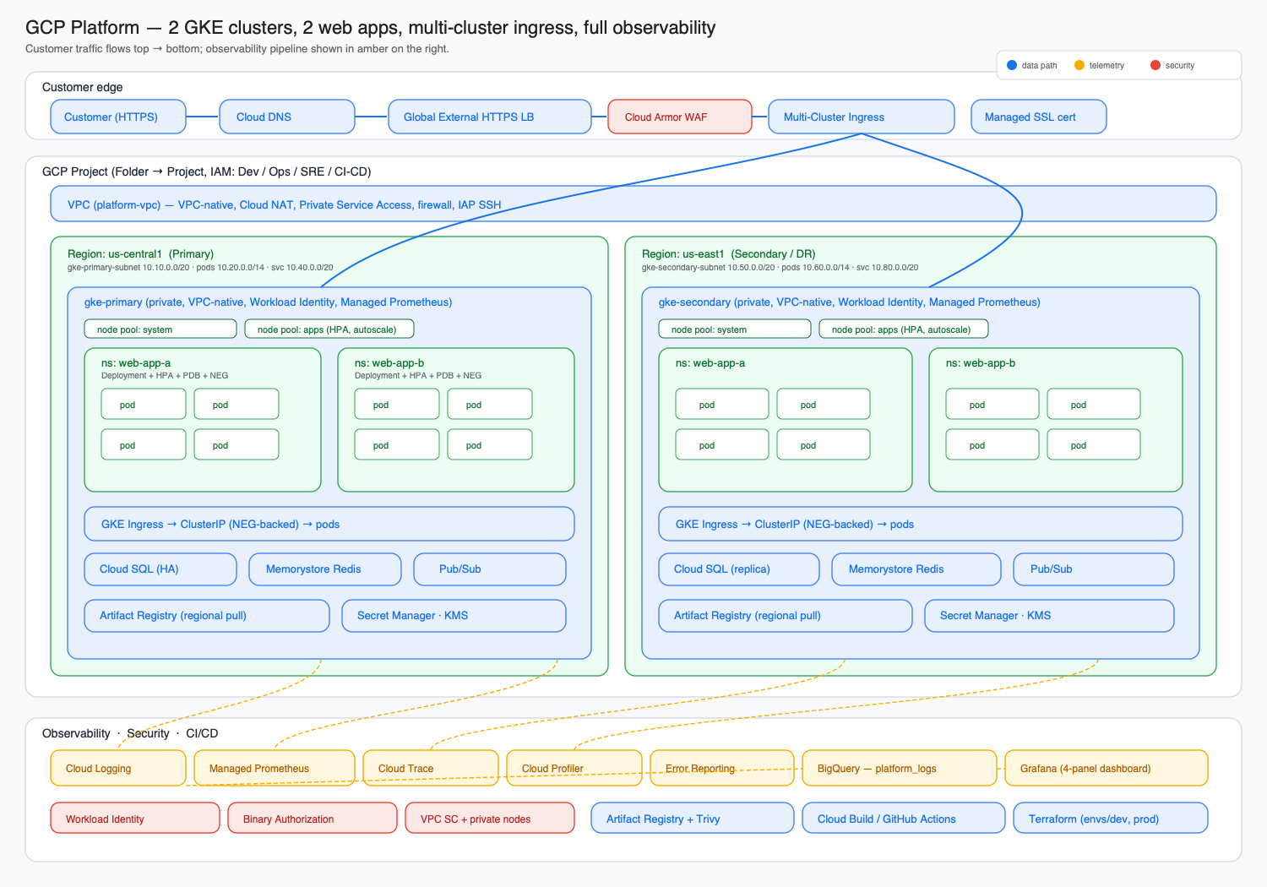
GCP × SRE × O11y · PRODUCTION-GRADE · GA
Architecture Overview
AI Engineer / SRE Architect – Abhay Ojha
Notes:
MEETING NOTES — Architecture Overview
- Diagram: customer edge → GCP project → 2 regional GKE clusters → observability
- Customer traffic top-to-bottom; observability pipeline in amber on right
- Two identical regional clusters (us-central1 primary, us-east1 secondary/DR)
- Each cluster: system + apps node pools, web-app-a and web-app-b namespaces
- Terraform module chain: project → network → iam → gke-cluster (×2) → mci → cloud-armor → observability

Slide 5
GCP × SRE × O11y · PRODUCTION-GRADE · GA
GKE Cluster Design
Setting | Primary (us-central1) | Secondary (us-east1)
Mode | GKE Standard (regional) | GKE Standard (regional)
Networking | VPC-native, private | VPC-native, private
Workload Identity | Enabled | Enabled
Managed Prometheus | Enabled | Enabled
Release Channel | REGULAR | REGULAR
Binary Authorization | Enforce-policy | Enforce-policy
Node Pools | system, apps | system, apps
Shielded Nodes | Enabled | Enabled
AI Engineer / SRE Architect – Abhay Ojha
Notes:
MEETING NOTES — GKE Cluster Design
- Both clusters identical by design — symmetric failure modes
- Regional Standard over Autopilot: node-pool tuning, cost control at scale
- Workload Identity eliminates SA key management
- Managed Prometheus on both clusters for metric collection
- Binary Authorization enforce mode blocks unattested container images
- Separate system/apps node pools prevent workload interference

Slide 6
GCP × SRE × O11y · PRODUCTION-GRADE · GA
Application Deployment Strategy
Two Stateless Web Applications
web-app-a: Purely stateless (Cloud SQL HA optional)
web-app-b: Adds Pub/Sub + Memorystore — included in /readyz health checks
Deployment Model (identical for both apps)
Multi-pod Deployment with Kustomize base + per-region overlays (primary/secondary)
ConfigMap-driven configuration (region, log level, app name)
Workload Identity for downstream auth — no baked-in secrets
HPA on CPU + memory for auto-scaling
PDB (minAvailable: 2) for zero-downtime rollouts
Topology spread across zones for real availability
Dependency-aware /readyz — Redis outage removes pod from rotation without restart
Graceful drain on SIGTERM for clean shutdown
AI Engineer / SRE Architect – Abhay Ojha
Notes:
MEETING NOTES — Application Deployment
- Apps follow 12-factor principles: stateless, config-driven, health-aware
- Kustomize over Helm: 2 apps, no charts to publish, no parameter explosion
- PDB ensures at least 2 pods always available during voluntary disruptions
- Topology spread prevents all replicas landing on one node/zone
- web-app-b readyz includes Redis check: Memorystore outage removes pod gracefully
- Secrets go to Secret Manager, read via Workload Identity at startup

Slide 7
GCP × SRE × O11y · PRODUCTION-GRADE · GA
End-to-End Traffic Flow
1. DNS → Customer hits the domain; Cloud DNS returns the global anycast IP
2. TLS Termination → Google-managed SSL cert at the edge
3. Cloud Armor → OWASP WAF rules + adaptive L7 DDoS + per-IP rate limiting
4. Multi-Cluster Ingress → Routes to nearest healthy cluster via NEGs
5. Container-Native LB → Reaches healthy pods directly (bypasses kube-proxy)
6. Pod Processing → Structured JSON logs, Prometheus metrics, OTel traces
7. Response → Service → NEG → LB → Customer
Path Routing
/a/* → web-app-a | /b/* → web-app-b | /* → web-app-a (catch-all)
Failover
If primary cluster fails health checks, MCI shifts traffic to secondary — no DNS changes, sub-second
AI Engineer / SRE Architect – Abhay Ojha
Notes:
MEETING NOTES — Traffic Flow
- Single global anycast IP: one DNS record, one cert, one entry point worldwide
- Cloud Armor evaluates BEFORE traffic hits clusters — cheaper and faster than in-cluster WAF
- MCI is the key differentiator vs DNS-based failover: no TTL delays, no client caching issues
- Container-native NEG LB skips kube-proxy — lower latency, better health checking
- All telemetry (logs, metrics, traces) emitted at pod level flows to observability stack
- Failover is automatic and transparent — NOT manual

Slide 8
GCP × SRE × O11y · PRODUCTION-GRADE · GA
Security Posture
Identity & Access
Workload Identity: KSA → GSA binding, no JSON keys in pods
Persona-based IAM: Dev, Ops, SRE, CI/CD roles defined in Terraform
Workload Identity Federation for CI/CD — ephemeral, repo-scoped access
Network & Edge Security
Private nodes with IAP-SSH for break-glass only
Cloud Armor: OWASP preconfigured rules + adaptive protection
Default-deny NetworkPolicy per namespace; explicit allows only
Supply Chain & Data
Binary Authorization in enforce mode with Cloud Build attestor
Secret Manager for all secrets (mounted via CSI driver)
KMS-encrypted persistent disks; Artifact Registry with Trivy scanning
AI Engineer / SRE Architect – Abhay Ojha
Notes:
MEETING NOTES — Security
- ZERO service account JSON keys anywhere in the system
- WIF: GitHub Actions gets short-lived tokens scoped to this repo only
- Binary Authorization blocks ANY container not built by our pipeline
- Cloud Armor at LB edge: malicious traffic never reaches clusters
- NetworkPolicies are default-deny: only explicitly allowed traffic flows
- Secret Manager + CSI: secrets never in K8s objects or environment variables
- Aligns with OWASP Top 10 and GCP security best practices

Slide 9
GCP × SRE × O11y · PRODUCTION-GRADE · GA
Observability & Grafana Dashboards
Telemetry Stack
Container logs + K8s events → Cloud Logging (default GKE agent)
Metrics → Cloud Monitoring + Managed Prometheus + kube-state-metrics
Traces → Cloud Trace (OTel spans from apps)
Profiles → Cloud Profiler | Errors → Error Reporting
Grafana Dashboard — 4 Panels on BigQuery
Panel 1: Application errors per minute (per service)
Panel 2: Pod restarts by namespace
Panel 3: Request latency p50 / p95 / p99
Panel 4: Container CPU & memory utilization
Data Pipeline
Cloud Logging → BigQuery sink (platform_logs) → SQL Views → Grafana
Partitioned by timestamp, 60-day retention, pre-aggregated views for cost control
AI Engineer / SRE Architect – Abhay Ojha
Notes:
MEETING NOTES — Observability
- Full stack: logs, metrics, traces, profiles, error reporting
- 4 Grafana panels backed by BigQuery views — same data for ad-hoc forensic queries
- BigQuery: zero infra to run, dual-use for dashboards AND investigations
- Tradeoff: query latency is seconds not milliseconds — for sub-second metrics use Managed Prometheus
- Cost control: timestamp partitioning, 60-day expiry, filtered severity, pre-aggregated views
- Dashboard JSON is version-controlled and provisioned automatically

Slide 10
GCP × SRE × O11y · PRODUCTION-GRADE · GA
High Availability & Disaster Recovery
Multi-Region Failover
Two regional clusters — MCI auto-fails over within seconds when health checks drop
No DNS changes required — global anycast IP stays the same
Data Resilience
Cloud SQL HA + cross-region read replicas for persisted state
Memorystore Standard tier with HA + cross-region async replication
Artifact Registry is multi-regional (us) — image pull works during regional outage
Infrastructure State
Terraform state in GCS with versioning + 7-day soft-delete
GKE control plane etcd backed up by managed control plane (no operator action)
Recovery Testing
DR drill included in sprint plan: kill primary cluster pods, confirm MCI failover
AI Engineer / SRE Architect – Abhay Ojha
Notes:
MEETING NOTES — HA & DR
- MCI failover is sub-second and requires ZERO operator intervention
- Fundamentally better than DNS-based failover (TTL often 5–30 minutes)
- Cloud SQL HA: synchronous within-region; cross-region replicas are async
- Artifact Registry multi-regional: us-central1 outage doesn't block image pulls in us-east1
- Terraform state protected by GCS versioning — state corruption is recoverable
- DR drill on Day 9 — we prove failover works before handover
- Stateless apps have RPO=0, RTO=seconds

Slide 11
GCP × SRE × O11y · PRODUCTION-GRADE · GA
CI/CD Pipeline
Dual Pipeline Support
Cloud Build: Build → Trivy scan → Push to Artifact Registry → Kustomize deploy to both clusters
GitHub Actions: Same flow, authenticating via Workload Identity Federation (no JSON keys)
Authentication
GitHub OIDC + Workload Identity Federation → ephemeral, repo-scoped access
CI/CD service account with least-privilege IAM bindings
Supply Chain Security
Trivy vulnerability scanning on every build
Binary Authorization attestor signs images built by the pipeline
Unsigned/unattested images are rejected at cluster admission
Deployment Strategy
Deploy-on-merge to both clusters via Kustomize overlays
AI Engineer / SRE Architect – Abhay Ojha
Notes:
MEETING NOTES — CI/CD
- Two pipeline options: Cloud Build (GCP-native) and GitHub Actions (developer-familiar)
- Both: build → scan → push → deploy
- WIF: NO service account keys stored in GitHub secrets
- Trivy catches known CVEs before images reach the registry
- Binary Authorization last gate: even direct registry pushes are rejected by the cluster
- bootstrap.sh sets up the WIF pool and provider in one command
- Terraform changes go through separate workflow: plan → approve → apply

Slide 12
GCP × SRE × O11y · PRODUCTION-GRADE · GA
Project Timeline & Effort
# | Workstream | Eng-Days
1–2 | Project / IAM / VPC / NAT / GKE Clusters (×2) | 3.5
3–4 | Multi-Cluster Ingress + Cloud Armor | 2.0
5–6 | Artifact Registry + Binary Auth + App Skeletons | 1.5
7–8 | Kubernetes Manifests (Kustomize) + CI/CD | 3.0
9–10 | Observability: Log Sink → BigQuery → Grafana | 2.0
11–14 | Alerts, Hardening, Testing, Documentation | 3.5
 | TOTAL | ~15.5 days
Calendar Timeline
Solo: 15–20 days | 2 engineers: 10–12 days | 3+ engineers: 7–9 days
Add ~3 days buffer for org / billing / DNS provisioning waits
AI Engineer / SRE Architect – Abhay Ojha
Notes:
MEETING NOTES — Timeline
- 15.5 engineer-days is TOTAL effort across all workstreams
- 2-person team fits in a single 2-week sprint
- Week 1: Infrastructure (VPC, GKE, MCI, apps deployed end-to-end)
- Week 2: CI/CD, observability, hardening, DR drill, documentation
- 3-day buffer covers real-world waits: org policy, billing, DNS propagation, SSL cert
- All estimates assume engineers with prior GCP + GKE + Terraform experience

Slide 13
GCP × SRE × O11y · PRODUCTION-GRADE · GA
Key Design Decisions
GKE Standard over Autopilot — node-pool tuning flexibility, cost control at scale
Multi-Cluster Ingress over DNS-based failover — instant failover, single IP/cert
BigQuery as Grafana datasource — zero infra, dual-use (dashboards + forensics)
Kustomize over Helm — simpler for 2 apps, no chart publishing overhead
Workload Identity Federation for CI/CD — ephemeral tokens, no key rotation burden
Cloud Armor at LB edge — inspect before traffic hits cluster, lower cost
Binary Authorization enforce mode — supply chain security from day one
VPC-native (alias IPs) — required by MCI, clean Pod/Service CIDRs
Topology spread + PDB + readyz — actual availability, not just replica count
AI Engineer / SRE Architect – Abhay Ojha
Notes:
MEETING NOTES — Key Design Decisions
- Each decision is documented with rationale in docs/design-decisions.md
- Standard vs Autopilot: Autopilot constrains daemonsets, node taints, kernel tuning
- MCI vs DNS: DNS is TTL-bound (minutes); MCI is health-check-bound (seconds)
- BigQuery tradeoff: query latency seconds not milliseconds — acceptable for 4 panels
- Kustomize: base + overlays maps cleanly to 2-app, 2-region topology
- Every decision is designed to be reversible with localized changes

Slide 14
GCP × SRE × O11y · PRODUCTION-GRADE · GA
Risks & Mitigations
Risk | Mitigation
Managed SSL cert stuck in PROVISIONING | Confirm DNS A-record propagation before declaring done
MCI features disabled at project level | gke-hub + multiclusteringress APIs enabled in Terraform module
BinAuth enforce blocks first deploy | Run dry-run mode for first 24 h, then flip to enforce
BigQuery sink hits quota on log volume | Filter aggressively (severity≥INFO), partitioning ON, 60-day expiry
Region-pair latency impacts UX | Add 3rd cluster (eu-west1) — MCI handles N clusters natively
AI Engineer / SRE Architect – Abhay Ojha
Notes:
MEETING NOTES — Risks
- SSL cert provisioning is the most common 'stuck' issue — always verify DNS first
- MCI API enablement handled in Terraform but can fail if org policies block it
- Binary Authorization: recommend dry-run first day to catch image signing issues
- BigQuery cost: pre-aggregation + filter DEBUG/TRACE logs at the sink
- Region expansion: add 3rd gke-cluster module call and register with fleet
- No showstoppers identified — all risks have known mitigations

Slide 15
GCP × SRE × O11y · PRODUCTION-GRADE · GA
Deliverables Summary
Deliverable | Location
Terraform (entire infrastructure) | terraform/
Architecture diagrams (Mermaid + SVG) | docs/
Step-by-step setup instructions | README.md, terraform/README.md
BigQuery schema + sample queries | observability/bigquery/
Design decisions & rationale | docs/design-decisions.md
Sample apps + Dockerfiles | apps/
CI/CD pipelines | cicd/
Grafana dashboard + datasource | observability/grafana/
AI Engineer / SRE Architect – Abhay Ojha
Notes:
MEETING NOTES — Deliverables
- Everything in a single Git repository — version-controlled and auditable
- Terraform modules are reusable across environments (dev, prod)
- Architecture diagrams are Mermaid format (text-based, diffable) with SVG exports
- Runbook covers day-2 operations: scaling, failover, troubleshooting
- BigQuery sample queries help ops teams investigate incidents without full schema knowledge
- All deliverables listed are complete and committed to the repository

Slide 16
GCP × SRE × O11y · PRODUCTION-GRADE · GA
Next Steps & Ask
Immediate Next Steps
Secure GCP org/billing approval for the new project
Assign 2-person engineering team (1 platform, 1 app/observability)
Confirm DNS domain and hostname strategy
Set up GitHub repository with branch protection + required reviews
Ask from Leadership
Approval to proceed with the 2-week sprint plan
Confirm environment scope: Dev only first, or Dev + Prod in parallel?
Decision on Anthos Service Mesh (mTLS) — adds ~3 days if included
Budget approval for GCP resources (~$X/month estimated)
Out of Scope (unless explicitly added)
Anthos Service Mesh / mTLS | Shared VPC | Hybrid/on-prem fleet | Synthetic monitoring
AI Engineer / SRE Architect – Abhay Ojha
Notes:
MEETING NOTES — Next Steps
- Critical path blocker is org/billing approval — start immediately
- 2-person team is the sweet spot: fast (10–12 days) without coordination overhead
- DNS decision needed: what domain? Subdomains? Existing DNS zones?
- Dev environment first is recommended — validate everything, then clone to prod with different tfvars
- Anthos Service Mesh adds mTLS between services and traffic splitting — valuable but +3 days
- After approval, Day 1 starts with bootstrap.sh to create state bucket and WIF

Slide 17
● PRODUCTION-GRADE · GA
GCP × SRE × O11y
Multi-region GKE platform with Grafana-on-BigQuery observability
2 GKE clusters
Multi-Cluster Ingress
Cloud Armor WAF
BigQuery + Grafana
Thank You
Questions & Discussion
AI Engineer / SRE Architect — Abhay Ojha
AI Engineer / SRE Architect – Abhay Ojha
Notes:
MEETING NOTES — Closing
- Open the floor for questions
- Key decisions needed from leadership:
1. Approval to proceed
2. Team assignment
3. Environment scope (dev first vs dev+prod)
4. Anthos Service Mesh yes/no
5. Budget sign-off
- Offer to schedule a follow-up deep-dive on any specific area
- Share the repository link and docs for async review

