Slide 1

Agentic Search: Under the Hood
Abdul Muneer
September 22, 2026
Notes:
SLIDE 1 — TITLE (~30 sec)
"Good morning/afternoon. First a brief introduction, then we will build a mental model of the required components, run a chatbot, and trace the request through ml-commons."
"Flow and Plan–Execute–Reflect are available in the appendix if time permits."

Slide 2

Speaker introduction
SPEAKER
Abdul Muneer
Open Source Developer · NetApp Instaclustr
Maintainer: OpenSearch ml-commons
Committer: OpenJDK
linkedin.com/in/muneer-kolarkunnu
github.com/akolarkunnu
Notes:
SLIDE 2 — SPEAKER INTRODUCTION (~30 sec)
"I’m Abdul Muneer, an open source developer at NetApp Instaclustr."
"I maintain OpenSearch ml-commons and am an OpenJDK committer."
Keep this short and move to today’s journey.

Slide 3
Today’s journey
1 Build the mental model — what an agentic search solution needs
2 See it working — build and run a chatbot
3 Go under the hood — execution path and shared design
Notes:
SLIDE 3 — TODAY’S JOURNEY (~1 min)
1. Define agentic search and its required components.
2. Use those components in the live chatbot tutorial.
3. Follow the request from REST to the selected runner.
4. Inspect the conversational ReAct loop in detail.
"The ordering is deliberate: every class in the second half maps to behavior already visible in the demo."
Flow and PER details are optional appendix material.

Slide 4
What an agentic search solution needs
BUILDING BLOCKS
DATA
CONNECTOR
MODEL
Indices, mappings, and content that tools can inspect and retrieve.
Endpoint, protocol, and encrypted credentials for remote services.
A registered LLM that reasons, selects tools, and writes the response.
AGENT
TOOLS
MEMORY
Orchestration type, model, prompt, tools, memory, and limits.
Native OpenSearch tools and optional external MCP tools.
Optional conversation state for contextual follow-up questions.
Notes:
SLIDE 5 — REQUIRED BUILDING BLOCKS (~3 min)
DATA — Indices, mappings, and content are the grounding source.
CONNECTOR — Describes access to an external service and stores credentials securely.
MODEL — The LLM understands the question, selects tools, and generates the answer.
AGENT — Binds orchestration type, model, prompt, tools, memory, and limits.
TOOLS — Permitted actions: native OpenSearch operations or external MCP capabilities.
MEMORY — Optional conversation state for contextual follow-ups.
Key line: "The agent is configuration plus orchestration—not the model itself."

Slide 5
Connectors: how OpenSearch reaches models and tools
BUILDING BLOCKS
MODEL CONNECTOR
MCP CONNECTOR
SECURITY
Invokes a remote model provider such as Amazon Bedrock or OpenAI.
Discovers and invokes tools exposed by an external MCP server.
Credentials are stored in connector documents and encrypted at rest.
Notes:
SLIDE 7 — CONNECTORS (~2 min)
MODEL CONNECTOR — Reaches hosted inference; contains protocol, endpoint, parameters, and credentials.
MCP CONNECTOR — Reaches an MCP server exposing tool names, descriptions, and schemas.
SECURITY — Credentials belong to the connector, not the agent, and are encrypted at rest. Tenant identity is propagated during credential loading/decryption.
Distinction: a connector establishes access; a model or tool supplies capability.

Slide 6
Models: the reasoning engine
BUILDING BLOCKS
CONNECT
REGISTER
INVOKE
Create a connector that describes the provider endpoint and authentication.
Register a model so the agent can reference a stable model_id.
The runner uses MLPredictionTaskAction; provider-specific parsing stays behind an abstraction.
Notes:
SLIDE 8 — MODELS (~2 min)
"A connector alone does not give an agent a model_id. Registration gives the remote capability a stable OpenSearch identity."
CONNECT — Define provider access.
REGISTER — Obtain model_id.
INVOKE — The runner delegates through MLPredictionTaskAction.
"FunctionCallingFactory keeps provider-specific function-calling formats out of orchestration logic."
Show where the demo agent references the Bedrock model_id.

Slide 7
Agent types — choose an orchestration pattern
HIGH-LEVEL VIEW · 6 TYPES IN MLAGENTTYPE
CONVERSATIONAL
FLOW
CONVERSATIONAL FLOW
Adaptive ReAct loop; model selects tools and uses memory.
Deterministic sequence of tools with output chaining.
Flow pipeline enriched with conversation memory.
PLAN–EXECUTE–REFLECT
CONVERSATIONAL V2
AG-UI
Dynamically plans, executes, and refines multi-step workflows to solve complex tasks.
Enhanced version of the conversational agent with built-in multimodal support.
AG-UI protocol for integrating AI agents with frontend applications.
Notes:
SLIDE 9 — AGENT TYPES (~3 min)
"The current MLAgentType enum contains six types. MCP is integration, not an agent type."
CONVERSATIONAL — Adaptive ReAct with model-selected tools and memory.
FLOW — Fixed tool order and output chaining.
CONVERSATIONAL_FLOW — Flow plus conversation context.
PLAN_EXECUTE_AND_REFLECT — Planner delegates steps and reflects.
CONVERSATIONAL_V2 — Message-centric standardized architecture.
AG_UI — Streaming events for interactive UIs.
"All share _execute; the selected MLAgentRunner differs."
Keep Flow/PER internals for the appendix.

Slide 8
Tools and memory define the agent’s operating boundary
BUILDING BLOCKS
Native tools understand OpenSearch: list indices, inspect mappings, query, rerank, visualize.
MCP tools extend the same agent to external systems without a Java plugin.
Tool descriptions and schemas guide influence model behavior.
Memory preserves conversation context; message limits and hooks control context growth.
Notes:
SLIDE 10 — TOOLS AND MEMORY (~2 min)
"Tools define the operating boundary. If a capability is not exposed, the agent cannot invoke it."
Native tools understand OpenSearch. MCP tools add external capability. Names, descriptions, and schemas influence model behavior.
"Memory is separate from the LLM. The runner loads selected history and writes interactions back. Hooks can trim or transform context."
Transition: "Here is the native tool catalog those agents actually bind."

Slide 9
Native tools the agent can invoke
NATIVE, SKILLS, AND MCP TOOLS THE AGENT CAN BIND
ListIndexTool
IndexMappingTool
SearchIndexTool
Lists cluster indices with health, status, docs, and store size.
Returns field mappings and settings for specified indices.
Runs Query DSL against an index and returns matching documents.
QueryPlanningTool
VisualizationTool
MLModelTool
Generates OpenSearch Query DSL from a natural-language question.
Finds saved visualizations by name and returns titles and IDs.
Invokes a registered ML model from inside the agent loop.
ConnectorTool
AgentTool
MCP SSE / HTTP
Calls an external service through a connector_id.
Runs another registered agent as a nested tool.
Wraps tools discovered on an MCP server as first-class agent tools.
Notes:
SLIDE 11 — NATIVE TOOLS (~2 min)
"These are the important tools an agent can bind."
SEARCH CLUSTER — ListIndexTool, IndexMappingTool, SearchIndexTool, QueryPlanningTool, VisualizationTool.
COMPOSE — MLModelTool, ConnectorTool, and AgentTool let one agent call models, remote APIs, or other agents.
MCP — SSE and Streamable HTTP wrappers turn external MCP tools into the same Tool.run() contract.
"The chatbot demo typically binds ListIndex, IndexMapping, and SearchIndex. QueryPlanning is the NL-to-DSL path."
Do not read every card. Point at the groups, then move to the demo.

Slide 10
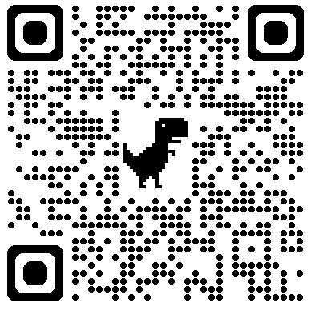
Live chatbot demo
Connector → model → conversational agent → _execute
https://docs.opensearch.org/latest/tutorials/gen-ai/chatbots/build-chatbot/
Notes:
SLIDE 12 — LIVE CHATBOT DEMO
"We have data, connector, model, agent, tools, and memory. Now we assemble them using the official build-chatbot tutorial."
"Watch IDs flow: connector_id supports model registration; model_id is referenced by the agent; agent_id is used by _execute."
Switch to the prepared terminal/browser.

Slide 11
Demo path: build your own chatbot
1
Create connector
2
Register model
3
Register agent + tools
4
Prepare searchable data
5
Execute and inspect trace
Notes:
SLIDE 13 — DEMO PATH (~10 min)
1. CREATE CONNECTOR — Show endpoint/protocol and credential strategy; do not expose secrets.
2. REGISTER MODEL — Capture model_id.
3. REGISTER AGENT — type=conversational; model_id; native tools; memory.
4. PREPARE DATA — Use searchable tutorial content.
5. EXECUTE — POST /_plugins/_ml/agents/{agent_id}/_execute.
Run one question and a memory-based follow-up.
If time permits, use verbose=true and point out thought/action/observation. Promise to map it to code next.
Keep known-good requests/responses as fallback.

Slide 12
Now go under the hood
https://github.com/opensearch-project/ml-commons
Notes:
SLIDE 14 — TECHNICAL DEEP DIVE (~30 sec)
"The demo established the objects and visible behavior. Now follow the same _execute request under the hood."
"First cover the path common to every type. Then stop at MLChatAgentRunner and inspect conversational orchestration."

Slide 13
Connector type hierarchy
PROTOCOL SELECTS THE CONCRETE CLASS
Connector · interface
AbstractConnector
shared payload, credentials, validation
HTTP family · model connectors
MCP family · tool connectors
HttpConnector · protocol http
McpConnector
mcp_sse
AwsConnector
aws_sigv4
GoogleCloudConnector
google_cloud
McpStreamableHttpConnector
mcp_streamable_http
AwsConnector and GoogleCloudConnector extend HttpConnector. MCP types extend AbstractConnector. MLCommonsClassLoader.initConnector(protocol) constructs the annotated class.
Notes:
SLIDE 15 — CONNECTOR HIERARCHY (~2 min)
"A connector is a protocol plus a Java class. protocol in the document selects the implementation."
Connector is the interface. AbstractConnector holds substitution, encrypt/decrypt, and payload validation.
HTTP FAMILY — HttpConnector is protocol=http. AwsConnector (aws_sigv4) and GoogleCloudConnector extend it. The Bedrock demo uses AwsConnector.
MCP FAMILY — McpConnector (mcp_sse) and McpStreamableHttpConnector extend AbstractConnector directly. These are tool discovery/invocation, not agent types.
"Class loading is MLCommonsClassLoader.initConnector(protocol). New protocols add a class with @Connector, not a switch in the agent runner."

Slide 14
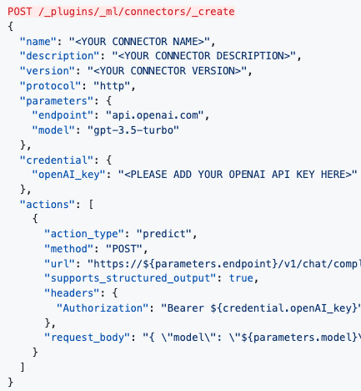
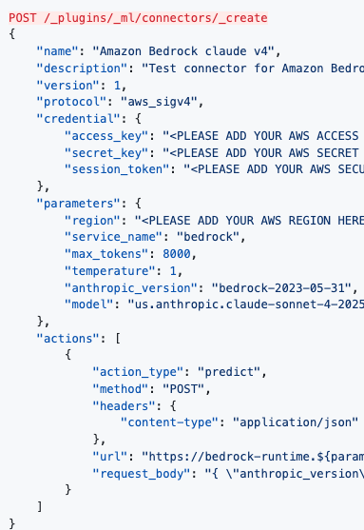
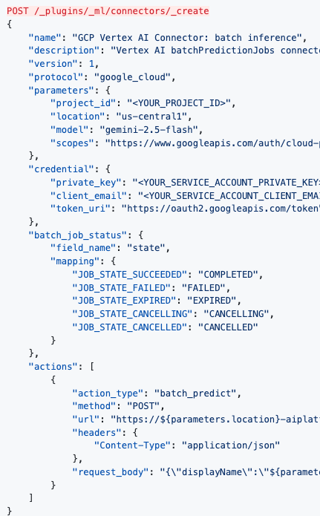
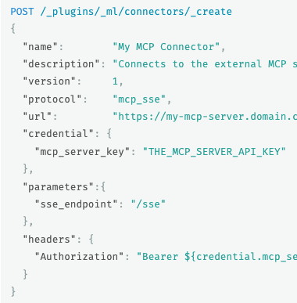
Connectors
Notes:
SLIDE 14 — TECHNICAL DEEP DIVE (~30 sec)
"The demo established the objects and visible behavior. Now follow the same _execute request under the hood."
"First cover the path common to every type. Then stop at MLChatAgentRunner and inspect conversational orchestration."

Slide 15
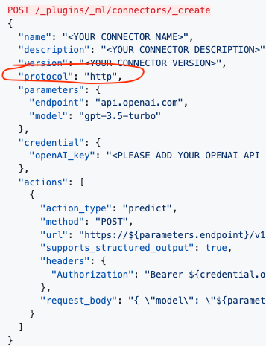
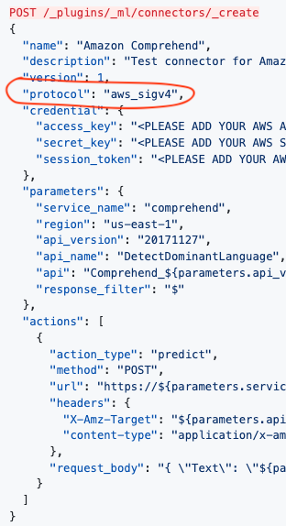
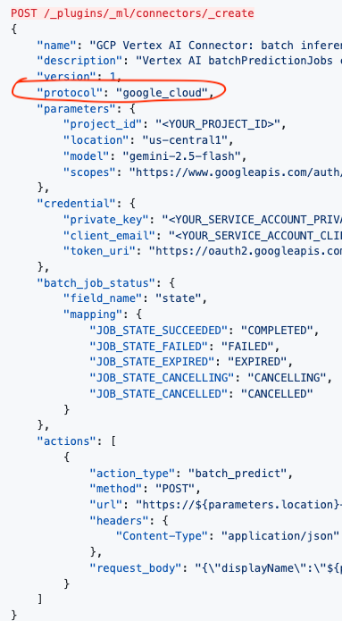
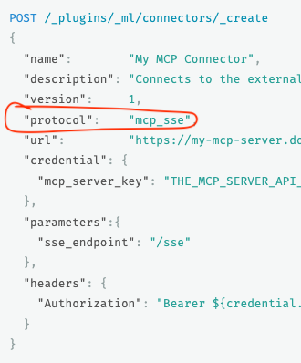
Connectors
Notes:
SLIDE 14 — TECHNICAL DEEP DIVE (~30 sec)
"The demo established the objects and visible behavior. Now follow the same _execute request under the hood."
"First cover the path common to every type. Then stop at MLChatAgentRunner and inspect conversational orchestration."

Slide 16
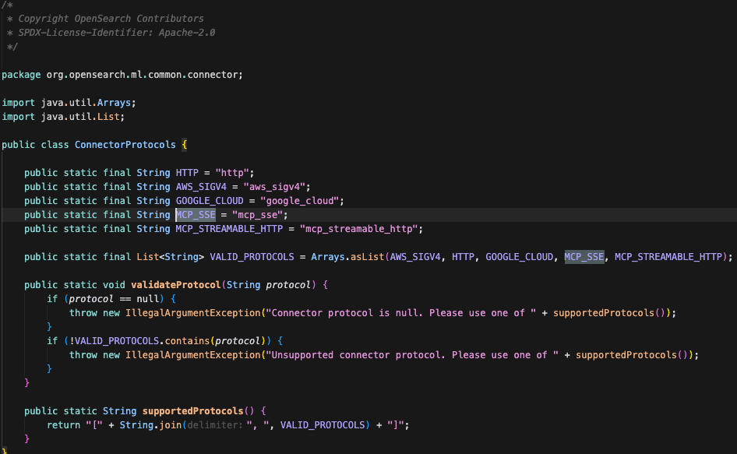
Connectors
Notes:
SLIDE 14 — TECHNICAL DEEP DIVE (~30 sec)
"The demo established the objects and visible behavior. Now follow the same _execute request under the hood."
"First cover the path common to every type. Then stop at MLChatAgentRunner and inspect conversational orchestration."

Slide 17
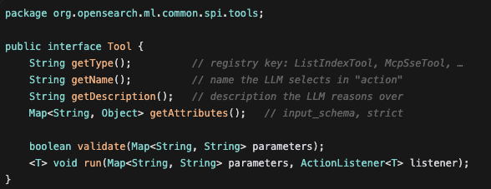
Tools
Notes:
SLIDE 14 — TECHNICAL DEEP DIVE (~30 sec)
"The demo established the objects and visible behavior. Now follow the same _execute request under the hood."
"First cover the path common to every type. Then stop at MLChatAgentRunner and inspect conversational orchestration."

Slide 18
Agent runner hierarchy
AGENT TYPE SELECTS THE RUNNER
MLAgentRunner · interface
V1 · implements MLAgentRunner directly
V2 · message-centric
MLChatAgentRunner
CONVERSATIONAL
MLFlowAgentRunner
FLOW
MLConversationalFlow
AgentRunner
CONVERSATIONAL_FLOW
AbstractV2AgentRunner
shared V2 setup
MLPlanExecuteAndReflect
AgentRunner
PLAN_EXECUTE_AND_REFLECT
MLAGUIAgentRunner
AG_UI
MLChatAgentRunnerV2
CONVERSATIONAL_V2
MLAgentExecutor.getAgentRunner(type) constructs the matching runner. REST, transport, and MLEngine stay the same. Only CONVERSATIONAL_V2 extends AbstractV2AgentRunner today.
Notes:
SLIDE 16 — AGENT RUNNER HIERARCHY (~2 min)
"MLAgentRunner is the strategy interface. getAgentRunner maps MLAgentType to a concrete class."
V1 — MLChatAgentRunner, MLFlowAgentRunner, MLConversationalFlowAgentRunner, MLPlanExecuteAndReflectAgentRunner, and MLAGUIAgentRunner all implement the interface directly.
V2 — AbstractV2AgentRunner holds shared message-centric setup; MLChatAgentRunnerV2 is the only subclass today.
"The demo used CONVERSATIONAL, so the rest of the deep dive stays on MLChatAgentRunner."
Do not walk constructors. Point at the switch in the next code slide.

Slide 19
End-to-end execution architecture
TECHNICAL DEEP DIVE
REST API
POST /agents/{id}/_execute
TransportExecute
TaskAction
MLExecuteTask
Runner
MLEngine
FunctionName.AGENT
MLAgentExecutor
route by type
Conversational
ReAct
Plan–Execute–Reflect
Flow / Conv. Flow
Conversational V2 / AG-UI
Shared services: model inference · native/MCP tools · memory · hooks · ActionListener callbacks
Notes:
SLIDE 17 — EXECUTION ARCHITECTURE (~2 min)
REST creates AgentMLInput with FunctionName.AGENT.
TransportExecuteTaskAction delegates to MLExecuteTaskRunner.
MLExecuteTaskRunner handles dispatch, thread pool, hooks, and response wrapping.
MLEngine uses generic execute(), not train(), predict(), or deploy().
MLAgentExecutor loads the agent, prepares common services, and chooses a runner.
Bottom row: all strategies sit behind MLAgentRunner.
"MLAgentExecutor is engine/business logic, not a transport action."

Slide 20
Agent _execute — call sequence
TECHNICAL DEEP DIVE
REST · Rest action
TransportExecuteTaskAction · Transport action
MLExecuteTaskRunner · Task runner
MLEngine
MLAgentExecutor · Agent executor
RUN · Agent runner
client.execute(MLExecuteTaskAction)
run(AGENT, request)
mlEngine.execute(input, listener)
initInstance(AGENT) → execute()
getAgentRunner(type).run()
↩ ActionListener carries the response back to REST; no transport thread waits on the LLM
Notes:
SLIDE 18 — CALL SEQUENCE (~3 min)
1. REST calls client.execute(MLExecuteTaskAction).
2. Transport action calls mlExecuteTaskRunner.run(AGENT, ...).
3. Task runner calls mlEngine.execute(input, listener).
4. MLEngineClassLoader resolves AGENT; MLEngine invokes MLAgentExecutor.execute().
5. MLAgentExecutor calls getAgentRunner(type).run().
"The response travels through ActionListener in reverse. Methods may return while inference/tool I/O is in flight; no transport thread waits synchronously."
MLEngineClassLoader is dispatch machinery, not a separate service.

Slide 21
Agent type routing
SOURCE WALKTHROUGH
MLAgentExecutor.java · getAgentRunner()
protected MLAgentRunner getAgentRunner(MLAgent agent, HookRegistry hooks) {
MLAgentType type = MLAgentType.from(agent.getType());
return switch (type) {
case CONVERSATIONAL -> new MLChatAgentRunner(...);
case FLOW -> new MLFlowAgentRunner(...);
case CONVERSATIONAL_FLOW -> new MLConversationalFlowAgentRunner(...);
case PLAN_EXECUTE_AND_REFLECT -> new MLPlanExecuteAndReflectAgentRunner(...);
case CONVERSATIONAL_V2 -> new MLChatAgentRunnerV2(...);
case AG_UI -> new MLAGUIAgentRunner(...);
};
}
The transport and engine path is shared; only the runner strategy changes.
Notes:
SLIDE 20 — AGENT TYPE ROUTING (~2 min)
"Inside MLAgentExecutor, the loaded agent type selects the strategy."
Summarize the six switch branches.
"Nothing above this switch changes. REST, transport, MLEngine, common loading, and validation are reused."
The slide code is condensed; actual constructors receive shared dependencies.

Slide 22
The common runner contract
SOURCE WALKTHROUGH
MLAgentRunner.java
public interface MLAgentRunner {
void run(MLAgent agent, Map<String, String> params,
ActionListener<Object> listener, TransportChannel channel);
}
Flow, conversational, PER, V2, and AG-UI plug into this contract.
Notes:
SLIDE 22 — MLAgentRunner CONTRACT (~2 min)
"This interface is the seam between common execution and type-specific orchestration."
The default non-streaming overload delegates to the channel-aware method.
Every runner receives agent configuration, parameters, completion listener, and optional streaming channel.
Dependencies are supplied when MLAgentExecutor constructs the runner.
Extension point: implement MLAgentRunner, then add one route.

Slide 23
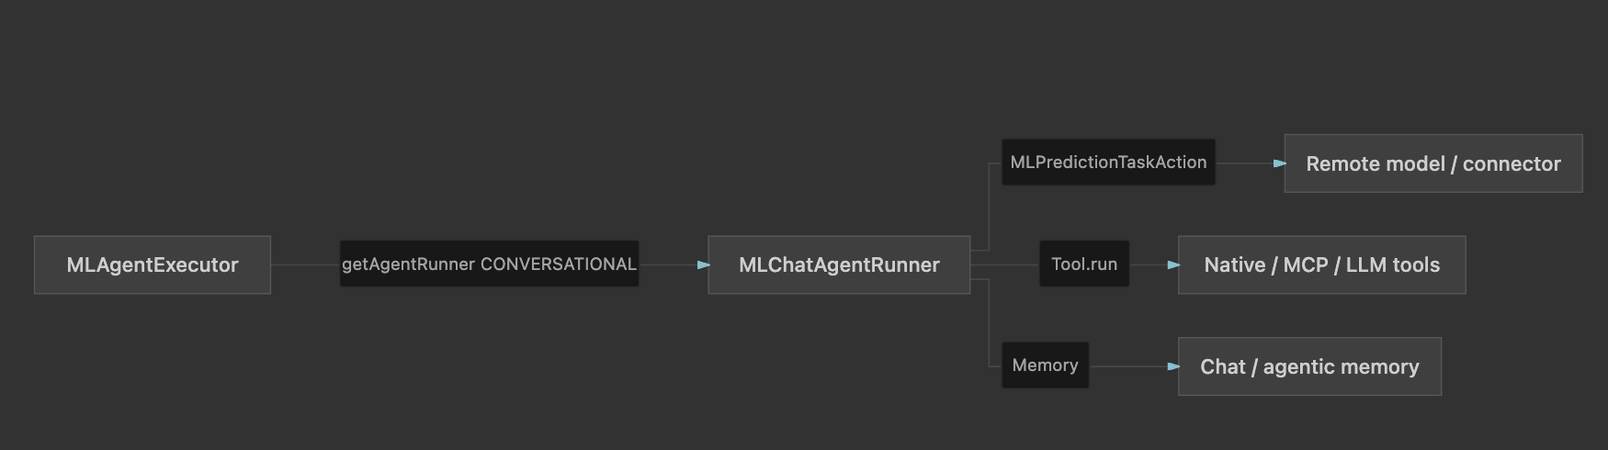
Conversational agent
MLChatAgentRunner.java
Notes:
SLIDE 14 — TECHNICAL DEEP DIVE (~30 sec)
"The demo established the objects and visible behavior. Now follow the same _execute request under the hood."
"First cover the path common to every type. Then stop at MLChatAgentRunner and inspect conversational orchestration."

Slide 24
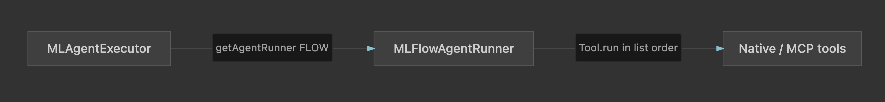
Flow agent
MLFlowAgentRunner.java
Notes:
SLIDE 14 — TECHNICAL DEEP DIVE (~30 sec)
"The demo established the objects and visible behavior. Now follow the same _execute request under the hood."
"First cover the path common to every type. Then stop at MLChatAgentRunner and inspect conversational orchestration."

Slide 25
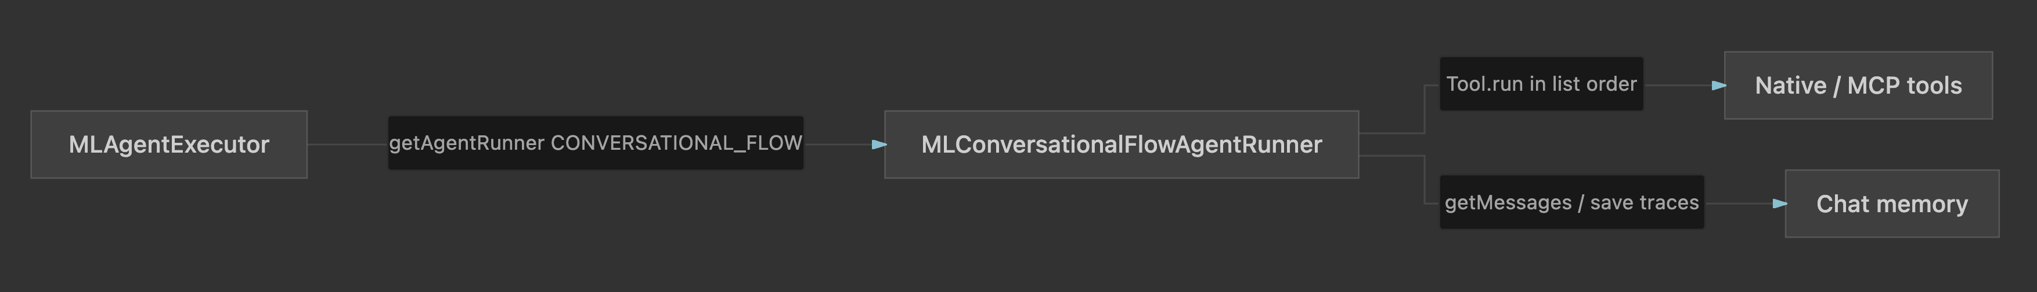
Conversational Flow agent
MLConversationalFlowAgentRunner.java
Notes:
SLIDE 14 — TECHNICAL DEEP DIVE (~30 sec)
"The demo established the objects and visible behavior. Now follow the same _execute request under the hood."
"First cover the path common to every type. Then stop at MLChatAgentRunner and inspect conversational orchestration."

Slide 26
External MCP tools — same Tool.run() contract
MCP INTEGRATION
1
Agent lists mcp_connectors
2
Executor calls listTools()
3
Wrap as MLToolSpec
4
Merge with native tools
5
ReAct selects; callTool()
No separate agent loop. Discovery is MCP-specific; selection and observation are shared.
Notes:
SLIDE 27 — MCP TOOL PATH (~2 min)
"External MCP tools do not get a second ReAct loop. They join the same tool map."
1. Agent parameters include mcp_connectors with connector_id, optional tool_filters and tool_descriptions.
2. McpConnectorExecutor or McpStreamableHttpConnectorExecutor decrypts the connector and calls listTools().
3. Each remote tool is an MLToolSpec of type McpSseTool or McpStreamableHttpTool, with the live McpSyncClient attached as a runtime resource.
4. createTools() instantiates them beside ListIndexTool and SearchIndexTool.
5. The LLM selects by name; Tool.run() issues callTool.
"If listing fails, chat continues with native tools only. Use List Tools to debug the connector independently."

Slide 27
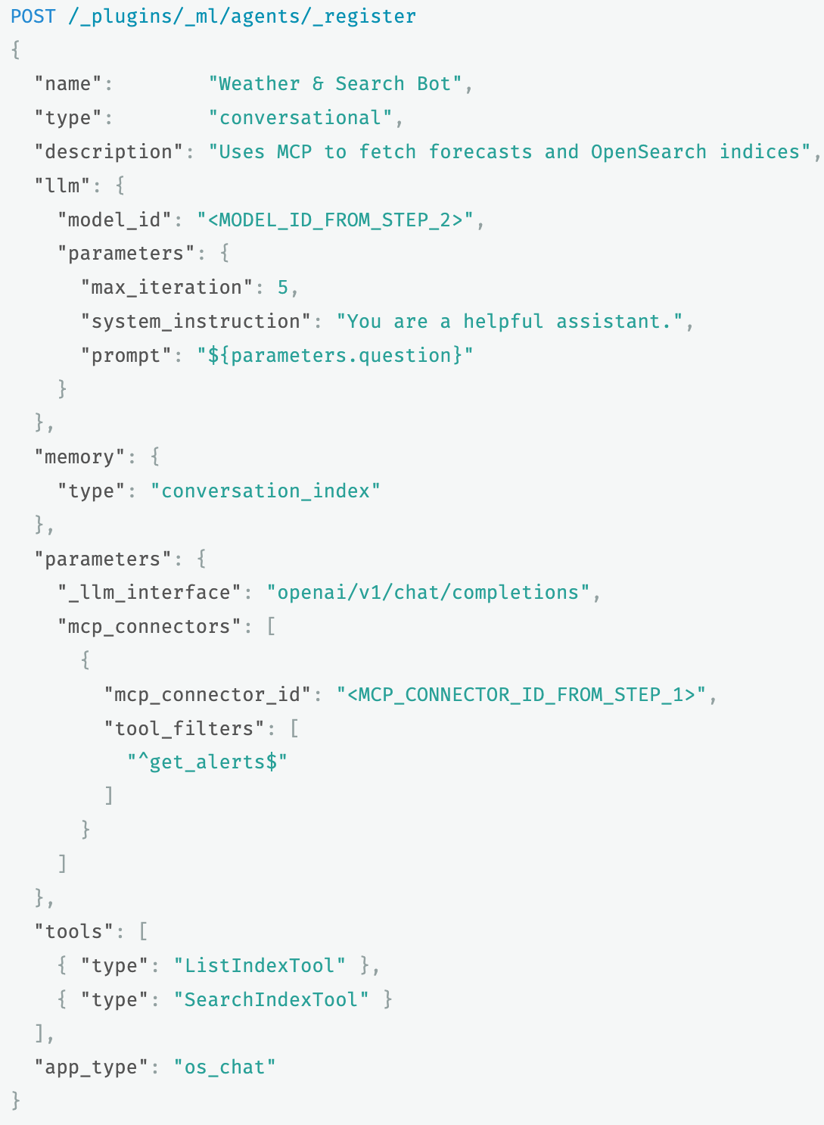
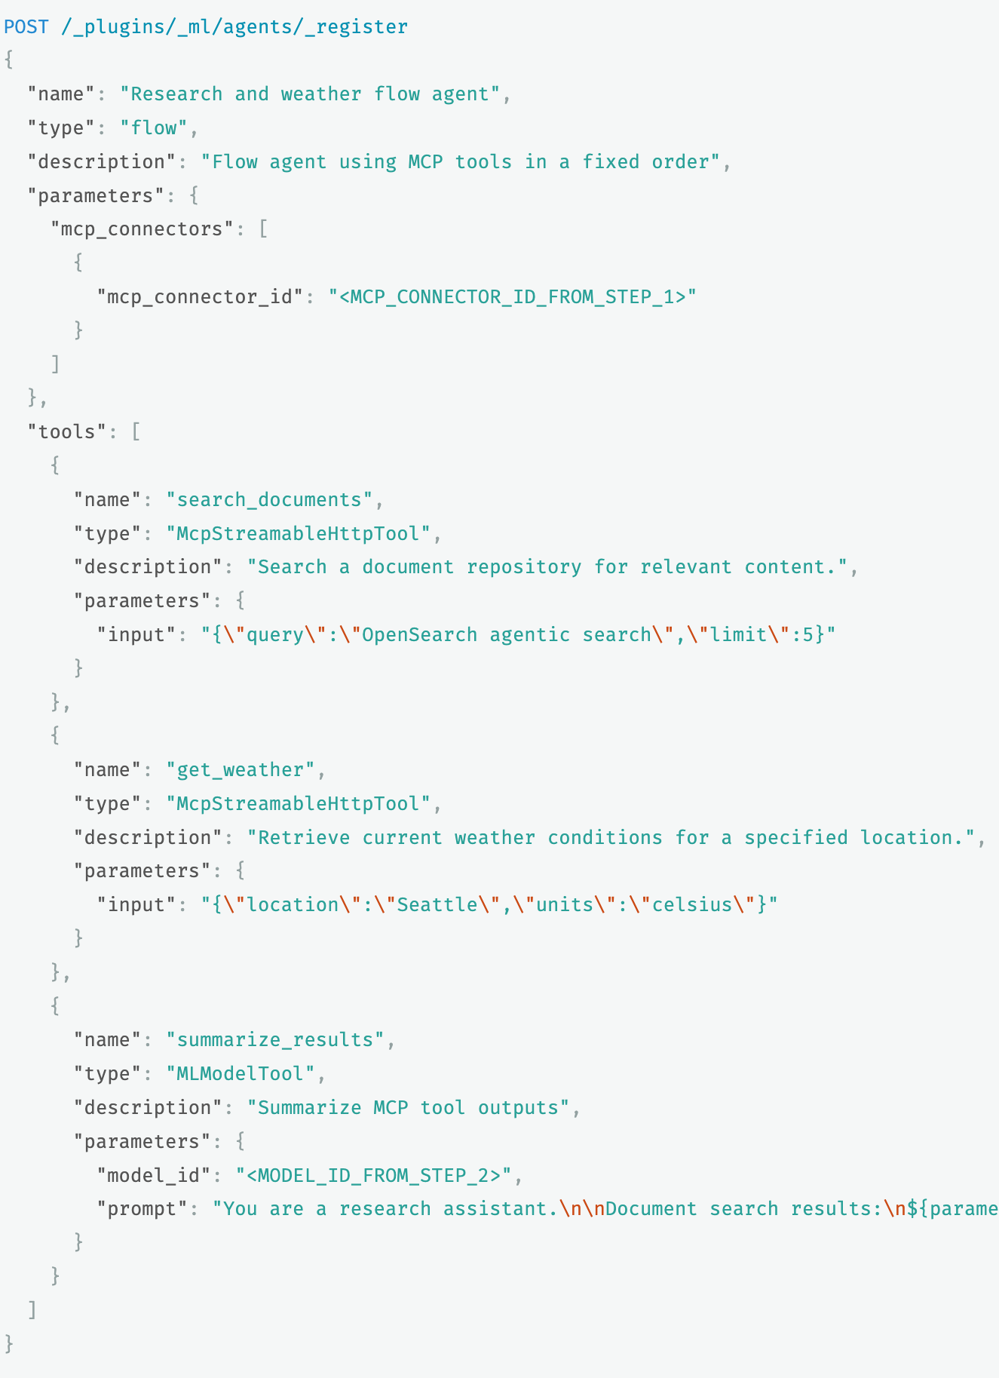
Agents with MCP Tools
Notes:
SLIDE 14 — TECHNICAL DEEP DIVE (~30 sec)
"The demo established the objects and visible behavior. Now follow the same _execute request under the hood."
"First cover the path common to every type. Then stop at MLChatAgentRunner and inspect conversational orchestration."

Slide 28
Chat MCP listing — call sequence
MCP DISCOVERY
MLChatAgentRunner
AgentUtils
AgentUtils
Connector
McpConnectorExecutor
McpSyncClient
processUnifiedTools → getMcpToolSpecs
getMCPToolSpecsFromConnector(id)
getConnector(connector_id)
decrypt · initInstance(protocol)
listTools() → wrap MLToolSpec
↩ completeIfLast merges specs back to MLChatAgentRunner. Async ActionListener; a failed connector is skipped.
Notes:
SLIDE 31 — CHAT MCP LISTING SEQUENCE (~2 min)
Same visual language as the _execute call-sequence slide.
CHAT is MLChatAgentRunner.processUnifiedTools.
UTILS is AgentUtils.getMcpToolSpecs — fans out per mcp_connectors entry.
FROM is getMCPToolSpecsFromConnector.
STORE is getConnector plus decrypt.
EXEC is McpConnectorExecutor or McpStreamableHttpConnectorExecutor.
MCP is the remote listTools() call; each tool becomes an MLToolSpec with the live McpSyncClient.
"Return path is completeIfLast, then addAll into native backend tools and createTools."
Listing is async. Soft failures continue with native tools only.

Slide 29
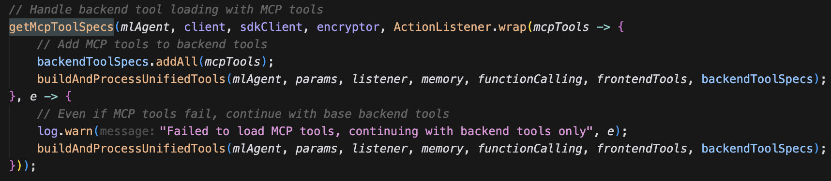
MCP invoke: merge then callTool
SOURCE WALKTHROUGH
MLChatAgentRunner.java
If MCP listing fails, the conversational runner continues with native tools only.
Notes:
SLIDE 29 — MCP INVOKE CODE (~2 min)
Chat runner: getMcpToolSpecs then addAll then createTools.
McpSseTool.run parses JSON arguments and calls mcpSyncClient.callTool(name, args).
"From the model's point of view this is just another tool. The difference is the transport."

Slide 30
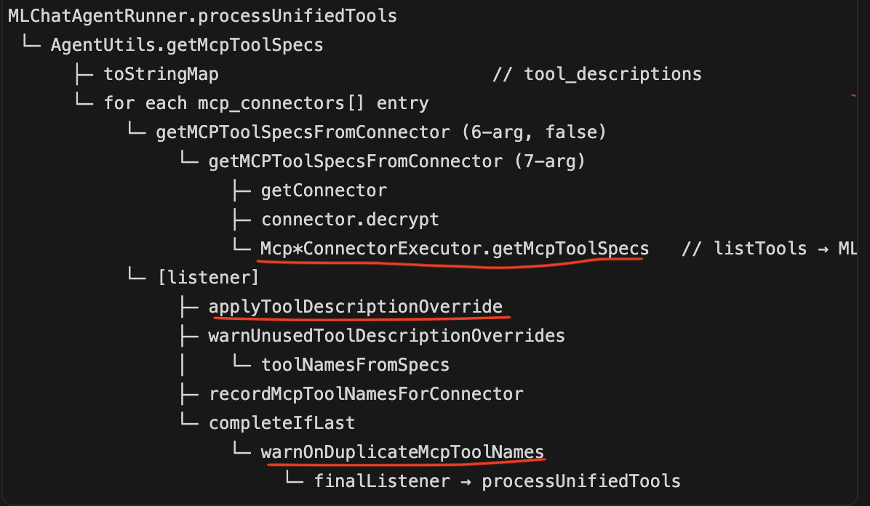
AgentUtils
SOURCE WALKTHROUGH
AgentUtils.java
Notes:
SLIDE 29 — MCP INVOKE CODE (~2 min)
Chat runner: getMcpToolSpecs then addAll then createTools.
McpSseTool.run parses JSON arguments and calls mcpSyncClient.callTool(name, args).
"From the model's point of view this is just another tool. The difference is the transport."

Slide 31
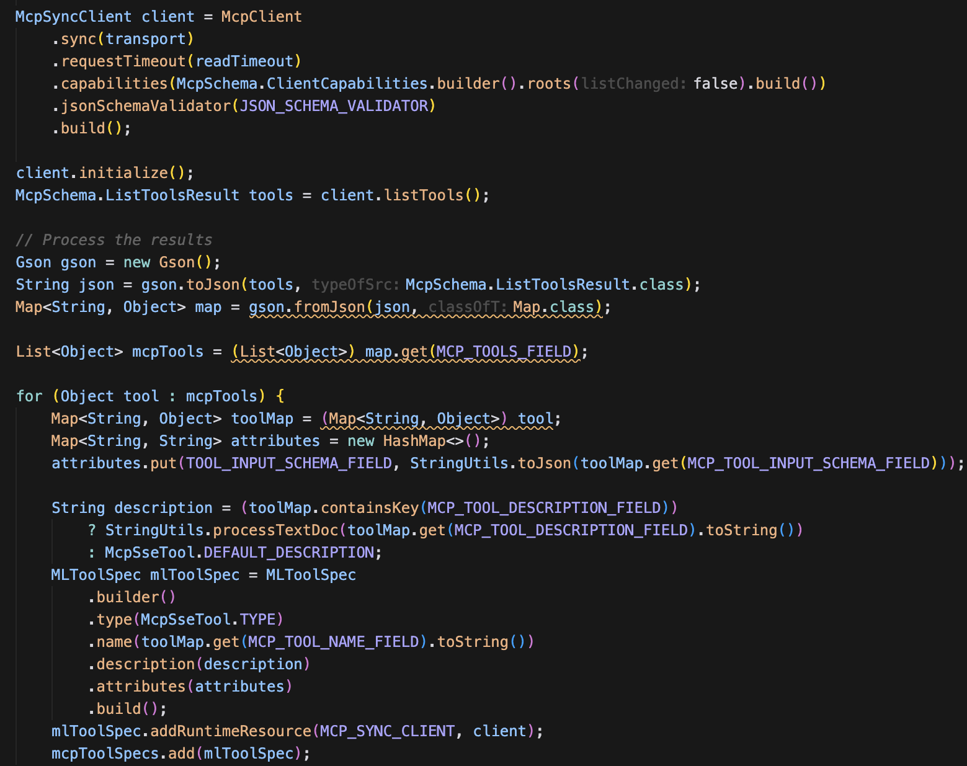
MCP discovery: listTools becomes MLToolSpec
SOURCE WALKTHROUGH
McpConnectorExecutor.java · getMcpToolSpecs()
Notes:
SLIDE 28 — MCP DISCOVERY CODE (~2 min)
Walk listTools → MLToolSpec. Point at type, name, description, input_schema, and addRuntimeResource.
"The client is created at discovery time and reused at invoke. That is why MCP tools are not a REST predict call."
Mention mcp_sse vs mcp_streamable_http as protocol, not agent type.

Slide 32
Extend and debug
PRACTICAL CHECKLIST
Start with the agent document: model_id, tools, mcp_connectors, prompt, and limits.
Use the List Tools API to validate MCP connectivity and schemas independently.
For a new orchestration pattern: implement MLAgentRunner and add one routing case.
For a new capability: implement Tool and register its factory.
Notes:
SLIDE 30 — EXTEND AND DEBUG (~2 min)
1. Verify model_id, type, tools, MCP connectors, prompt, and limits.
2. Run with verbose=true.
3. Validate MCP independently with List Tools.
4. New orchestration: implement MLAgentRunner.
5. New action: implement Tool and register its factory.
Common failures: wrong tool → descriptions/prompt; invalid arguments → schema; exhausted iterations → convergence; MCP load → endpoint/credentials/tenant/protocol.

Slide 33
Key takeaways
An agentic search solution is a composition: data + connector + model + agent + tools + memory.
Every agent type shares one path: REST → transport → MLEngine → MLAgentExecutor → MLAgentRunner.
The runner strategy is the only thing that changes: ReAct, Flow, Conversational Flow, or Plan–Execute–Reflect.
Tool.run() is the single contract — MCP tools differ only in discovery, not in how the agent calls them.
Notes:
SLIDE 34 — KEY TAKEAWAYS (~1 min)
1. Agentic search composes data, connector, model, agent, tools, and memory.
2. One shared path: REST, transport action, MLEngine, MLAgentExecutor, then the runner.
3. Orchestration differs only in the runner: ReAct, Flow, Conversational Flow, PER.
4. Tool.run() hides native versus MCP; MCP adds discovery, not a second loop.
"Verbose traces, discovery APIs, and open source make behavior inspectable."
Appendix has the strategy comparison plus PER and Flow code if there is time.

Slide 34


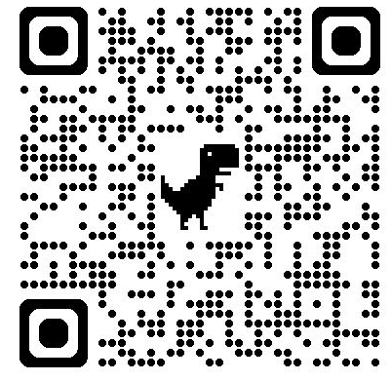
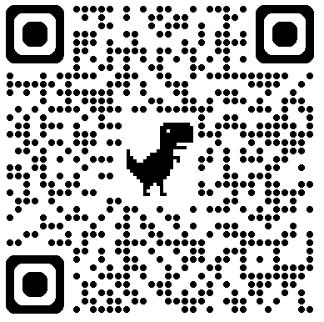
Q&A
Demo
LinkedIn
Announcements:
Launching InstaAcademy - https://www.instaclustr.com/instacademy-courses/
Launching Instaclustr Labs - https://github.com/instaclustr/labs
Labs
InstaAcademy
Notes:
SLIDE 30 — Q&A
"Thank you. Questions about the chatbot, execution path, conversational agents, MCP, or contributing?"
Point to the QR codes: Demo on the left, LinkedIn on the right.
Q: Is MLAgentExecutor transport? A: No; it is engine/business logic.
Q: Does MLEngine predict for agents? A: No; agents use execute(), resolving AGENT to MLAgentExecutor.
Q: MCP versus native? A: Discovery differs; both become tool specs selected by the runner.
Q: Why not detail Flow/PER? A: They are alternative strategies; see appendix.

Slide 35
Resources
ML Commons Repo - https://github.com/opensearch-project/ml-commons
Chatbot Documentation - https://docs.opensearch.org/latest/tutorials/gen-ai/chatbots/build-chatbot/
My Demo - https://github.com/akolarkunnu/experiments/tree/main/talks/agentic_search_under_the_hood
InstaAcademy - https://www.instaclustr.com/instacademy-courses/
Instaclustr Labs - https://github.com/instaclustr/labs
Notes:
SLIDE 34 — KEY TAKEAWAYS (~1 min)
1. Agentic search composes data, connector, model, agent, tools, and memory.
2. One shared path: REST, transport action, MLEngine, MLAgentExecutor, then the runner.
3. Orchestration differs only in the runner: ReAct, Flow, Conversational Flow, PER.
4. Tool.run() hides native versus MCP; MCP adds discovery, not a second loop.
"Verbose traces, discovery APIs, and open source make behavior inspectable."
Appendix has the strategy comparison plus PER and Flow code if there is time.

Slide 36
Thank You

