Slide 1
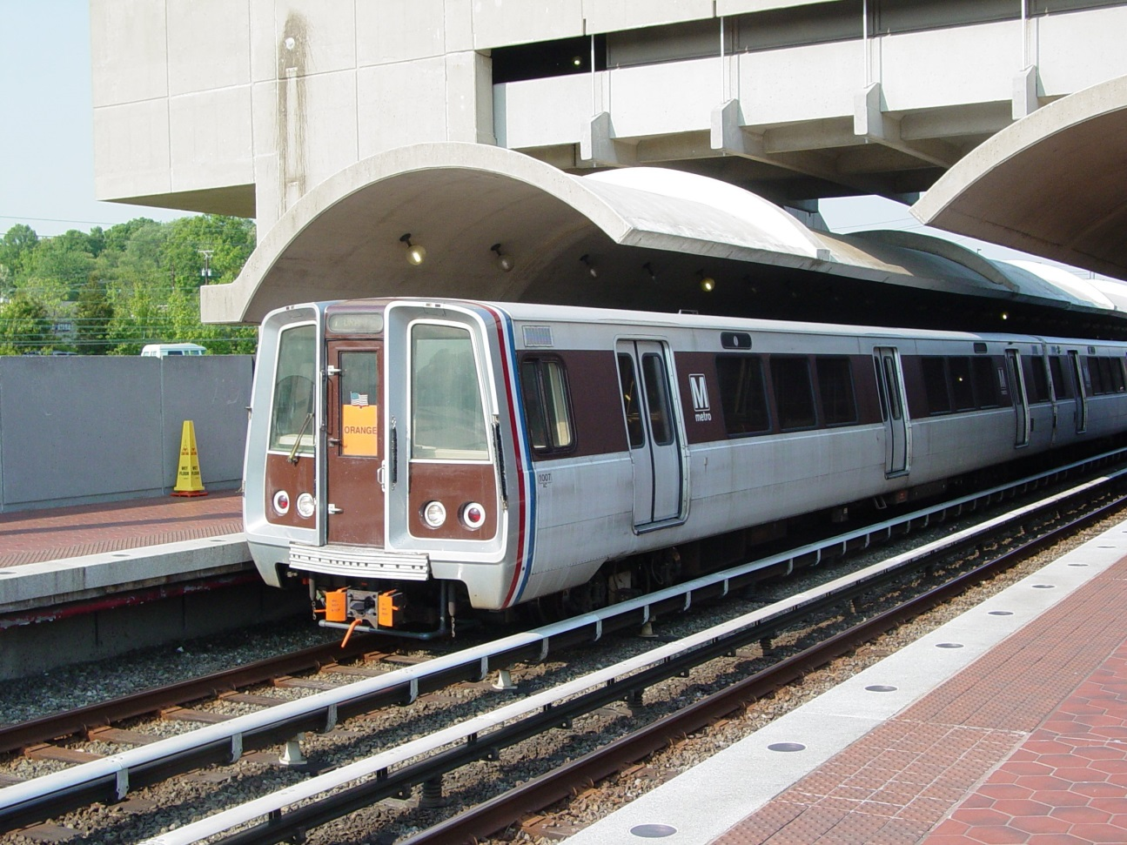
DAT7 – Alok Kommajesula
DC Metrorail Ridership Project

Slide 2
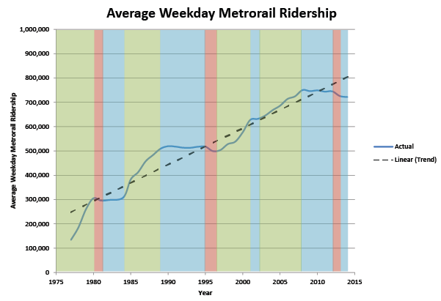
DC ridership Trend

Slide 3
The Question
What are the main factors that determine DC metrorail ridership everyday?
Can these factors be used to predict how many people will ride the metrorail on a particular day?

Slide 4
The Data
Daily Ridership: 2005-2014
Weekly gas price average
Daily weather (Mean Temperature)
Consumer Price Index(CPI)
Metrorail fare
Day of the week

Slide 5
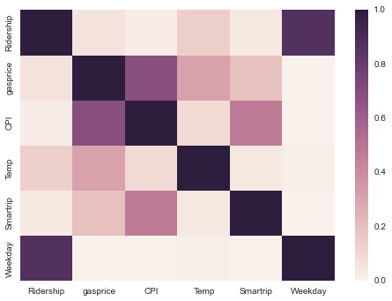
Correlation Matrix

Slide 6
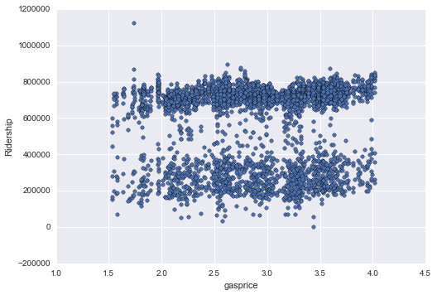
Ridership vs. Gas Prices

Slide 7
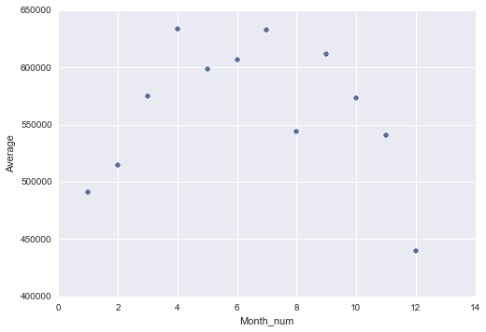
Average Riders in 2014

Slide 8
Model: Linear Regression
Split data randomly into train / test
X_train: 2739 rows, 5 Columns
y_train: 2739 rows, 1 Column
X_test: 913 rows, 5 Columns
y_test: 913 rows, 1 column
Y intercept = 212096
X Coefficients:
Gas Price: 1.64782866e+04
Temperature: 1.45707852e+03
Weekday: 4.27437919e+05
CPI: -6.69439492e+02
Smartrip Benefit: 1.15289669e+02

Slide 9
Strength of Predictions
R-squared:
.7367
Mean Absolute Error (MAE):
68086
Mean Squared Error (MSE):
13027113660
Root Mean Squared Error (RMSE):
261

