Slide 1
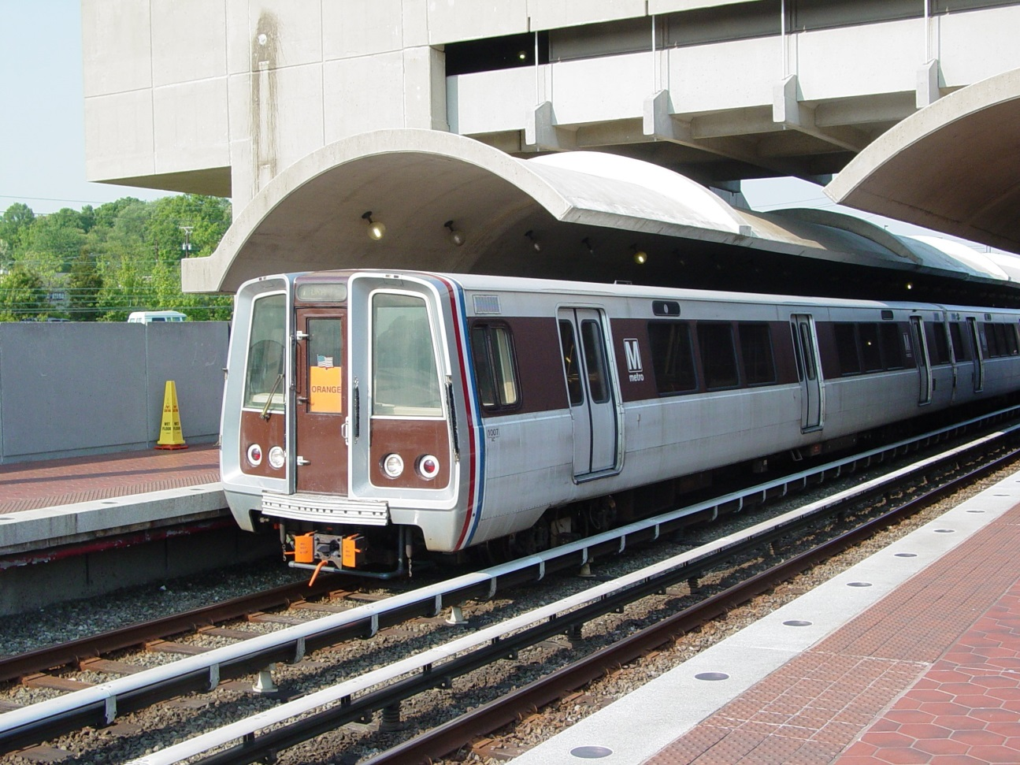
DAT7 – Alok Kommajesula
DC Metrorail Ridership Project

Slide 2
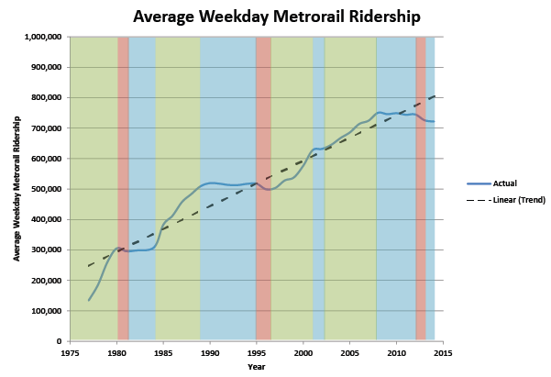
DC ridership Trend

Slide 3
The Question
What are the main factors that determine DC metrorail ridership everyday?
Can these factors be used to predict how many people will ride the metrorail on a particular day?

Slide 4
The Data
Daily Ridership: 2004-2014 (done)
Weekly gas price average (done)
Special Events (done)
Daily weather (nearly done)
Unemployment Rates (started)
Median Income (started)
Metrorail fare (not started)

Slide 5
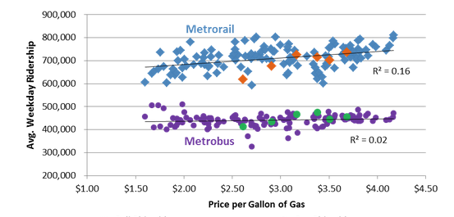
Ridership vs. Gas Prices (not mine)

Slide 6
Plan
Linear Regression – How significant are the indicators collected and what story do they tell about Metrorail ridership?
Use the results to test prediction accuracy using 2014 data as test data.

