Slide 1

CQRS Pattern – Student Registration System
CSC9010: Cloud Native Application Design & Development
Anughna Kommalapati

Slide 2
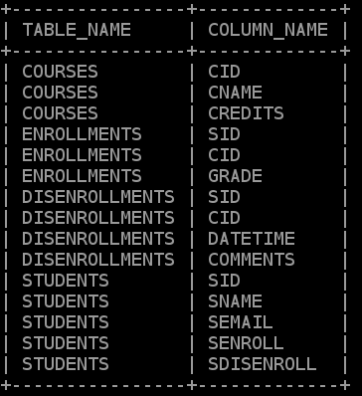
Introduction
Student Registration System – CQRS and CAP Pattern Solution
Created database and tables in Amazon RDS using EC2 instance
Limitation for “SENROLL” column in STUDENTS table
Student disenrolls from a course, record should be:
Deleted from the ENROLLMENT table
Inserted into DISNEROLLMENT table
Updates the values in STUDENTS table
DML operations on tables
Query results

Slide 3



High Level description of AWS Services
Amazon Relational Database Service
Amazon RDS is a web service running "in the cloud" designed to simplify the setup, operation, and scaling of a relational database for use in applications.
Elastic Compute Cloud
An EC2 instance is nothing but a virtual server in Amazon Web services terminology. AWS provides multiple instance types for the respective business needs of the user
Amazon Simple Queue Service
SQS is a fully managed message queuing service that enables you to decouple and scale microservices, distributed systems, and serverless applications.

Slide 4



Contd..
Identity and Access Management user
IAM user is an entity that you create in AWS to represent the person or application that uses it to interact with AWS.
Lambda
AWS Lambda is a computing service that runs code in response to events and automatically manages the computing resources required by that code.
CloudWatch
It is a monitoring and management service that provides data and actionable insights to monitor applications and respond to system-wide performance changes.

Slide 5




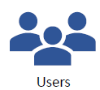



Design Diagram
Write Function
Write DB
Desktop App
Queue Service
Read DB
Read Function

Slide 6
Challenges and Successes
Challenges:
Identifying the appropriate AWS services for each functionality, such as Queue service and serverless function
Figuring out the permissions required for IAM users and roles.
Identifying the Message Body format in postman to insert/update/delete the data.
Establishing the connection between lambda function and RDS using python.
Unable to retrieve the data from read function using postman calls.
Successes:
Able to connect desktop application with AWS services to perform DML and read operations on the databases.
Creating read replica database for write DB to retrieve the data.
Able to integrate SQS with Lambda function by attaching required policies to the role and creating trigger.

Slide 7
/
Likes
Dislikes
Expected
Not Expected
Course Structure
Cloud Services
Labs and assignments
Labs and assignments
Final Project
Online Class

Slide 8
References
https://levelup.gitconnected.com/aws-lambda-with-rds-using-pymysql-23ad3cde46c8
https://docs.aws.amazon.com/lambda/latest/dg/services-rds-tutorial.html
https://www.isc.upenn.edu/accessing-mysql-databases-aws-python-lambda-function
https://medium.com/apis-with-valentine/getting-started-with-aws-sqs-in-postman-cdf4a55131af
https://docs.aws.amazon.com/AmazonRDS/latest/UserGuide/USER_ReadRepl.html

Slide 9


