Slide 1
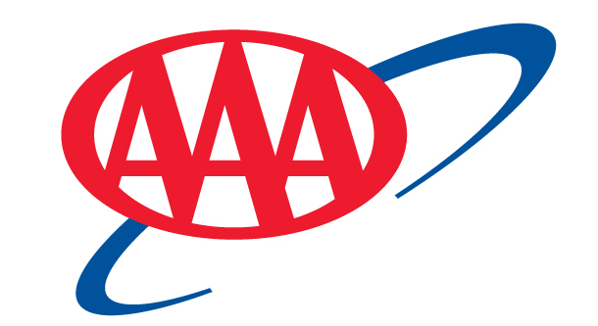
California State Automobile Association
$3.5 Billion
Company value
AAA Mid-Atlantic Insurance Group
was acquired by AAA
8x Expansion
Expanded from 3 to 23 states within a year
17M Members
1.7M Automobiles
A+ Rating
By A.M. Best, most respected Insurance ratings agency
AAA NCNU original states
AAA NCNU partner states
Notes:
1

Slide 2
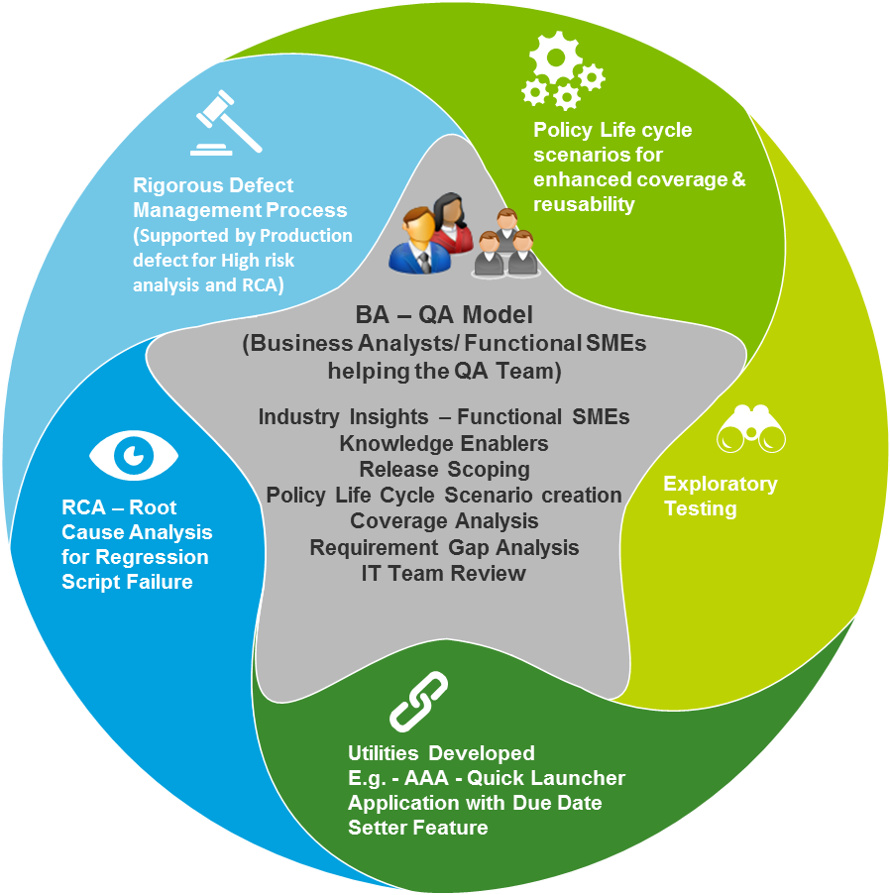
Issue to Impact
External Factors
Internal Factors
ISSUE
Mobility
Cloud
Analytics
Social
Fragmented
Integrated
Manual
VMWare
Automation
Selenium
Integration
Conversion
Eclipse
Automated Doc Testing
Environment & Tools
Deloitte Regression Testing
Jenkins
Backward Compatibility Testing
SVN
High Volume Packet Printing
Controlled Financial Testing
JIRA
Exploratory Testing
Confluence
Browser Compatibility
Quantitative Benefits
Qualitative Benefits
IMPACT
133
100%
25X
Legacy Systems Reduced
Policies inforce on PAS System
Test Execution Efficiency
Operating Cost
Testing Efficiency
Automated Quality Coverage
Time To Market

Slide 3



CSAA Transformation Journey
Approaching Goal
Enhanced regression suite by having specific teams for major functional areas
Onboarding Internal Functional SME’s to help understand key business functionalities
Internal knowledge enablers to help team function efficiently
Developed unique approach for Policy Life Cycle testing
Enhanced Regression
Started with Property products testing
Analyzed Scope
Created Regression Suite
2015
Started testing auto implementation across states
Property
Regression Testing
2014
Performed Regression Testing Pilot for 1 release
Defect capture rate was significant
Took over regression testing piece
Auto Regression Testing
Identified Gaps in Forms related requirements
Scenario creation for Gaps identified
Regression Testing Pilot
Started with creation of delta User Stories based on signature series implementation
Provide support in resolving clarifications
2013
Gap Analysis
2012
Auto US Design
CSAA Transformation Phase
2009-2011

