Slide 1
Chapter 3
Arithmetic for Computers
Notes:
Morgan Kaufmann Publishers
*
Chapter 3 — Arithmetic for Computers
‹#›

Slide 2
Arithmetic for Computers
§3.1 Introduction
Operations on integers
Addition and subtraction
Multiplication and division
Dealing with overflow
Floating-point real numbers
Representation and operations
Chapter 3 — Arithmetic for Computers — ‹#›
Notes:
Morgan Kaufmann Publishers
*
Chapter 3 — Arithmetic for Computers
‹#›

Slide 3
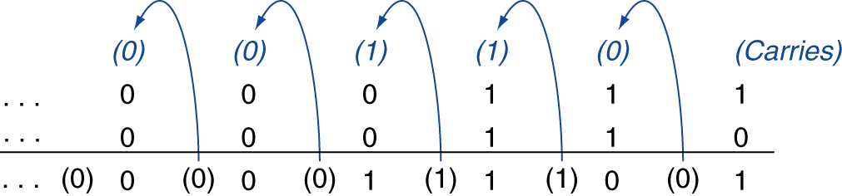
Integer Addition
Example: 7 + 6
§3.2 Addition and Subtraction
Overflow if result out of range
Adding +ve and –ve operands, no overflow
Adding two +ve operands
Overflow if result sign is 1
Adding two –ve operands
Overflow if result sign is 0
Chapter 3 — Arithmetic for Computers — ‹#›
Notes:
Morgan Kaufmann Publishers
*
Chapter 3 — Arithmetic for Computers
‹#›

Slide 4
Integer Subtraction
Add negation of second operand
Example: 7 – 6 = 7 + (–6)
+7: 0000 0000 … 0000 0111 –6: 1111 1111 … 1111 1010 +1: 0000 0000 … 0000 0001
Overflow if result out of range
Subtracting two +ve or two –ve operands, no overflow
Subtracting +ve from –ve operand
Overflow if result sign is 0
Subtracting –ve from +ve operand
Overflow if result sign is 1
Chapter 3 — Arithmetic for Computers — ‹#›
Notes:
Morgan Kaufmann Publishers
*
Chapter 3 — Arithmetic for Computers
‹#›

Slide 5
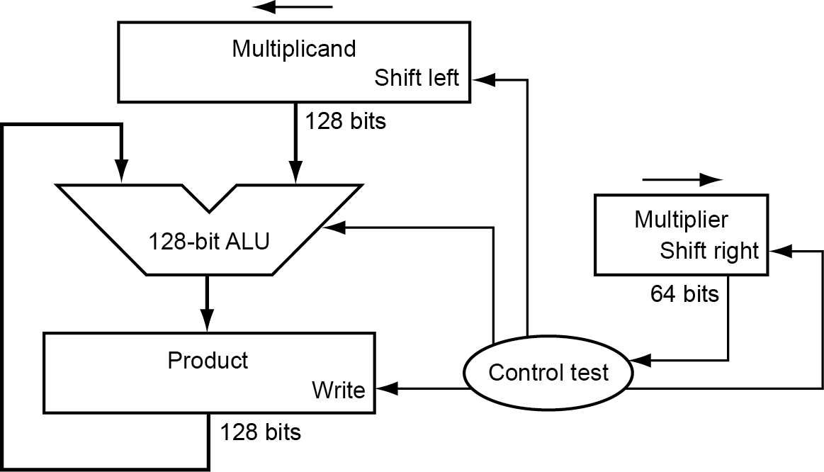
Multiplication
§3.3 Multiplication
Start with long-multiplication approach
multiplicand
1000
× 1001
1000
0000
0000
1000
1001000
multiplier
product
Length of product is the sum of operand lengths
Chapter 3 — Arithmetic for Computers — ‹#›
Notes:
Morgan Kaufmann Publishers
*
Chapter 3 — Arithmetic for Computers
‹#›

Slide 6
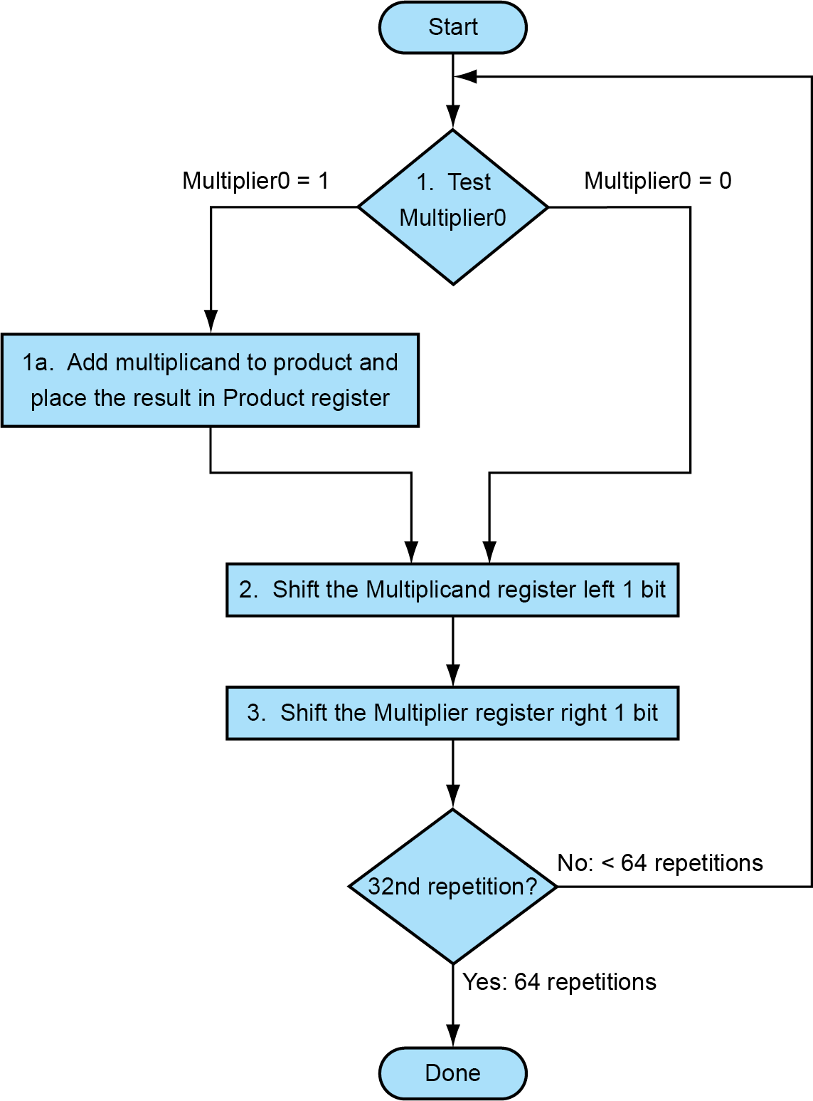
Multiplication Hardware
Initially 0
Chapter 3 — Arithmetic for Computers — ‹#›
Notes:
Morgan Kaufmann Publishers
*
Chapter 3 — Arithmetic for Computers
‹#›

Slide 7
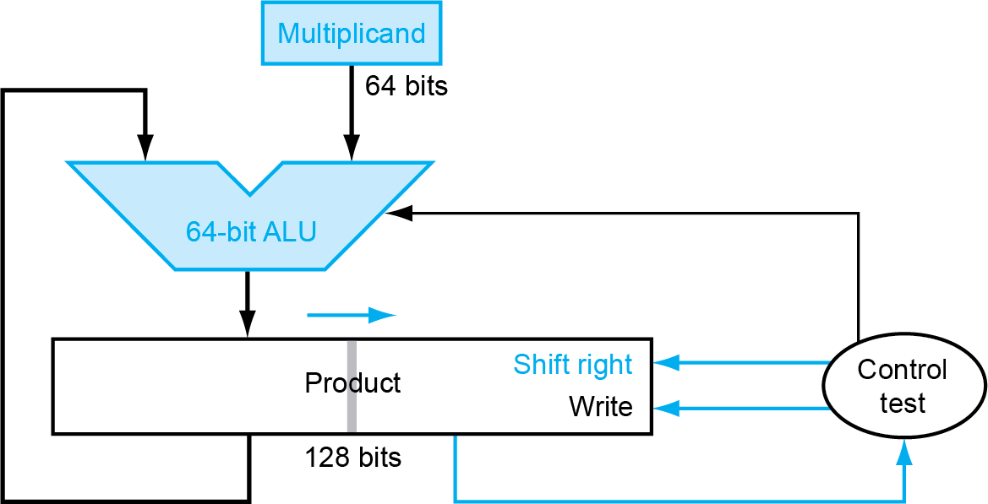
Optimized Multiplier
Perform steps in parallel: add/shift
One cycle per partial-product addition
That’s ok, if frequency of multiplications is low
Chapter 3 — Arithmetic for Computers — ‹#›
Notes:
Morgan Kaufmann Publishers
*
Chapter 3 — Arithmetic for Computers
‹#›

Slide 8
RISC-V Multiplication
Four multiply instructions:
mul: multiply
Gives the lower 64 bits of the product
mulh: multiply high
Gives the upper 64 bits of the product, assuming the operands are signed
mulhu: multiply high unsigned
Gives the upper 64 bits of the product, assuming the operands are unsigned
mulhsu: multiply high signed/unsigned
Gives the upper 64 bits of the product, assuming one operand is signed and the other unsigned
Use mulh result to check for 64-bit overflow
Chapter 3 — Arithmetic for Computers — ‹#›
Notes:
Morgan Kaufmann Publishers
*
Chapter 3 — Arithmetic for Computers
‹#›

Slide 9
Floating Point
§3.5 Floating Point
Representation for non-integral numbers
Including very small and very large numbers
Like scientific notation
–2.34 × 10⁵⁶
+0.002 × 10^{–4}
+987.02 × 10⁹
In binary
±1.xxxxxxx₂ × 2^{yyyy}
Types float and double in C
normalized
not normalized
Chapter 3 — Arithmetic for Computers — ‹#›
Notes:
Morgan Kaufmann Publishers
*
Chapter 3 — Arithmetic for Computers
‹#›

Slide 10
Floating Point Standard
Defined by IEEE Std 754-1985
Developed in response to divergence of representations
Portability issues for scientific code
Now almost universally adopted
Two representations
Single precision (32-bit)
Double precision (64-bit)
Chapter 3 — Arithmetic for Computers — ‹#›
Notes:
Morgan Kaufmann Publishers
*
Chapter 3 — Arithmetic for Computers
‹#›

Slide 11
IEEE Floating-Point Format
single: 8 bits double: 11 bits
single: 23 bits double: 52 bits
S
Exponent
Fraction
S: sign bit (0 ⇒ non-negative, 1 ⇒ negative)
Normalize significand: 1.0 ≤ |significand| < 2.0
Always has a leading pre-binary-point 1 bit, so no need to represent it explicitly (hidden bit)
Significand is Fraction with the “1.” restored
Exponent: excess representation: actual exponent + Bias
Ensures exponent is unsigned
Single: Bias = 127; Double: Bias = 1203
Chapter 3 — Arithmetic for Computers — ‹#›
Notes:
Morgan Kaufmann Publishers
*
Chapter 3 — Arithmetic for Computers
‹#›

Slide 12
Single-Precision Range
Exponents 00000000 and 11111111 reserved
Smallest value
Exponent: 00000001 ⇒ actual exponent = 1 – 127 = –126
Fraction: 000…00 ⇒ significand = 1.0
±1.0 × 2^{–126} ≈ ±1.2 × 10^{–38}
Largest value
exponent: 11111110 ⇒ actual exponent = 254 – 127 = +127
Fraction: 111…11 ⇒ significand ≈ 2.0
±2.0 × 2⁺¹²⁷ ≈ ±3.4 × 10⁺³⁸
Chapter 3 — Arithmetic for Computers — ‹#›
Notes:
Morgan Kaufmann Publishers
*
Chapter 3 — Arithmetic for Computers
‹#›

Slide 13
Double-Precision Range
Exponents 0000…00 and 1111…11 reserved
Smallest value
Exponent: 00000000001 ⇒ actual exponent = 1 – 1023 = –1022
Fraction: 000…00 ⇒ significand = 1.0
±1.0 × 2^{–1022} ≈ ±2.2 × 10^{–308}
Largest value
Exponent: 11111111110 ⇒ actual exponent = 2046 – 1023 = +1023
Fraction: 111…11 ⇒ significand ≈ 2.0
±2.0 × 2⁺¹⁰²³ ≈ ±1.8 × 10⁺³⁰⁸
Chapter 3 — Arithmetic for Computers — ‹#›
Notes:
Morgan Kaufmann Publishers
*
Chapter 3 — Arithmetic for Computers
‹#›

Slide 14
Floating-Point Precision
Relative precision
all fraction bits are significant
Single: approx 2^{–23}
Equivalent to 23 × log₁₀2 ≈ 23 × 0.3 ≈ 6 decimal digits of precision
Double: approx 2^{–52}
Equivalent to 52 × log₁₀2 ≈ 52 × 0.3 ≈ 16 decimal digits of precision
Chapter 3 — Arithmetic for Computers — ‹#›
Notes:
Morgan Kaufmann Publishers
*
Chapter 3 — Arithmetic for Computers
‹#›

Slide 15
Floating-Point Example
Represent –0.75
–0.75 = (–1)¹ × 1.1₂ × 2^{–1}
S = 1
Fraction = 1000…00₂
Exponent = –1 + Bias
Single: –1 + 127 = 126 = 01111110₂
Double: –1 + 1023 = 1022 = 01111111110₂
Single: 1011111101000…00
Double: 1011111111101000…00
Chapter 3 — Arithmetic for Computers — ‹#›
Notes:
Morgan Kaufmann Publishers
*
Chapter 3 — Arithmetic for Computers
‹#›

Slide 16
Floating-Point Example
What number is represented by the single-precision float
11000000101000…00
S = 1
Fraction = 01000…00₂
Fxponent = 10000001₂ = 129
x = (–1)¹ × (1 + 01₂) × 2^{(129 – 127)}
= (–1) × 1.25 × 2²
= –5.0
Chapter 3 — Arithmetic for Computers — ‹#›
Notes:
Morgan Kaufmann Publishers
*
Chapter 3 — Arithmetic for Computers
‹#›

Slide 17
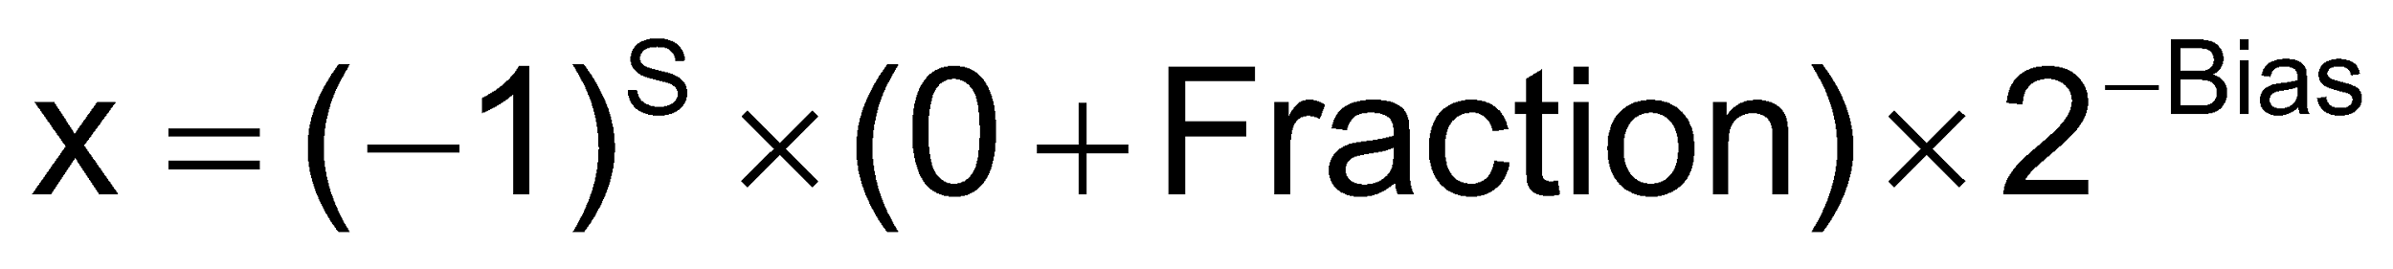
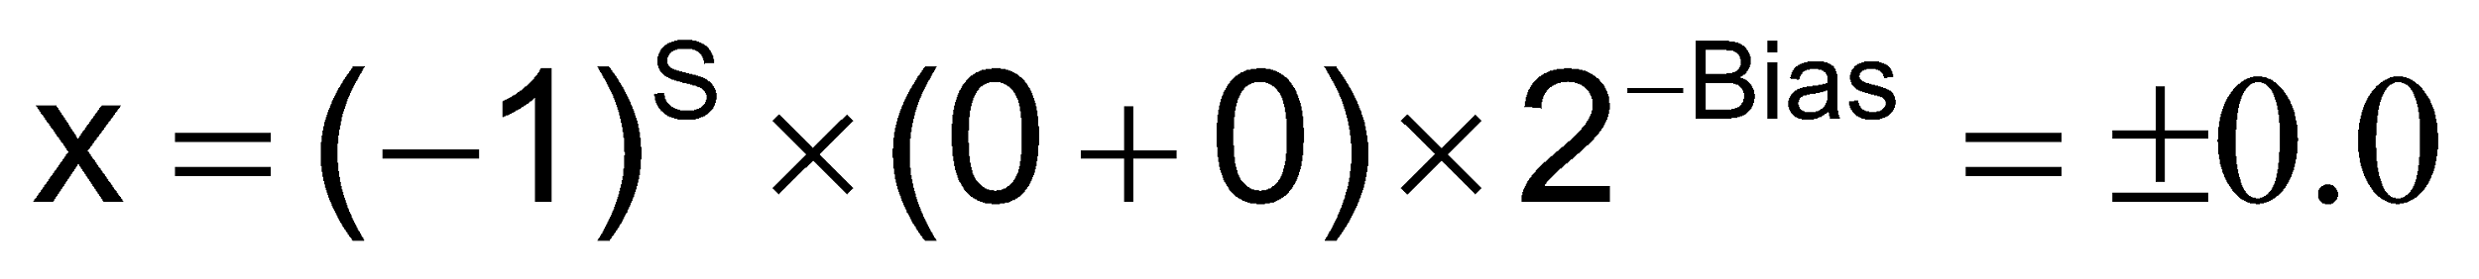
Denormal Numbers
Exponent = 000...0 ⇒ hidden bit is 0
Smaller than normal numbers
allow for gradual underflow, with diminishing precision
Denormal with fraction = 000...0
Two representations of 0.0!
Chapter 3 — Arithmetic for Computers — ‹#›
Notes:
Morgan Kaufmann Publishers
*
Chapter 3 — Arithmetic for Computers
‹#›

Slide 18
Infinities and NaNs
Exponent = 111...1, Fraction = 000...0
±Infinity
Can be used in subsequent calculations, avoiding need for overflow check
Exponent = 111...1, Fraction ≠ 000...0
Not-a-Number (NaN)
Indicates illegal or undefined result
e.g., 0.0 / 0.0
Can be used in subsequent calculations
Chapter 3 — Arithmetic for Computers — ‹#›
Notes:
Morgan Kaufmann Publishers
*
Chapter 3 — Arithmetic for Computers
‹#›

Slide 19
Floating-Point Addition
Consider a 4-digit decimal example
9.999 × 10¹ + 1.610 × 10^{–1}
1. Align decimal points
Shift number with smaller exponent
9.999 × 10¹ + 0.016 × 10¹
2. Add significands
9.999 × 10¹ + 0.016 × 10¹ = 10.015 × 10¹
3. Normalize result & check for over/underflow
1.0015 × 10²
4. Round and renormalize if necessary
1.002 × 10²
Chapter 3 — Arithmetic for Computers — ‹#›
Notes:
Morgan Kaufmann Publishers
*
Chapter 3 — Arithmetic for Computers
‹#›

Slide 20
Floating-Point Addition
Now consider a 4-digit binary example
1.000₂ × 2^{–1} + –1.110₂ × 2^{–2} (0.5 + –0.4375)
1. Align binary points
Shift number with smaller exponent
1.000₂ × 2^{–1} + –0.111₂ × 2^{–1}
2. Add significands
1.000₂ × 2^{–1} + –0.111₂ × 2–1 = 0.001₂ × 2^{–1}
3. Normalize result & check for over/underflow
1.000₂ × 2^{–4}, with no over/underflow
4. Round and renormalize if necessary
1.000₂ × 2^{–4} (no change) = 0.0625
Chapter 3 — Arithmetic for Computers — ‹#›
Notes:
Morgan Kaufmann Publishers
*
Chapter 3 — Arithmetic for Computers
‹#›

Slide 21
Floating-Point Multiplication
Consider a 4-digit decimal example
1.110 × 10¹⁰ × 9.200 × 10^{–5}
1. Add exponents
For biased exponents, subtract bias from sum
New exponent = 10 + –5 = 5
2. Multiply significands
1.110 × 9.200 = 10.212 ⇒ 10.212 × 10⁵
3. Normalize result & check for over/underflow
1.0212 × 10⁶
4. Round and renormalize if necessary
1.021 × 10⁶
5. Determine sign of result from signs of operands
+1.021 × 10⁶
Chapter 3 — Arithmetic for Computers — ‹#›
Notes:
Morgan Kaufmann Publishers
*
Chapter 3 — Arithmetic for Computers
‹#›

Slide 22
Floating-Point Multiplication
Now consider a 4-digit binary example
1.000₂ × 2^{–1} × –1.110₂ × 2^{–2} (0.5 × –0.4375)
1. Add exponents
Unbiased: –1 + –2 = –3
Biased: (–1 + 127) + (–2 + 127) = –3 + 254 – 127 = –3 + 127
2. Multiply significands
1.000₂ × 1.110₂ = 1.1102 ⇒ 1.110₂ × 2^{–3}
3. Normalize result & check for over/underflow
1.110₂ × 2^{–3} (no change) with no over/underflow
4. Round and renormalize if necessary
1.110₂ × 2^{–3} (no change)
5. Determine sign: +ve × –ve ⇒ –ve
–1.110₂ × 2^{–3} = –0.21875
Chapter 3 — Arithmetic for Computers — ‹#›
Notes:
Morgan Kaufmann Publishers
*
Chapter 3 — Arithmetic for Computers
‹#›

Slide 23
FP Arithmetic Hardware
FP multiplier is of similar complexity to FP adder
But uses a multiplier for significands instead of an adder
FP arithmetic hardware usually does
Addition, subtraction, multiplication, division, reciprocal, square-root
FP ↔ integer conversion
Operations usually takes several cycles
Can be pipelined
Chapter 3 — Arithmetic for Computers — ‹#›
Notes:
Morgan Kaufmann Publishers
*
Chapter 3 — Arithmetic for Computers
‹#›

Slide 24
FP Instructions in RISC-V
Separate FP registers: f0, …, f31
double-precision
single-precision values stored in the lower 32 bits
FP instructions operate only on FP registers
Programs generally don’t do integer ops on FP data, or vice versa
More registers with minimal code-size impact
FP load and store instructions
flw, fld
fsw, fsd
Chapter 3 — Arithmetic for Computers — ‹#›
Notes:
Morgan Kaufmann Publishers
*
Chapter 3 — Arithmetic for Computers
‹#›

Slide 25
FP Instructions in RISC-V
Single-precision arithmetic
fadd.s, fsub.s, fmul.s, fdiv.s, fsqrt.s
e.g., fadds.s f2, f4, f6
Double-precision arithmetic
fadd.d, fsub.d, fmul.d, fdiv.d, fsqrt.d
e.g., fadd.d f2, f4, f6
Single- and double-precision comparison
feq.s, flt.s, fle.s
feq.d, flt.d, fle.d
Result is 0 or 1 in integer destination register
Use beq, bne to branch on comparison result
Branch on FP condition code true or false
B.cond
Chapter 3 — Arithmetic for Computers — ‹#›
Notes:
Morgan Kaufmann Publishers
*
Chapter 3 — Arithmetic for Computers
‹#›

Slide 26
Concluding Remarks
Bits have no inherent meaning
Interpretation depends on the instructions applied
Computer representations of numbers
Finite range and precision
Need to account for this in programs
§3.10 Concluding Remarks
Chapter 3 — Arithmetic for Computers — ‹#›
Notes:
Morgan Kaufmann Publishers
*
Chapter 3 — Arithmetic for Computers
‹#›

Slide 27
Concluding Remarks
ISAs support arithmetic
Signed and unsigned integers
Floating-point approximation to reals
Bounded range and precision
Operations can overflow and underflow
Chapter 3 — Arithmetic for Computers — ‹#›
Notes:
Morgan Kaufmann Publishers
*
Chapter 3 — Arithmetic for Computers
‹#›

