Slide 1
Software licenses © 2013 By Mantas Urbonas, WWW.VISMA.COM
Short unofficial overview of

Slide 2
DISCLAIMER
I am NOT a lawyer, thus this presentation reflects my own (amateur) understanding of the underlying issues. However, the presentation is based on many online sources, and probably is correct in general – you can (and should) always verify everything by yourself.
YOU SHOULD CONSULT A PROFESSIONAL LAWYER AND OBEY THE RULES AND POLICIES OF YOUR EMPLOYER. THIS PRESENTATION DOES NOT GUARANTEE TO BE CORRECT AND PRECISE. IT’S AN INTRODUCTORY AND UNOFFICIAL MATERIAL.

Slide 3
Aim
Short (and shallow) overview of
software licensing practices
Rough understanding of major software licenses
Implications for you as a software enduser / modifier / entrepreneur.
Notes:
Reiketu isklausyti vieno semestro kursa apie autorines ir gretutines teises VU ir tada dar gerai paanalizuoti pagrindines licencijas.

Slide 4
Intellectual Property
“Creation of mind” like books, music, drawings etc.
All “original works of authorship”: everything from computer software to architecture.
Can be:
Copyright
Patents
Trademarks
Industrial Design Rights
Trade Dress

Slide 5
Copyright
Automatic rights of the creator of an original work
Copyright = Economic rights + Moral rights
Economic rights (sellable) | Moral rights (non-sellable)
Reproduce Publish Translate Adapt and modify Rent, sell, export,… Display Perform Make available for public etc | Claim authorship Demand mentioning Object to any distortion
Notes:
Viena is IP formu
Žymima (C)
Taikoma: knygoms, paskaitoms, pamokslams, dramoms, spektakliams, muzikai, skulptūrai, parkų projektams,

Slide 6
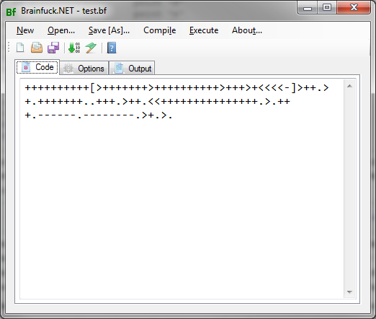

Copyright Laws and Computer Software
Protected just as literary works.
=

Slide 7
Copyright Laws and Computer Software (2)
Computer programs, whether in source or object code, shall be protected as literary works under the Berne Convention (1971).
WTO TRIPS convention article 10 part 1
[…]shall protect computer programs, by copyright [just like] Literary and Artistic Works. […]
Protection […] shall apply to the expression in any form of a computer program. Ideas and principles which underlie any element of a computer program [...] are not protected by copyright under this Directive.
A computer program shall be protected if it is original in the sense that it is the author's own intellectual creation.
EP directive 2009/24/EB
But: there are special cases for software!
Notes:
Išimtys susiję su darbdavio turtinėmis teisėmis

Slide 8
Copyright Laws and Computer Software (3)
Without author’s permission you cannot
Publish
Distribute
Assume authorship
Translate
Adapt, modify, distort
etc
…neither books nor software.
For software, you also cannot execute it

Slide 9
Adaptation of an Original Art
Derivative work
a creation that includes copyrighted aspects of an original work.
Examples
take a pre-existing book and add one page
take a single chapter and add 90% of new material
take a single page add 99,9999% of new material
In general, the proportions of the derived and the original art don’t matter;
the material must be original and copyrightable in itself.
Notes:
Liet. Išvestiniai kūriniai

Slide 10
Adaptation of an Original Art in Software
Whenever you include another piece of software in your own, your software becomes a “derivative work”.
Applies to:
source code,
compiled or pre-compiled binaries,
statically linked libraries
dynamically linked libraries,
or any other original or derived work.
You need a permission from the copyright holder to “adopt” his intellectual property

Slide 11
Licenses
The copyright holder may issue special permissions to use it’s art – the “licenses” or “contracts”.
It’s a promise of the copyright holder not to sue you if certain conditions are met.
Notes:
Example sing an athemn

Slide 12
Licenses (2)
Creating a proper license is VERY difficult
Consider:
Variety of jurisdictions
Loopholes
Your user
Enforceability
Side effects
There are lots of software licenses in the wild
Many of them have problems with enforceability and/or side effects
Notes:
Garantija
jmri

Slide 13
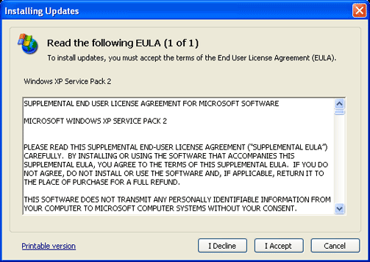
License Variety
Proprietary products often have their own licenses.
Try clarifying the issues with the vendor itself.
You may still need a lawyers advice.
*Microsoft’s restrictions for reverse engineering.

Slide 14
License Variety (2): Open Source Licenses
Open-source projects often re-use licenses.
The number of different open-source licenses is infinite. And growing.
Most popular:
MIT
BSD
Apache
LGPL
GPL
You don’t have to be a law professor to know 5 licenses.
Still be careful with those less-popular licenses.
Notes:
Išmok šitas, ir jei gali, į kitas nežiūrėk.
Dar yra Artistic ir Creative Commons

Slide 15
MIT License a.k.a. X11
Simple, permissive license
Explicitly allows to use software without restrictions and limitations.
use, copy, modify, merge, publish, distribute, sublicense, and/or sell
Conditions: copyright notice must be present in the original source files.
It means that derived work can be incorporated anywhere without fee.
Xwindows, RubyOnRails, etc

Slide 16
Modified BSD License (not the original BSD License)
Simple, permissive license.
Explicitly allows redistribution in binary or source forms, with or without modification
Conditions:
the license text must remain on the original source files.
the binary distribution must somehow reproduce the original copyright and license somewhere in documentation.
the authors name cannot be used for promoting the derived works.
It means that derived work from BSD-licensed software can be incorporated in any proprietary software without fee.
BSD license text must be included in the documentation somewhere
Microsoft, Apple

Slide 17

Apache License 2.0
Complex, permissive license
Requires preservation of copyright note and disclaimer
Lots of quality source code released under Apache License

Slide 18
What is “Copyleft”?
The Moral Dilema:
Opensource developers are altruistic and give their source code to the public for free.
Everyone in the world is having constantly improving software.
Greedy companies use opensource in their proprietary products.
Not even the original developers get anything.
Notes:
1. Once the code is free to use and free to change, some other open source developers often improve the original version.
2. The benefit is mutual
3. the derivative works of their software are unavailable even for them.

Slide 19

What is “Copyleft”? (2)
Copyleft: a free program requiring all derived work to be free as well.
It’s “viral” – a piece of free, “copylefted” source code in your program makes whole program free and “copylefted”.
“Once free, forever free”

Slide 20

Best Known Copyleft License: GNU Generic Public License (GPL)
Complex, carefully crafted copyleft license.
Use and adaptation are permitted.
Affects only redistribution
Redistribution is only permitted, if:
Whole derived work is covered by GPL license
Distribution includes whole source code.
License terms cannot be changed.
…so ?

Slide 21
How GPL Works
You can use the GPLed software for free
You can modify the GPLed software
…and use the modified version.
You can redistribute, but:
Whole derived work must have a single license – GPL.
It means whole source code must be included into the distribution
It also means each of the customers can distribute your program for free.
Impractical to sell many copies: the first client will legally distribute his version to everyone in the world

Slide 22
Infringing GPL Terms
IF we don’t follow the requirements
I.e. if the distribution doesn’t include all source code,
or the included source code is not totally GPLed
THEN violation automatically voids the license:
The derived work now doesn’t have a permission of original work’s author → Copyright violation! → Serious $$$ loss
Has anyone tried that?
There were successful court rulings in USA and Germany confirming that GPL is enforceable.

Slide 23
Is Your Program a “Derivative Work” of a GPL-Covered Software?
Your source code incorporates piece of GPL’ed source code, or
Your program statically links to the GPL’ed library (link-time dependency), or
Your program dynamically links to the GPL’ed library (run-time dependency)
Note: this claim has not been tried in courts yet.

Slide 24
Enduser Perspective: Why Use GPLed Software?
It’s free.
It’s usage alone does not violate copyright = legal to use
Opensource community.

Slide 25
Software Producer (Corporate) Perspective: When to Use GPLed Components in My Products?
The products get GPL’ed automatically.
Its possible if the customer doesn’t mind the GPL’ed product.
I.e. internal customer
Single, unique customer for that product in the world

Slide 26
Dual Licensing
Must be the only copyright holder
A copyright holder may distribute his work under various licenses.
One license can be GPL for those clients who can use GPL
Universities, schools, opensourcers
Another license can be proprietary license – for those who want to create proprietary derivative works.
MySQL, RedHat, TrollTech, Jaspersoft
In general, dual licensing means:
Marketing tool: maximum popularity
Free contributions from opensource community
Possibility to sell the same software for proprietary clients

Slide 27
LGPL (GNU Lesser General Public License)
“GPL for libraries”
Permits use of the library in proprietary programs

Slide 28
GPL and LGPL FAQ
If I know somebody is having a copy of GPL program, can I demand a copy?
No.
GPL only requires source code alongside the binary distribution, but doesn’t require anyone to distribute anything.
If someone steals the CD with a version of GPL-covered program, can he distribute it?
No.
If the version is unpublished, it can be considered to be a trade secret. Distribution without owner’s permission is prohibited.
What if a company distributes a copy as a trade secret?
It’s a violation of GPL: license requires free distribution.
Notes:
What if my employer has a GPL software?

Slide 29
Poor Licenses In Courts : Artistic License
Jacobsen (JMRI) vs Matt Katzer

Slide 30
Proper Licenses In Courts: GPL
BusyBox
D-Link Germany GmbH
Maryanovsky vs Rabinovitch
Notes:
EK bandymai leisti pazeisti licencijas

Slide 31
Major Java libs
GPL:
MySQL
Ext.js
Resin
Magnolia CMS
…
LGPL:
JBoss
JOnAS
JFreeChart
…
ASF:
Tomcat
Geronimo
OSCache
ServiceMix
…

