Slide 1

MARKETING STUDY results
By: Laura Arevalo, Roland Abrahantes,
Parth Patel, Aboubakar Kone

Slide 2
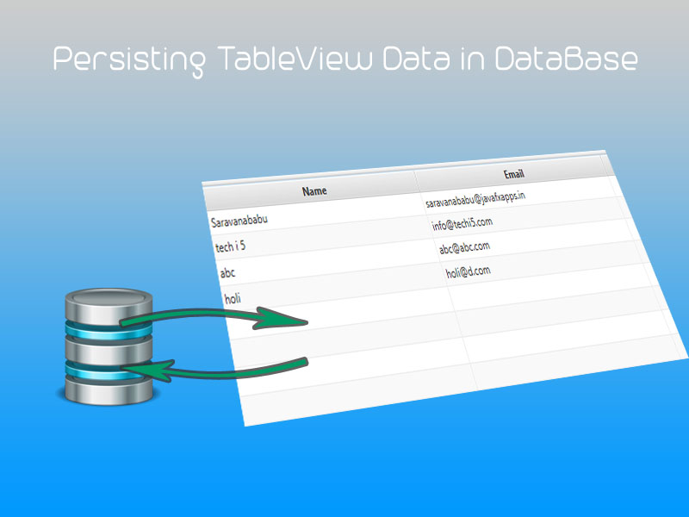
TEAM ROLES
Roland Abrahantes DBA Software Engineer
Laura Arevalo JAVA_FX Software Engineer
Parth Patel Software Engineer
Aboubakar Kone Software Engineer and GD

Slide 3
HYPOTHESIS
An affordable inventory application is needed by small beauty product entrepreneurs.
Small beauty product entrepreneurs have access to inventory applications, however they are too difficult to navigate and maintain for a small one-person business.
Small beauty entrepreneurs need an inventory application which is accessible anywhere and on any device.

Slide 4
Question 1
What kind of beauty store do you operate?
Independent seller of one specific brand.
Independent seller of many brands.
Storefront of many brand.
Results: A 40%
B 40%
C 20%

Slide 5
Question 2
Do you currently have software which helps you keep track of inventory? If No, skip to Question 6.
Yes
No
Results: A 80%
B 20%

Slide 6
Question 3
Does your software meet all of your needs?
Yes
No
Results: A 0%
B 100%

Slide 7
Question 4
What else would you like your software to do?
I would like software to send emails to my personal account when an item is requested.
It could be more user-friendly in terms of easy navigation just like any other given Microsoft suite.
More user-friendly. It’s too complicated for my small business.
User authentication to track who made changes
Easy to adopt

Slide 8
Question 5
What did you pay for your software?
Nothing
$0 - $50
$50 - $100
$100 – 200
$200 +
Results: A 50%
C 25%
C 25%

Slide 9
Question 6
How much would you pay for software that met all of your needs?
Nothing
$0 - $50
$50 - $100
$100 – 200
$200 +
Results: C 20%
D 20%
E 60%

Slide 10
Question 7
Would you pay more for software that could be used on all of your devices?
Yes
No
Results: A 80%
B 20%

Slide 11
Question 8
Please list functions that you would like to have your software perform?
Be able to add new products easily
Track sales by groups (Shampoo, lipsticks, etc)
Look at my inventory by categories
User friendly
Useful function only
Authentication
Track how many of each product are in stock
Show which items sold most last month, pie chart maybe?
Send email to my personal account when an item is requested
Alert for low inventory

Slide 12
Question 9
On a scale of 1 to 10 how likely would you be to use the beauty organizer?
Average Score: 8.2

Slide 13
Question 10
On a scale of 1 to 10 how would you rate the performance of the app at this stage of production?
Average Score: 7.6

Slide 14
Question 11
On a scale of 1 to 10 how likely are you to purchase this app in the future after it includes all planned functionality?
Average Score: 9.8

Slide 15
Question 12
Additional comments

