Slide 1

The Price of Victory: Analyzing Front Office Strategies in the NBA
Mehmed Akif Şentürk
DSA 210 Term Project

Slide 2
MOTIVATION & OBJECTIVES
Project Motivation:
  In the modern NBA, winning isn't just about on-court talent; it's about financial efficiency and roster engineering.
  Does spending more money bring a championship?
  We aim to move beyond box-score stats and analyze front office decisions.
  Objectives:
  -- Analyze Financial Impact: Determine if paying the "Luxury Tax" leads to higher win rates.
  -- Identify Inefficiency: Measure how "Dead Money" (wasted cap space) hurts team performance.
  -- Predict Success: Use Machine Learning to find the #1 factor driving winning.

Slide 3
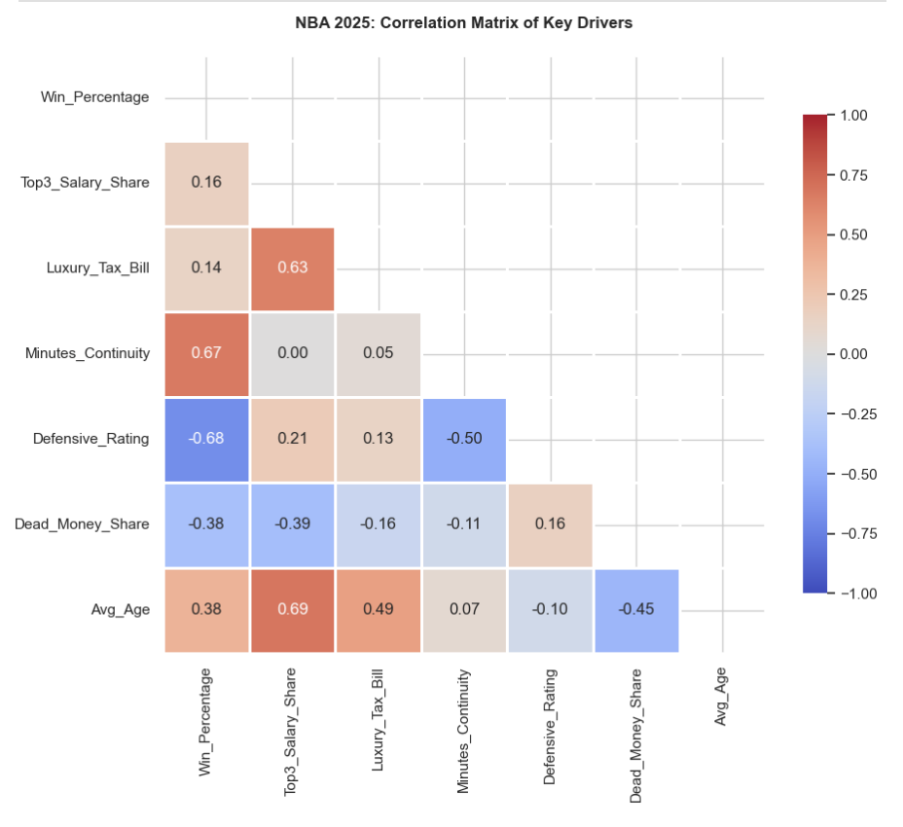
2)Correlation Matrix
-- To understand the relationships between our target variable (Win_Percentage) and the Front Office metrics, we generated a heatmap of correlation coefficients.
-- Key Observations:
1) Strongest Positive Correlation:
Minutes_Continuity shows a strong positive color intensity. This gives us the first hint that maintaining the roster is critical for winning.
3) Weak Correlations: Surprisingly, financial metrics like Top3_Salary_Share and Avg_Age
show very faint colors, suggesting a weak linear relationship with success.

Slide 4
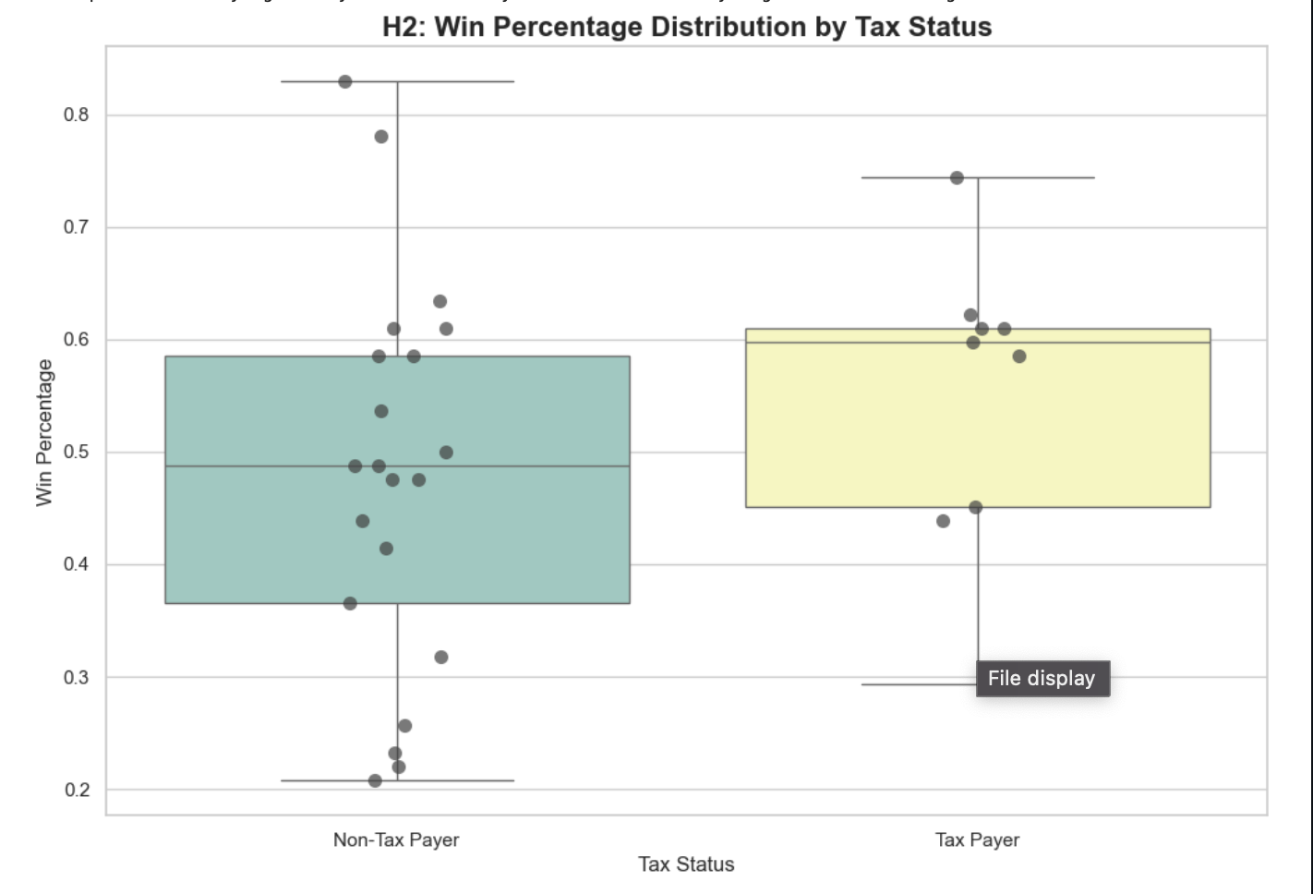
3) Boxplots
We analyzed the spread of key variables using Boxplots to identify outliers and league standards.
-- The boxplot reveals massive outliers. While the median tax bill is low (many teams pay $0), a few "super-spenders" pay exponential amounts.

Slide 5
Hypothesis Testing

Slide 6
Hypotesis 1 :
Financial Strategies (Superstars)
H0​: There is no significant relationship between Top3_Salary_Share and Win_Percentage
H1​: There is a positive relationship; teams that allocate more cap space to top stars win more.
Method: Pearson Correlation Test
Result:
-- Coefficient (r): 0.1571
-- p-value: 0.4072 (p>0.05)
Conclusion:
-- Fail to Reject H0​.
-- Allocating massive cap space to superstars does not significantly predict regular season success

Slide 7
Hypothesis 2:
Luxury Tax Impact
H0: Paying Luxury Tax has no effect on Win_Percentage.
H1: Paying Luxury Tax is positively correlated with Win_Percentage.
Method: T-Test
Result:
-- T-Statistic: 1.1082
-- p-value: 0.2772 (p>0.05)
Conclusion:
-- Fail to Reject H0​.
-- There is no statistically significant difference in win rates between tax-paying teams and non-tax payers.

Slide 8
Hypothesis 3:
Roster Engineering (Continuity)
H0: Roster continuity implies no change in success..
H1: Higher Minutes_Continuity is positively correlated with Win_Percentage.
Method: Linear Regression/Pearson Correlation
Result:
-- Correlation Coefficient (r): 0.6714 (Strong Positive)
-- p-value: 0.0000 (p<0.05)
Conclusion:
-- Reject H0​.
-- Strong evidence found. Roster continuity is a highly significant predictor of regular season success.

Slide 9
Hypothesis 4:
Experience and Defense
H0: There is no relationship between Avg_Age and Defensive_Rating.
H1: There is a negative relationship (Older age -> Lower/Better Def Rating)
Method: Pearson Correlation
Result:
-- Correlation Coefficient (r): -0.1042
-- p-value: 0.5836 (p>0.05)
Conclusion:
-- Fail to Reject H0​.
-- Team age is not a significant predictor of defensive capability. Younger teams can defend just as well as veterans.

Slide 10
Hypothesis 5:
The "Dead Money" Drag
H0: Dead Money has no impact on winning.
H1: There is a negative relationship between Dead_Money_Share and Win_Percentage.
Method: Spearman Rank Correlation
Result:
-- Correlation Coefficient (rs​): -0.4116 (Moderate Negative)
-- p-value: 0.0238 (p<0.05)
Conclusion:
-- Reject H0​.
-- Statistically significant negative impact. Teams with high "dead money" loads win significantly fewer games.

Slide 11
Machine Learning Approach: Predicting Success
To build a predictive model that estimates a team’s Regular Season Win Percentage based on the identified Front Office and Roster Engineering metrics.
Input Features: Minutes_Continuity, Dead_Money_Share, Defensive_Rating, Offensive_Rating, Avg_Age, Tax_Payer.
Target Variable: Win_Percentage (0.0 to 1.0).
Model Selection: We compared three distinct algorithms to find the best fit for the dataset:
Linear Regression: Baseline model for linear relationships.
Random Forest Regressor: To capture non-linear complexities.
Gradient Boosting: For ensemble learning performance.

Slide 12
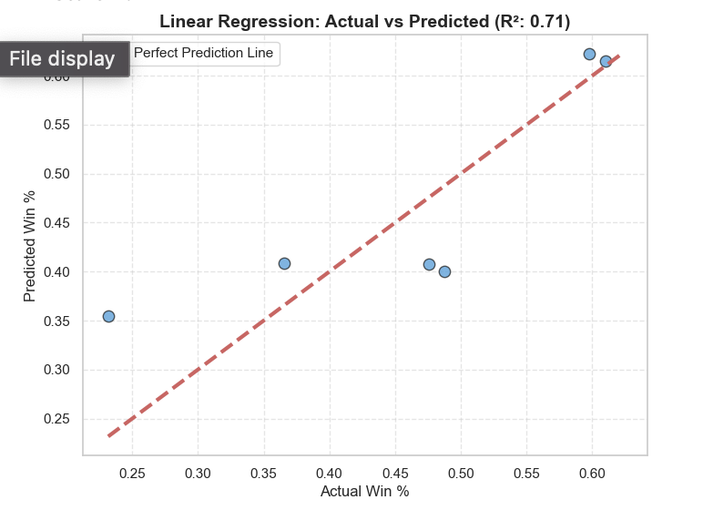
Model Evaluation & Feature Importance
Performance Comparison:
-- Winner: Linear Regression achieved the highest accuracy with an R2 Score of 0.7127.
-- Comparison: Complex models like Random Forest (R2≈0.55) suffered from overfitting due to the limited sample size (30 NBA teams). The linear nature of the strongest features (Continuity and Defense) favored the simpler regression model.
Model Accuracy:
-- With an R2 of 0.71, our model explains 71% of the variance in team success, making it a robust tool for strategic planning.
Feature Importance Analysis:
--The model coefficients highlight the most critical factors for winning:
Defensive Rating (Negative Coeff): The strongest predictor. Lower rating (better defense) directly drives wins.
Minutes Continuity (Positive Coeff): Confirmed as the most vital roster construction metric.
Dead Money (Negative Coeff): Acts as a significant drag on performance.

Slide 13
Key Findings
1. The "Superteam" Myth is Busted:
-- Our analysis proved that financial dominance does not equal success. Neither allocating massive cap space to
top 3 stars nor paying the Luxury Tax showed a significant correlation with winning. You cannot simply "buy" a championship in the regular season.
2. Continuity is the New Market Inefficiency:
-- The strongest predictor of success was Roster Continuity (r=0.67). Teams that
kept their core rotation together significantly outperformed those that rebuilt, regardless of talent level. Chemistry is a measurable asset.
3. Defense & Efficiency Drive Wins:
-- Our Machine Learning model (R2=0.71) identified Defensive Rating and Low Dead Money
as critical success factors. Inefficiency (paying players not to play) is a silent killer of team performance.
Recommendation GMs
-- Based on the data, a winning Front Office strategy should prioritize retention over acquisition.
-- Instead of chasing expensive free agents or trading for superstars (high financial risk), teams should invest in developing a defensive identity and keeping their core group together for multiple seasons.
-- Final Verdict: "Chemistry > Cash"
-- Success in the 2024-2025 NBA season is engineered through patience and stability, not just through the checkbook.

