Slide 1
Proving Liveness with Fairness using Rewriting


Adam Koprowski and Hans Zantema
Jürgen Giesl and Hans Zantema, Liveness in rewriting.
In Proc. 14th RTA, LNCS 2706, pages 321-336, 2003
Adam Koprowski and Hans Zantema, Proving Liveness with Fairness using Rewriting.
Tech. Report CS-Report 05-06, Technical University of Eindhoven, 2005
(submitted for FroCoS ’05)

Slide 2
General idea
Verify liveness properties by transforming them to termination problems of TRSs.
Liveness problem
Does liveness hold?
Modelling
TRS
Transformation
TRS’
Is TRS’ terminating?

Slide 3
Motivation: why?
Termination is the well-studied concept in term rewriting and there exist a number of techniques for proving termination of TRSs and it is a subject of ongoing research.
There exist tools for proving termination of term rewriting fully automatically.
It’s easy to express infinite state space models by means of (finite) TRSs so this technique can be applicable where model checking fails.

Slide 4
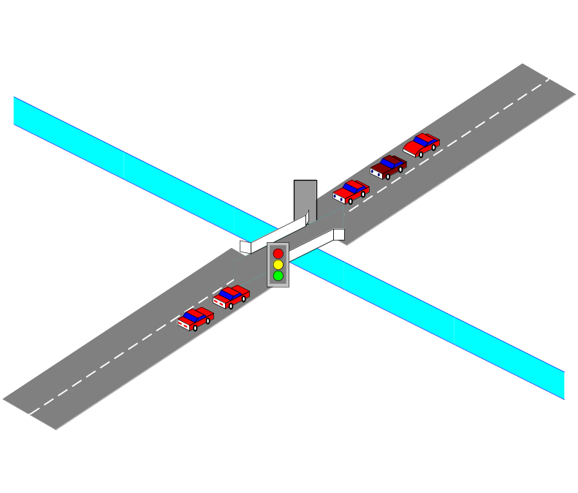
Example: cars over a bridge
Liveness: no car will wait forever
Trivial?
We need some assumption about the lights:
Fairness
State space is infinite!

Slide 5
Example continued: Cars over a bridge – model
top
car
top
left
old/new
car
left/right
car
bot
old/new
left lane
right lane
new
car
bot
old
bot
top(left(car(x, y), z)) → top(right(y, z))
top(right(x, car(y, z)) → top(left(x, z))
top(left(bot, y)) → top(right(bot, y))
top(right(x, bot)) → top(left(x, bot))
top(left(car(x, y), z)) →= top(left(y, z))
top(right(x, car(y, z)) →= top(right(x, z))
bot →= car(new, bot)

Slide 6
Definitions 1
S – set of states
I ⊆ S – set of initial states
G ⊆ S – set of “good” states
→, →= ⊆ S×S – transition relations
→/→= ≡ →=* · → · →=*
SN(I, →) ≡ ¬∃_{t1, t2,…} : t₁∈I ∧ (∀_{i} : t_{i} → t_{i+1})
→_{G} ≡ { (s, t) | s → t ∧ s∉G }

Slide 7
Definitions 2: Liveness
Definition: Liveness
Live(I, →, →=, G) holds iff:
t₁∈I
∀_{i} : t_{i} → t_{i+1} ∨ t_{i} →= t_{i+1}
∀_{i} ∃_{j>i} : t_{j} → t_{j+1}
⇒
∀ _{t1, t2,…}
∃_{i} : t_{i}∈G
Theorem
Live(I, →, →=, G) ⇔ SN(I, →_{G} / →=_{G})

Slide 8
Definitions: top TRSs
∑ – signature
V – variables
T(∑, V) – terms
Definition: Top TRS
Let top be an unary symbol fresh in ∑ (top ∉ ∑)
A term t ∈T(∑∪{top}, V) is called a top term if it contains exactly one instance of top symbol, at the root of the term.
T_{top}(∑, V) – set of top terms.
TRS is top if for every l → r rule:
both l and r are top terms, or
both l and r do not contain instance of top symbol.

Slide 9
Liveness in TRS world.
S
I ⊆ S
G ⊆ S
→, →= ⊆ S×S
T(∑,V)
T_{top}(∑,V)
G(P) = {t∈T_{top}(∑,V) | ¬∃_{p∈P, δ, C}: t = C[pδ]}
Rewrite relations of top TRSs: R, R⁼
Live(T_{top}(∑,V), R, R⁼, G(P))

Slide 10
Back to cars over a bridge…
top(left(car(x, y), z)) → top(right(y, z))
top(right(x, car(y, z)) → top(left(x, z))
top(left(bot, y)) → top(right(bot, y))
top(right(x, bot)) → top(left(x, bot))
top(left(car(x, y), z)) →= top(left(y, z))
top(right(x, car(y, z)) →= top(right(x, z))
bot →= car(new, bot)
R
R⁼
P = {old}

Slide 11
Idea for transformation
top
top
top
top
top
top
top
top
top
top
right
check
left
ok
ok
check
left
left
left
ok
car
car
check
right
right
car
left
car
car
ok
car
car
left
car
left
old
car
bot
old
car
car
car
car
car
car
car
new
car
bot
new
new
new
bot
bot
bot
bot
check
bot
ok
bot
car
car
car
new
bot
old
new
bot
old
old
old
bot
bot
bot
bot
bot
old
old
car
old
new
car
new
bot
old
bot
bot
old
old
new
new
bot
bot
top(left(car(x, y), z)) → top(right(y, z))
top(right(x, car(y, z)) → top(left(x, z))

Slide 12
Transformation
For TRSs R and R⁼ over ∑ ∪ {top} and P ⊆ T(∑,V)
we define transformation LT as follows:
LT(R)
l
top(ok(l))
→ r
→ top(check(r))
for all non-top rules l → r in R
for all top rules top(l) → top(r) in R
LT⁼(R⁼, P)
l
top(ok(l))
check(p)
check(f(x₁, … x_{n}))
f(x₁, … ok(x_{i}), … x_{n})
→ r
→ top(check(r))
→ ok(p)
→ f(x₁, … check(x_{i}), … x_{n})
→ ok(f(x₁, … x_{n}))
for all non-top rules l → r in R
for all top rules top(l) → top(r) in R
for all p∈P
for all f∈∑, ar(f)=n≥1, i∈{1..n}
for all f∈∑, ar(f)=n≥1, i∈{1..n}

Slide 13
Back to cars over a bridge…
top(ok(left(car(x, y), z)))
top(ok(right(x, car(y, z)))
top(ok(left(bot, y)))
top(ok(right(x, bot)))
top(ok(left(car(x, y), z)))
top(ok(right(x, car(y, z)))
bot
check(old)
check(car(x, y))
check(car(x, y))
check(left(x, y))
check(left(x, y))
check(right(x, y))
check(right(x, y))
car(ok(x), y)
car(x, ok(y))
left(ok(x), y)
left(x, ok(y)
right(ok(x), y)
right(x, ok(y))
→ top(check(right(y, z)))
→ top(check(left(x, z)))
→ top(check(right(bot, y)))
→ top(check(left(x, bot)))
→= top(check(left(y, z)))
→= top(check(right(x, z)))
→= car(new, bot)
→= ok(old)
→= car(check(x), y)
→= car(x, check(y))
→= left(check(x), y)
→= left(x, check(y))
→= right(check(x), y)
→= right(x, check(y))
→= ok(car(x, y))
→= ok(car(x, y))
→= ok(left(x, y))
→= ok(left(x, y))
→= ok(right(x, y))
→= ok(right(x, y))

Slide 14
Soundness of the transformation
Theorem
SN(LT(R) / LT⁼(R⁼, P)) ⇒ Live(T_{top}(∑,V), R, R⁼, G(P))
Proof
Assume SN(LT(R) / LT⁼(R⁼, P)) holds and Live(T_{top}(∑,V), R, R⁼, G(P)) does not hold.
So SN(T_{top}(∑,V), →_{G} / →=_{G}) does not hold and we have an infinite →_{G} / →=_{G} reduction. We have to show that it maps to infinite LT(R) / LT⁼(R⁼, P) reduction.
It easily follows if we can show that:
(I) top(t) →_{G} top(u) ⇒ top(ok(t)) →_{LT} /→=_{LT} top(ok(u))
(II) top(t) →=_{G} top(u) ⇒ top(ok(t)) →=_{LT}* top(ok(u))
Ad. (I)
If top(t) →_{G} top(u) by application of non-top rule then easy.
If top(t) →_{G} top(u) by application of top rule top(l) → top(r) then:
top(ok(t)) = top(ok(lδ)) →_{LT} top(check(rδ)) = top(check(C[pβ])) →=_{LT}* top(C[check(p)β]) →=_{LT} top(C[ok(p)β]) →=LT* top(ok(C[pβ])) = top(ok(u))
Ad. (II) Analogously. ⃞

Slide 15
TPA – Termination Proved Automatically
Cars over a bridge: after applying transformation we have to prove that transformed TRS is relatively terminating. TPA:
does that fully automatically;
supports relative termination;
got 3rd place (out of 6 participating programs) in Termination Competition ‘05
uses following termination proving techniques:
  polynomial interpretations,
  RPO (recursive path order),
  DP transformation,
  dummy elimination,
  semantic labelling with booleans and with natural numbers.
CoLoR – Coq Library on Rewriting and Termination (http://color.loria.fr)
Visit http://www.win.tue.nl/tpa for more information.

Slide 16
LT vs old transformations
In Jürgen Giesl and Hans Zantema, “Liveness in rewriting” two transformations were presented:
L – sound and complete and
LS – only sound but significantly simpler.
L is so complicated that it has no practical meaning.
LS is simple enough but often leads to non-terminating TRSs while the liveness problem in question does hold.
LT tries to get the best from both:
it is only slightly more complicated than LS
case study shows that often it succeeds where LS fails
with some additional (mild) requirements it is even complete.

Slide 17
Completeness of the transformation
Theorem
Let R, R= be top TRSs over ∑∪{top}.
If the following conditions are satisfied:
if u contains an instance of some p∈P and t → u or t →= u then t also contains an instance of p.
Both R and R⁼ are non-duplicating.
there is at least one symbol of arity ≥2 in ∑.
Then:
Live(T_{top}(∑,V), R, R⁼, G(P)) ⇒ SN(LT(R) / LT⁼(R⁼, P))

Slide 18

Conclusions
Another technique for proving liveness.
Only human activity is to model the problem.
Can deal with problems involving infinite state space.
Generalizations possible and will be subject of further research.
Thank you for attention!

