Slide 1
Establishing trust in an updatable fTPM using remote attestation
Andreas Korb
München, 06. Juli 2023

Slide 2
Motivation

Slide 3
Are you trustworthy?
Verifier
Yes, here is the evidence.
Prover
How can I trust
this evidence?
Provider needs trust anchor
on the device of user.

Slide 4
dTPM
Trustworthy because of validation of its EKCert
Untrusted
system
dTPM
B
A
Trust anchor
Vendor

Slide 5
fTPM (before)
FW1
FW2
FW3
fTPM
A
A
A
A
Assumed to be trustworthy
(because we as the vendor know what we provisioned the device with)
Known because of endorsement certificate
Trust anchor
Manufacturer

Slide 6


TEE
Traditional
Network access
User applications
Security services
Sensitive data
REE
Network access
User applications
TEE
Security services
Sensitive data

Slide 7
Prover
Attested
system
Attester
Verifier
Measure-
ments
Evidence

Slide 8
TPM types
CPU
CPUTPM
CPU
TPM
TEE
TPM
CPU
VMM
TPM

Slide 9

Verifier
Do I trust
?
EKcert
𝓜
𝓜
Prover
EKcert
𝓜
FW1
FW2
FW3
fTPM
A
𝓜
𝓜
𝓜
𝓜

Slide 10



DICE
DICE
Layer 0
Layer 1
Layer 2
TCI0
TCI1
TCI2
Public key
CDI0
CDI1
CDI2
Private key
signs
Manufacturer
DeviceID Key
Alias Key1
Alias Key2
derived
included
TCI0
TCI1
TCI2
https://coolors.co/086788-07a0c3-f0c808-fff1d0-dd1c1a

Slide 11
fTPM (before)
FW1
FW2
FW3
fTPM
A
A
A
A
Assumed to be trustworthy
(because we as the vendor know what we provisioned the device with)
Known because of endorsement certificate
Trust anchor
Manufacturer

Slide 12

fTPM (after)
Trustworthy because full chain verifiable
ROM
…
SW OS
fTPM
A
B
C
D
E
Proven by certificate chain
Trust anchor
Trust chain
Vendor

Slide 13

fTPM identities
CDI
FW1
FW2
TCI
fTPM

Slide 14

Privacy architecture
Public key
Private key
signs
AK
Quote
included
TCI

Slide 15



fTPM identity (DICE)
+
=
binary
configuration
TCI

Slide 16

fTPM identity (TPM)
+
=
binary
FW stack
EK identity

Slide 17

Design
DICE
Trusted OS
fTPM
TCIfTPM
Public key
...
CDIn
CDIn+1
Private key
signs
Manufacturer
Alias Keyn
EPS
Storage
key
derived
included
EK
TCIOS
TCIfTPM
...

Slide 18



Storage
secure RAM
fTPM
decrypt
encrypt
Persistent
(e.g., HDD)

Slide 19
TPM hierarchies
Storage
Endorsement
Platform
Null
SPS
EPS
PPS
NPS
EK

Slide 20
Conclusion: benefits
Pull trust anchor into hardware
→ better security guarantees
Verify fTPM including its underlying software stack
Boot chain components can have independent vendors

Slide 21
Concept

Slide 22
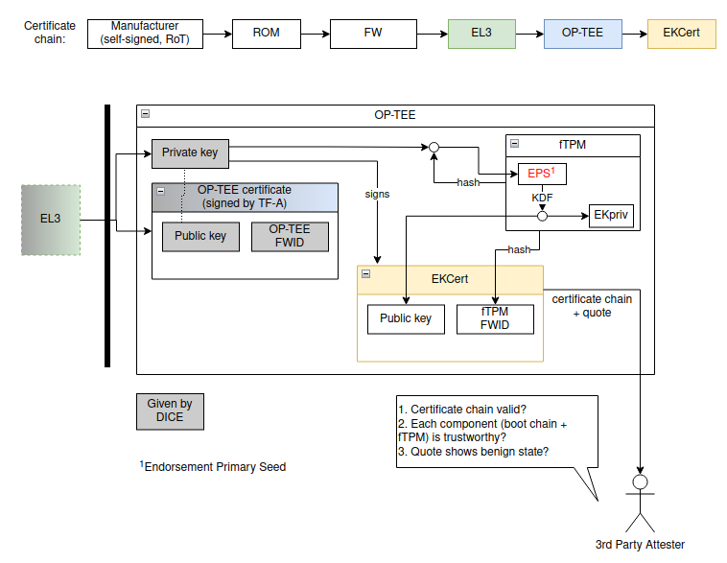

Slide 23
Research questions
How to combine DICE and TPM infrastructure?
(e.g., AliasCert ∪ EKcert)
How to manage fTPM persistent data securely?
(e.g., flush data on update)
What does the identity of fTPM include?
(e.g., hash, configuration, boot chain)
How to enable privacy for the certificate chain?

Slide 24
Technical questions
How to measure fTPM hash? (restricted to OP-TEE OS support)
How to establish static Root for certificate chain?
(must not change if measurements change)
How to inject EPS (i.e., the root secret) into fTPM?
  on each boot
    non-destructive (if EPS is same)
    destructive (if EPS changed)
How to distinguish legit update vs illegal manipulation?
(if we want to flush data only on illegal manipulation)

