Slide 1
Establishing trust in an updatable fTPM using remote attestation
Andreas Korb
München, 06. Juli 2023

Slide 2
Motivation

Slide 3
Are you trustworthy?
Prover
Yes, here is the evidence.
Verifier
How can I trust
this evidence?
Provider needs trust anchor
on the device of user.

Slide 4
dTPM
Trustworthy because of validation of its EKCert
Untrusted
system
dTPM
B
A
Trust anchor
Vendor

Slide 5
fTPM (before)
FW1
FW2
FW3
fTPM
A
A
A
A
Assumed to be trustworthy
(because we as the vendor know what we provisioned the device with)
Known because of endorsement certificate
Trust anchor
Manufacturer

Slide 6


TEE
Traditional
Network access
User applications
Security services
Sensitive data
REE
Network access
User applications
TEE
Security services
Sensitive data

Slide 7

Verifier
Do I trust
?
EKcert
𝓜
𝓜
Prover
EKcert
𝓜
FW1
FW2
FW3
fTPM
A
𝓜
𝓜
𝓜
𝓜

Slide 8


DICE
DICE
Layer 0
Layer 1
Layer 2
TCI0
TCI1
TCI2
Public key
UDS
CDI0
CDI1
CDI2
Private key
signs
DeviceID Key
Alias Key1
Alias Key2
derived
included
TCI0
TCI1
TCI2
Manufacturer
https://coolors.co/086788-07a0c3-f0c808-fff1d0-dd1c1a

Slide 9
fTPM (before)
FW1
FW2
FW3
fTPM
A
A
A
A
Assumed to be trustworthy
(because we as the vendor know what we provisioned the device with)
Known because of endorsement certificate
Trust anchor
Manufacturer

Slide 10

fTPM (after)
Trustworthy because full chain verifiable
ROM
…
SW OS
fTPM
A
B
C
D
E
Proven by certificate chain
Trust anchor
Trust chain
Vendor

Slide 11

fTPM identities
CDI
TCI
fTPM

Slide 12



fTPM identity (DICE)
+
=
binary
configuration
TCI

Slide 13

fTPM identity (TPM)
+
=
binary
FW stack
EK identity

Slide 14
DICE
DICE
Trusted OS
fTPM
TCIfTPM
Public key
UDS
CDI
CDI
Private key
signs
...
Alias Key
EPS
Storage
key
derived
included
EK
TCIOS
TCIfTPM

Slide 15




Storage
RAM
fTPM
decrypt
encrypt
Persistent
(e.g., HDD)

Slide 16
Conclusion: benefits
Pull trust anchor into hardware
→ better security guarantees
Verify fTPM including its underlying software stack
Boot chain components can have independent vendors

Slide 17
Concept

Slide 18
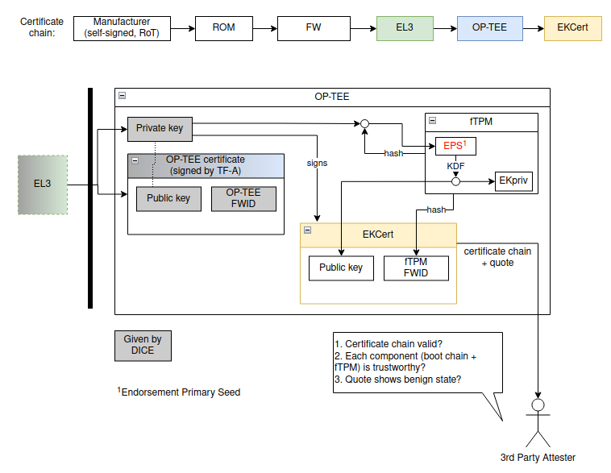

Slide 19
Research questions
How to combine DICE and TPM infrastructure?
(e.g., AliasCert ∪ EKcert)
How to manage fTPM persistent data securely?
(e.g., flush data on update)
What does the identity of fTPM include?
(e.g., hash, configuration, boot chain)
How to enable privacy for the certificate chain?

Slide 20
Technical questions
How to measure fTPM hash? (restricted to OP-TEE OS support)
How to establish static Root for certificate chain?
(must not change if measurements change)
How to inject EPS (i.e., the root secret) into fTPM?
  on each boot
    non-destructive (if EPS is same)
    destructive (if EPS changed)
How to distinguish legit update vs illegal manipulation?
(if we want to flush data only on illegal manipulation)

